Slide 1
Experience of use the MMT-9 telescope for observation of brightness variations of LEO space debris objects
V. Agapov, N. Sakva, D.Davydov, E.Katkova
35th IADC meeting
Darmstadt, 24-26 April 2017

Slide 2
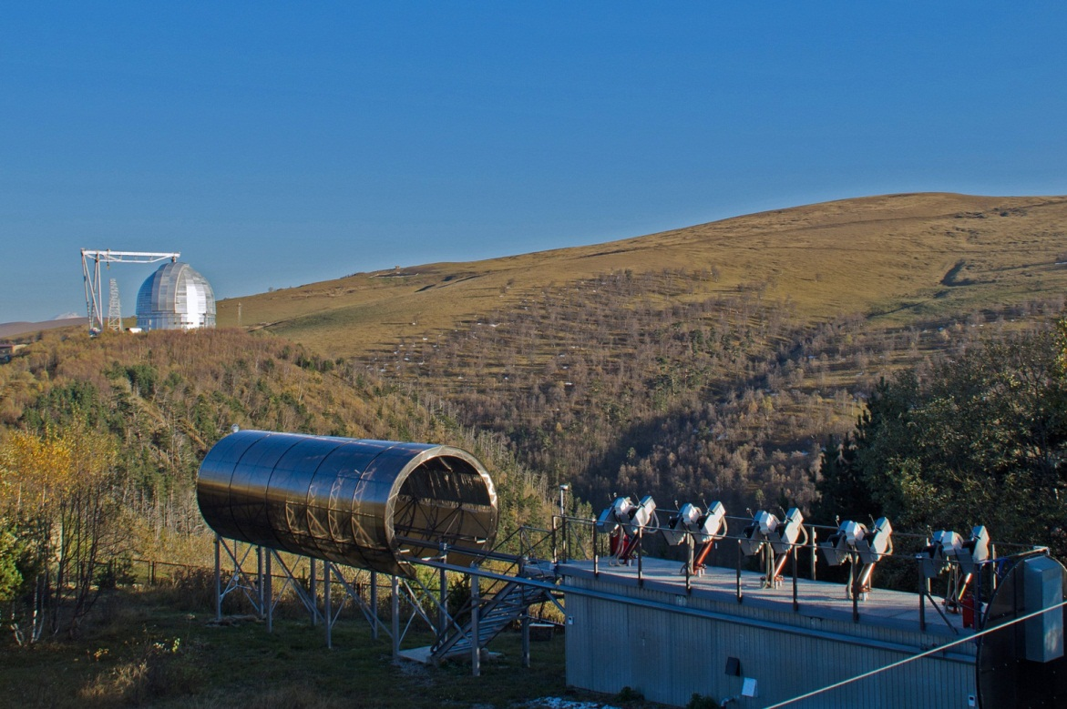
MMT – Multichannel Monitoring Telescope
MMT is developed and built by «Parallax» company for Kazan Federal University (KFU) with the goal to detect and characterize fast optical transients of various origin (cosmological, galactic, near-Earth).
Institute of physics of KFU together with SAO RAS use MMT for fundamental scientific research projects.
Analysis of optical transients associated with near-Earth objects is performed by Institute of physics of KFU in cooperation with Station “Arkhyz” of Research and Production Enterprise “Precision Systems and Instruments”.
ASPOS OKP receives data from MMT under contract by Roscosmos.
MMT is located at the upper scientific facility of Special Astrophysical Observatory (SAO) of the Russian Academy of Sciences

Slide 3
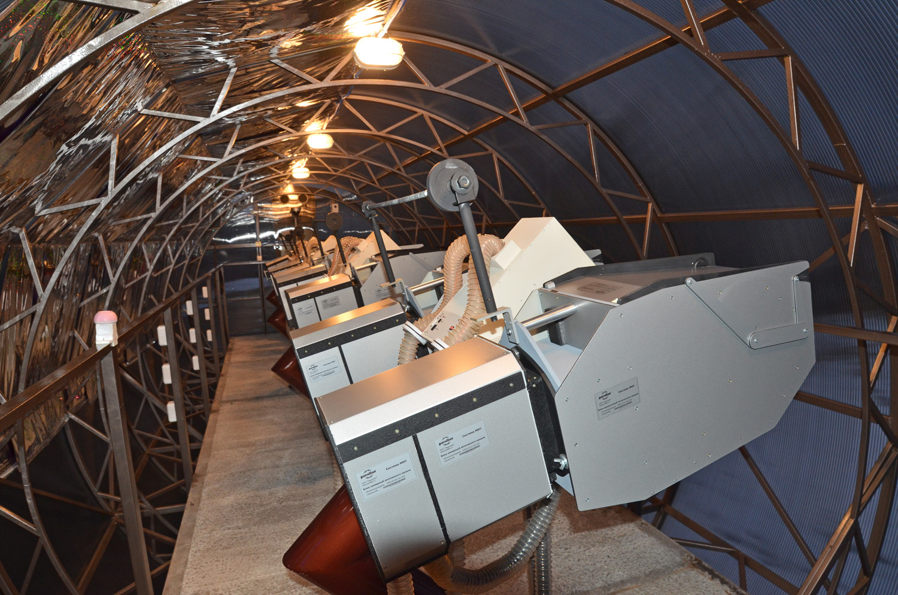
MMT – Multichannel Monitoring Telescope
The MMT system includes a set of nine individual channels.
Each channel has a coelostat mirror installed before the Canon EF85/1.2 objective for a rapid adjusting of the objective direction in a limited range, sCMOS detector and a set of color and polarimetric filters.
Field of view of each channel is 100 sq. deg (11x9.5 deg), total FOV of the system is 900 sq. deg.
Temporal resolution of the system is 0.1 s (10 frames per second).

Slide 4
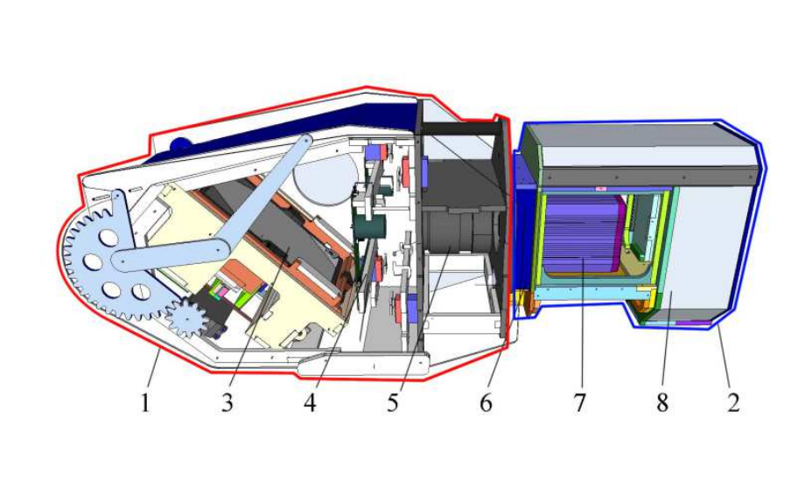
SCHEMATIC VIEW OF A MMT CHANNEL
Each channel composed of following elements:
coelostat unit;
camera unit;
coelostat mirror;
set of installable color and polarimetric filters;
Canon EF85/1.2 objective;
optical corrector;
Andor Neo sCMOS detector;
conditioner.

Slide 5
KEY CHARACTERISTICS OF MMT
Key technical characteristics of the system
Diameter of aperture | 71 mm
Type of sensos | Andor Neo sCMOS
Sensor size | 2560 × 2160 pix
Pixel szie | 6.5 × 6.5 μm
Scale | 16 arcsec/pix
FOV of each channel | ~ 11° × ~ 9.5°
Number of channels | 9
FOV of the system | 900 sq. deg
Temporal resolution | 0.1 s (10 frames per second)
Mount | equatorial
Mount slew rate | 2°/s
Limited star magnitude | 11-12^{m}
Limited moving objects magnitude | 10.5^{m}

Slide 6
MMT – OBSERVATION NIGHT STATISTICS

Slide 7
MMT – CUMULATIVE DURATION OF WORK PER MONTH

Slide 8
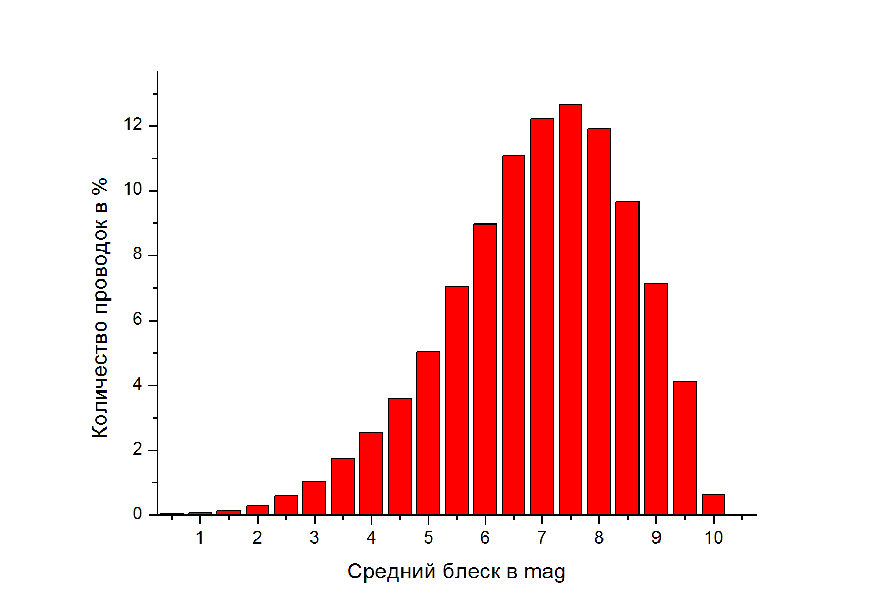
MMT – DISTRIBUTION OF DETECTED SATELLITE BRIGHTNESS
MMT is a robotic system with possibility of control in a remote mode. FOV of the system may be formed depending of the need including possibility of overlapping of several or all channels.
A satellite crosses FOV of the system in 60 s with angular velocity 0.3°/s.

Slide 9
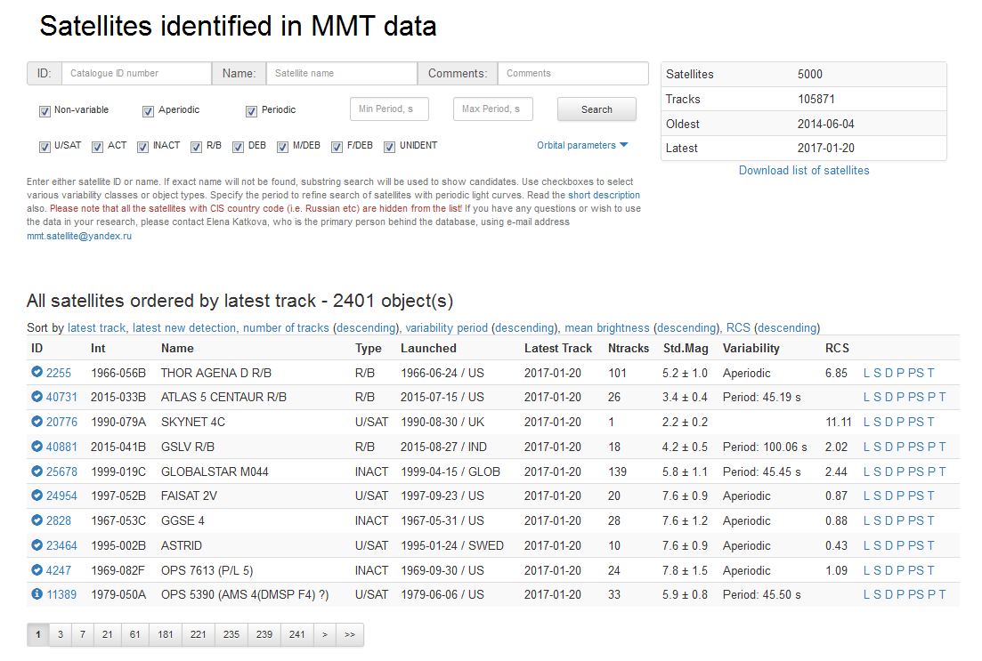
MMT – SATELLITE DATABASE
The database stores (as of Apr 1st, 2017) information on 5105 satellites measured in 113658 tracks. Information on 2489 satellites (50857 tracks) is accessible via Web-interface without any restrictions at http://astroguard.ru/satellites
Available data for individual tracks:
- Measured brightness (including w/filters BVR)
- Standard brightness (1000 km/90 deg phase angle)
- Light curves
- Photometric brightness variation period
- Range
- Phase angle
Averaged data per track and per object are available

Slide 10
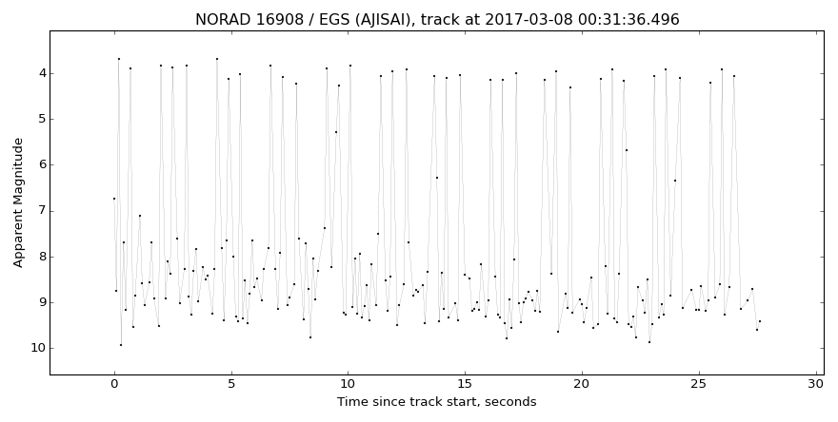
AJISAI – SATELLITE PRODUCING BRIGHT FLARES
Ajisai (1986-061A, 16908) light curve, track on 8 Mar 2017

Slide 11
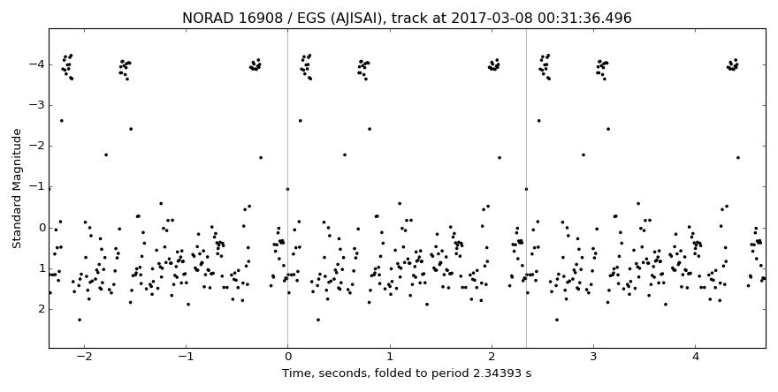
AJISAI – ASSESMENT OF BRIGHTNESS VARIATIONS PERIOD
Light curve of Ajisai (1986-061A, 16908) folded to period 2.34393 sec,
track on 8 Mar 2017

Slide 12
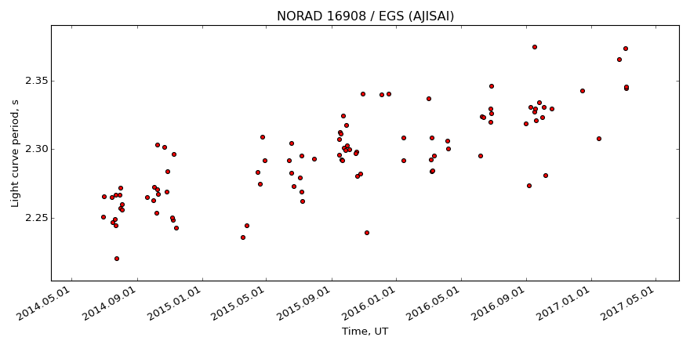
AJISAI – LONG-TERM EVOLUTION OF BRIGHTNESS VARIATION PERIOD
Ajisai (1986-061A, 16908) – 2014-2017

Slide 13
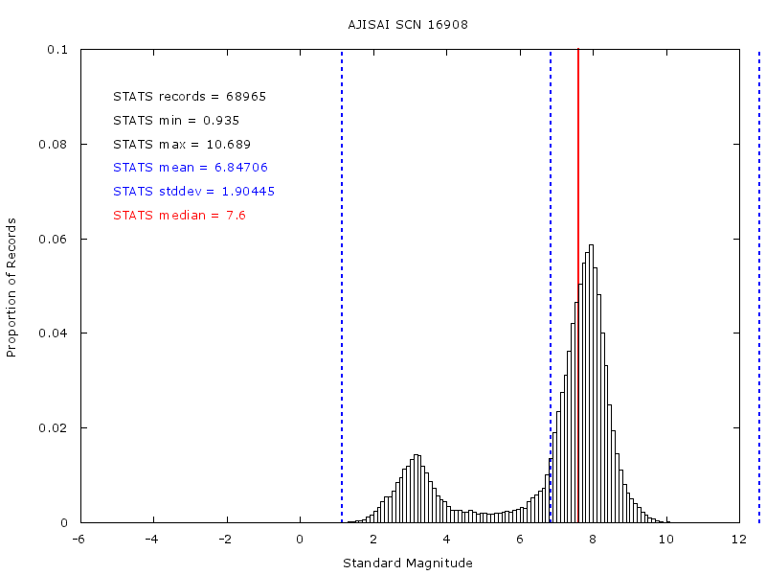
AJISAI – STATISTICS OF MEASURED BRIGHTNESS
Distribution of Ajisai (1986-061A, 16908) brightness measured in tracks obtained by MMT

Slide 14
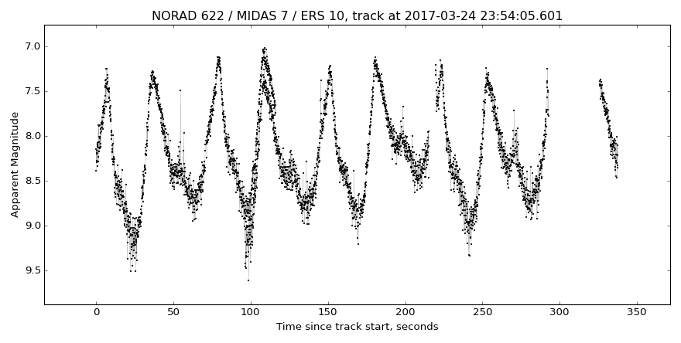
Midas-7 – STRONG VARIATIONS OF BRIGHTNESS
Light curve for Midas-7 (1963-030A, 622), track 24 Mar 2017

Slide 15
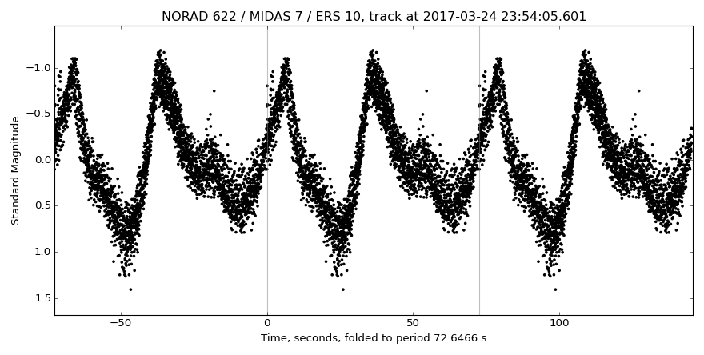
Midas-7 – ASSESSMENT OF BRIGHTNESS VARIATIONS PERIOD
Light curve of Midas-7 (1963-030A, 622) folded to period 72.6466 s,
track 24 Mar 2017

Slide 16
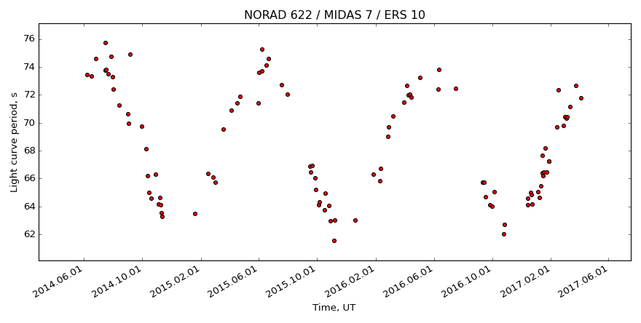
Midas-7 – LONG-TERM EVOLUTION OF BRIGHTNESS VARIATION PERIOD
Midas-7 (1963-030A, 622) – 2014-2017

Slide 17
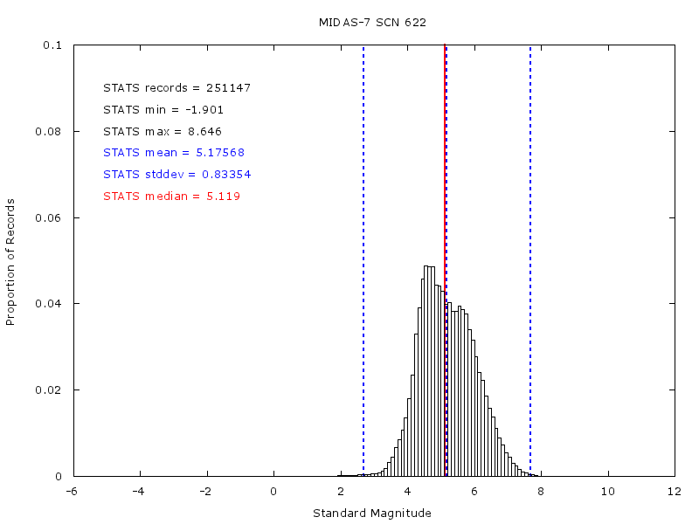
Midas-7 – STATISTICS OF MEASURED BRIGHTNESS
Distribution of Midas-7 (1963-030A, 622) brightness measured in tracks obtained by MMT

Slide 18
MMT – STATISTICS OF OBSERVATIONS OF L/V STAGES
 | TOTAL | With determined photometric period
Total R/Bs in the MMT database (as of 6 Mar 2017, including re-entered objects) | 1356 | 420
2nd stage Ariane-5 (EPS и ECS-A) | 50 | 41
3rd stage Ariane-1 … Ariane-4 | 39 | 7
Centaur upper stage (Atlas/Centaur, all modifications) | 74 | 63
2nd stage CZ-2C | 13 | 0
2nd stage CZ-2D | 6 | 1
3rd stage CZ-4 | 36 | 2
2nd stage H-2 and H-2A | 23 | 11
4th stage PSLV | 28 | 10

Slide 19
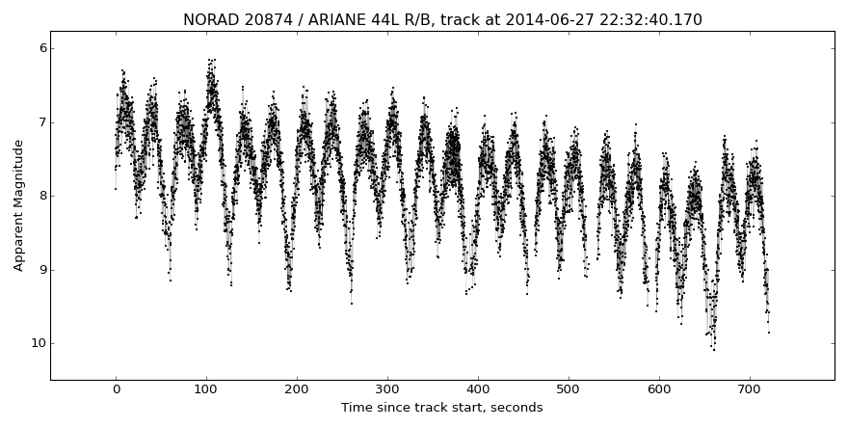
VARIATIONS OF BRIGHTNESS OF THE ARIANE-44L 3rd STAGE
Light curve of the Ariane-44L 3rd stage (1990-091C, 20874),
track 27 Jun 2014

Slide 20
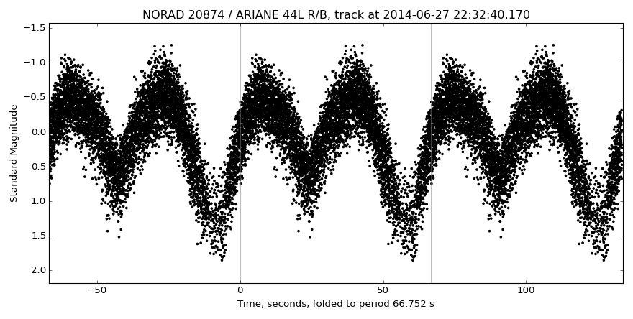
1990-091C – ASSESMENT OF BRIGHTNESS VARIATIONS PERIOD
Light curve of Ariane-44L 3rd stage (1990-091C, 20874) folded to period 66.752 s,
track 27 Jun 2014

Slide 21
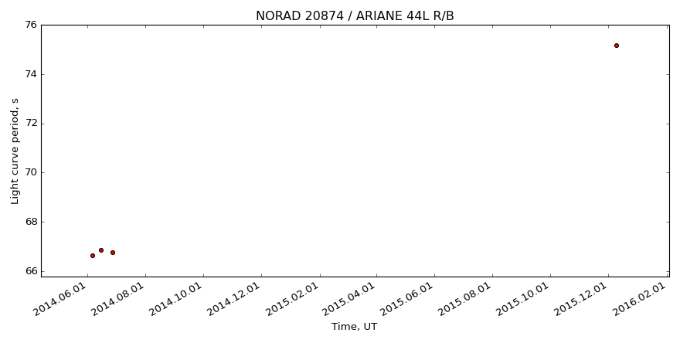
1990-091C – LONG-TERM EVOLUTION OF BRIGHTNESS VARIATION PERIOD
3rd stage of Ariane-44L (1990-091C, 20874) – 2014-2016
Re-entered on 20 Sep 2016

Slide 22
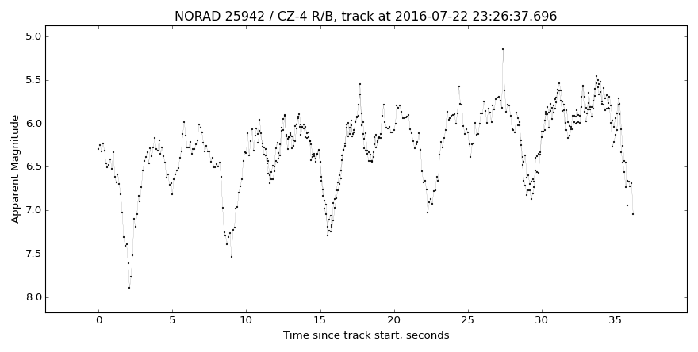
VARIATIONS OF BRIGHTNESS OF THE CZ-4B 3rd STAGE
Light curve of CZ-4B 3rd stage (1999-057C, 25942),
track 22 Jul 2016

Slide 23
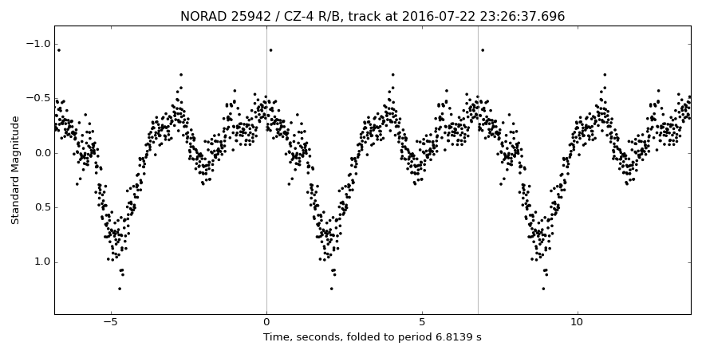
1999-057C – ASSESMENT OF BRIGHTNESS VARIATIONS PERIOD
Light curve of the CZ-4B 3rd stage (1999-057C, 25942) folded to period 6.8139 s,
track 22 Jul 2016

Slide 24
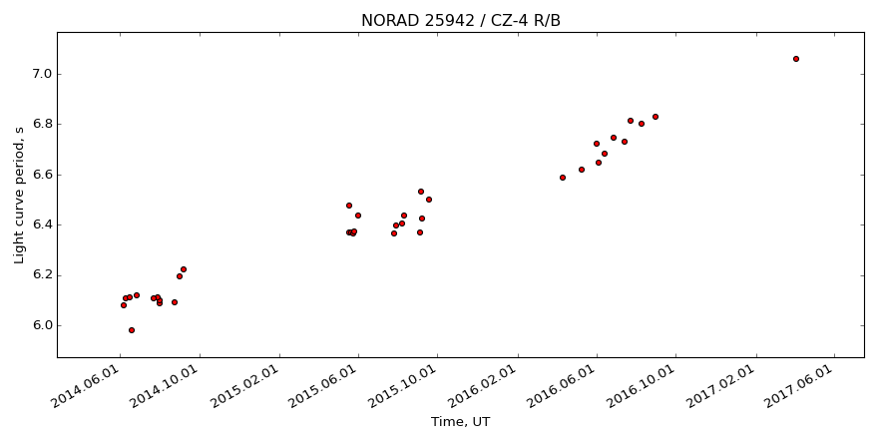
1999-057C – LONG-TERM EVOLUTION OF BRIGHTNESS VARIATION PERIOD
3rd stage of CZ-4B (1999-057C, 25942) – 2014-2017.
The stage experienced explosion on 11 Mar 2000.

Slide 25
Контакты
Thank you for your attention!
v.agapov@mcc.rsa.ru

