Slide 1



Collaborative observations to search 1968-081E fragments
UETSUHARA Masahiko¹, YANAGISAWA Toshifumi², KINOSHITA Daisuke³,
HANADA Toshiya¹, KITAZAWA Yukihito⁴
¹ Kyushu University, Fukuoka, Japan
² Japan Aerospace Exploration Agency, Tokyo, Japan
³ National Central University, Taoyuan, Taiwan
⁴ IHI Corporation, Tokyo, Japan

Slide 2
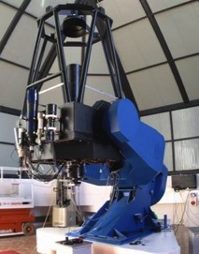

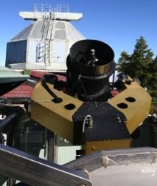
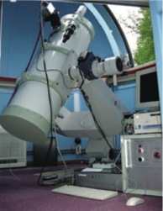
Overview of the collaborative observations
  LOT (Φ1m)
  FOV: 26.4’×13.2’
  CCD: 4k2k
  Nyukasa
  observatory
  TAOS (Φ50cm)
  FOV: 1.74°×1.78°
  CCD: 2k2k
  JNO (Φ35cm)
  FOV: 1.27°×1.27°
  CCD: 2k2k
  Lulin observatory
Search target | 1968-081E (Titan IIIC Transtage) fragments
Observation period | 20 – 22 Oct. 2011 (3 nights)
Observation mode | Survey (6 hours / night)
40 uncataloged objects are detected to be identified with the 1968-081E fragments
Notes:
This presentation introduces the search strategy of breakup fragments especially focusing on the observation planning and origin identification techniques demonstrated in the collaborative observations. I have been validating the search strategy by selecting the search target from a confirmed breakup event in GEO. This collaborative observation targets the well-known breakup event of Titan IIIC Transtage whose ID is 1968-081E. (As you can see in the map, I employed three sensors from two observation sites in Japan and Taiwan. (and more explanation about the sensors if necessary)) The purpose of collaboration is to assure the detectability of target fragments. Usually suffered by the weather conditions, and any operational issues unexpected. In near future, I am going to apply the developing search strategy to the unconfirmed breakup events in the earth orbits.
I acquired a remarkable result in the collaborative observation, which detected forty uncataloged objects that are associated with the target breakup event. So, From now, I would like to introduce the search strategy we have demonstrated in the collaborative observations.

Slide 3
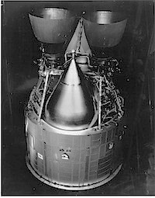
Breakup fragments
BREAKUP
Transtage (ref. U.S. Air Force website)
Properties of breakup fragments
Small size (<1m) = Faint objects
Large part remains lost = Uncertainties in states
Necessity of predictive analyses
Notes:
Let’s begin with reviewing characteristics of breakup fragments …
Therefore we need introducing predictive analyses of fragments into a strategy to effectively search them.

Slide 4
The search strategy
Notes:
This is the workflow of the search strategy demonstrated in the collaborative observation. After defining hypothesis of target breakup event, I predict the population and motion of the breakup fragments at observation epoch. And then I plan a observation using the prediction results. The consideration of motion in the planning is enhances the effectiveness of the observation because, Smaller the motion in sensor frames becomes, Better the SN ratio we can get. After the observation, I may detect uncataloged objects that are usually called UCT. Again, I evaluate whether origin identification of UCTs are associated with the target breakup event as the final procedure. These predictive analyses utilize the orbital debris modeling technique including the NASA standard breakup model to generate breakup fragments, and numerical propagator to propagate the orbits of the fragments.
From now, (Click), I would like to focus on how I conducted observation planning and origin identifications.

Slide 5
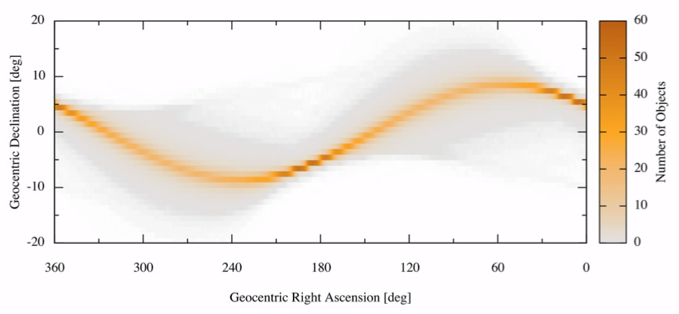
Observation planning (1)
Predicted population of 1968-081E fragments
as 6 hours time-integrated distribution (Bin size = 1°×1°)
Geocentric declination [°]
Geocentric right ascension [°]
Notes:
Prediction results hereinafter assumes scale factor, the scale of explosion breakup, as 1.0, and size of fragments larger than 10 cm.
I planned the observation period at each night as 6 hours, so that this distribution represents the population of fragments during 6 hours in the sphere defined by right ascension and declination.
You can see one peak region for each right ascension column, which forms a peak line, and you will also see two peak regions in the peak line.
In the next slide, I evaluate the speed of fragments in the peak lines seen from the ground.

Slide 6
Observation planning (2)
Traveling speed of 1968-081E fragments in the peak population bins seen from the Lulin Observatory
Traveling speed at peak bin [“/sec]
Geocentric right ascension [°]
Notes:
From this result, You will see an importance of considering the traveling speed of fragments to plan the observations.
Difference of maximum speed and minimum speed is approximately 2.0 “/seconds. The maximum exposure time to keep the image of a fragment within one pixel (e.g. 1 pixel = 3“ × 3“) per each shot is the optimal exposure time. The difference will alternate a optimal exposure time by 1.5 seconds. Such a difference in an exposure time results in a serious one for total exposure time of each night. Taking a advantage of longer exposure time also may result in the higher detection rate.

Slide 7
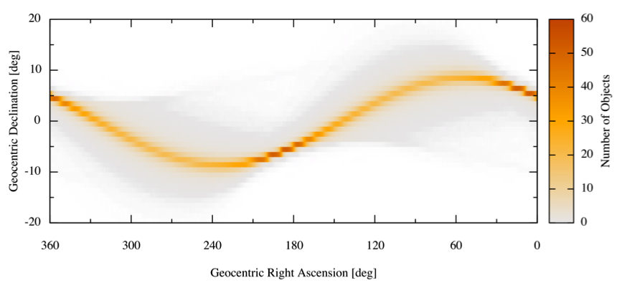
Observation planning (3)
Nyukasa
B
A
Earth Shadow
Geocentric declination [°]
Invisible region
Lulin
Geocentric right ascension [°]
Sensor Name | Population (6 hrs.) [#] |  | Traveling speed [“/sec]
 | A | B | A | B
TAOS | 56.47 ± 1.09 | 39.95 ± 1.80 | 2.01 ± 0.55 | 0.87 ± 0.61
LOT | 27.56 ± 2.04 | 14.82 ± 1.77 | 1.96 ± 0.43 | 0.74 ± 0.42
JNO | 53.16 ± 1.32 | 33.21 ± 2.01 | 1.94 ± 0.49 | 0.80 ± 0.53
Notes:
To conclude the observation planning, I select two specific candidates as a observation point. Temporal positions of fragments are unknown, so that we have to keep looking at a point for night. The point A is the bin of (6°, 5°) where the predicted population is the highest among whole bins, whereas the point B is the bin of (43°, 8°) where the traveling speed is almost half the point A’s but the predicted population is also half. Consequently, I select the point B for the search survey point.

Slide 8
Origin identification (1)
Demonstrating the origin identification
by estimating the orbits as circular ones
Separation angle (φ) between 2 observed points (α₁, δ₁) and (α₂, δ₂)
Mean motion (n) is approximated from φ and observation interval (Δt) between the 2 observations
Semi-major axis (a), inclination (i), and right ascension of ascending node (Ω) can be recovered from φ and n
Correlations in the icos(Ω)-isin(Ω) plane (Hanada et al., 2005)
Notes:
51 CTs and 96 UCTs
Precise orbit determination was not conducted in the collaborative observations by some operational constraints, so that this presentation demonstrates the origin identification of UCTs with the Transtage fragments by estimating their orbits as circular ones.
Simple calculations can recover the semi-major axis, inclination, and right ascension of ascending node from two angles measurements.
And then we can conduct the origin identification in the icos(omega) vs isin(omega) plane, where features of fragments appear clearly.
----- 会議メモ (12/07/10 16:38) -----
円軌道を仮定したorbit determinationでもorigin identificationできることを強調する．

Slide 9
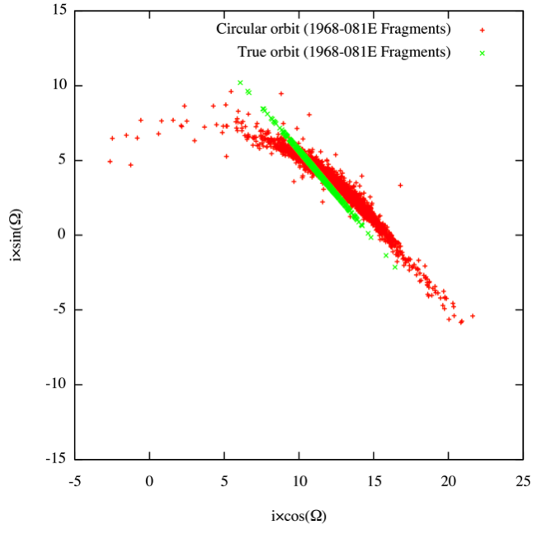
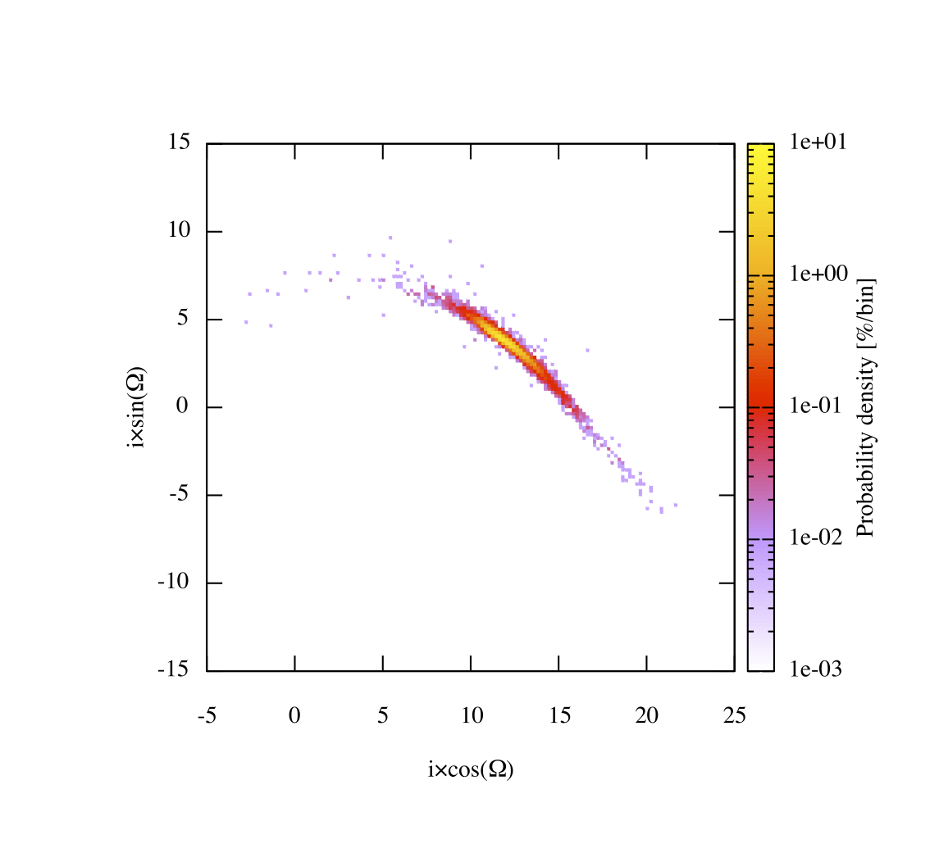
Origin identification (2)
1968-081E fragments (generated by the breakup model)
in the icos(Ω)–isin(Ω) plane at the breakup epoch
Notes:
This figure shows the distributions of the Transtage fragments at the breakup epoch. As you can see, there two legends, the green one is given true orbit, that means full elements are given, whereas the red one is given the circular orbit.
The distribution of circular orbit fragments are changed from the true orbit fragments, but still forms shape like a banana. I evaluated this red points’ distribution into a probability distributions, (Click) As you can see in the right figure, circular orbit fragments shapes a probability distribution with single peak.
This feature can be good enough to correlate the observation results with.

Slide 10
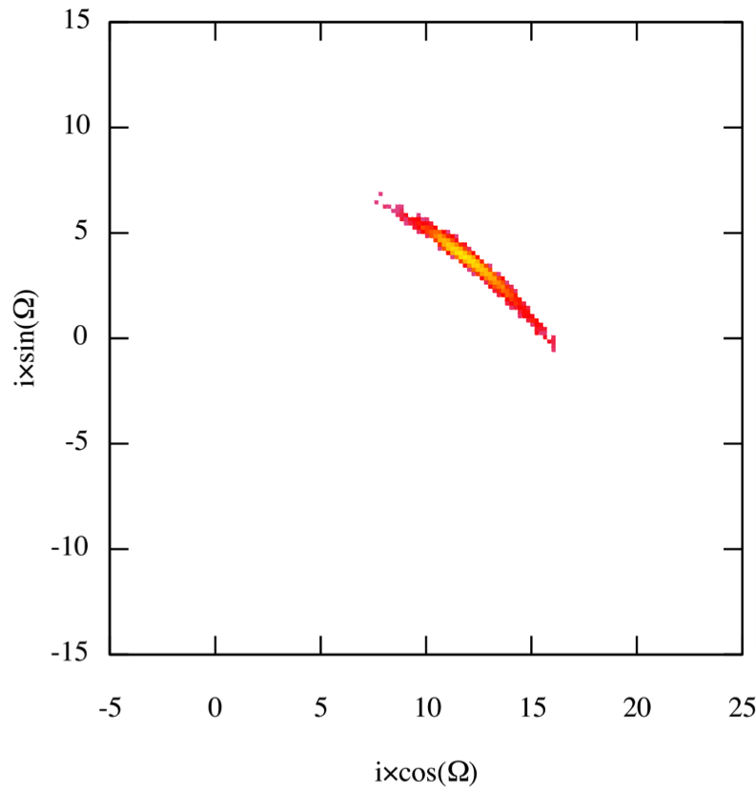
Origin identification (3)
Probability distribution of 1968-081E fragments, applied a threshold
Notes:
Let’s conduct the correlation between measurements and predictions. After eliminating the too-small probability bins, (Click)

Slide 11
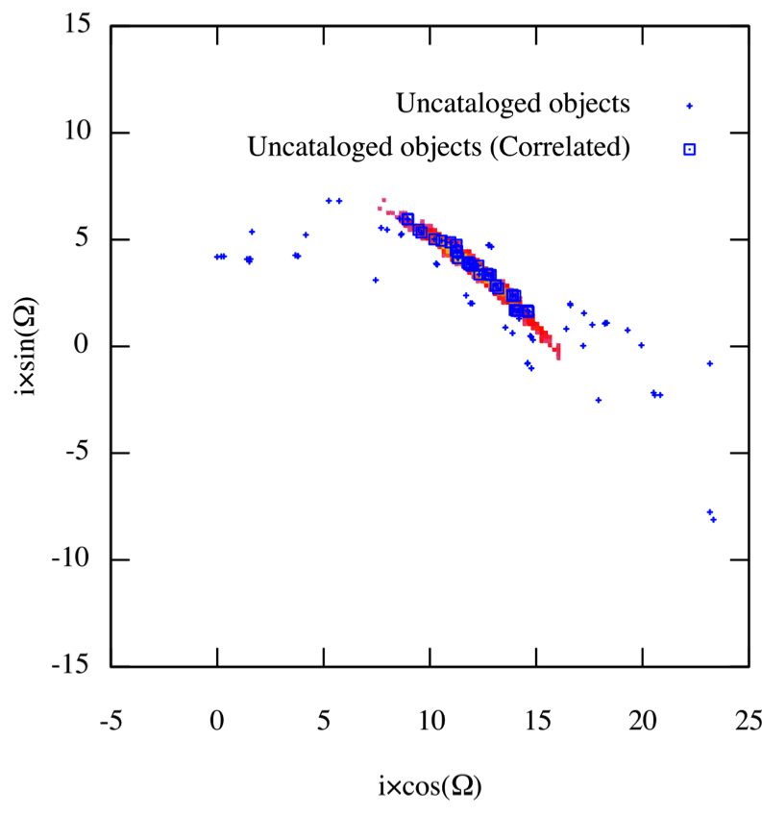
Origin identification (3)
40 UCTs are correlated with the 1968-081E fragments in total
Notes:
40 measurement points out of 96 are finally associated with the probability distribution. Thus, we can conclude that the 40 UCTs are identified with the Transtage fragments.

Slide 12
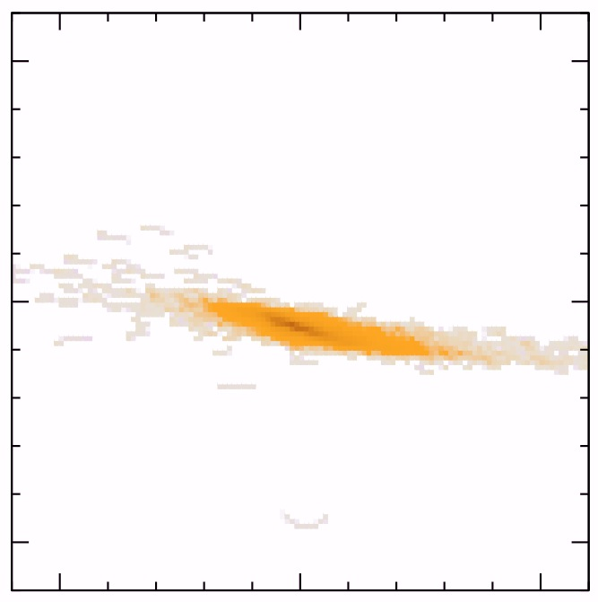
Validation of observation planning
Traveling speed of correlated objects
  1.25 ± 0.76 “/sec
Prediction results
  0.87 ± 0.61 “/sec
Qualitative features of measured motions and predicted ones are in good correspondence
Notes:
The associated UCTs have also unique feature in motion frame. In the motion frame, the associated UCTs are clearly distinguished from not associated ones. The traveling speed of associated UCTs have a bias from the prediction results. However, (Click) the qualtitative features of measured motions and predicted ones are in good correspondence. From these evidences, we can conclude the observation planning worked well as intended.

Slide 13
Conclusions
Collaborative observations with the search strategy successfully demonstrated the detections of 1968-081E fragments
  Observation planning with a consideration of traveling speed of the fragments in a sensor’s FOV
  Origin identification of UCTs by the circular obit estimation
40 objects were correlated with 1968-081E fragments, which will be evaluated to characterize the breakup event… stay tuned!
Notes:
I would like to conclude the presentation. First, blablabla…. Second, blablabla….

Slide 14
Acknowledgements
For dedicated assistances to the observations
Mr. Hirohisa Kurosaki, Mr. Yoshitaka Nakaniwa, Mr. Osamu Hikawa, Mr. Takenori Ohtsuka, Mr. Taku Izumiyama, Mr. Andrew Wang, Mr. Dunkan Chen, Mr. Jason Wu, Dr. Shin-ichiro Okumura, Dr. Tsuyoshi Sakamoto, and the Japan Space Guard Association
For contributions to the research
Dr. Hitoshi Yamaoka, Dr. Tomoko Fujiwara, Dr. Tetsuharu Fuse, Mrs. Kozue Hashimoto, and Mr. Aritsune Kawabe
IHI Corporation wishes to acknowledge US Air Force Office of Scientific Research (AFOSR) Asian Office of Aerospace Research and Development (AOARD) to support the research under the grant No. FA2386-10-1-4136 (AOARD 104136).
Notes:
I am really appreciated that many persons joined in this research with interests. I could not accomplished the collaborative observations without the supports by them. This is the end of my presentation. Thank you for your kind listening.

Slide 15
Backup slides

Slide 16
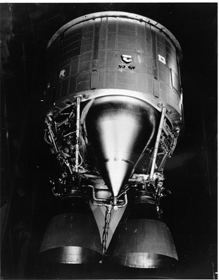
Historical breakup events in GEO
Ekran II (1977-092A)
  Breakup epoch: 1978.6.23
  Explosion breakup (battery malfunction)
  4 cataloged fragments
Titan IIIC Transtage (1968-081E)
  Breakup epoch: 1992.2.21
  Explosion breakup (remnant fuel)
  23 fragments have been observed in near breakup epoch (Pensa, et al., 1996)
  8 cataloged fragments
Transtage (ref. U.S. Air Force website)
And ≥ 9 suspected (unconfirmed) events
Notes:
The targets of this research are breakup events in the geostationary region. There are two confirmed breakup events. Explosion of the Ekran II is the first major breakup that have been reported in a past conference.
The second one is the explosion of Titan IIIC transtage. And this transage is the search target in the collaborative observations. And also, there might be 9 or more unconfirmed breakups occurred in the geostationary region that will be discussed in my another presentation tomorrow.

Slide 17
Research objective
Final goal aims to contribute to Space Situational Awareness
Investigation of orbital debris generation process
  Model predictions vs. Observation results
Evaluation of orbital debris environment
  Better definition of the current situation for secure space activities
This study;
Establishment of effective search strategy applicable for breakup fragments in the geostationary region
by means of optical observations
Notes:
This research aims to contribute to space situational awareness (SSA) in the geosynchronous orbit (GEO) region by two approaches.
This research proposes to apply the orbital debris (OD) modeling techniques to devise an effective search strategy applicable for breakup fragments in the geostationary region. The OD modeling techniques describe debris generation and propagation to effectively conduct predictive analyses of space objects that include characterizing, tracking and predicting the behavior of individual and groups of space objects.

Slide 18
Modeling of breakup fragments
Notes:
This figure shows a basic scheme of the breakup fragments modeling for the predictive analyses
… In general, a propagation period from a breakup epoch to a observation epoch becomes 10 years or 20 years or more, so that propagation error of their positions become huge. And that is true for the Transtage fragments.

Slide 19
The search strategy (previous)
Notes:
The introduced search strategy can be summarized into a sequence as shown in this figure.

Slide 20
Breakup model
Parent spacecraft fixed frame
Parent spacecraft
Breakup fragments
Δv vector
The NASA standard
breakup model
Ref. MASTER-2009 final report

Slide 21
Detection result
Detection results at TAOS (φ50-cm)
by the FPGA-based stacking method (Yanagisawa et al., 2011)
51 CTs and 96 UCTs
100 cm
16 cm
Notes:
189 sets of images / 3 nights
51 objects are correlated with cataloged objects of SSN, while 96 objects are uncorrelated.

Slide 22
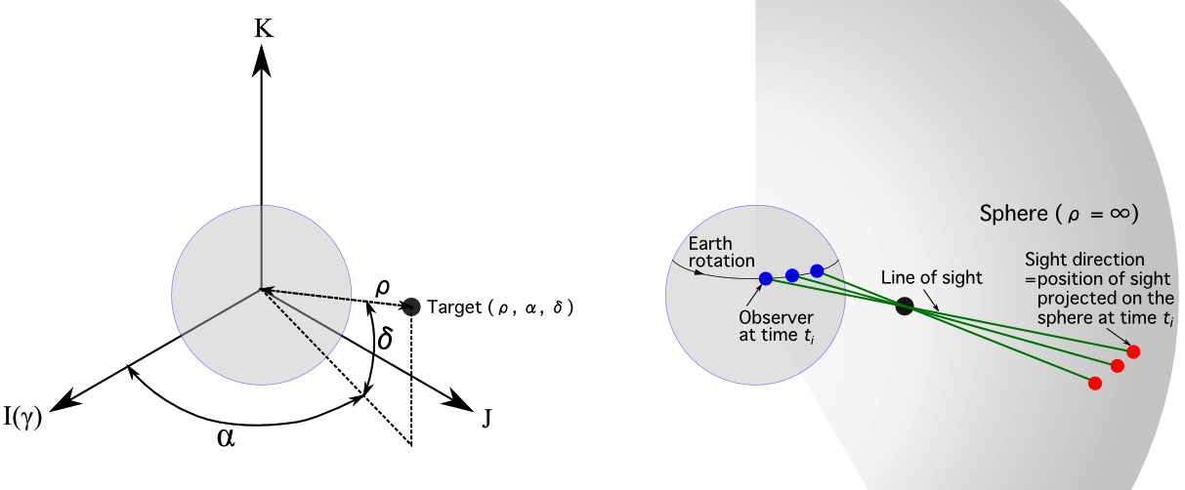
Survey planning
Notes:
Again, I took a survey method for breakup fragments as shown in this figure. First, I select a observation point in inertial space
where most fragments will pass through. And then, a sensor keeps pointing at the observation point. But, a sensor stops the tracking during taking images to get a higher signal-to-noise ratio of fragments in the geostationary region.
So, the tracking direction shifts from a point to another point by several minutes.

Slide 23
A keyword to develop
the effective search strategy
= Identification

Slide 24
Identification
time
Tracklet
=
Signal
Tracklets
FOV
Orbit
・・・
x_{n}
x₁
x₂
x₃
Orbital elements space
Signal identification
Tracklet identification
Physical object identification
Origin identification
Process

Slide 25
Identification
time
Tracklet
=
Signal
Tracklets
FOV
Orbit
・・・
x_{n}
x₁
x₂
x₃
Orbital elements space
Signal identification
Tracklet identification
Physical object identification
Origin identification
Image processing
Orbit determination
Orbital debris modeling (ODM)

Slide 26
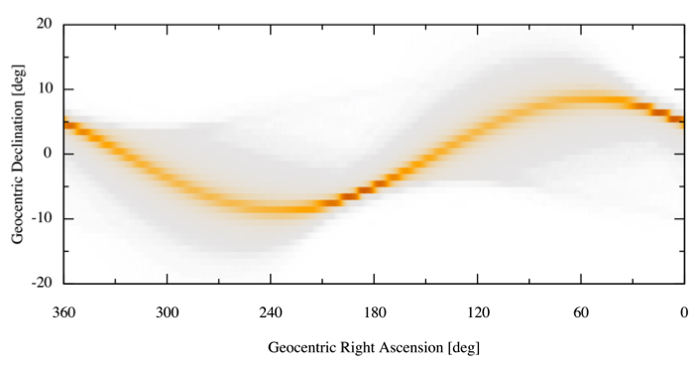

Contributions of ODM (1)
  Predictions of population and motion
  Detection of fainter fragments
time
Tracklet
=
Signal
δ
Tracklets
ΔY
FOV
Orbit
・・・
x_{n}
x₁
x₂
x₃
Orbital elements space
α
ΔX
Signal identification
Tracklet identification
Physical object identification
Origin identification
After stacking
32 images
Stack images along a shift vector
Before stacking
…and Detect
The stacking method
Notes:
検出例(2011.3.4, 17.7等級)

Slide 27
Contributions of ODM (2)
  Identification of tracklets to a right origin
time
Tracklet
=
Signal
Tracklets
FOV
Orbit
・・・
x_{n}
x₁
x₂
x₃
Orbital elements space
Signal identification
Tracklet identification
Physical object identification
Origin identification

Slide 28
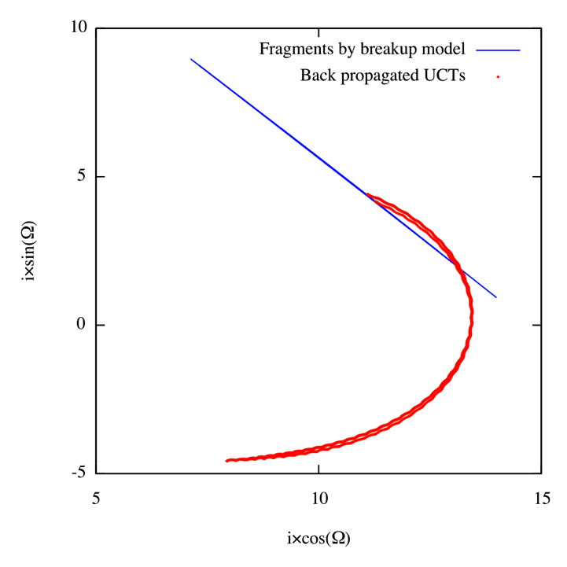
Contributions of ODM (3)
  Identification of a physical object to
  a right origin
time
Tracklet
=
Signal
Tracklets
FOV
Orbit
・・・
x_{n}
x₁
x₂
x₃
Orbital elements space
Signal identification
Tracklet identification
Physical object identification
Origin identification

Slide 29
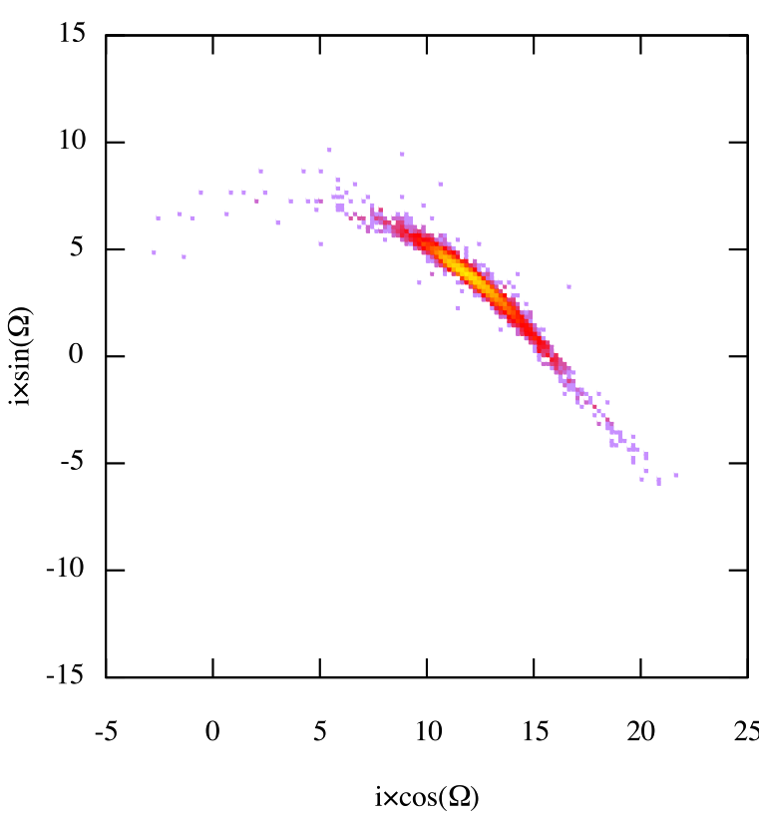
Origin identification (3)
1968-081E fragments, whose cumulative probability is 97%.

