Slide 1


Results of extended GEO surveys and fragments discovery by the ISON network in 2012
Vladimir Agapov, Igor Molotov
Keldysh Institute of Applied Mathematics RAS
Roscosmos delegation
31st IADC Meeting
April 17-19, 2013, Darmstadt, Germany

Slide 2
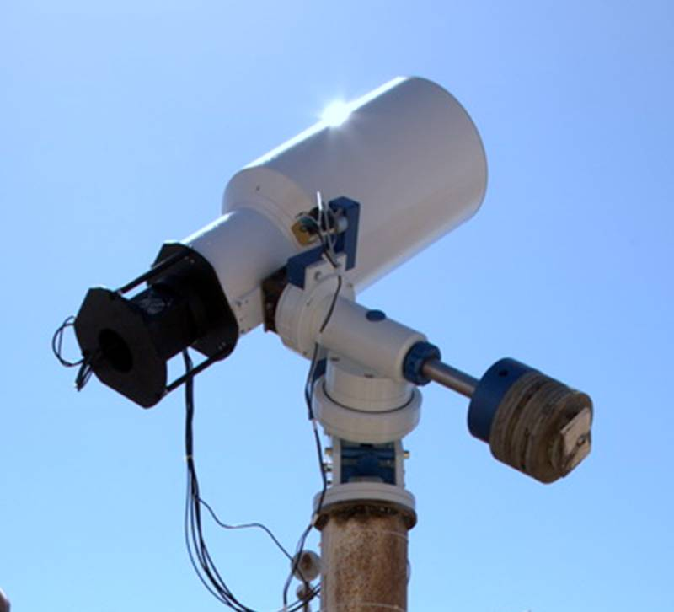
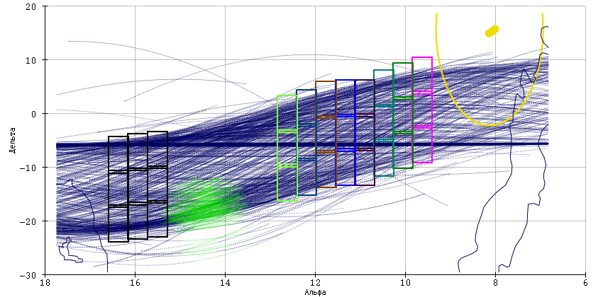
Molniya HEO surveys, extended GEO surveys
19.2 cm VT-78e and 18 cm VT-52c telescopes with 7x7 degree FOV
VT-78e are installed in Sanglok, Khureltogoot
VT-52c is installed in Nauchnyi-1
Sanglok carries out extended GEO survey
Nauchniy-1 – both extended GEO survey and surveys of HEO objects (apogee region of Molniya-type orbits)

Slide 3
Extended GEO surveys
Sanglok VT-78e first extended GEO surveys, Jan 2012
Nauchniy-1 VT-52c first extended GEO surveys, Apr 2012
Date | Duration, hh:mm | Tracks | Measurements | Objects
12.04.2012 | 2:05 | 471 | 3607 | 459
13.04.2012 | 2:42 | 355 | 2626 | 330
16.04.2012 | 4:13 | 742 | 5175 | 405
25.04.2012 | 7:43 | 1341 | 10190 | 601
27.04.2012 | 8:01 | 1255 | 9533 | 584

Slide 4
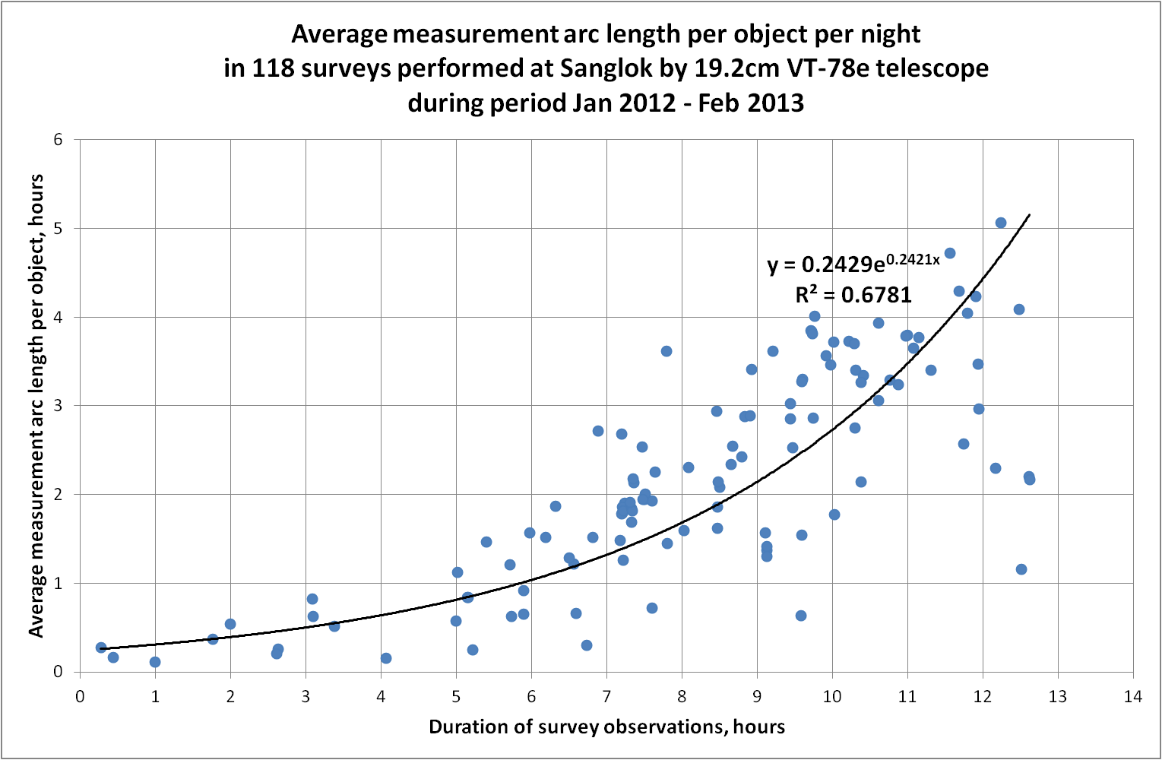
Extended GEO surveys. Measurement arc length.
Sanglok VT-78e.

Slide 5
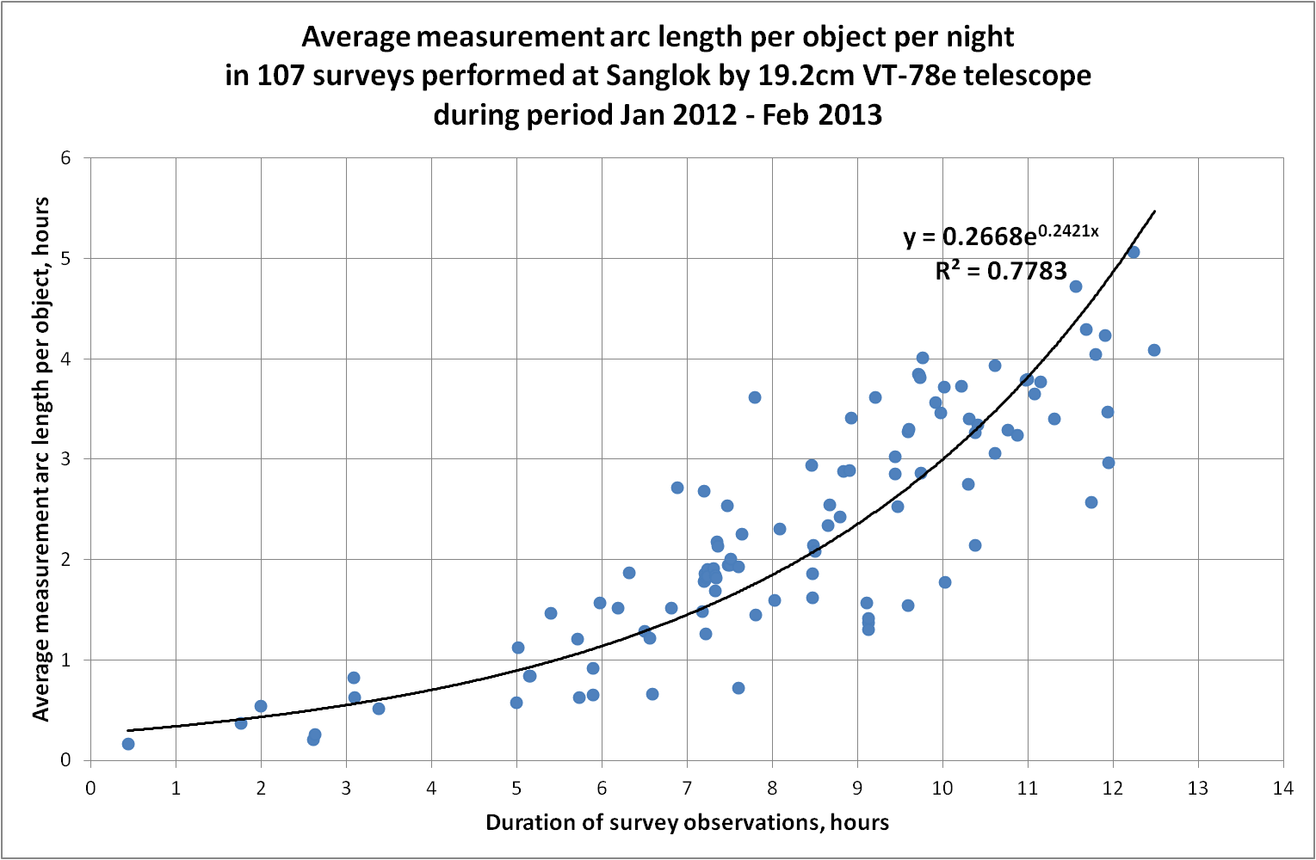
Extended GEO surveys. Measurement arc length.
Sanglok VT-78e.

Slide 6
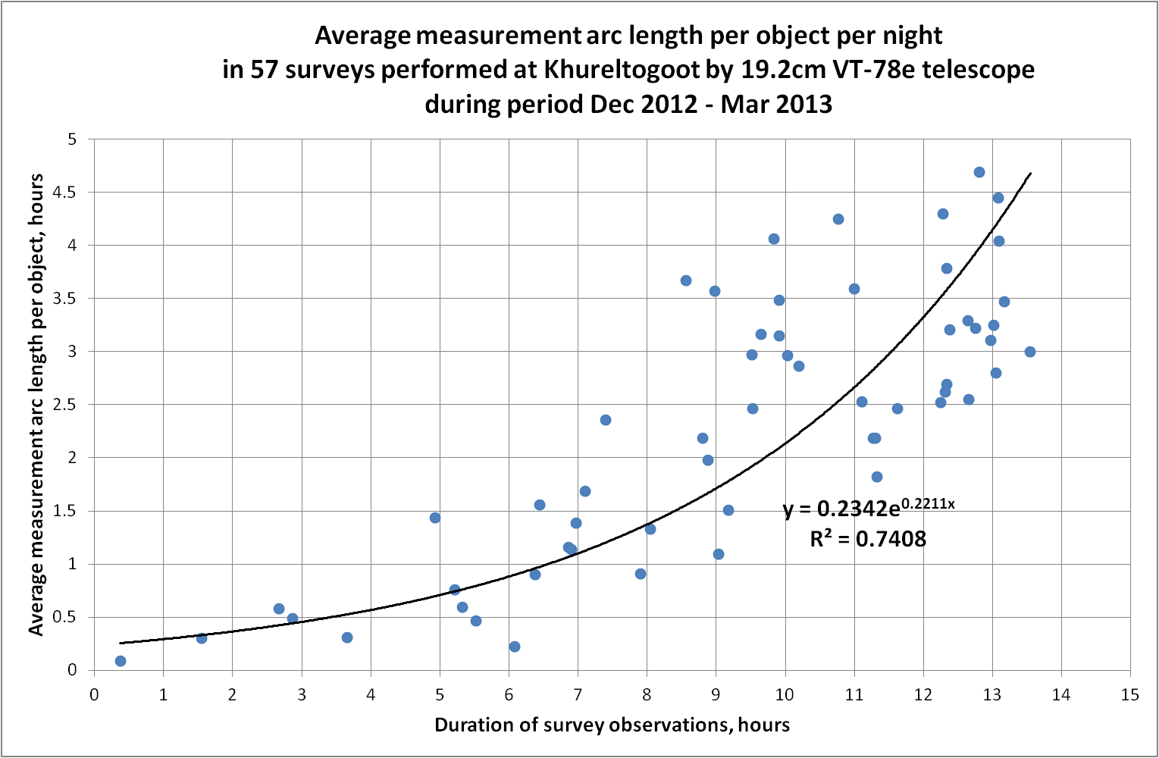
Extended GEO surveys. Measurement arc length.
Khureltogoot VT-78e.

Slide 7
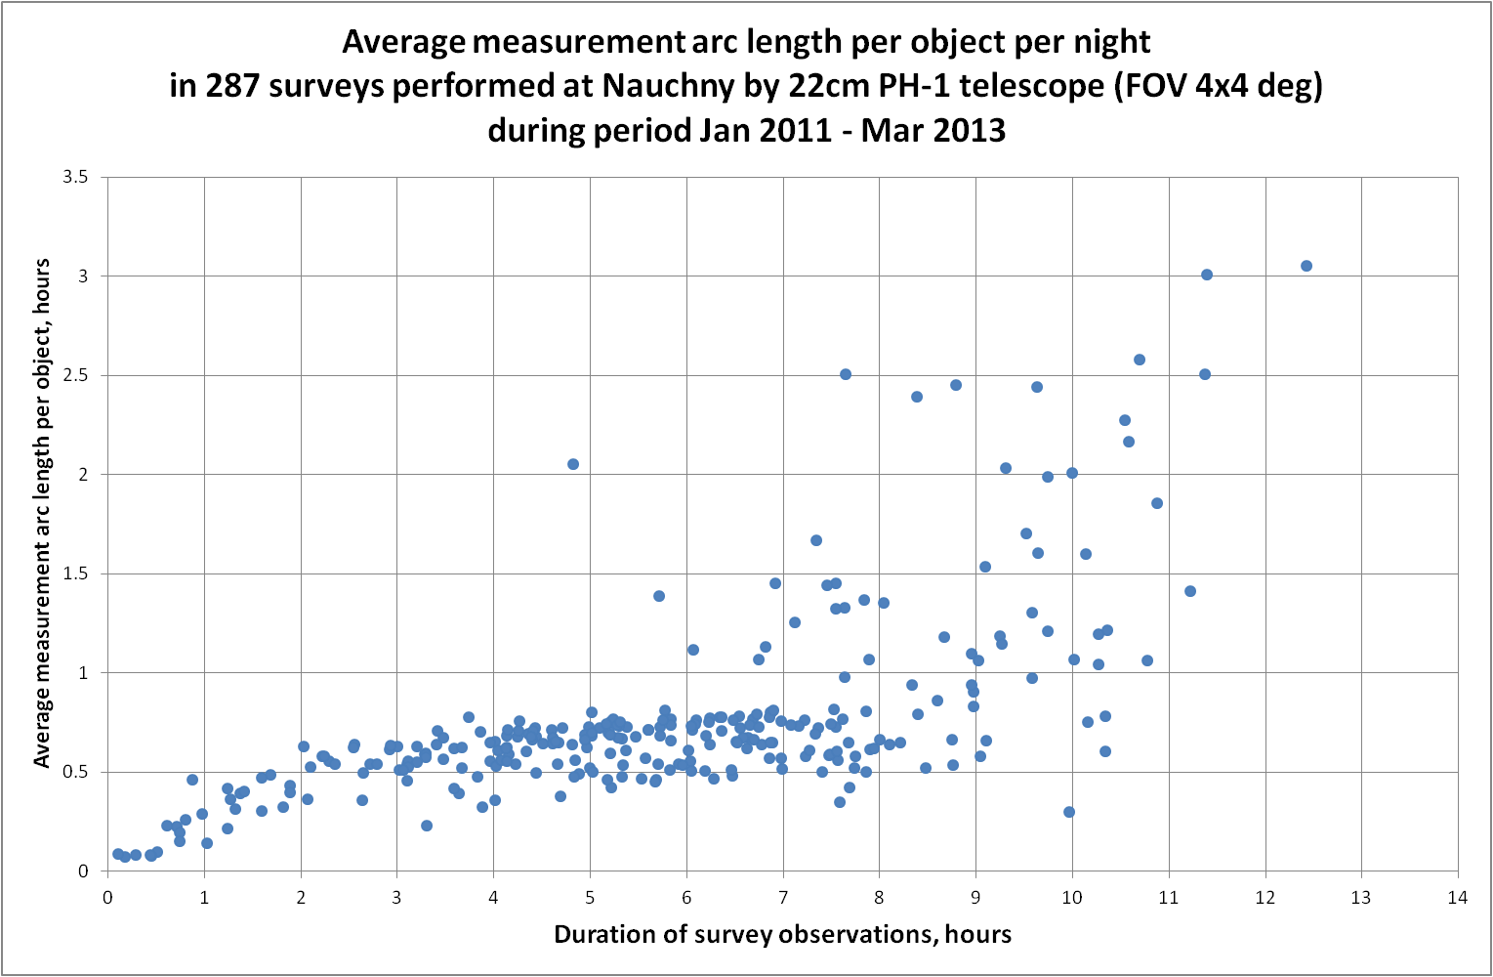
Extended GEO surveys. Measurement arc length.
Nauchny PH-1.

Slide 8
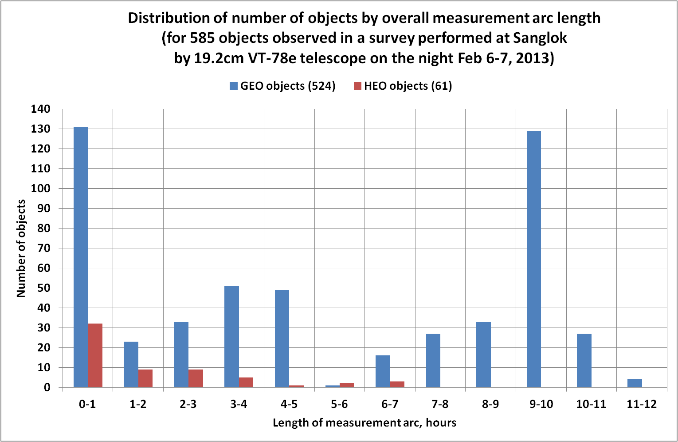
Extended GEO surveys. Measurement arc length.
Sanglok VT-78e.

Slide 9
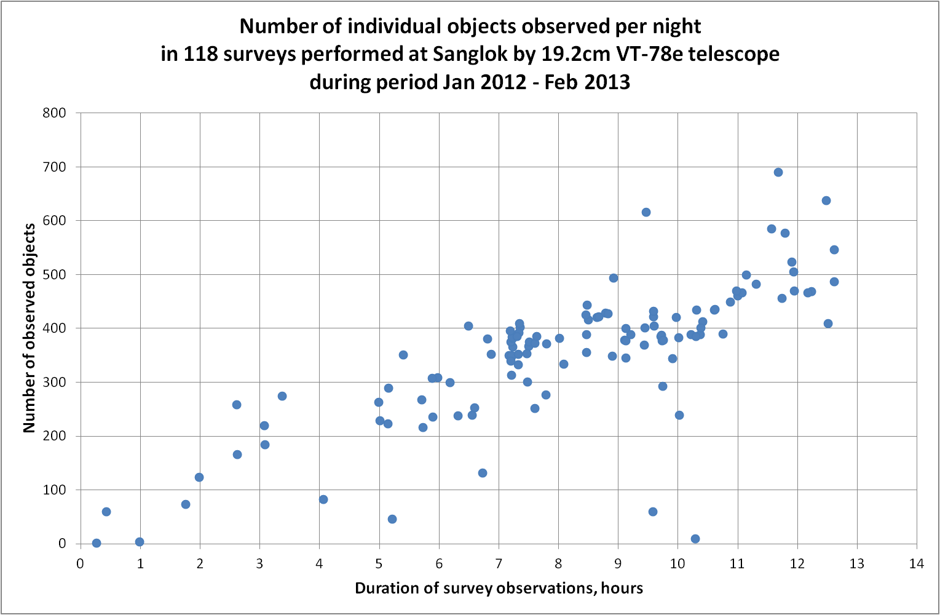
Extended GEO surveys. Number of objects.
Sanglok VT-78e.

Slide 10
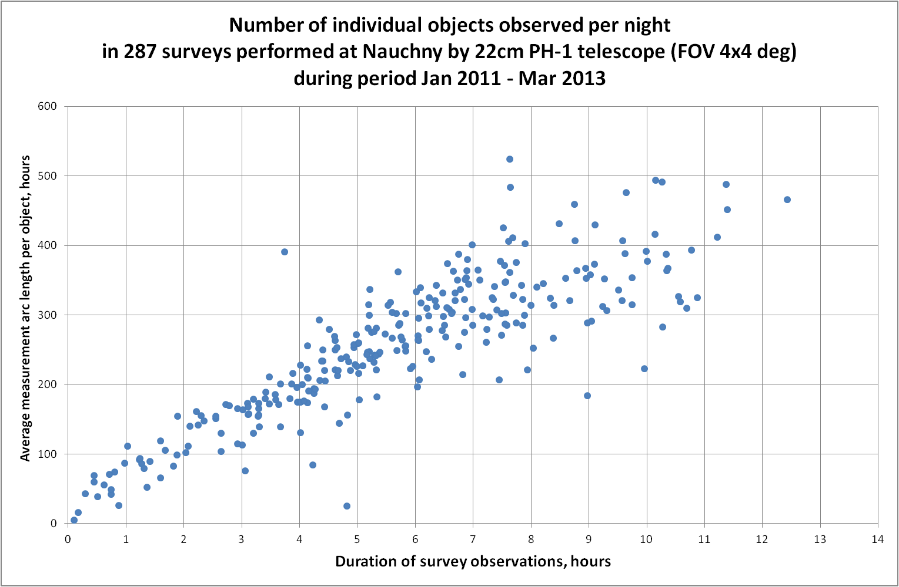
Extended GEO surveys. Number of objects.
Nauchny PH-1.

Slide 11
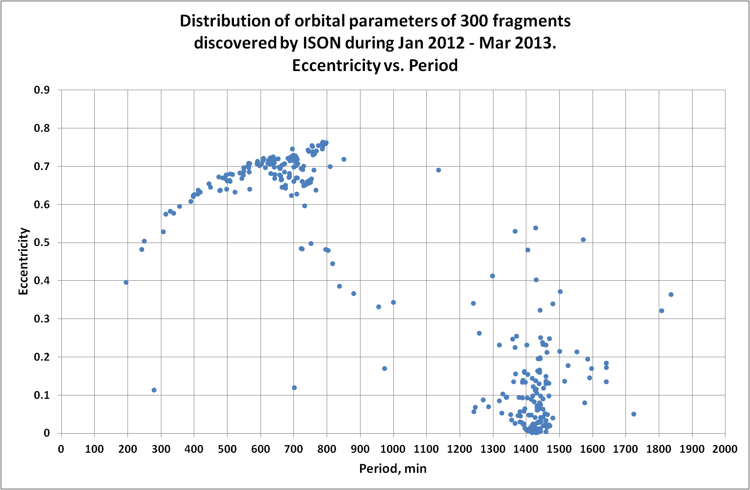
Discovered fragments.

Slide 12
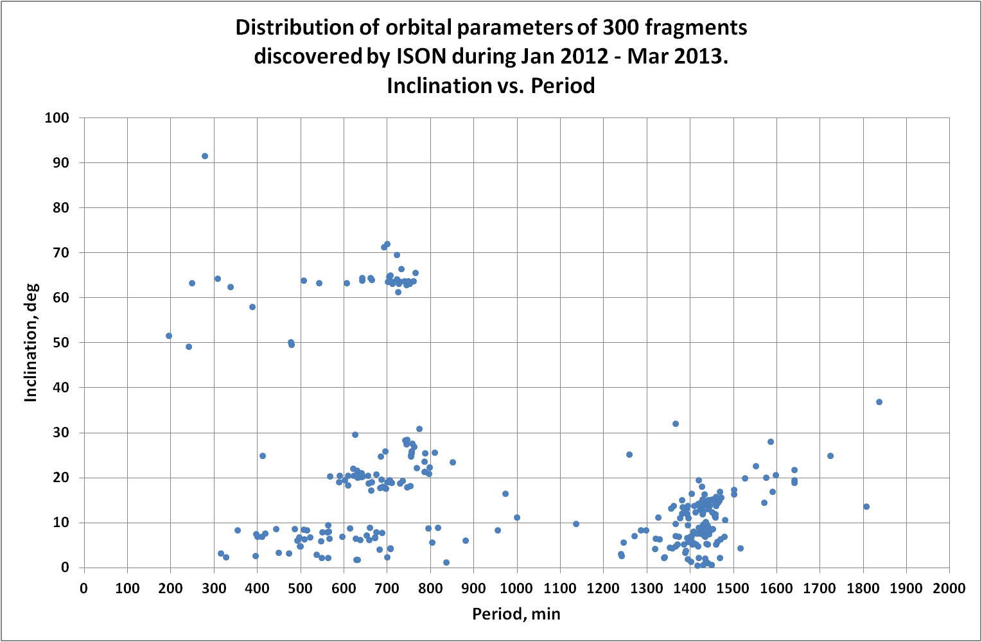
Discovered fragments.

Slide 13
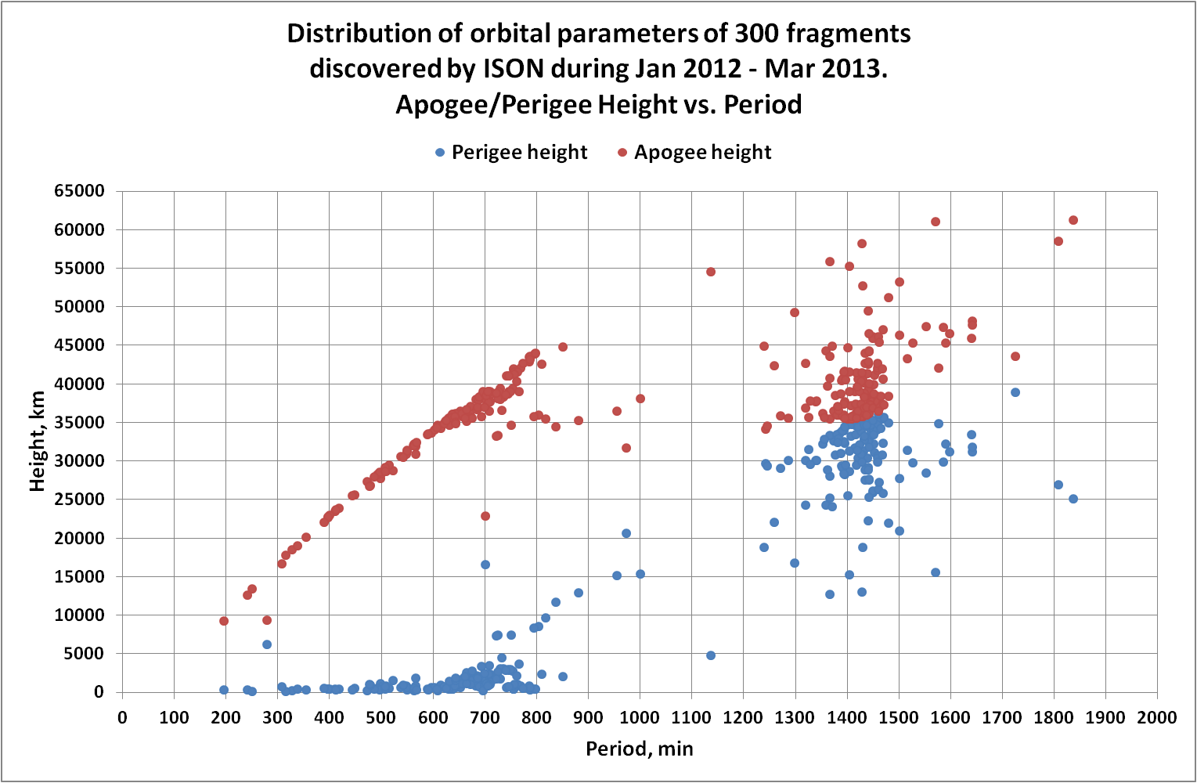
Discovered fragments.

Slide 14
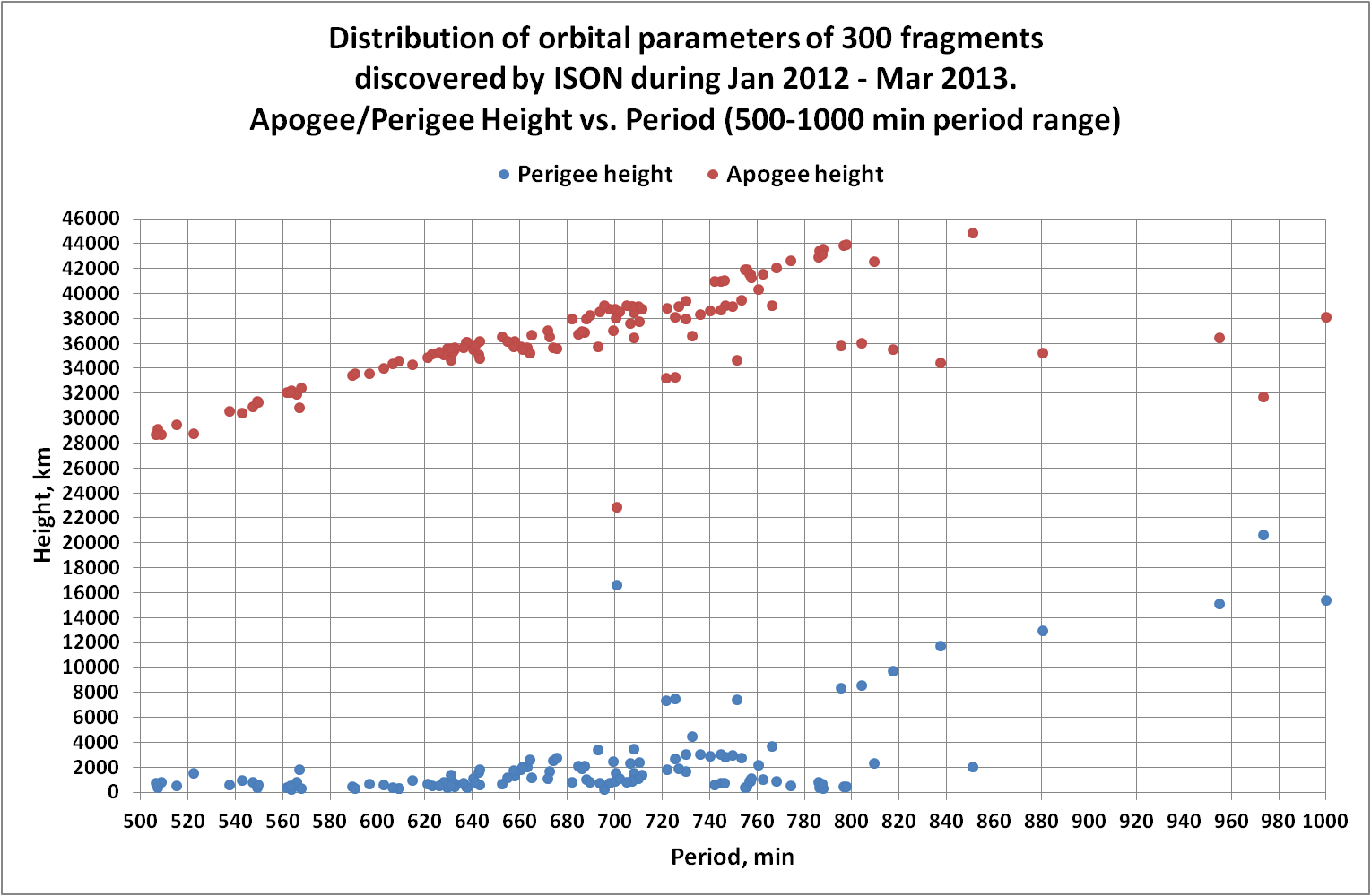
Discovered fragments.

Slide 15
Unusual HAMR object 90212 at polar orbit
Discovered on Nov 8, 2012
Orbit is very unusual – object is located in a nearly “empty” part of space
No candidates for a “parent” after analysis of evolution for 1980-2013 time frame
AMR ~ 20 sq.m/kg
Brightness at observation is varying between 11.7 and 14.0 mag
Date | Period, min | Inclination, deg | Eccentricity
09.11.2012 | 278.35 | 90.78 | 0.00375
01.12.2012 | 278.48 | 90.81 | 0.05338
01.01.2013 | 278.56 | 90.97 | 0.09513
01.02.2013 | 278.54 | 91.28 | 0.09499
01.03.2013 | 278.66 | 91.55 | 0.07905
01.04.2013 | 278.96 | 91.61 | 0.09838

Slide 16
Unusual GEO HAMR object 90310
First detected on Oct 31, 2012 and Nov 1, 2012 as bright (10.8-13.2 mag) uncorrelated object in surveys performed by ISON telescope in Cosalá (Mexico)
AMR ~ 20 sq.m/kg
For the first time bright HAMR object was detected at 0.1 deg inclination ‘true GEO’ orbit with eccentricity 0.0008
Because regular surveys of the whole GEO arc are performing there is no chance the object was missed in earlier observations
As of Apr 15 eccentricity of the object increased to 0.44 and inclination increased to 0.71 deg

