Slide 1
Improved SSA through Orbit Determination of Two-Line Element Sets
David A. Vallado, Benjamin Bastida Virgili, and Tim Flohrer
Paper 6ECSD 13-4a.0-7 presented at the 6th European Conference on Space Debris in Darmstadt, Germany, 2013 April 22-25

Slide 2
Outline
Introduction
  Two-Line Element Sets (TLEs)
Problem Definition
  TLEs have no covariance
  Operations increasingly require covariance
Previous Studies
Process
Results
Conclusions

Slide 3
Introduction
Development
  SGP
    Drag through mean motion rates
  SGP4
    Drag through Bstar and analytical development
    Developed in late 1960’s and early 1970’s
      Brouwer and Kozai theories (1959)
    Documentation
      1980 – Consolidated code
      2006 – update from various versions (code and description)
      2008 – initial effort to assemble an OD version
Widespread Use
  Large data bases exist for a majority of the space catalog
    www.Celestrak.com
    www.space-track.org

Slide 4
Introduction
Force models
  Simplified J₂ - J₅ zonals
  Bstar for Atmospheric Drag
  Simplified terms for 3rd body, SRP
Much investigation
  Hartman 2003, Boyce 2004, Muldoon et al. 2009, Flohrer et al. 2008, 2009, etc.
Comparisons
  To Reference orbits (high quality)
  To TLEs over time (lower quality)

Slide 5
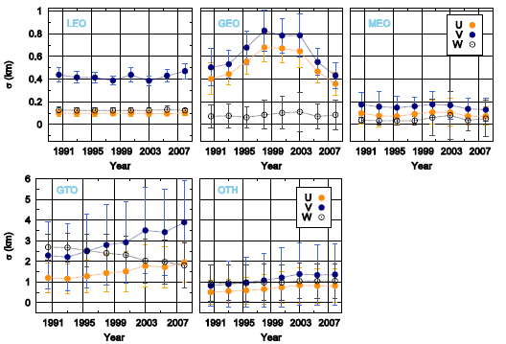
Whole Catalog processing
Flohrer et al. 2008, 2009

Slide 6
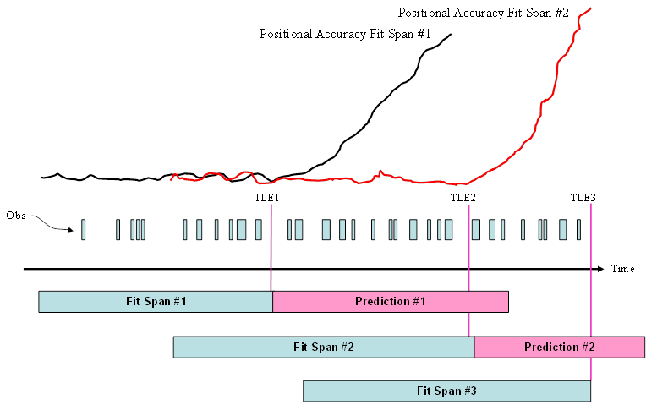
TLE Formation and Prediction
Fit Spans
  Uncertainty increases with prediction

Slide 7
OD Processing and Prediction
Comparison to future TLEs
  KF processing, initial uncertainty 1 km
    Vallado and Cefola (2012)

Slide 8
OD Processing and Prediction (II)
Comparison to future TLEs
  KF processing, initial uncertainty 5 km

Slide 9
Process
Develop Orbital Classes to study
Sub-categories
  Active (maneuvering)
  Calibration
  Debris – fragments, PL, RB, Mission Related Objects (MRO)
Examine options
  How to form the reference orbit
    Backwards, midpoint, etc
  OD Force Models
  OD Fit Span
  Number of TLEs used
  Object Size

Slide 10
Orbital Categories
Satellite Catalog Feb 2013
  ~17000 objects
  Satellites tested
    ~74%

Slide 11
Force Models
Gravity
  JGM3 30 × 30
  JGM3 8 × 8 GEO
Atmosphere
  NRLMSIS-00
Third Body
Solar Radiation pressure

Slide 12
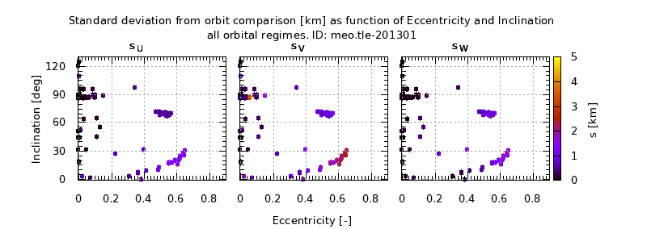
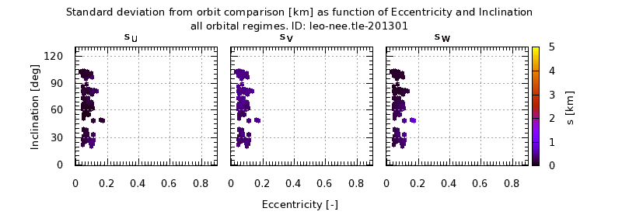
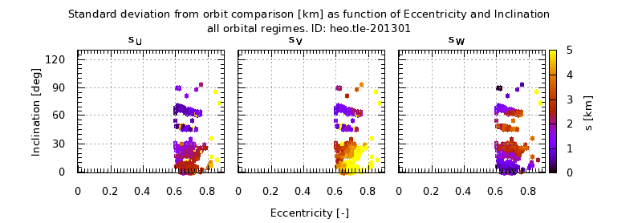
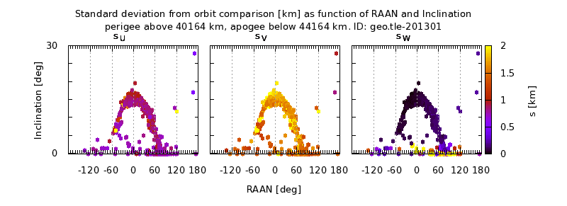
Results – UVW components
Eccentricity vs Inclination
  Uncertainty during OD of TLE ephemeris
  LEO, MEO, HEO, GEO

Slide 13
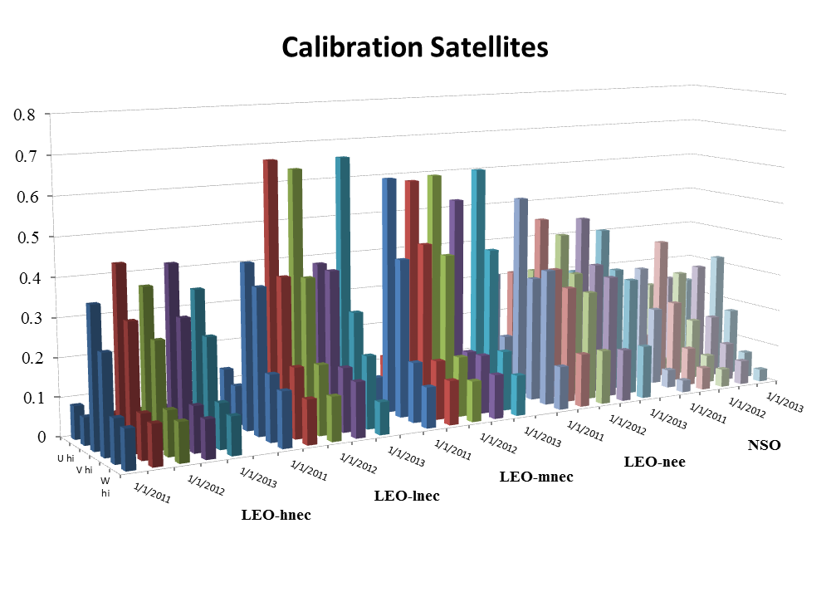
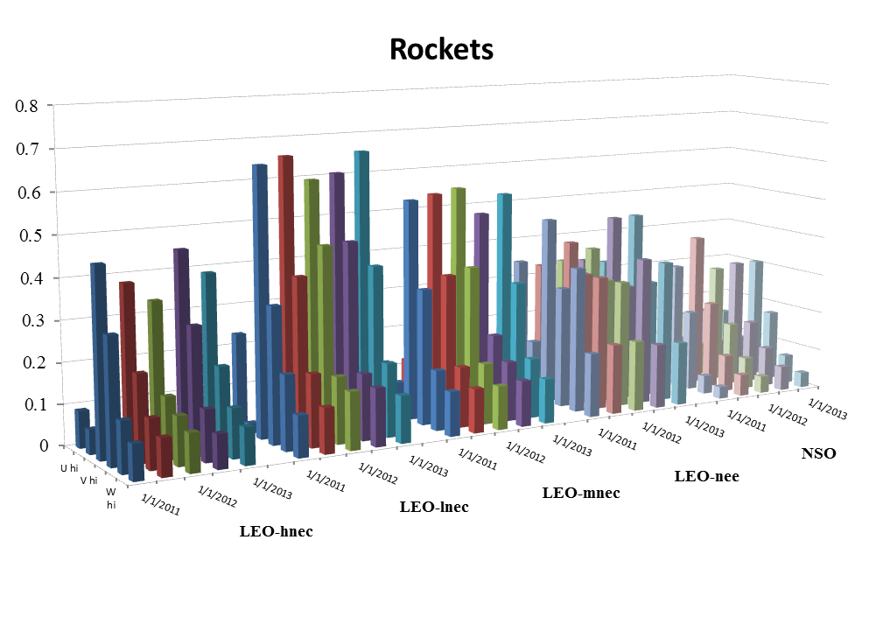
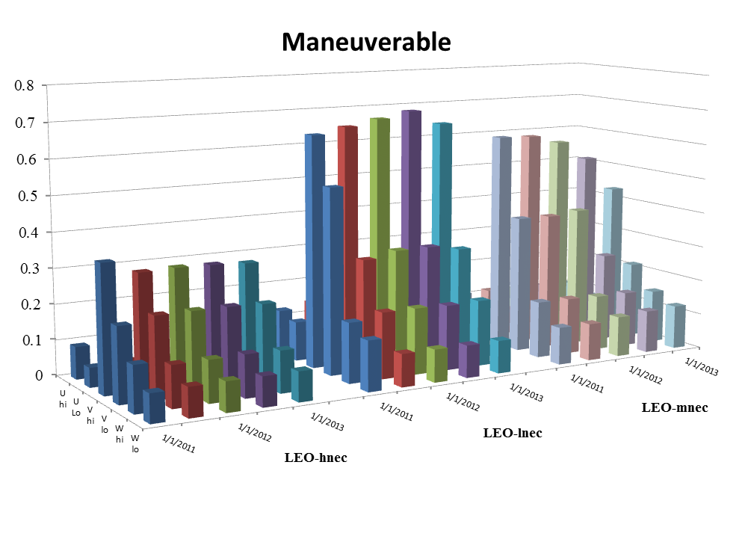
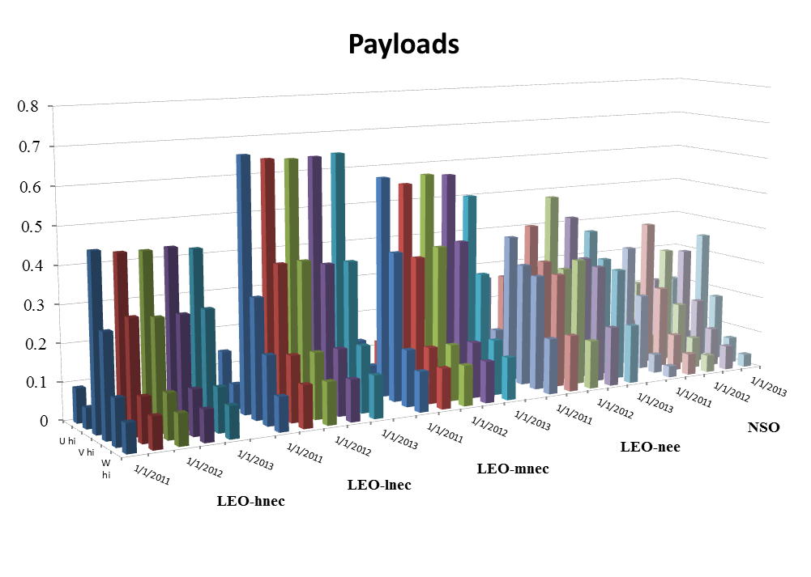
Results – smaller uncertainty

Slide 14
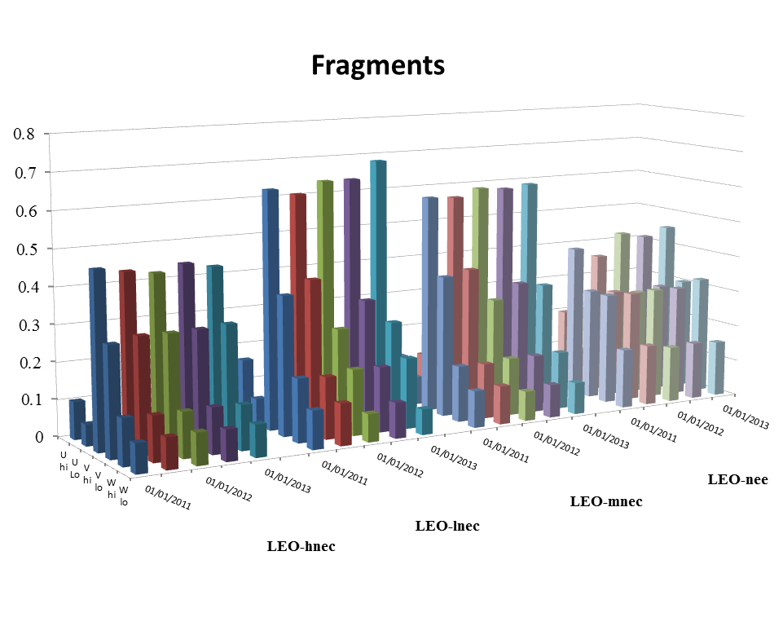
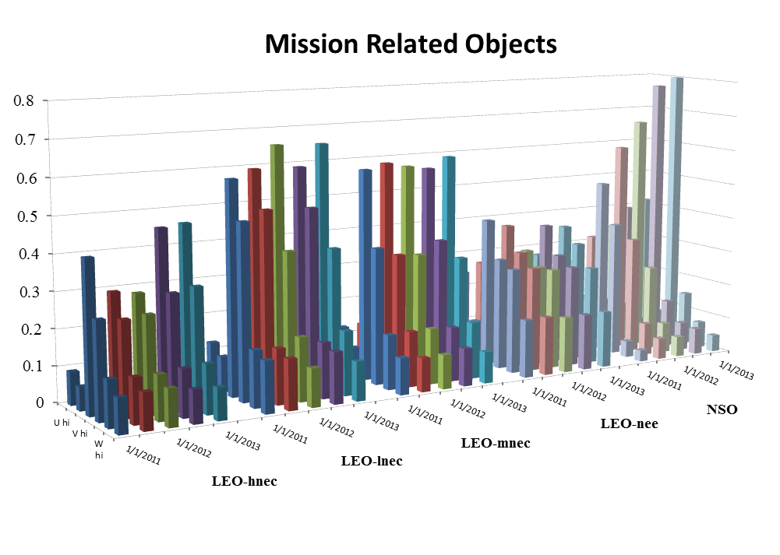
Results – smaller uncertainty

Slide 15
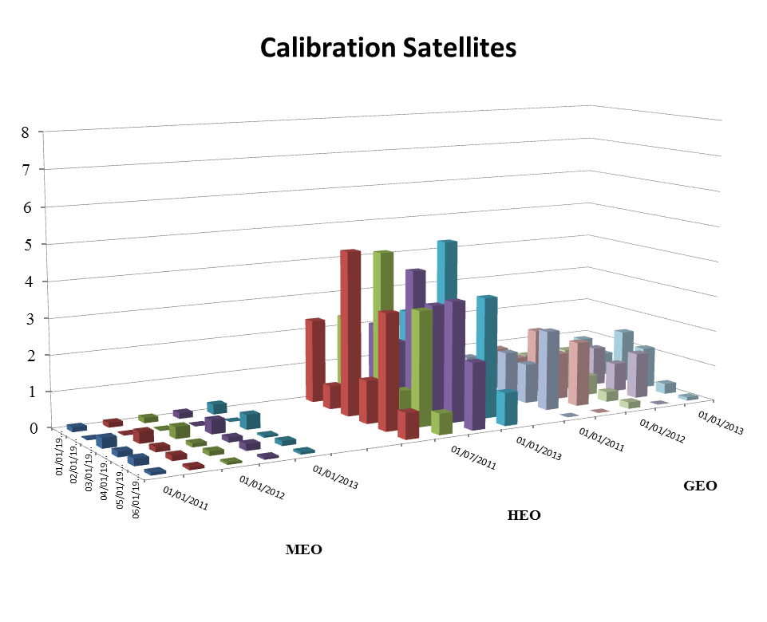
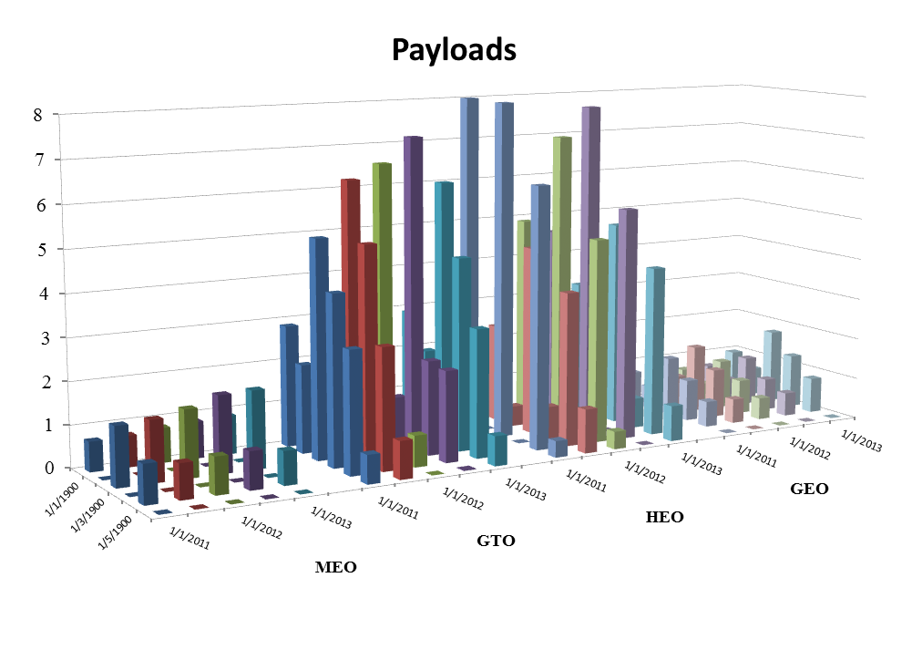
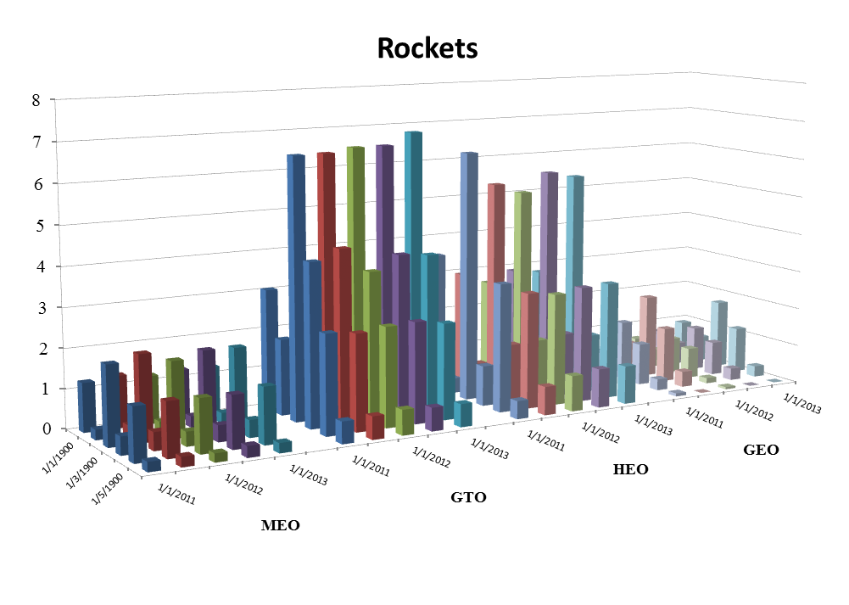
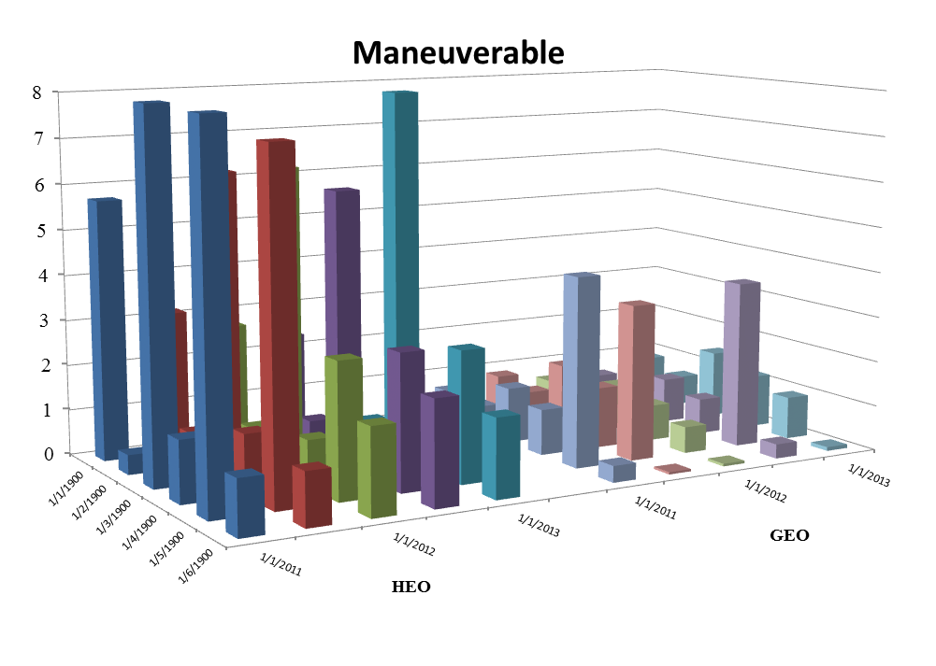
Results – larger uncertainty

Slide 16
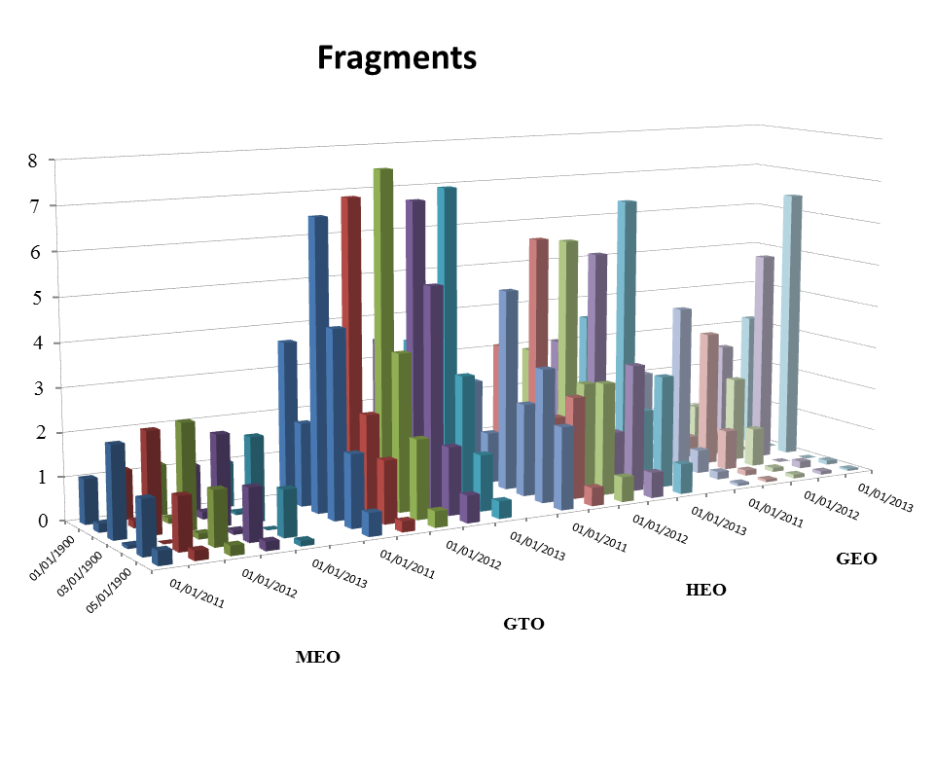
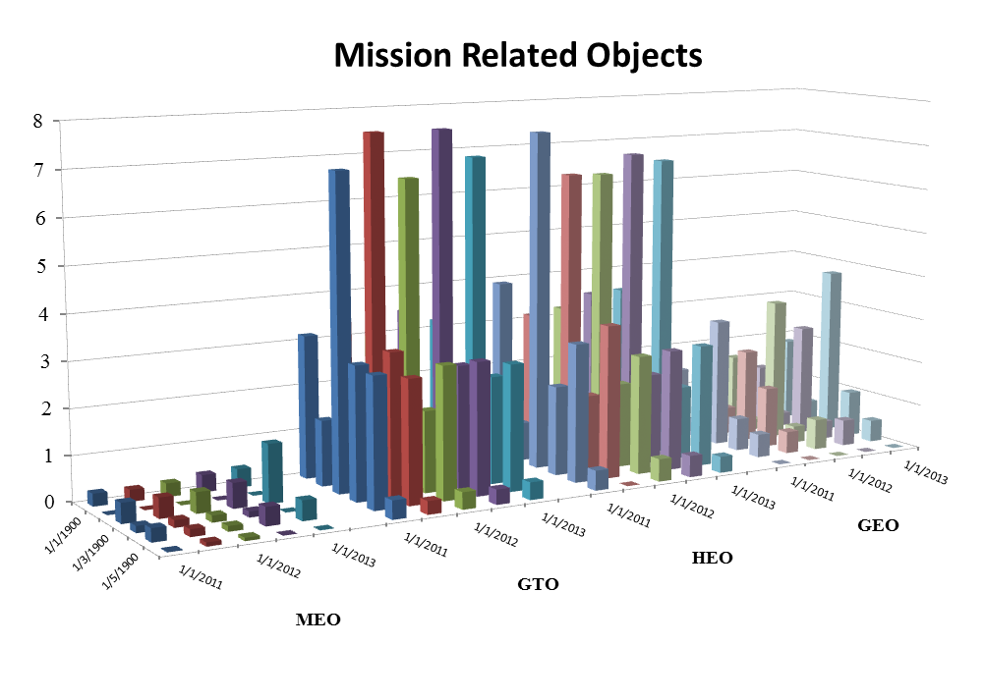
Results – larger uncertainty

Slide 17
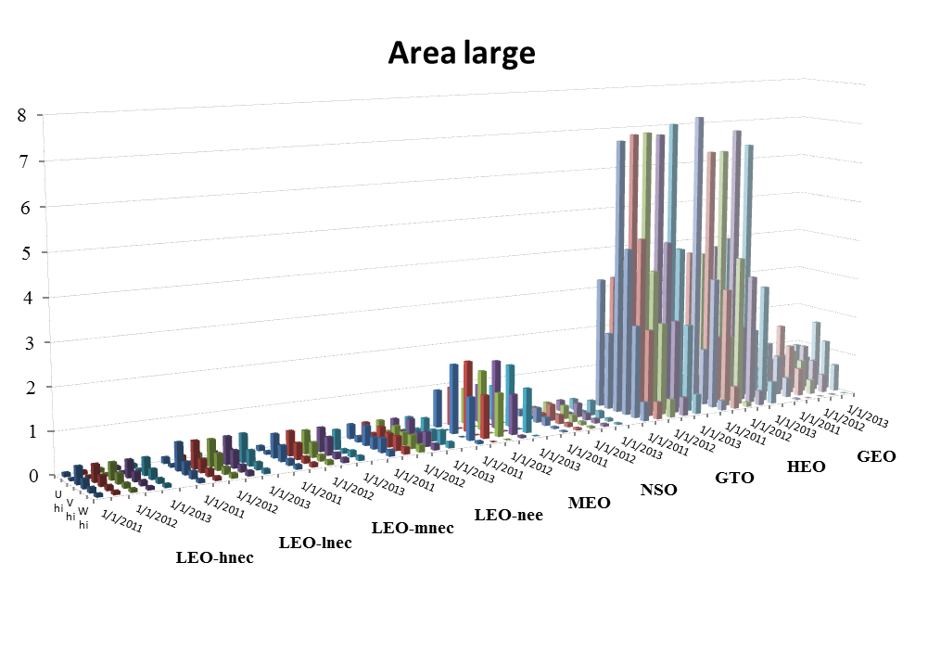
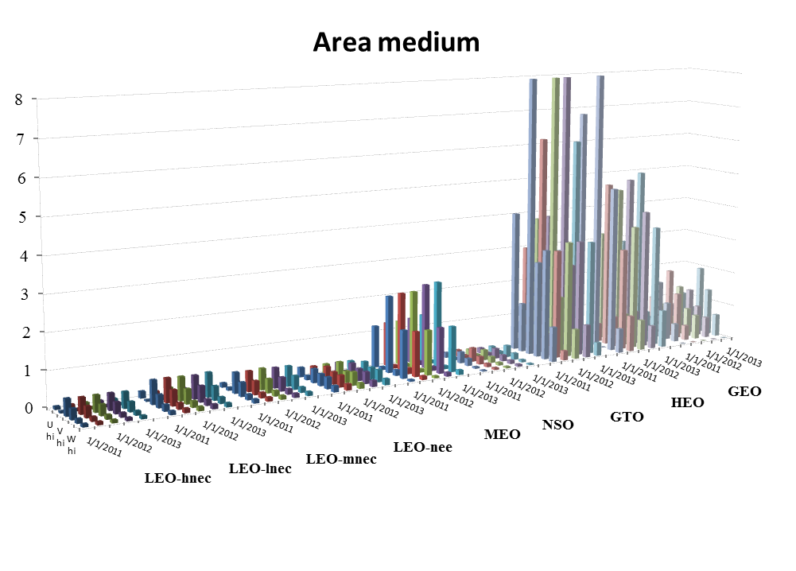
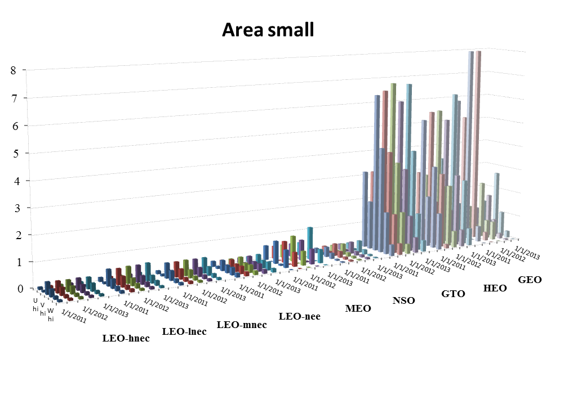
Object Size Results

Slide 18
Conclusions
Confirmed earlier results:
  Number of TLEs did not seem to matter
  Force models added only a small effect
New results:
  Reference orbit formed backwards appears to perform better
  Force models do not seem to make much difference
    Gravity and atmospheric in particular
  Object size
    Unable to find correlation between category and size
  Object type seemed to be a factor in some cases…
    Category, maneuverable, calibration, etc.
  Fit span
    Observed larger uncertainty with longer fit spans

Slide 19
Conclusions
Largest uncertainty in almost all cases was in the along-track direction
  GEO radial
HEO and GTO orbits consistently experienced largest uncertainty
  Then GEO and MEO
  Then the NSO
  Then all the LEO orbits
TLE Epoch “uncertainty”
  LEO ~ 0.5 km
  NSO ~ 0.5 km
  MEO ~ 1-2 km
  GEO ~ 2-4 km
  HEO and GTO ~ 6-8 km

Slide 20
Questions?

