Slide 1
Analysis of Accuracy of Orbital Data in the ISON GEO and HEO Objects Database
Vladimir Agapov, Victor Stepanyants, Alexandr Samotokhin, Igor Molotov
Keldysh Institute of Applied Mathematics RAS
Natalia Golosova, Alexandr Lapshin
Astronomical Scientific Center “Project-technics”, JSC
6th European Conference on Space Debris
April 22-25, 2013, Darmstadt, Germany

Slide 2
International Scientific Optical Network
ISON is an open international non-government project developed to be an independent source of data about space objects for scientific analysis and S/C operators
Additional scientific goals – discovery and study of asteroids, comets and GRB afterglows
ISON optical network represents one of largest systems specializing in observation of space objects
Cooperative project already joins 33 observation facilities of various affiliation in 14 countries. Overall coordination is performing by the Keldysh Institute of Applied Mathematics of the Russian Academy of Sciences (KIAM).
Maintenance and operation of the network is performing jointly by KIAM and Astronomical scientific center (ASC) “Project-technics”, JSC

Slide 3
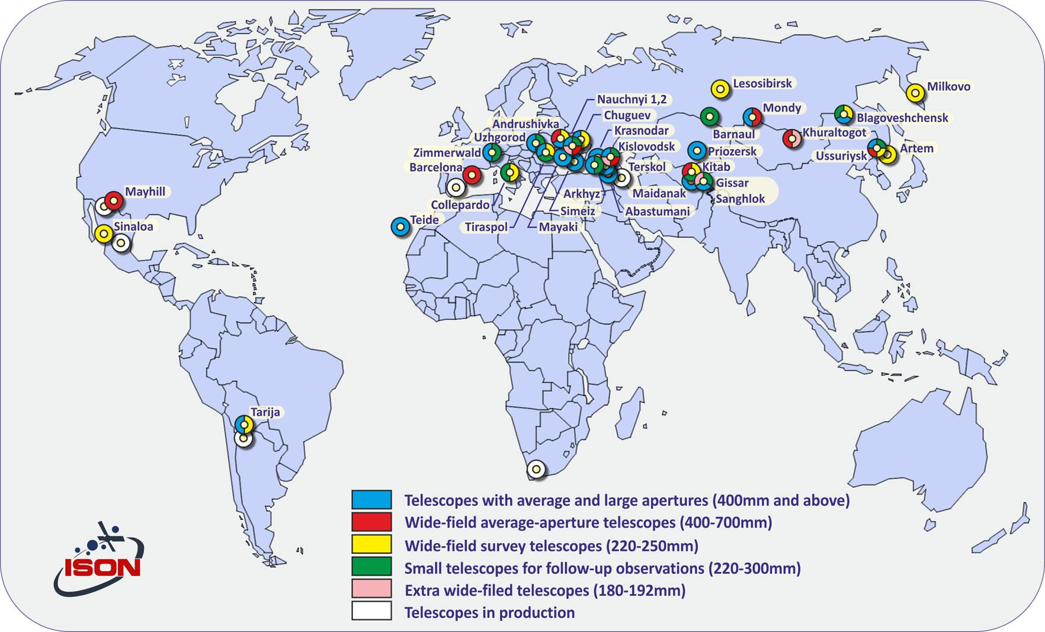
Map of ISON observatories

Slide 4
ISON Database
As of the mid of April 2013 stores:
Measurement, orbital and descriptive information on ~4800 objects ever observed by ISON, including
more than 1800 ones in GEO region,
more than 2700 ones at HEO orbits,
more than 270 ones at MEO orbits.
More than 15.6 millions of astrometric position (RA, DEC) measurements
More than 14.8 millions of brightness measurements
More than 2 millions records on estimated parameters of orbits and the corresponding covariance matrices of errors

Slide 5
Orbital Data in the ISON Database
Obtained by means of processing of positional measurements
Least squares method and numerical integration motion model are being used for orbit determination and propagation
6 (state vector), 7 (state vector + SRP coefficient or ballistic coefficient) or 8 (state vector + SRP coefficient + ballistic coefficient) parameters are usually estimated
Fit span for orbit determination:
automatically determined for ‘active’ objects (including the majority of HAMR ones)
2-5 months for ‘passive’ GEO objects and 1-2 months for ‘passive’ HEO ones (except those having H_{π}<(400-500) km), depending on measurement quantity and distribution over the fit span
A-priori data can be used in orbit determination if the fit span is too short

Slide 6
Accuracy vs. Precision
The ‘accuracy’ term should not be confused with the ‘precision’ one
To describe the accuracy of a measurement combination of the trueness and the precision is used in ISO 5725-1.
Trueness refers to the closeness of the mean of the measurement results to the "correct" ("true") value and precision refers to the closeness of agreement within individual results (thus defining the repeatability or reproducibility of the measurement).
Therefore, according to the ISO standard, the term "accuracy" refers to both trueness and precision.

Slide 7
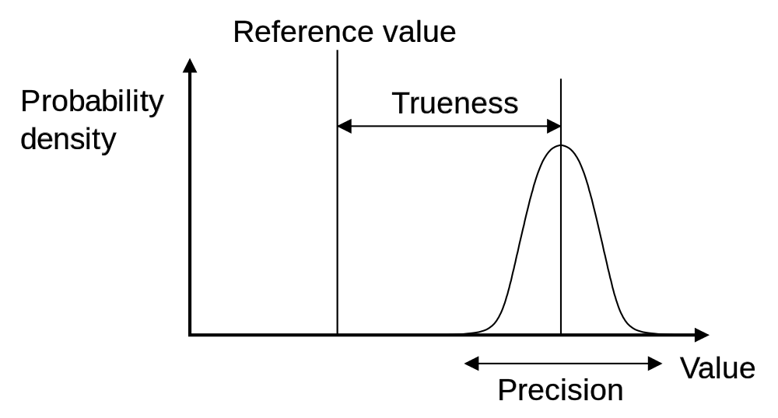
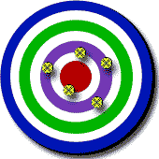
Accuracy vs. Precision (2)
Low accuracy,
good trueness,
poor precision
Low accuracy,
poor trueness,
good precision
High accuracy,
good trueness,
good precision

Slide 8
Accuracy of Orbital Data – Various Visions
Whether an orbit can be considered as ‘accurate’ (i.e. close enough to the ‘true’ one and precise), depends on the practical requirements:
spacecraft control requirements (for example, narrow FOV ground antennas pointing constraints, station-keeping constraints etc.)
spacecraft mission requirements (VLBI, geodesy, GNSS, mapping, proximity operations, formation flying, constellations etc.)
spacecraft user/customer requirements (fixed antenna pointing constraints for given frequency band etc.)
specific application requirements (conjunction assessment and avoidance maneuver decision making, provision of guaranteed repeated (follow-up) observability of an object, orbital archive/catalogue maintenance etc.)
It would be ideal if an orbit could be determined with high accuracy in each case, i.e. with both good trueness and good precision

Slide 9
Accuracy of Orbital Data – ISON Vision
Necessity to establish appropriate procedures to estimate and control ‘accuracy’ is dictated by the ISON operational constraints as well as by requirements defined by tasks solved with ISON measurements
Key requirements to define ‘accuracy’ control procedures:
minimize amount of measurements and observation time per instrument per object (in tasking mode) required to determine an orbit of a trueness level necessary from the point of view of measurement association/orbital archive maintenance tasks
collect sufficient number of measurements at as long time interval per orbit as feasible to maintain appropriate level of trueness for ‘active’ satellite orbits (assuming that perturbations not taken into account by the motion model can occur at every revolution)
implement an observation strategy (combination of survey and tasking modes) which would result in collection of amount of measurements enough to maintain close correspondence between estimated (calculated from covariance matrix of errors) and real (calculated as residuals to a propagated orbit) satellite position errors; important, for example, for reliable prediction of a conjunction circumstances
minimize instrument observation time spent to search a ‘lost’ object by means of keeping precision of the last successive orbit determinations within certain limits
Key requirements to define ‘accuracy’ estimation procedures:
to have, at any given time, an up-to-date measurement statistics for each sensor for proper measurement weighting in orbit determination process

Slide 10
ISON Operational Procedure for Orbital Database Maintenance
Sensor calibration
estimation of systematic and random measurement error
Observation planning to increase trueness and precision
increasing length of an overall measurement arc per object per night in surveys
“proper” scheduling in tasking mode (estimation of brightness and orbit covariance are taken into account along with sensor and observation condition constraints)
OD procedure:
automatic selection of a fit span
checking consistency between successive OD solutions for the same object (filtering outliers etc.)
making decision on necessity of usage of a-priori information
estimation of OD result quality (max along-track error at the time span equal to orbital period, starting from the last measurement etc.)

Slide 11
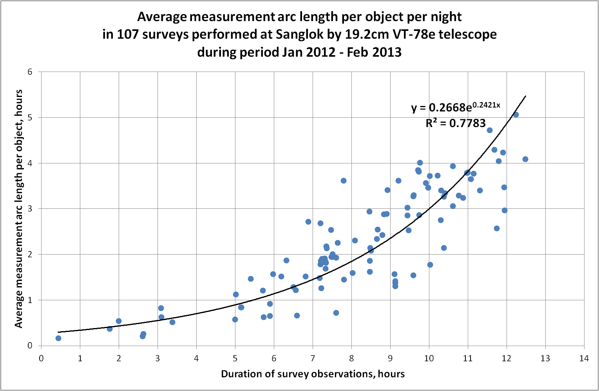
Extended GEO surveys. Measurement arc length. Sanglokh VT-78e.

Slide 12
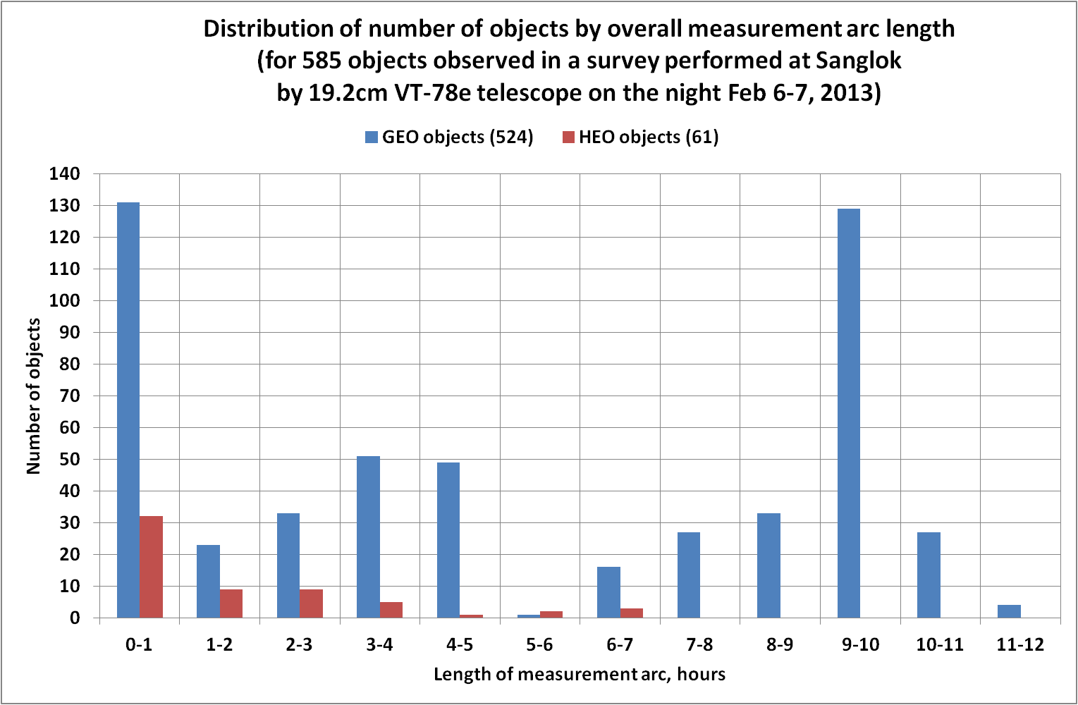
Extended GEO surveys. Measurement arc length. Sanglokh VT-78e.

Slide 13
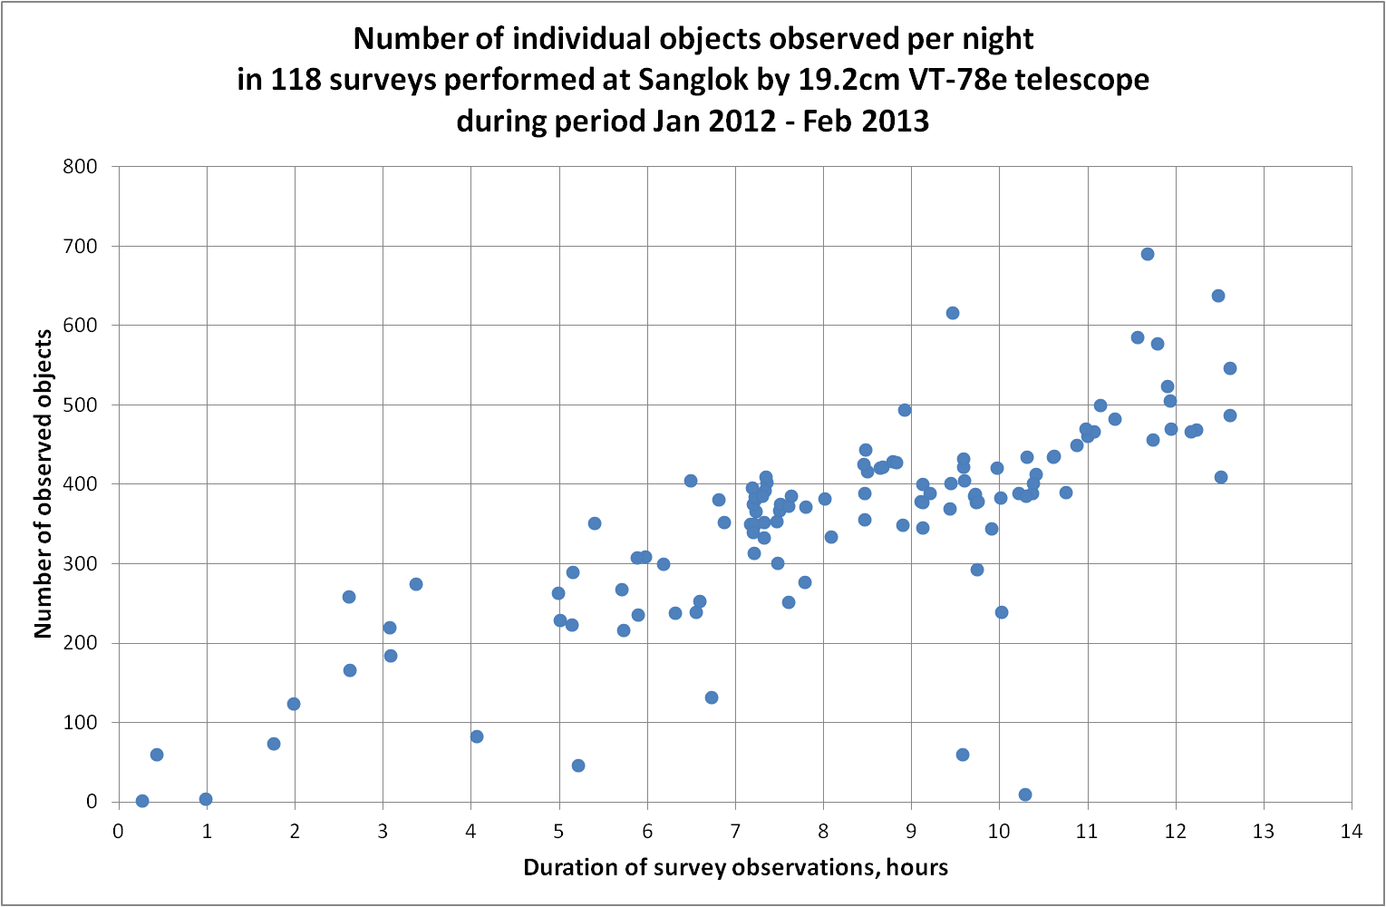
Extended GEO surveys. Number of objects. Sanglokh VT-78e.

Slide 14
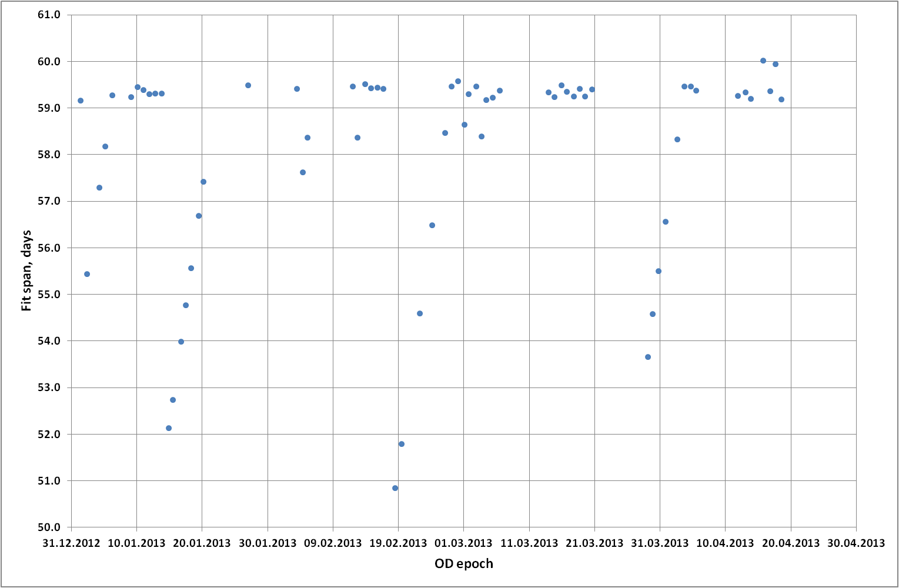
OD Fit Span. Object 2222 (TITAN 3C TRANSTAGE R/B).

Slide 15
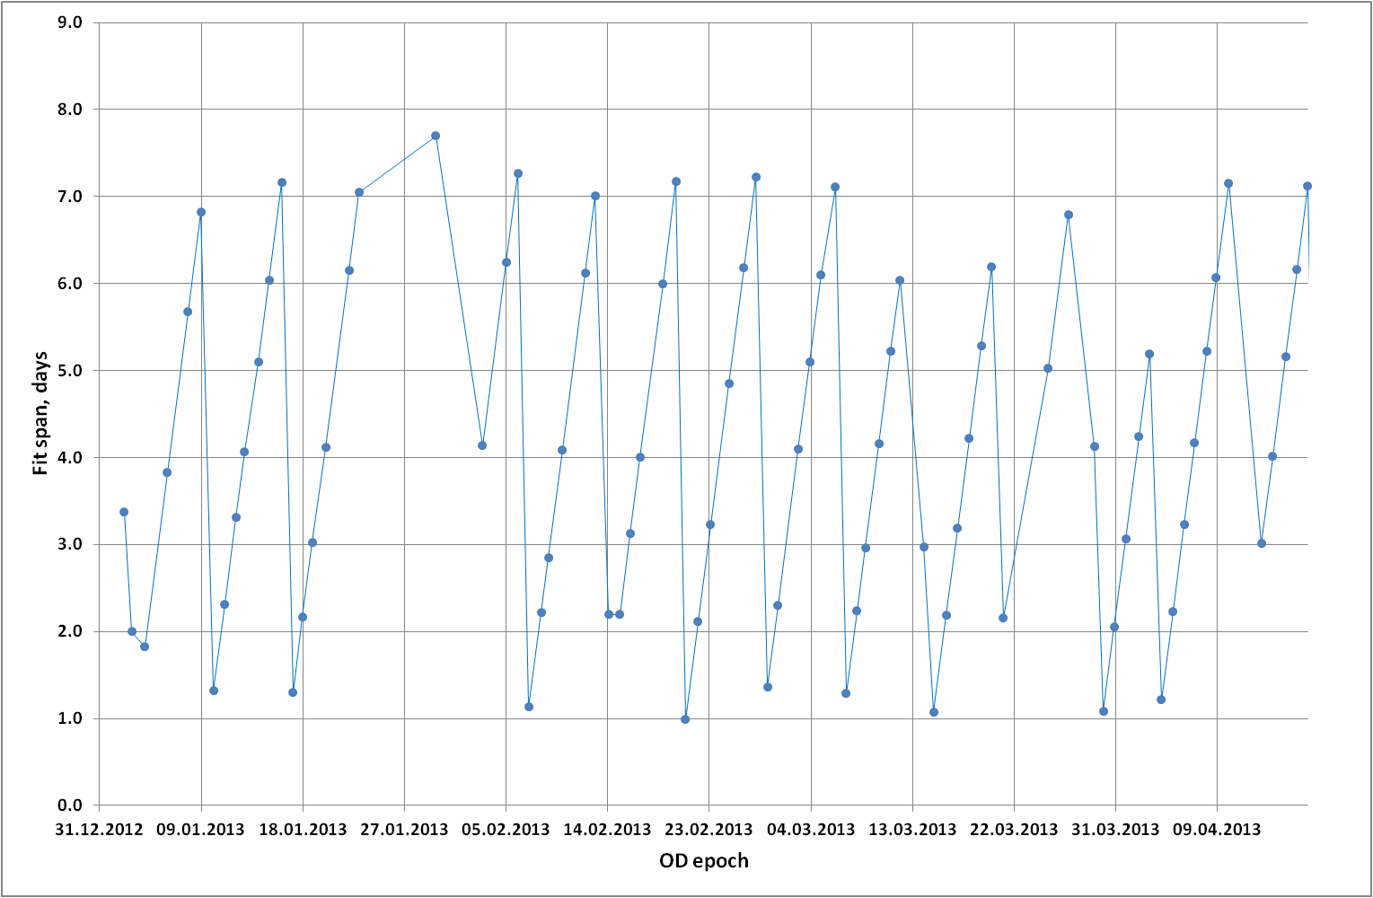
OD Fit Span. Object 23124 (INTELSAT 702)

Slide 16
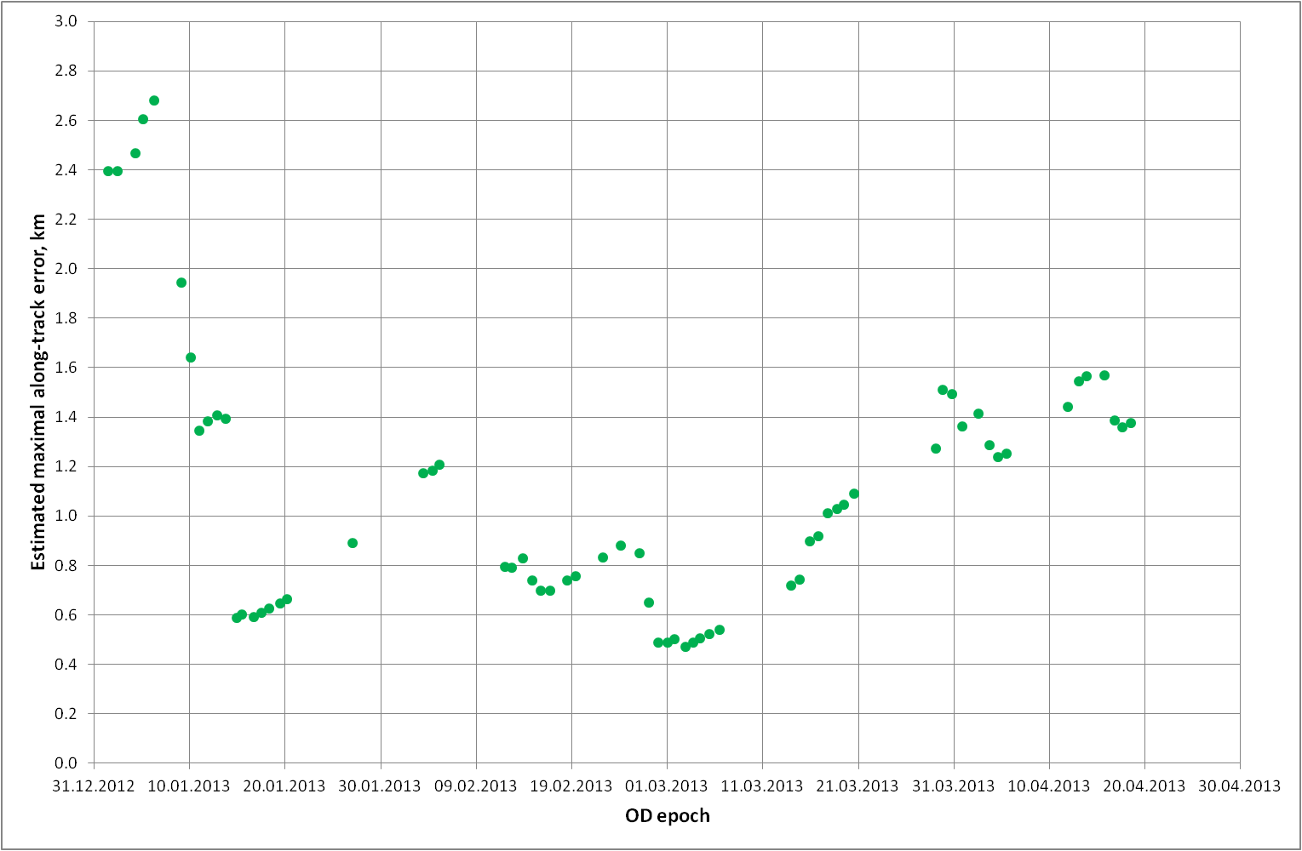
OD Estimated Maximal Along-Track Error. Object 2222 (TITAN 3C TRANSTAGE R/B).

Slide 17
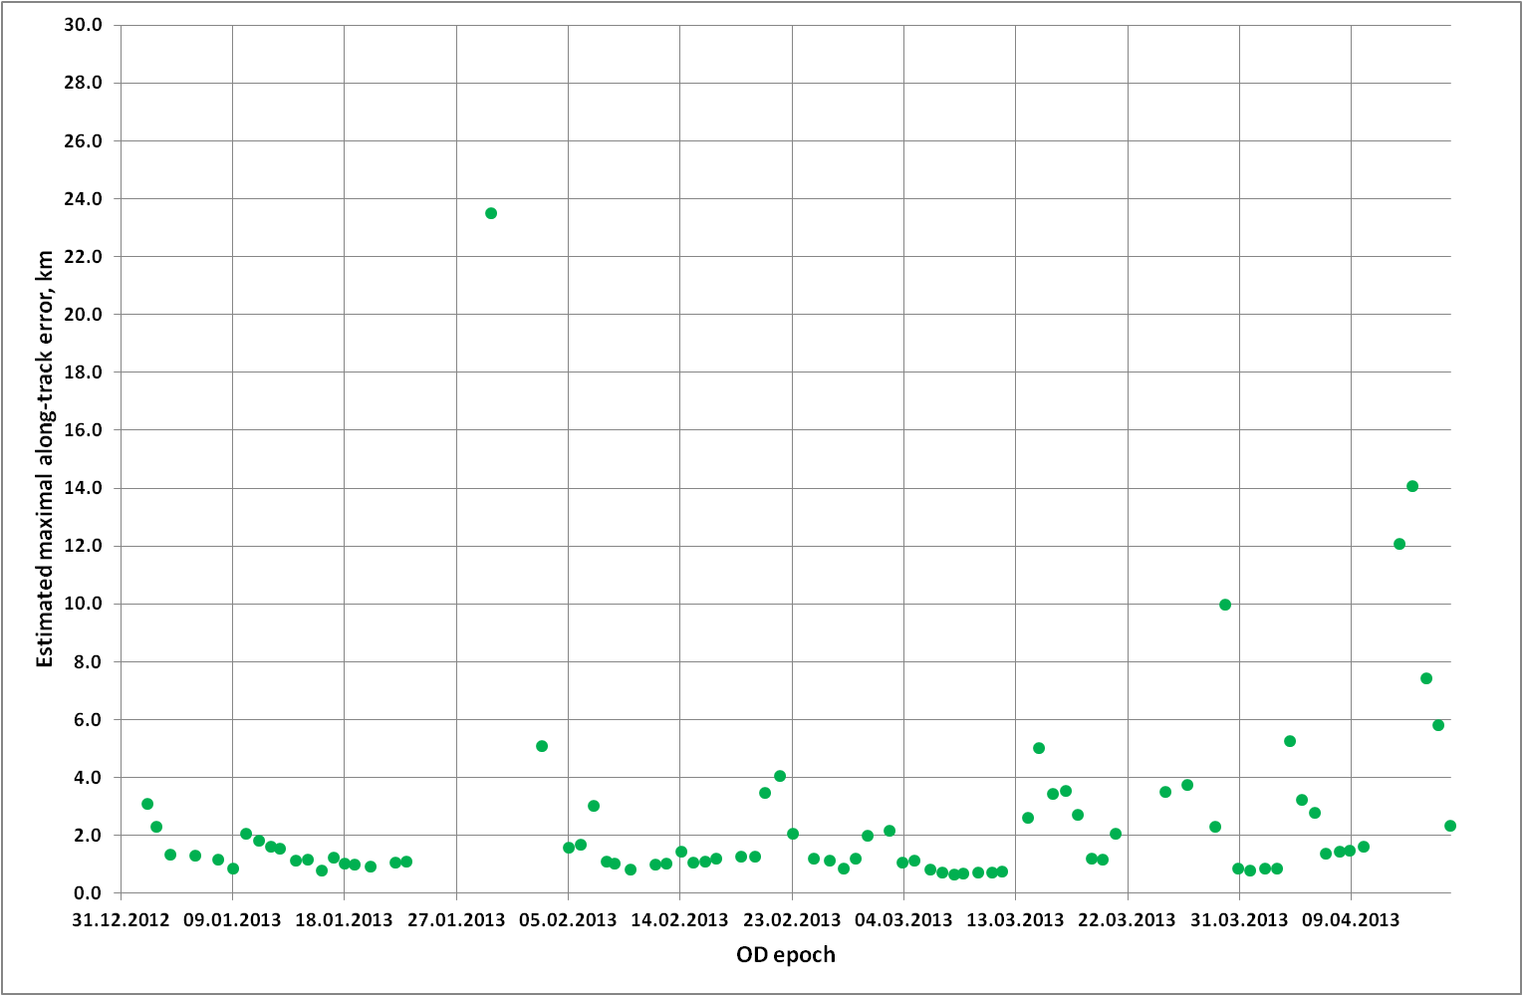
OD Estimated Maximal Along-Track Error. Object 23124 (INTELSAT 702)

Slide 18
ISON Orbit vs. Other Orbits. Example – IS-702 (GEO, 33E)
Data taken for comparison:
Intelsat produced ECF Ephemeris (available at the Intelsat Web-site):
i_ior_e_33.00_IS-702_20130326_000000.txt – considered as a reference (but not necessarily
to be an ‘absolute truth’)
ISON-produced orbit:
5.193 days fit span: 28/03/2013 19:05:50 - 02/04/2013 23:43:23,
257 measurements
J2000 state vector:
02/04/2013 23:43:23.000 UTC
-32227.0671 km
-27203.2051 km
673.726263 km
1.9813562 km/s
-2.3488188 km/s
-0.06652776 km/s
TLE data (object 23124):
epochs 13085.726…, 13087.070…, 13088.839…, 13090.056…, 13092.019…, 13093.080…
switched between each other at appropriate TCA points

Slide 19
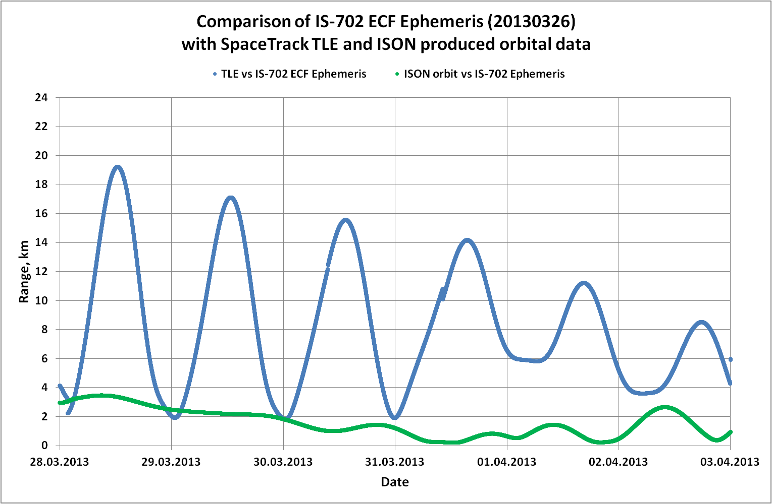
ISON Orbit vs. Other Orbits. Example – IS-702 (cont.)

Slide 20
Conclusions
ISON project database stores information on all obtained measurements and orbital parameters determined with these measurements
Operational procedure for orbital database maintenance is developed and implemented
Efforts are undertaken to establish accuracy estimation and control procedures including improvement in both trueness and precision
Appropriate strategies for objects observation are developed
Standard errors (measured as along-track maximal error value at prediction time span equal to one orbital period) of determined orbits for ‘active’ and ‘non-active’ GEO objects are of the order of 0.6-1.5 km

