Slide 1
Updated information on high altitude HAMR objects tracking by ISON
Vladimir Agapov, Igor Molotov
Roscosmos delegation
Presentation for the WG1 session
32nd IADC meeting, Beijing

Slide 2
KIAM/ISON Database Current Status
«High orbit» is defined as having period more than 200 min
4031 tracking high orbit objects with orbit epoch age not older than 1 year as of May 13, 2014:
3059 (75.9%) observing by ISON and having orbital data published at SpaceTrack
972 (24.1%) observing by ISON and partner teams only (no other public sources of orbital data)
Total number of high orbit objects with A/m > 0.1 sq.m/kg: 704 (225 with orbital data available from both sources/ 479 with orbital data producing by ISON and partner teams only):
A/m between 0.1 and 1 sq.m/kg: 420 (222/198)
A/m more than 1 sq.m/kg (HAMR): 284 (3/281) – 7.04% of total tracking high orbit objects population and 28.91% of tracking by ISON only population
Maximal A/m – 57.9 sq.m/kg

Slide 3
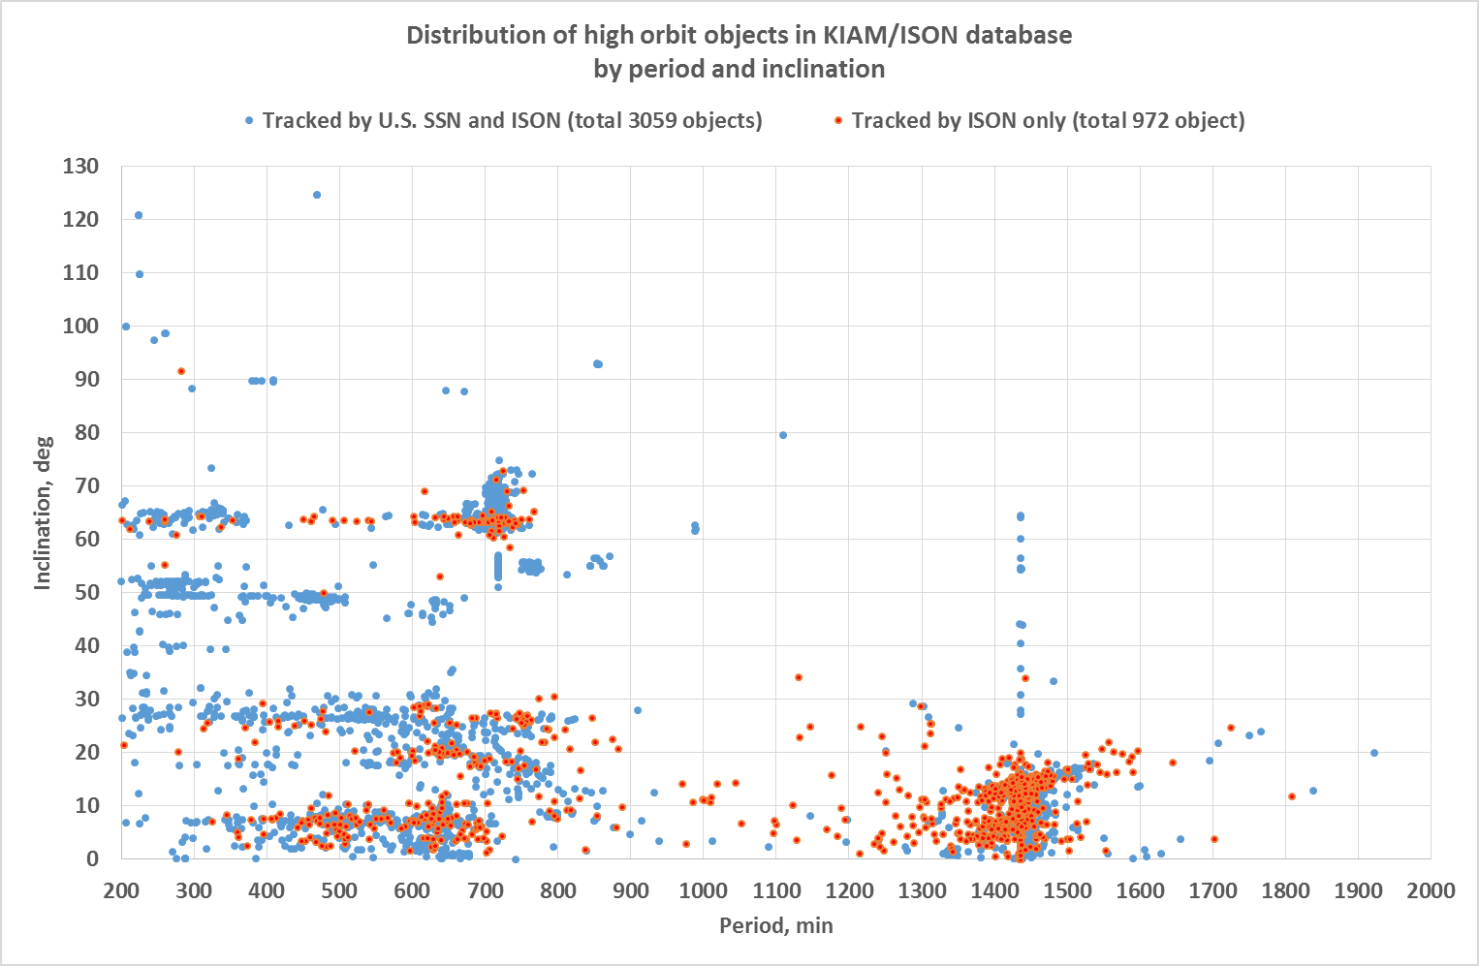
High orbit objects distribution (1)

Slide 4
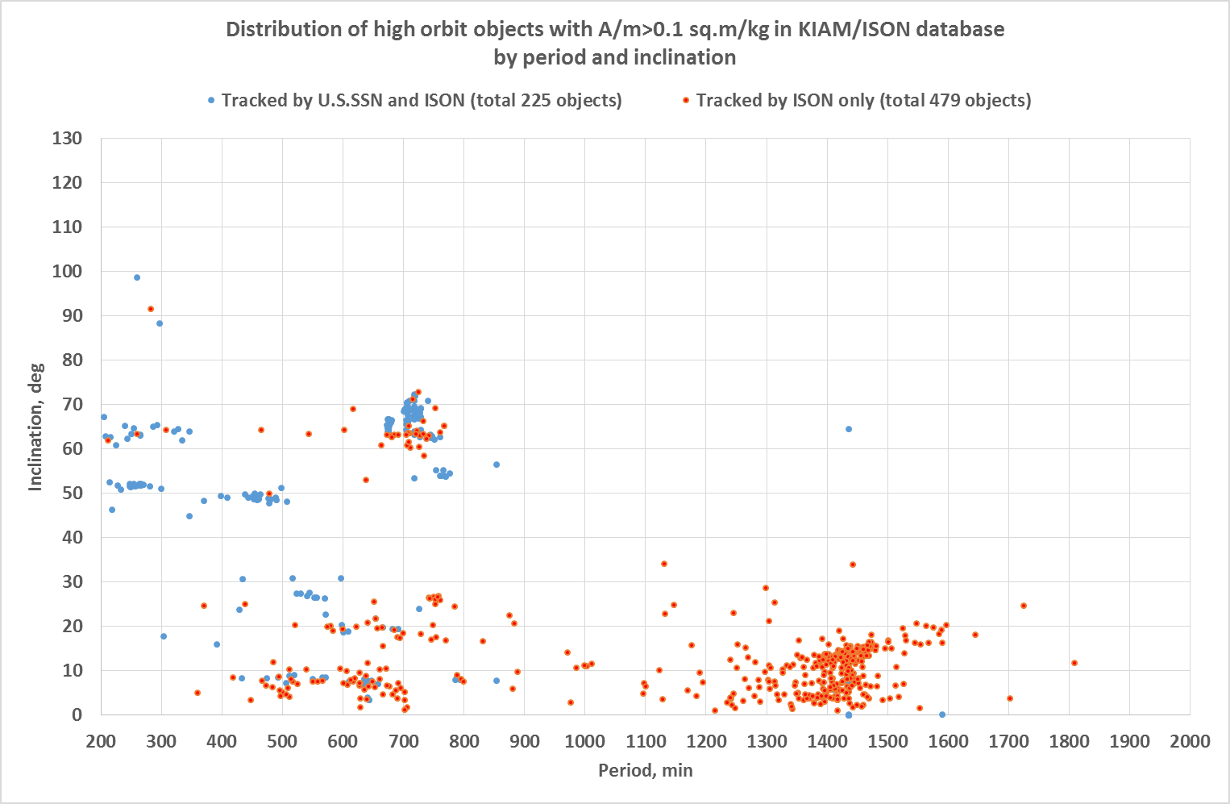
High orbit objects distribution (2)

Slide 5
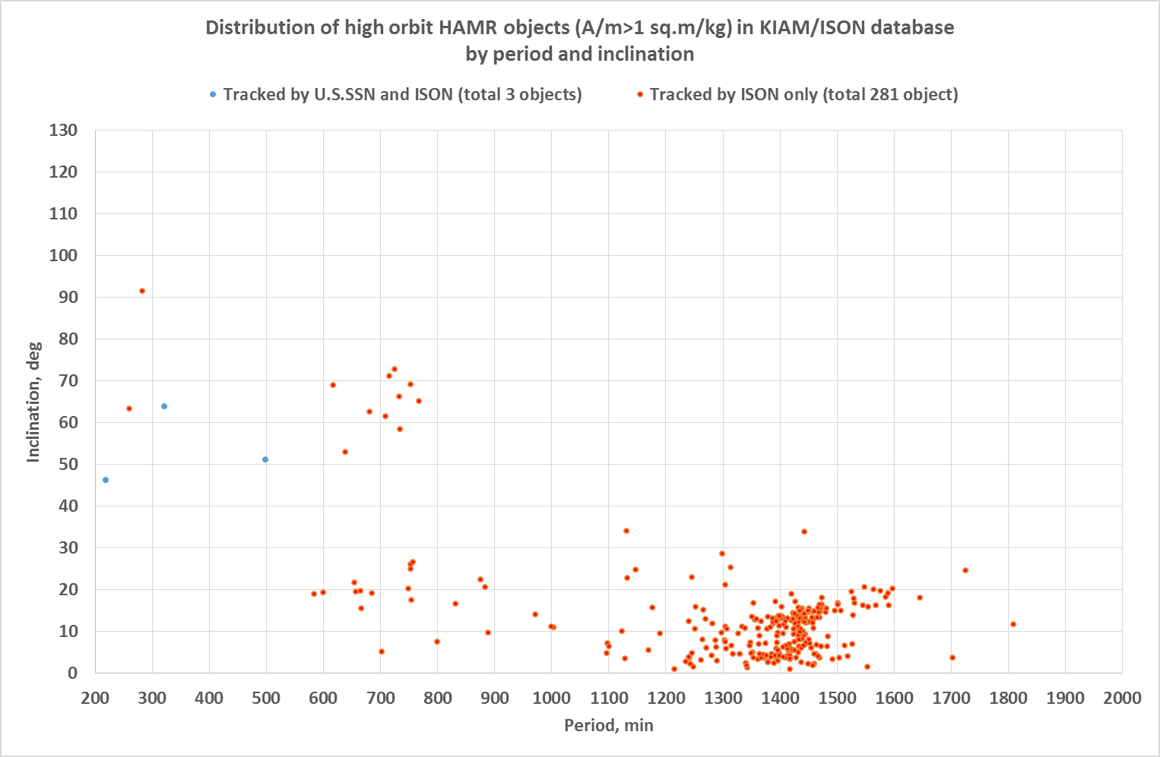
High orbit objects distribution (3)

Slide 6
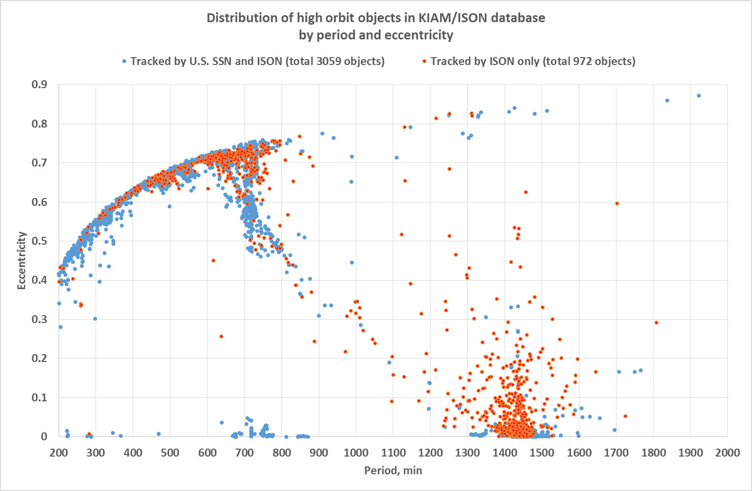
High orbit objects distribution (4)

Slide 7
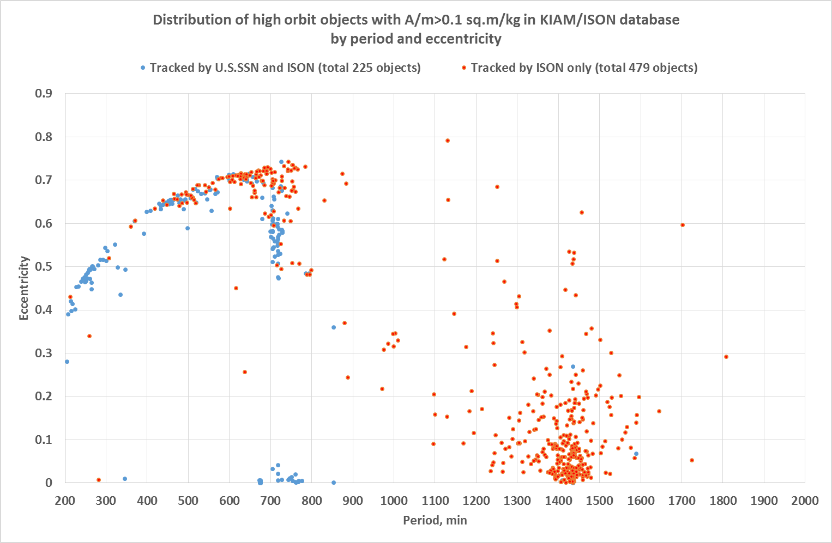
High orbit objects distribution (5)

Slide 8
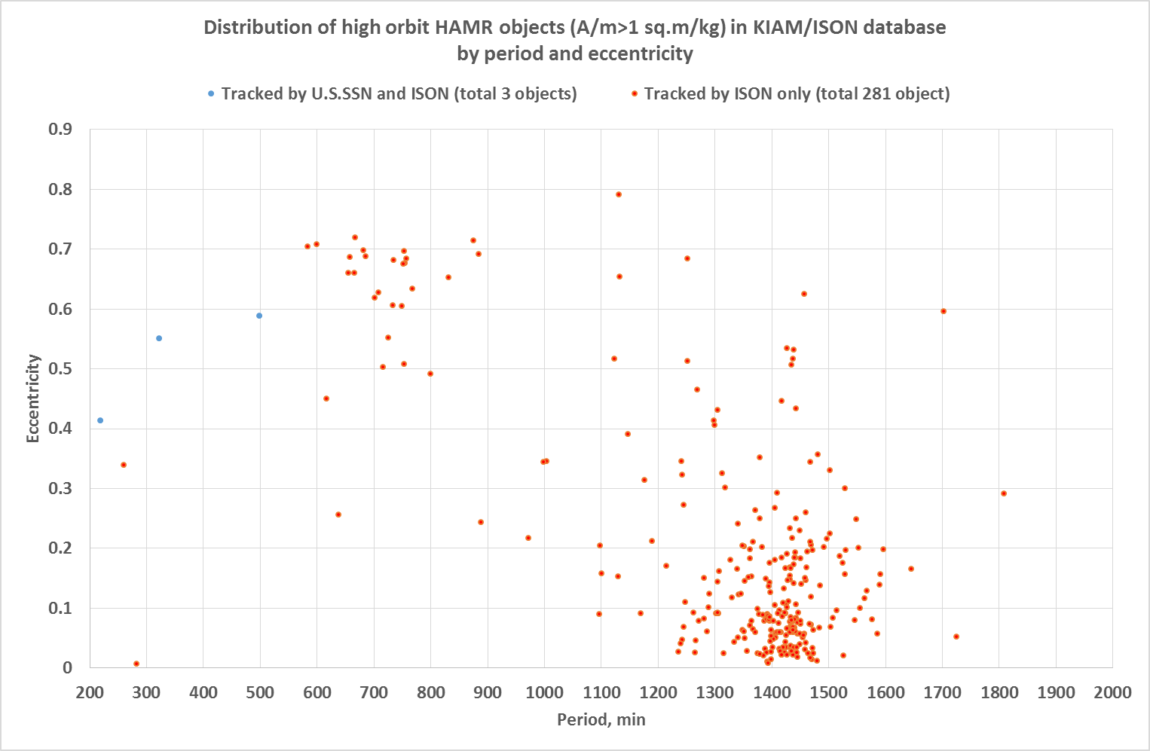
High orbit objects distribution (6)

Slide 9
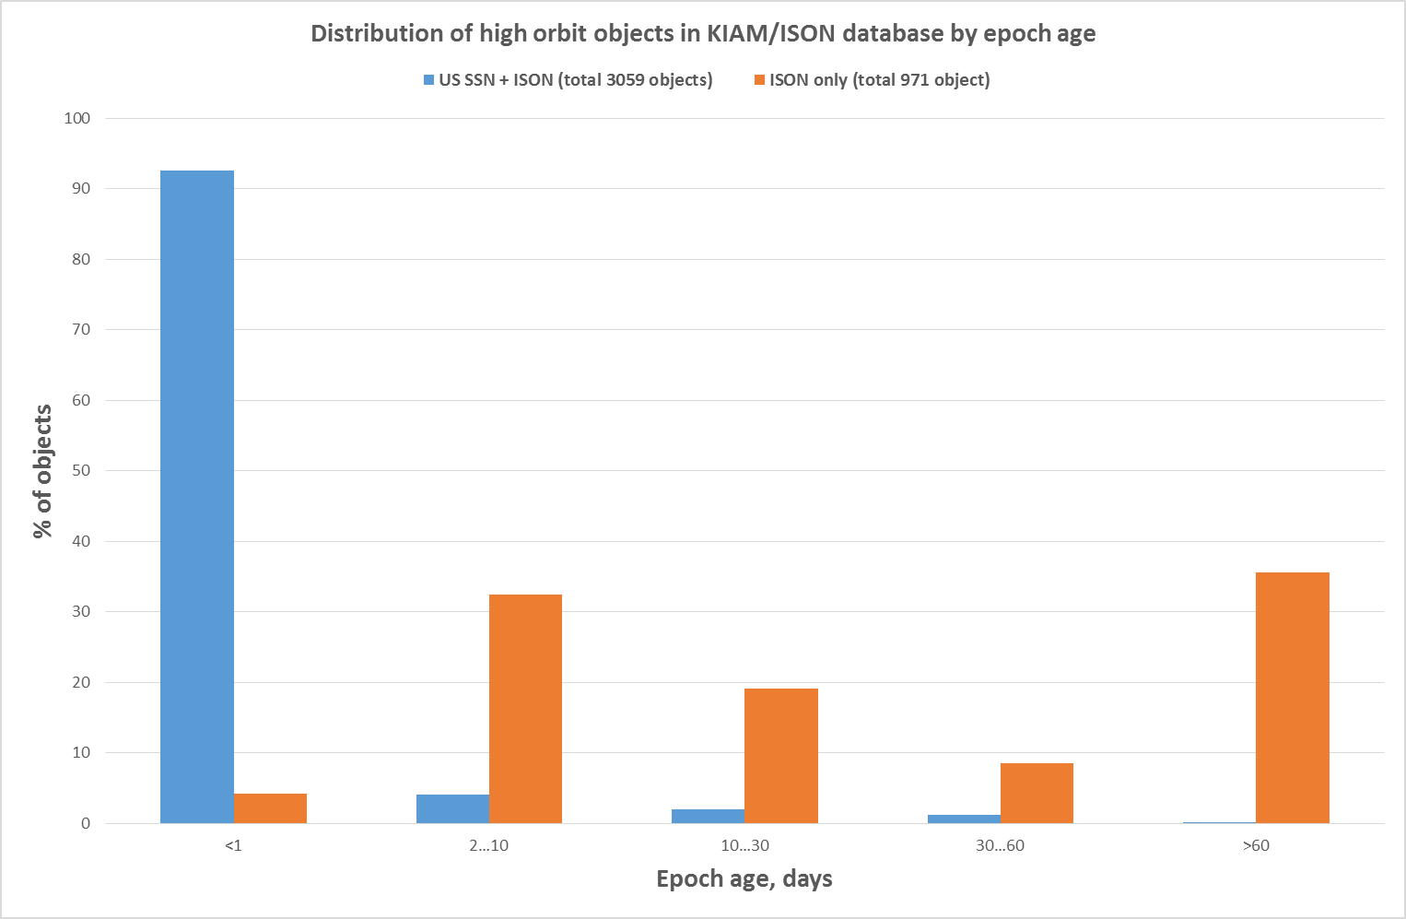
High orbit objects epoch age distribution

Slide 10
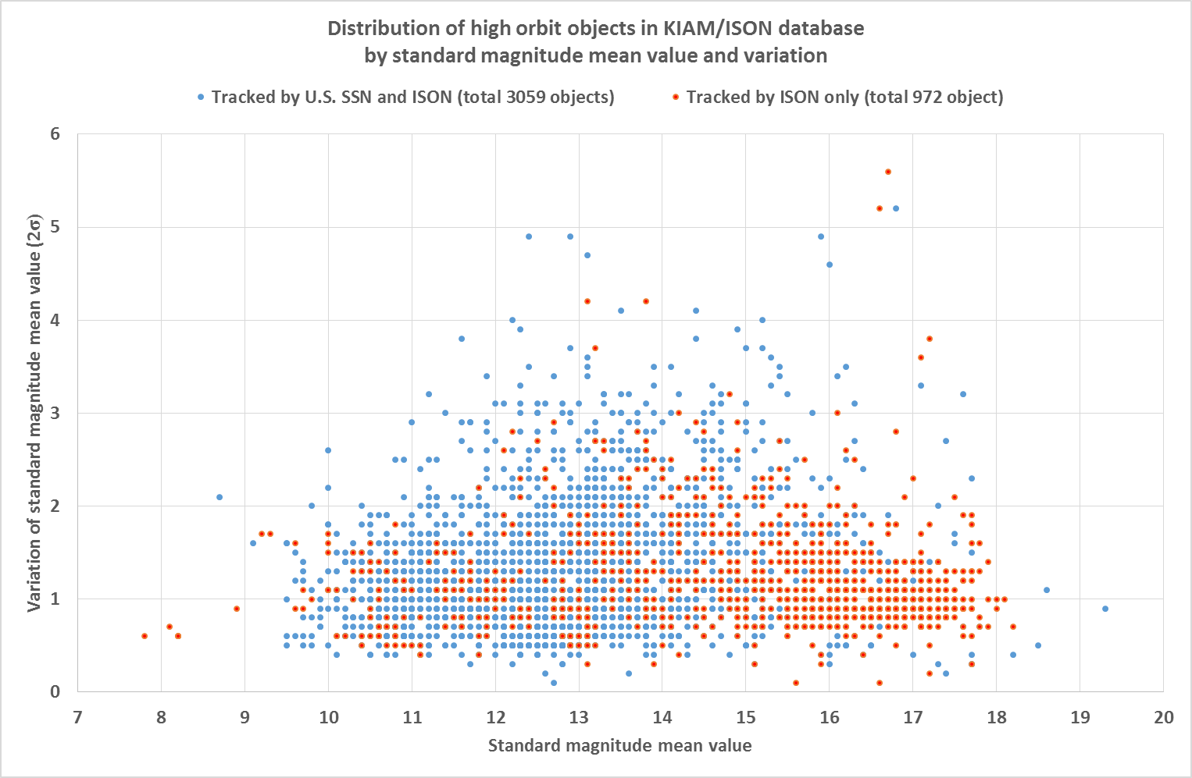
High orbit objects brightness distribution (1)

Slide 11
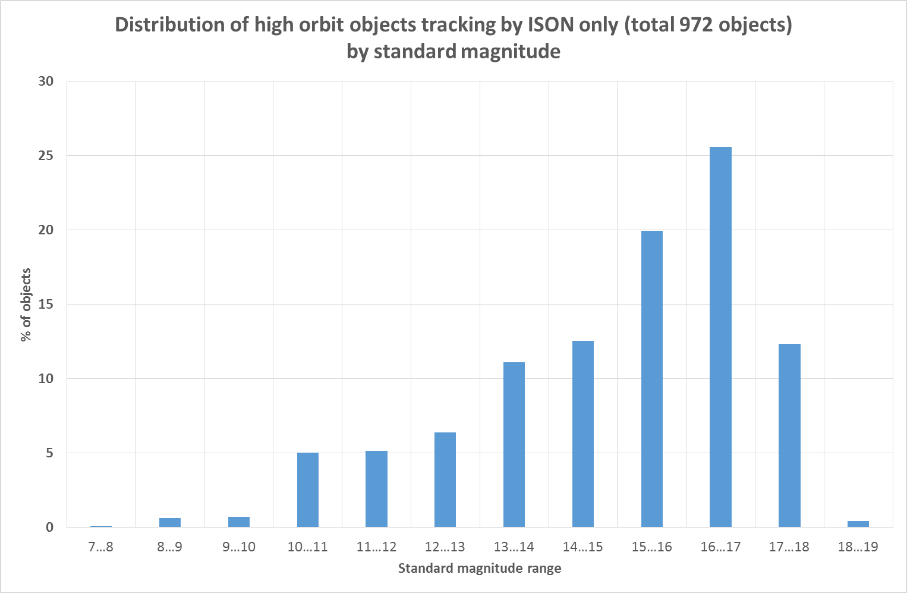
High orbit objects brightness distribution (2)

Slide 12
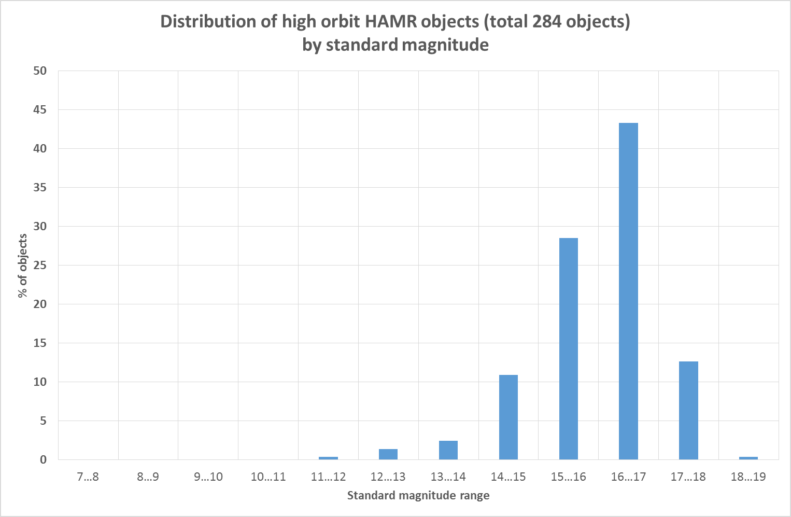
High orbit objects brightness distribution (3)

Slide 13
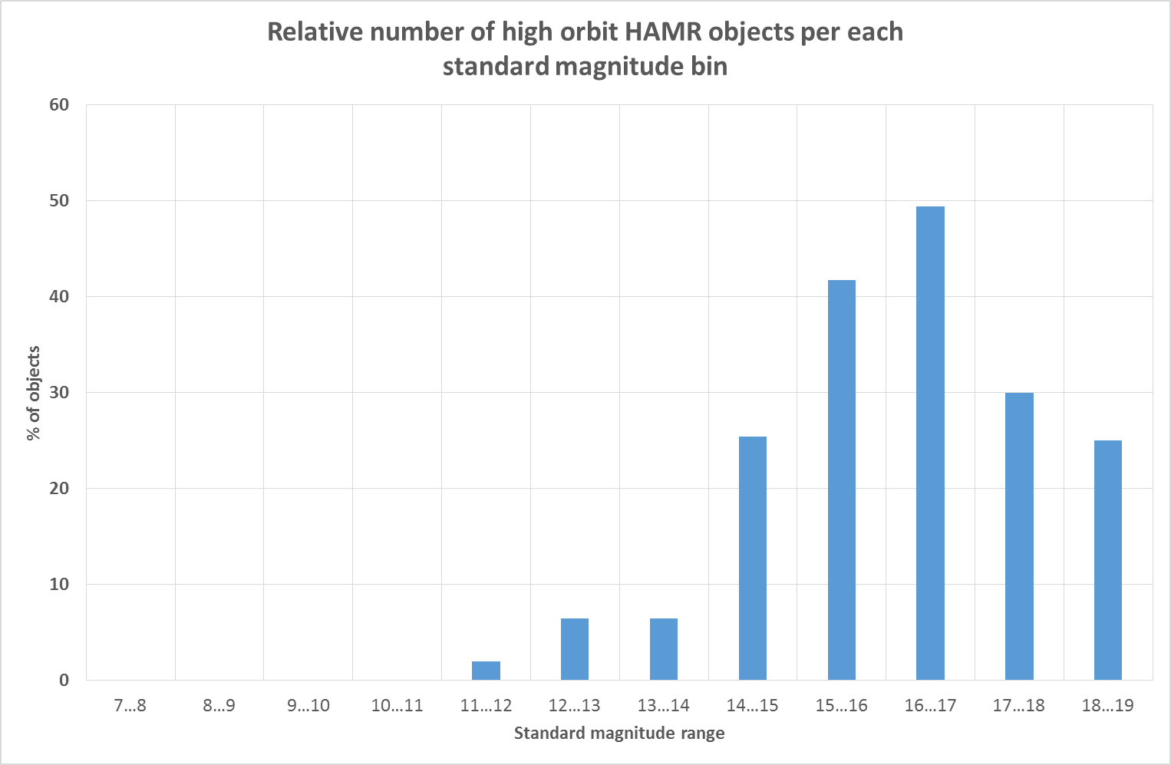
High orbit objects brightness distribution (4)

Slide 14
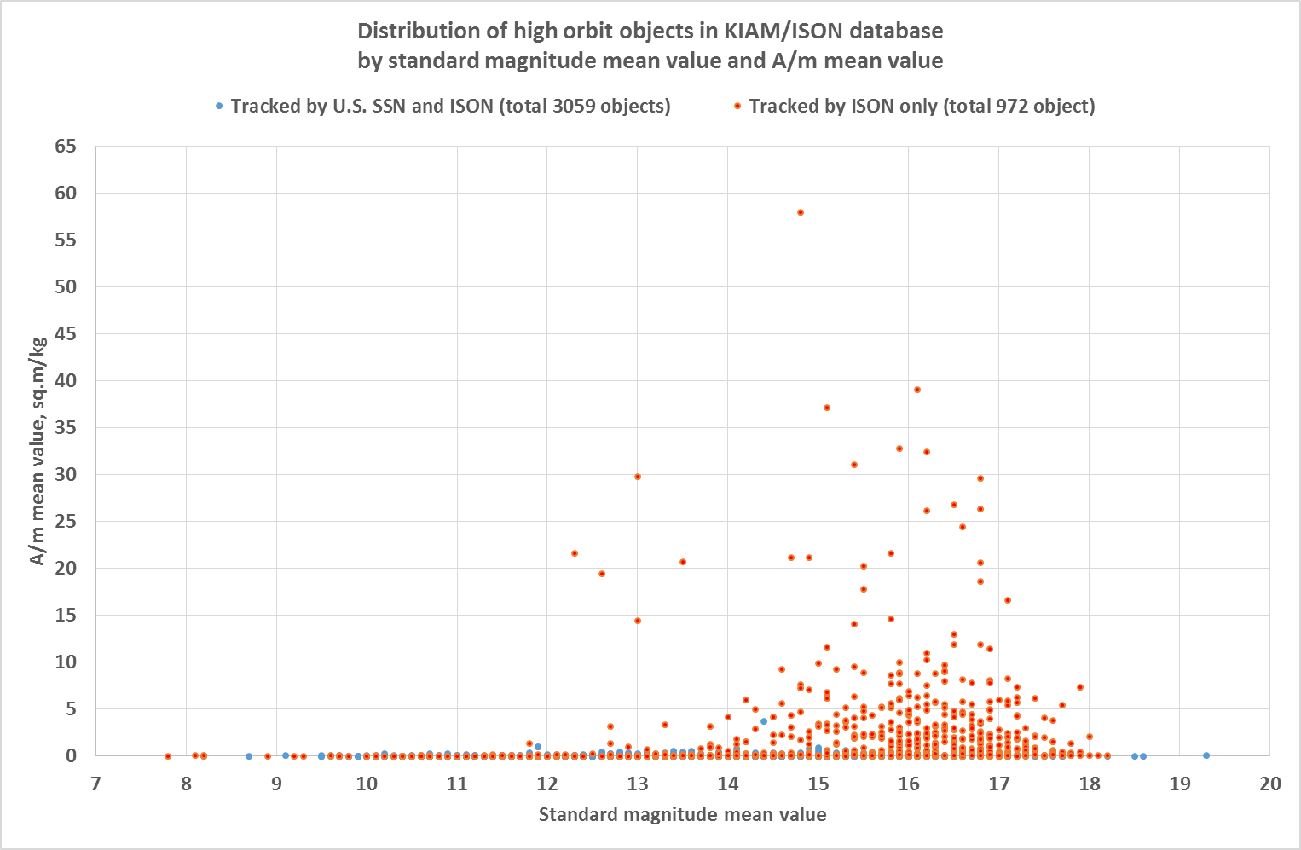
High orbit objects brightness vs. A/m distribution (1)

Slide 15
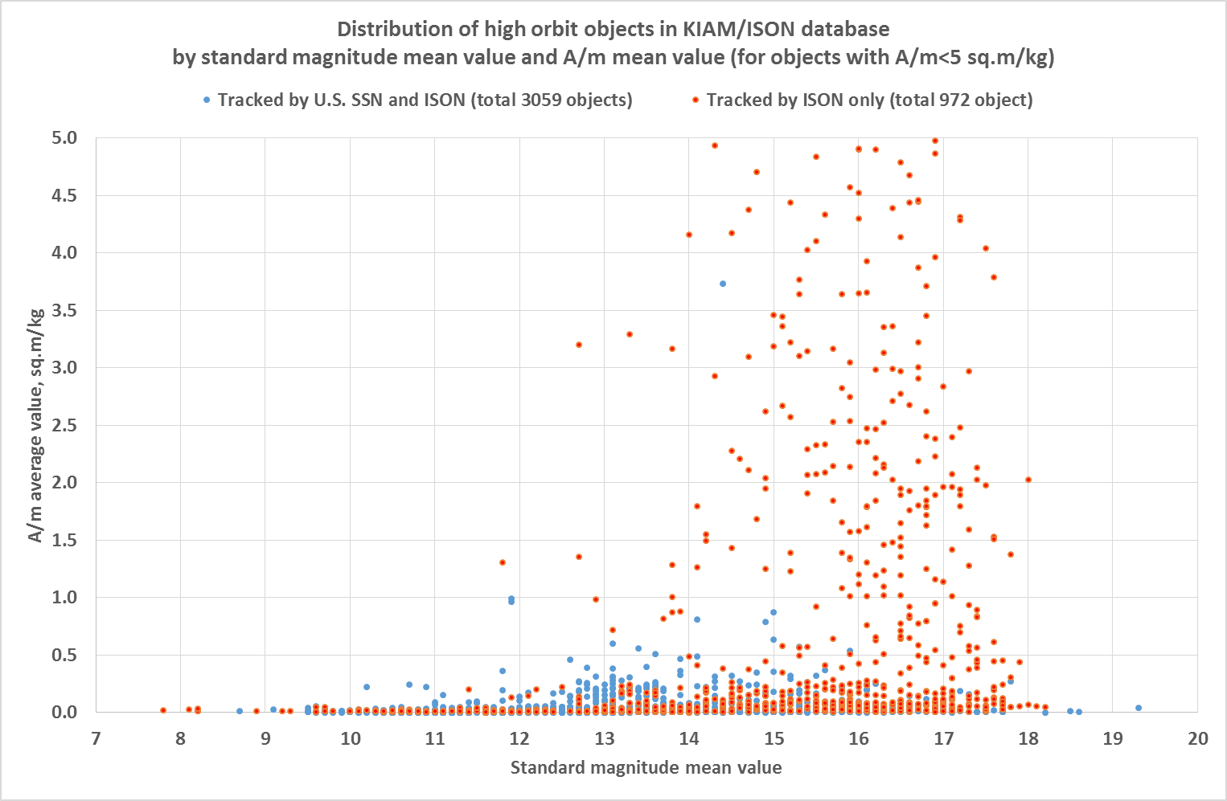
High orbit objects brightness vs. A/m distribution (2)

Slide 16
Conclusion
ISON tracks nearly 25% more objects at high orbits (T>200 min) than it is published at SpaceTrack
High orbit objects discovered by ISON are usually more faint than those included into the U.S. STRATCOM catalogue
Due to more complex properties of ISON-discovered high orbit objects the orbital updated period is usually longer than for bright U.S SSN objects

