Slide 1
Results of two years of Molniya-type HEO surveys
Vladimir Agapov, Igor Molotov (KIAM RAS),
Zakhary Khutorovsky (Vympel)
Roscosmos delegation
Presentation for the WG1 session
32nd IADC meeting, Beijing

Slide 2
Molniya-type HEO orbits
«True» Molniya-type orbits defined as having following parameters:
inclination is close to 63.4 deg → no precession of perigee
argument of perigee is in range 240-300 deg → apogee is over Northern hemisphere at high latitudes
orbital period is close to 718 min (half a sidereal day) → repeating ground track
eccentricity is in range 0.67-0.74 → high apogee and thus longer period of time for passing near-apogee part of orbit
18 known fragmentations of objects at «true» Molniya-type orbits occurred → more scattered distribution of all orbital parameters for fragments

Slide 3
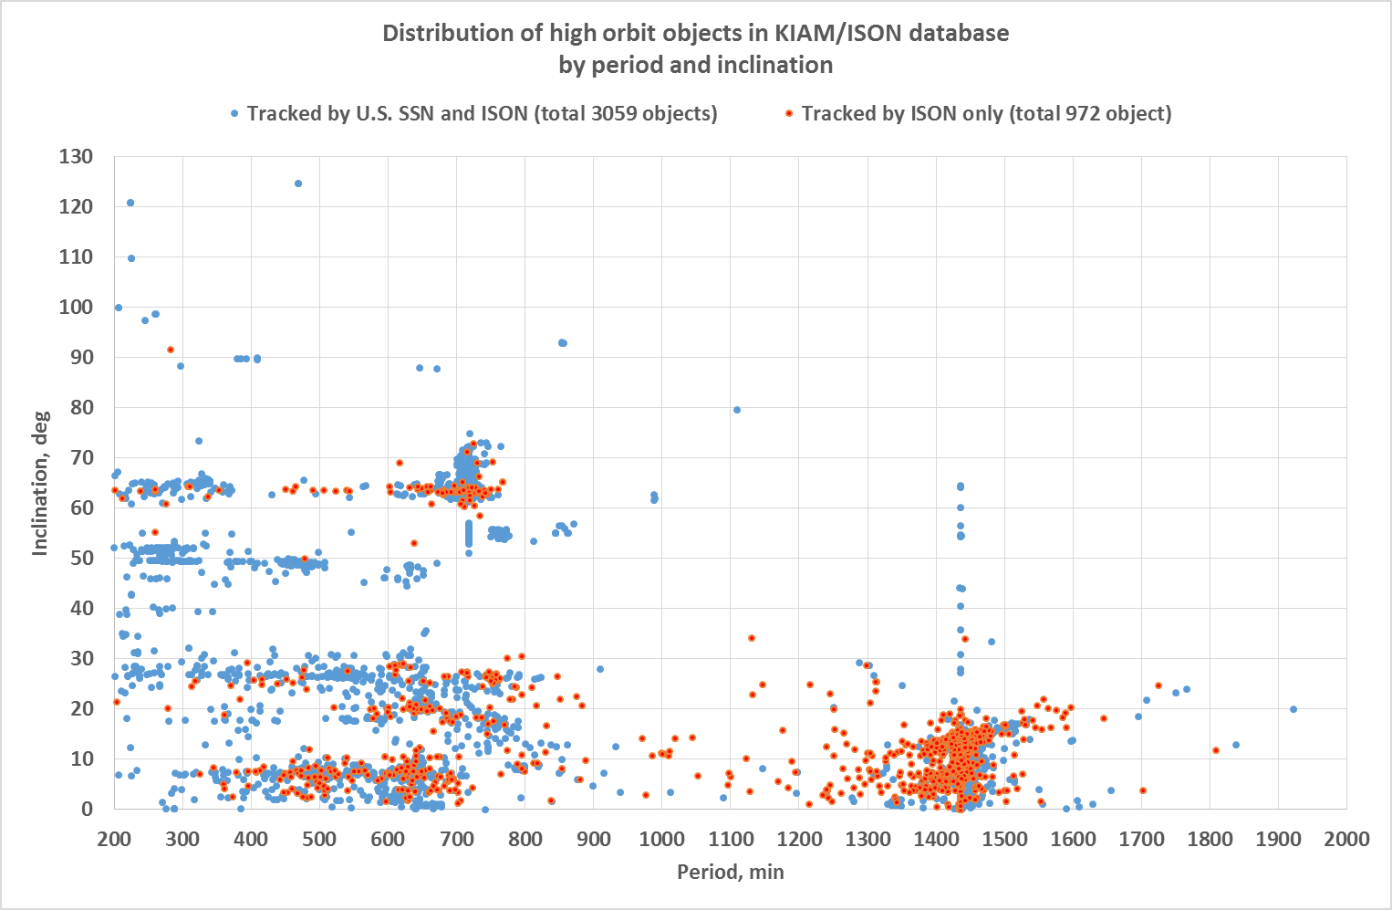
High orbit objects distribution (1)
Molniya-type HEO are
among these objects

Slide 4
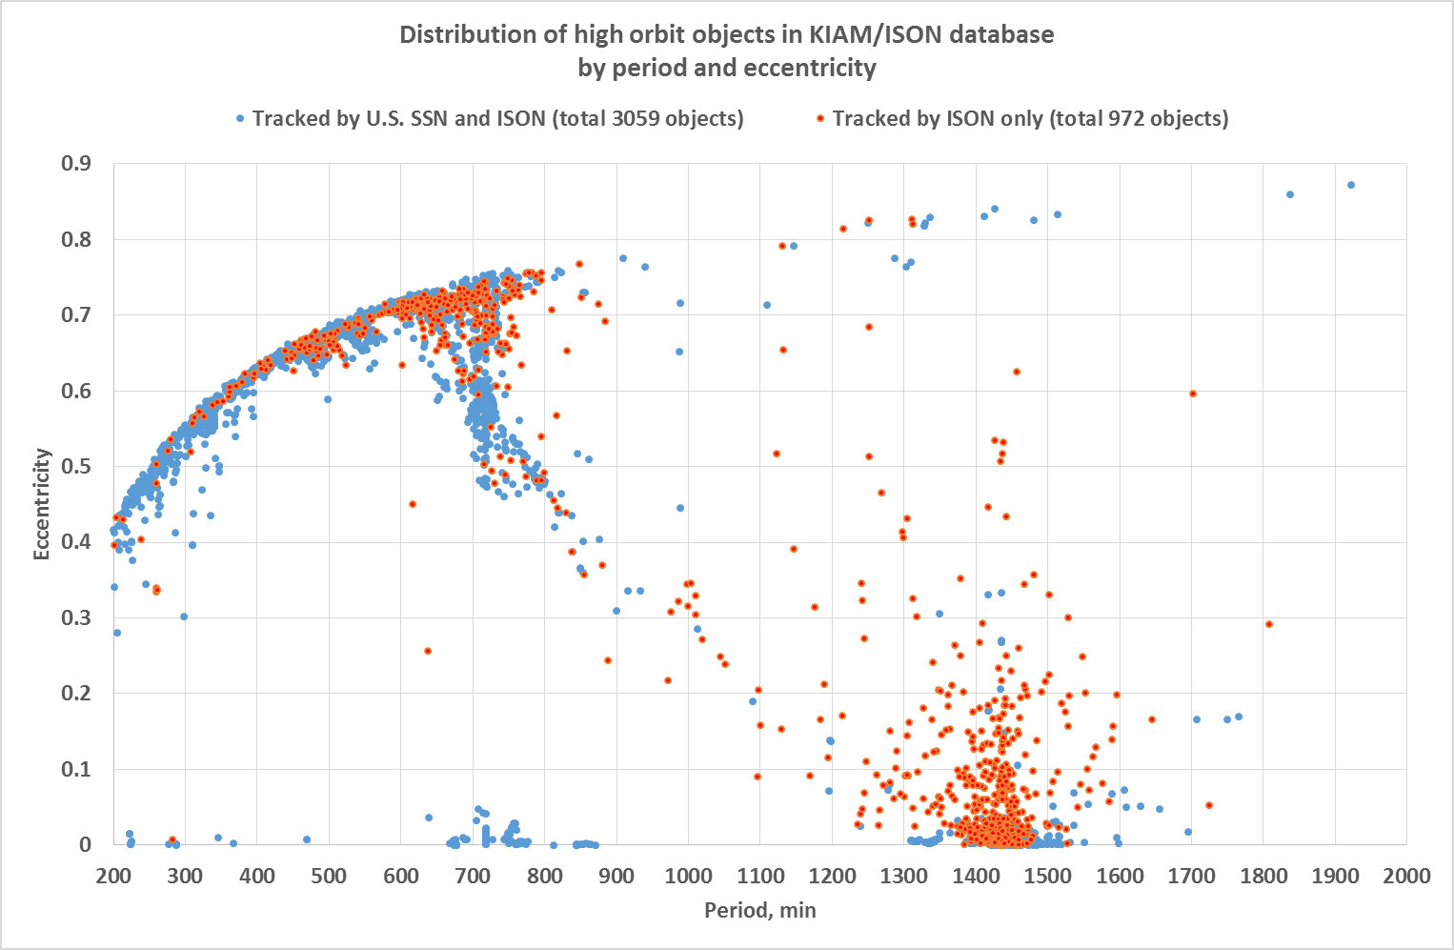
High orbit objects distribution (2)
Molniya-type HEO are
among these objects

Slide 5
Selection of objects by orbital parameters to define survey areas
Should be close to «true» Molniya-type orbits but with more wide range of parameters in order to cover possible fragments of explosions:
inclination: 63…72 deg
argument of perigee: no limit
orbital period: 600…800 min
eccentricity is in range 0.67-0.74
311 objects satisfies these criteria: 274 tracking by the U.S. SSN and ISON and 37 tracking by ISON only

Slide 6
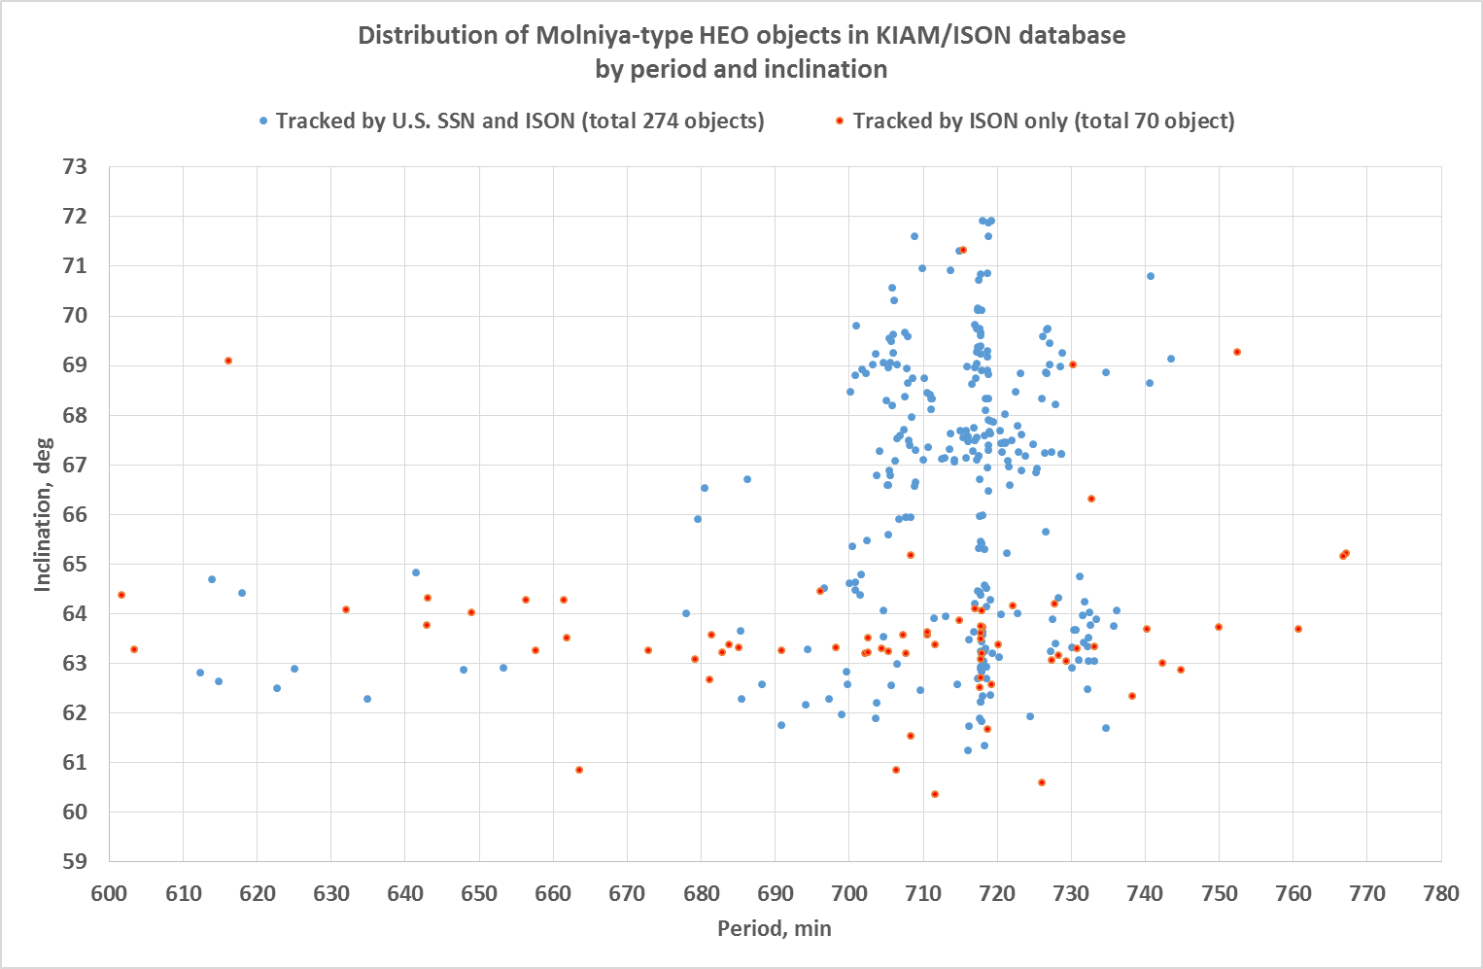
HEO objects selected to define survey area (1)
Culminating at higher declinations

Slide 7
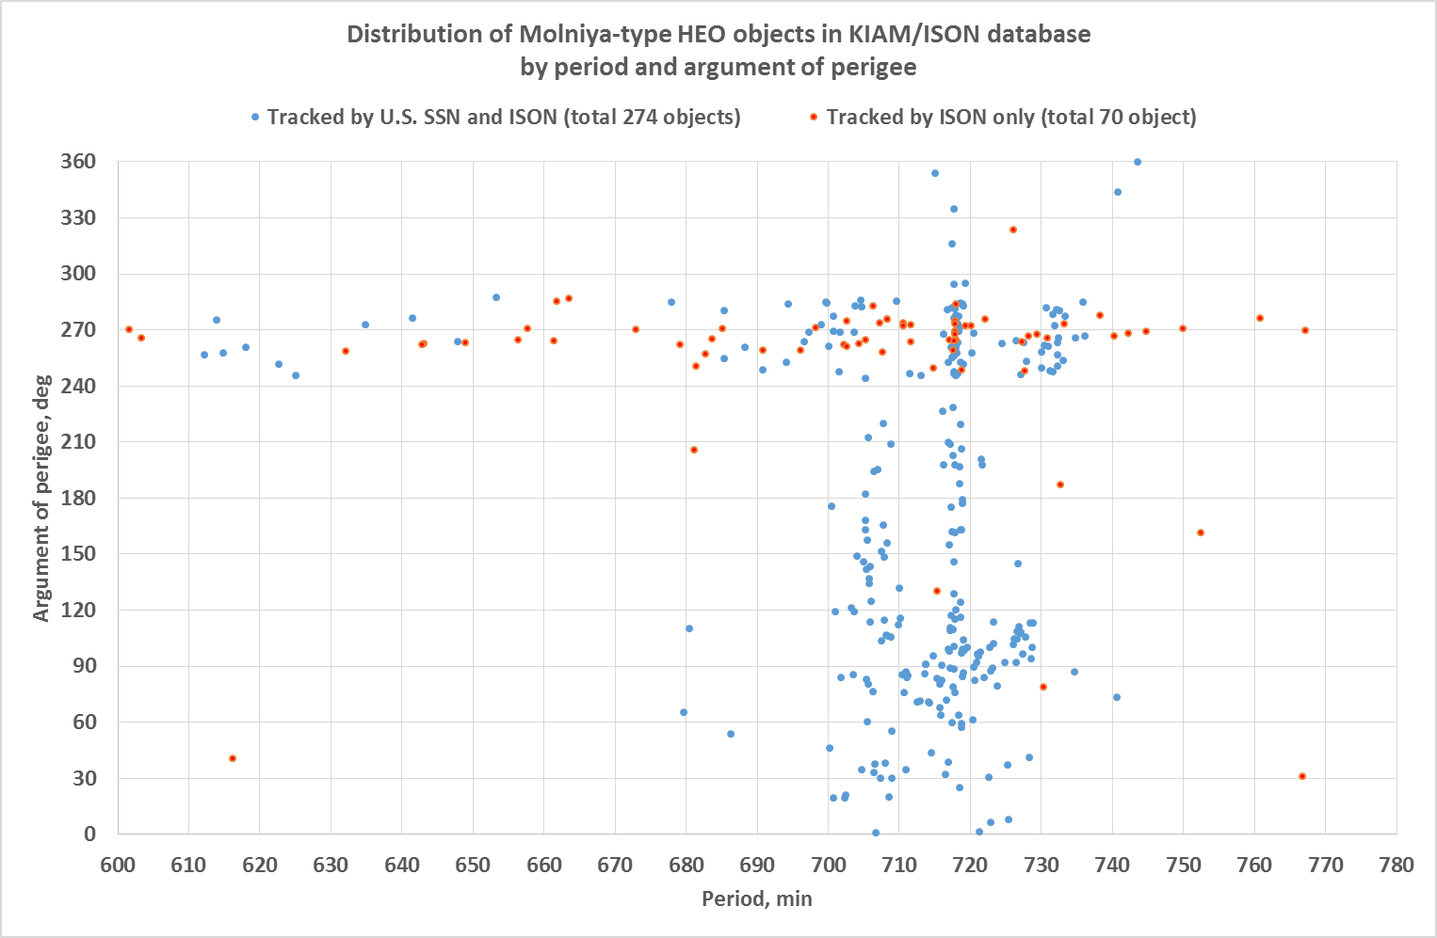
HEO objects selected to define survey area (2)
Apogee near equator –
candidates for detection
in GEO surveys
Apogee in Southern
hemisphere!

Slide 8
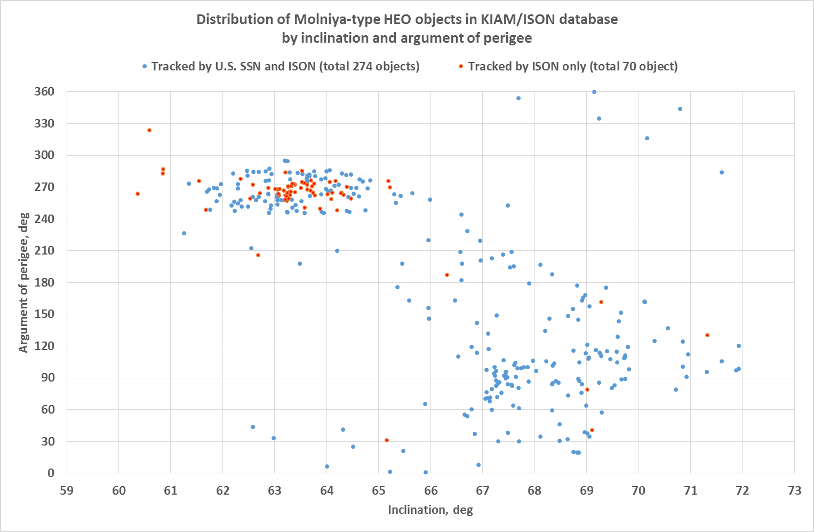
HEO objects selected to define survey area (3)
Apogee near equator –
candidates for detection
in GEO surveys
Apogee in Southern
hemisphere!

Slide 9
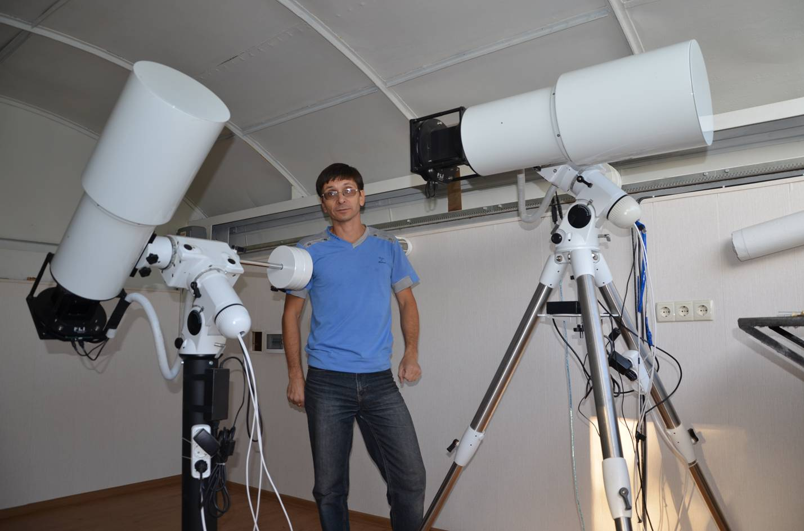
Molniya-type HEO surveys
Two 18 cm aperture VT-52c telescopes with 7 deg x 7 deg FOV
Installed in Nauchnyi-1
One telescope is using for GEO surveys, other – for Molniya-type HEO surveys in near-apogee region

Slide 10
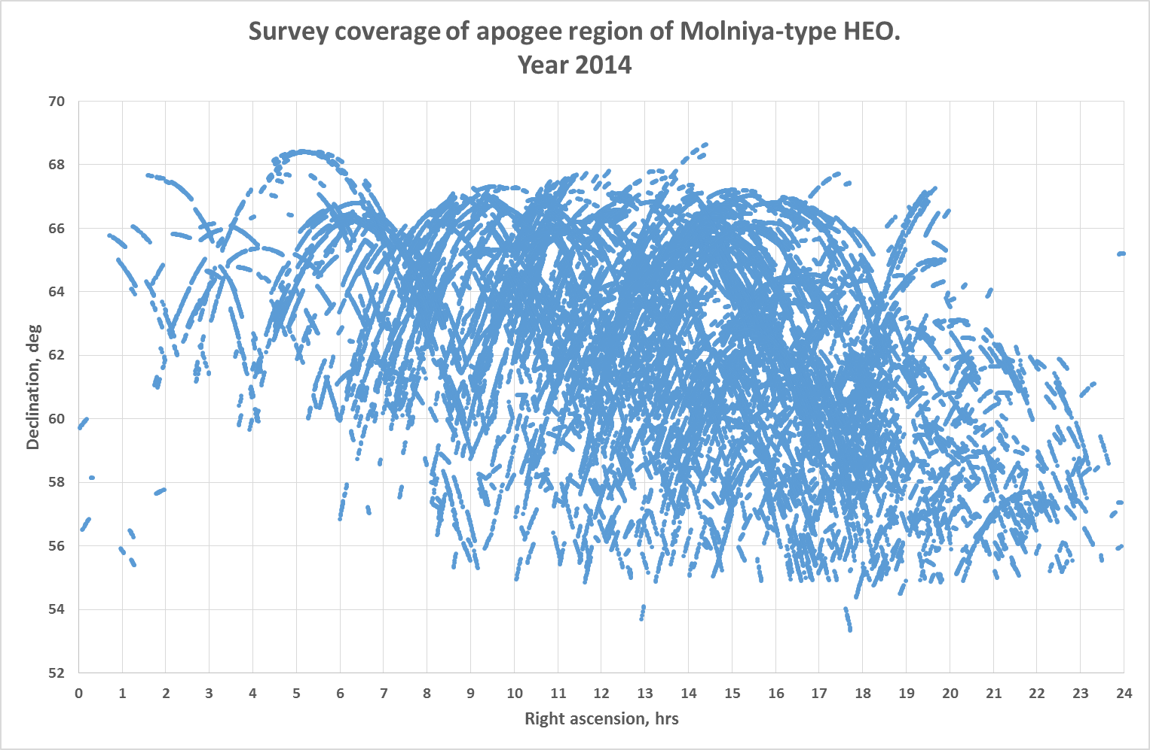
Real Surveys Coverage

Slide 11
Molniya-type HEO Surveys Statistics
Year | Number of observation nights | Number of measurements obtained | Number of individual objects observed
2012 | 103 | 95356 | 163
2013 | 188 | 186640 | 159
2014 (as of May 13) | 60 | 68383 | 132
TOTAL | 351 | 350379 | 188

Slide 12
Newly Discovered Objects in HEO Surveys. Year 2012
Total discovered – 21 objects
ISON Object # | Date of discovery | Period, min | Inclination, deg | Argument of perigee, deg | A/m, sq.m/kg | Std. visible magnitude
95633 | 03.03.2012 | 707.57 | 63.92 | 259.0 | 0.084 | 14.9
95652 | 23.04.2012 | 607.51 | 63.11 | 268.4 | 0.059 | 13.2
95660 | 07.05.2012 | 711.45 | 63.13 | 274.0 | 0.093 | 14.7
95678 | 01.06.2012 | 744.70 | 62.86 | 271.0 | 0.033 | 14.3
95666 | 05.06.2012 | 724.19 | 63.19 | 287.6 | 20.3 | 13.0
95702 | 05.06.2012 | 642.83 | 63.83 | 268.0 | 0.011 | 14.1
95669 | 14.06.2012 | 542.96 | 63.23 | 281.6 | 0.191 | 13.6
95707 | 09.08.2012 | 749.83 | 63.69 | 275.8 | 0.034 | 14.5
95709 | 15.08.2012 | 702.19 | 63.81 | 262.7 | 0.018 | 13.7
95710 | 21.08.2012 | 729.85 | 63.50 | 278.0 | 0.182 | 14.8
95729 | 11.09.2012 | 732.63 | 67.53 | 195.0 | 1.57 | 15.9
95730 | 11.09.2012 | 708.13 | 64.90 | 281.2 | 0.163 | 13.2
95752 | 12.09.2012 | 763.67 | 65.51 | 276.7 | 4.70 | 14.8
95740 | 13.09.2012 | 725.73 | 63.41 | 278.8 | 0.074 | 12.3
95782 | 28.09.2012 | 760.60 | 63.60 | 276.9 | 0.187 | 15.2
95779 | 06.10.2012 | 722.01 | 63.94 | 278.2 | 0.144 | 14.9
95781 | 07.10.2012 | 506.75 | 63.87 | 267.4 | 0.040 | 15.8
95793 | 17.10.2012 | 751.40 | 64.51 | 177.1 | 3.04 | 16.5
95796 | 14.10.2012 | 665.37 | 63.94 | 269.7 | 0.222 | 14.0
90201 | 21.10.2012 | 661.38 | 64.32 | 268.7 | 0.010 | 15.3
90229 | 18.11.2012 | 710.21 | 63.47 | 272.0 | 0.168 | 15.9

Slide 13
Newly Discovered Objects in HEO Surveys. Year 2013
Total discovered – 17 objects
ISON Object # | Date of discovery | Period, min | Inclination, deg | Argument of perigee, deg | A/m, sq.m/kg | Std. visible magnitude
90282 | 24.01.2013 | 727.44 | 63.16 | 264.3 | 0.143 | 13.6
90297 | 06.03.2013 | 740.30 | 63.73 | 269.6 | 0.010 | 13.0
90308 | 27.02.2013 | 643.01 | 64.36 | 266.6 | 0.022 | 15.8
90331 | 24.03.2013 | 664.32 | 60.77 | 276.7 | 0.483 | 14.0
90341 | 19.05.2013 | 706.52 | 60.80 | 274.8 | 0.412 | 14.1
90354 | 26.06.2013 | 710.49 | 63.53 | 275.9 | 0.074 | 16.2
90369 | 20.07.2013 | 674.42 | 63.35 | 269.3 | 0.267 | 14.5
90374 | 10.08.2013 | 706.57 | 61.76 | 271.6 | 3.20 | 12.7
90370 | 12.08.2013 | 679.07 | 63.14 | 262.9 | 0.170 | 13.6
90372 | 15.08.2013 | 711.55 | 60.42 | 258.1 | 0.222 | 14.9
90389 | 01.09.2013 | 733.27 | 63.21 | 272.7 | 0.221 | 14.9
90397 | 17.10.2013 | 690.37 | 63.52 | 259.0 | 0.381 | 14.4
90394 | 28.10.2013 | 730.93 | 63.28 | 265.5 | 0.064 | 13.8
90417 | 04.11.2013 | 705.02 | 63.31 | 265.2 | 0.373 | 14.7
90430 | 04.11.2013 | 634.21 | 60.71 | 263.6 | 57.9 | 14.8
90438 | 15.11.2013 | 727.70 | 64.32 | 249.0 | 0.098 | 14.2
90447 | 27.12.2013 | 742.39 | 63.01 | 267.6 | 0.230 | 15.5

Slide 14
Newly Discovered Objects in HEO Surveys. Year 2014 (as of May 13)
Total discovered – 5 objects
ISON Object # | Date of discovery | Period, min | Inclination, deg | Argument of perigee, deg | A/m, sq.m/kg | Std. visible magnitude
90474 | 03.03.2014 | 719.74 | 63.43 | 272.4 | 0.167 | 13.7
90487 | 07.03.2013 | 729.30 | 63.10 | 268.7 | 0.017 | 16.1
90482 | 19.03.2014 | 707.20 | 63.58 | 274.0 | 0.191 | 13.2
90499 | 19.03.2014 | 738.47 | 62.35 | 277.8 | 0.579 | 15.1
90504 | 01.05.2014 | 601.61 | 64.38 | 269.97 | 0.152 | 14.7
43 new objects in total are discovered in surveys by now of which 7 ones are lost. Thus the overall number of currently tracking ISON-discovered objects at near Molniya-type orbits increased to 70.

Slide 15
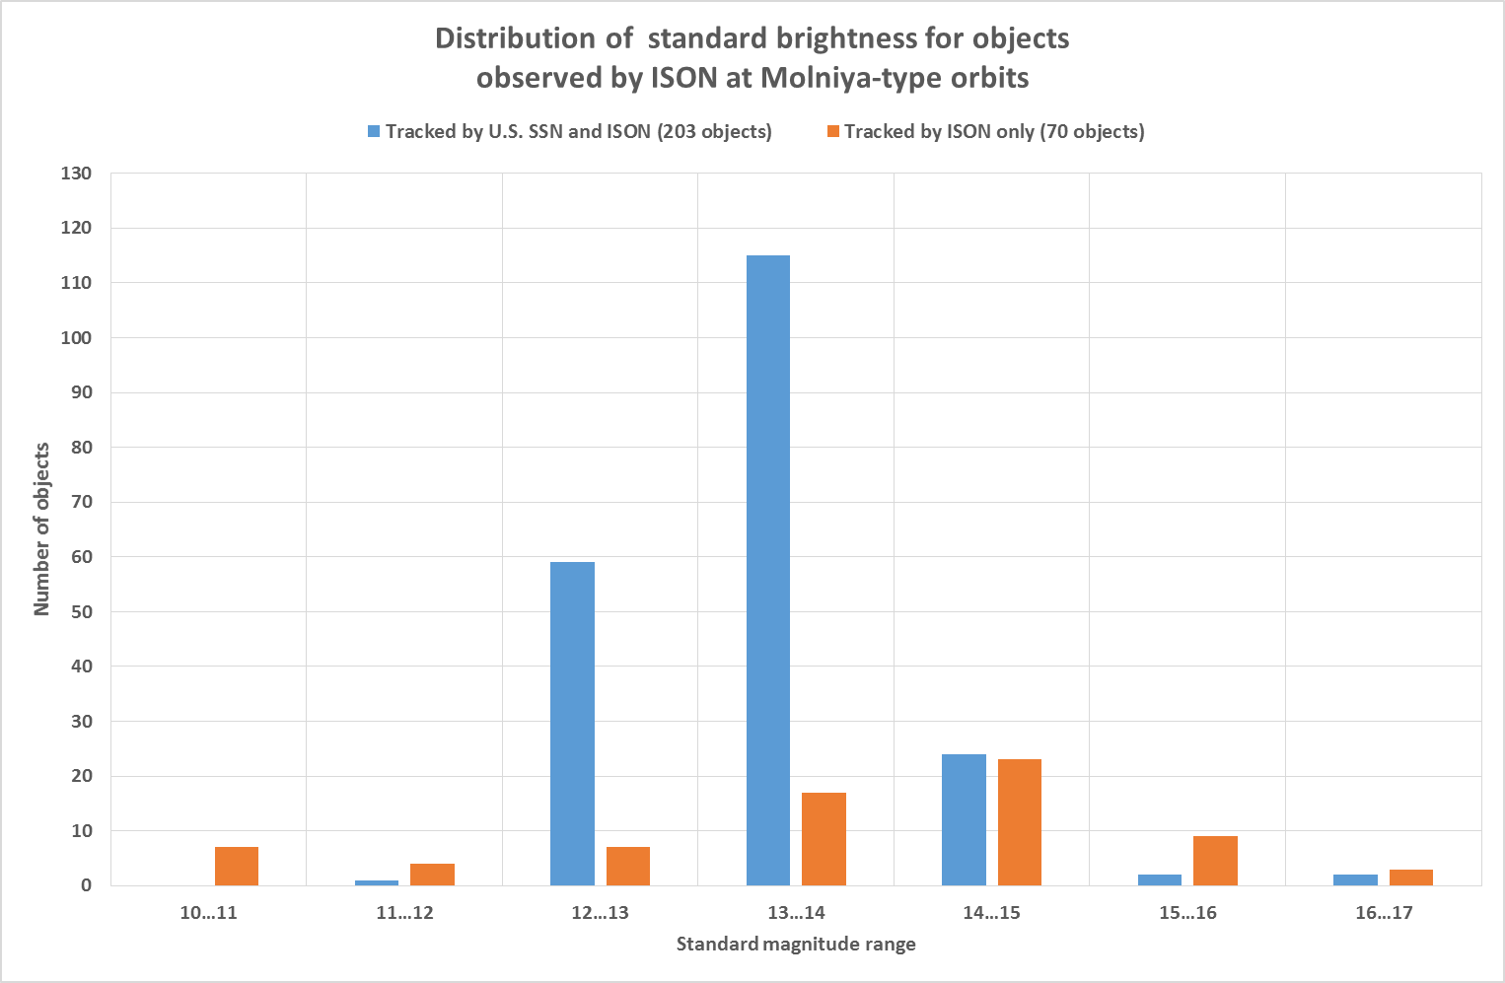
Brightness distribution for objects observing by ISON at Molniya-type orbits

Slide 16
Conclusion
Near-apogee region of Molniya-type orbit was surveyed during 351 observation nights in 2012-2014 by a single small-class wide FOV (7x7 deg) instrument
40 new objects are discovered (7 of them are lost at present)
ISON is tracking at present 70 objects (or 25.5%) more than published by the U.S. SSN for the same class of objects

