Slide 1
Unusual HAMR object at intermediate height orbit
Vladimir Agapov
Roscosmos delegation
Presentation for the WG1/WG2 joint session

Slide 2
ISON Object 90212
Discovered early Nov 2012
Orbit of discovery: period – 278.15 min inclination – 90.78 deg eccentricity – 0.0037 RAAN – 13.56 deg
Current orbit (May 13, 2014): period – 282.65 min inclination – 91.55 deg eccentricity – 0.0133 RAAN – 11.91 deg
Average area-to-mass ratio – 20.3 sq.m/kg
Observed at various distances within range 5500-13000 km and phase angles within ranges +10…+125 deg and -20…-135 deg
Observed visible magnitude – 11.5^{m}-15^{m} depending of a phase angle and aspect angle
Some brightness variations are observed (with main period of approx. 15 sec, amplitude of variations is approx. 1.5^{m}- (2σ)) but not regular; rarely produce flares as bright as 8.0^{m}-8.5^{m} (around some phase angle values)
No possible candidate for a «parent» object of origin

Slide 3
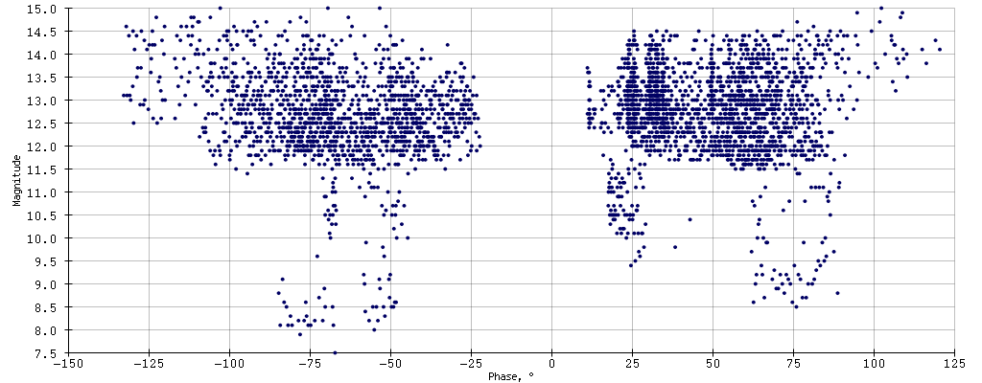
Observed brightness

Slide 4
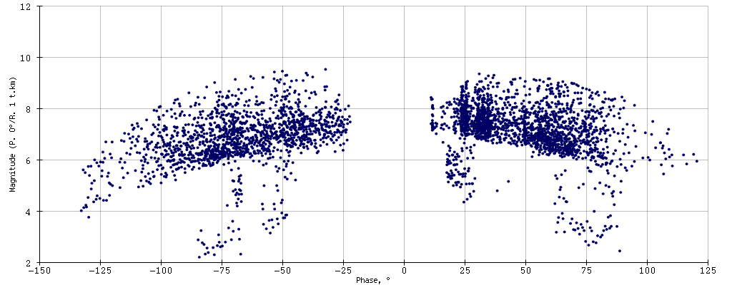
Brightness reduced to standard conditions (diffuse sphere model, distance 1000 km, phase angle 0 deg)

Slide 5
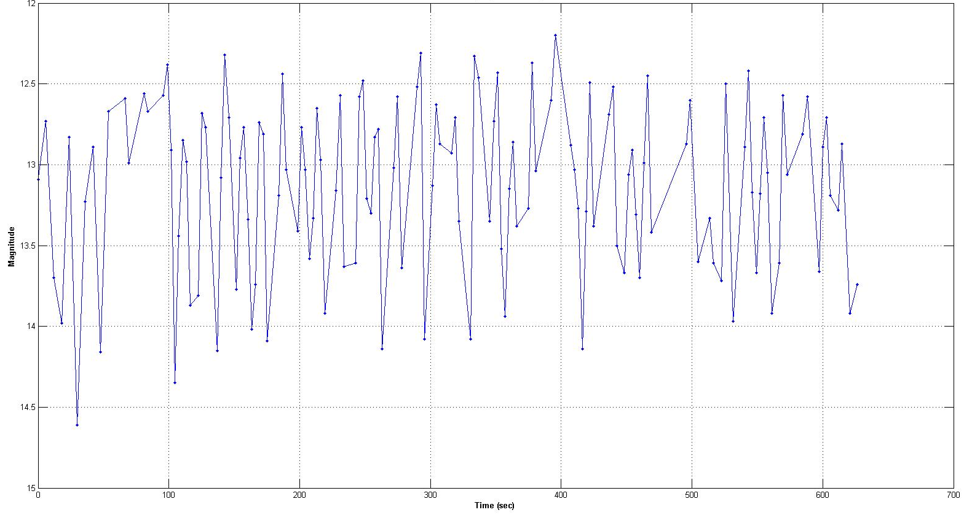
Brightness variations (example)

Slide 6
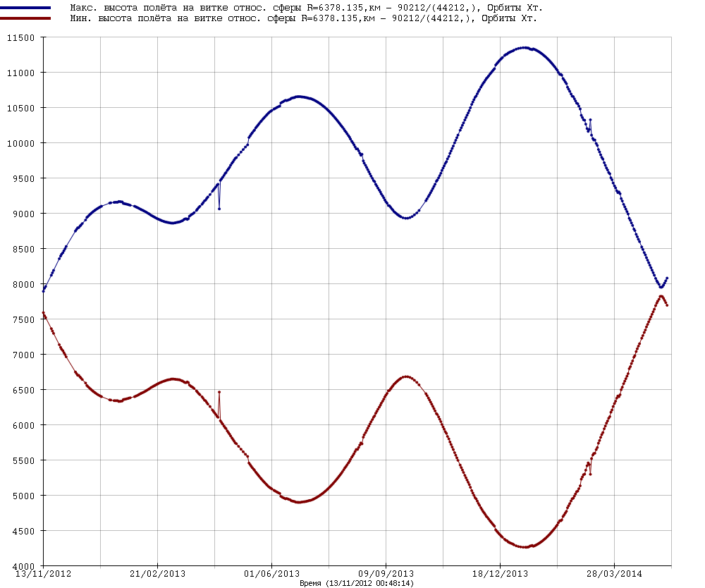
Evolution of minimal and maximal orbit height

Slide 7
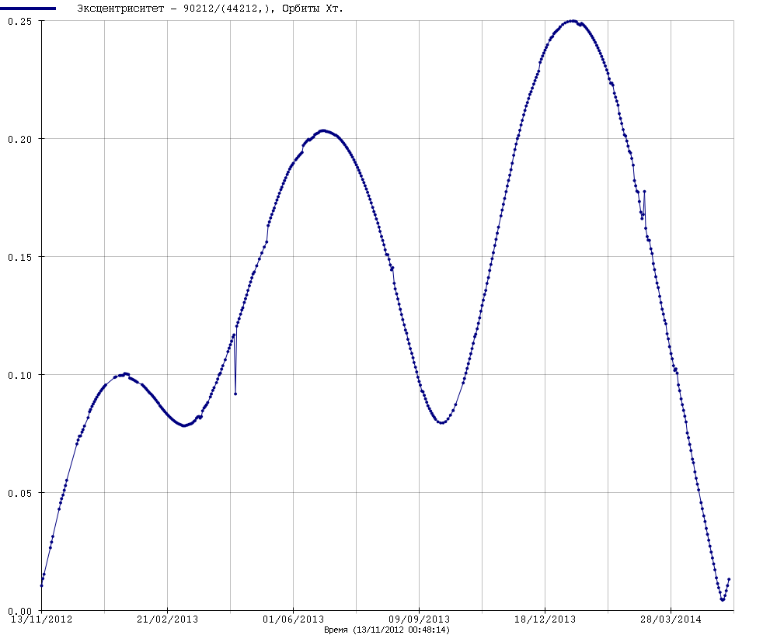
Evolution of eccentricity

Slide 8
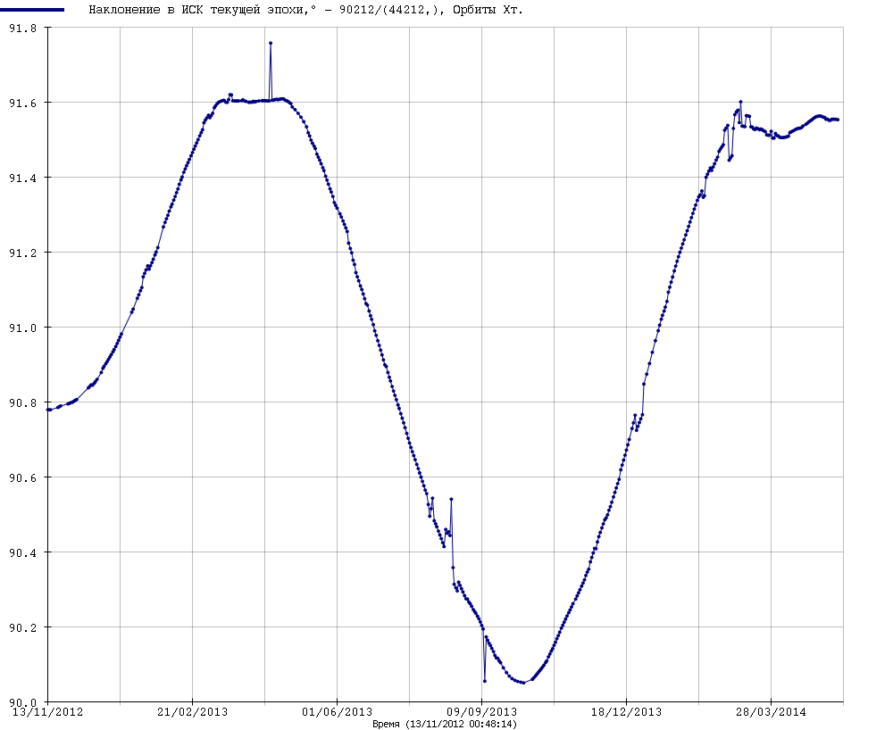
Evolution of inclination

Slide 9
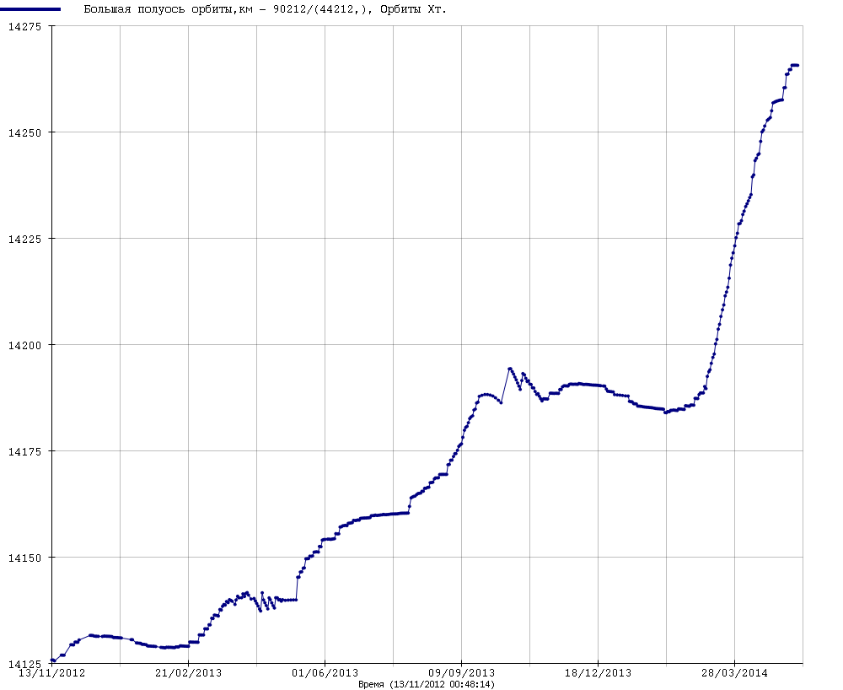
Evolution of semimajor axis
Steady increase of orbital energy!!!

Slide 10
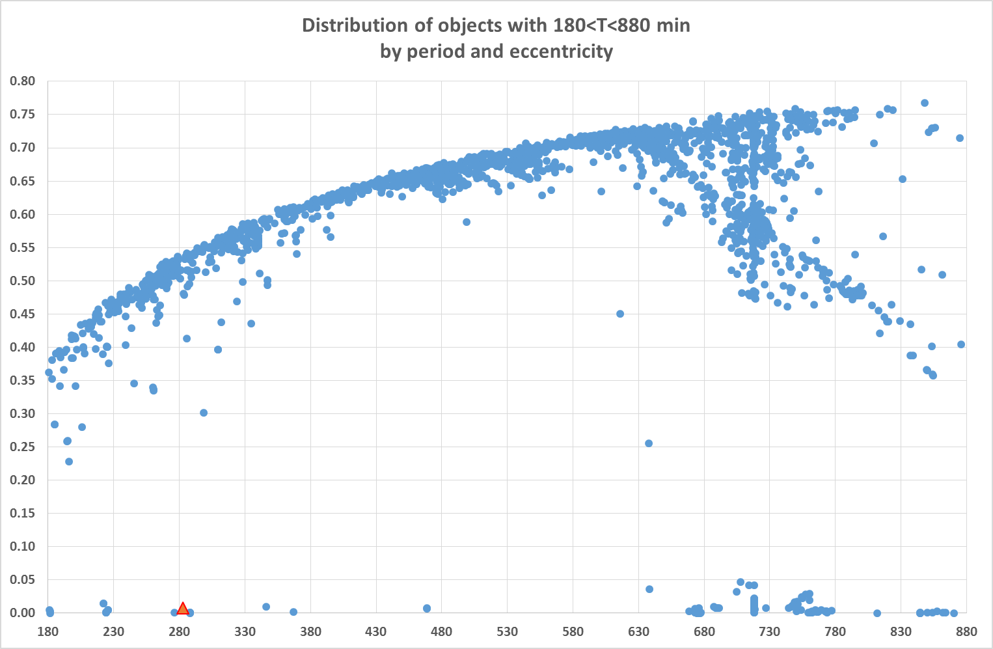
Analysis of possible origin (1)

Slide 11
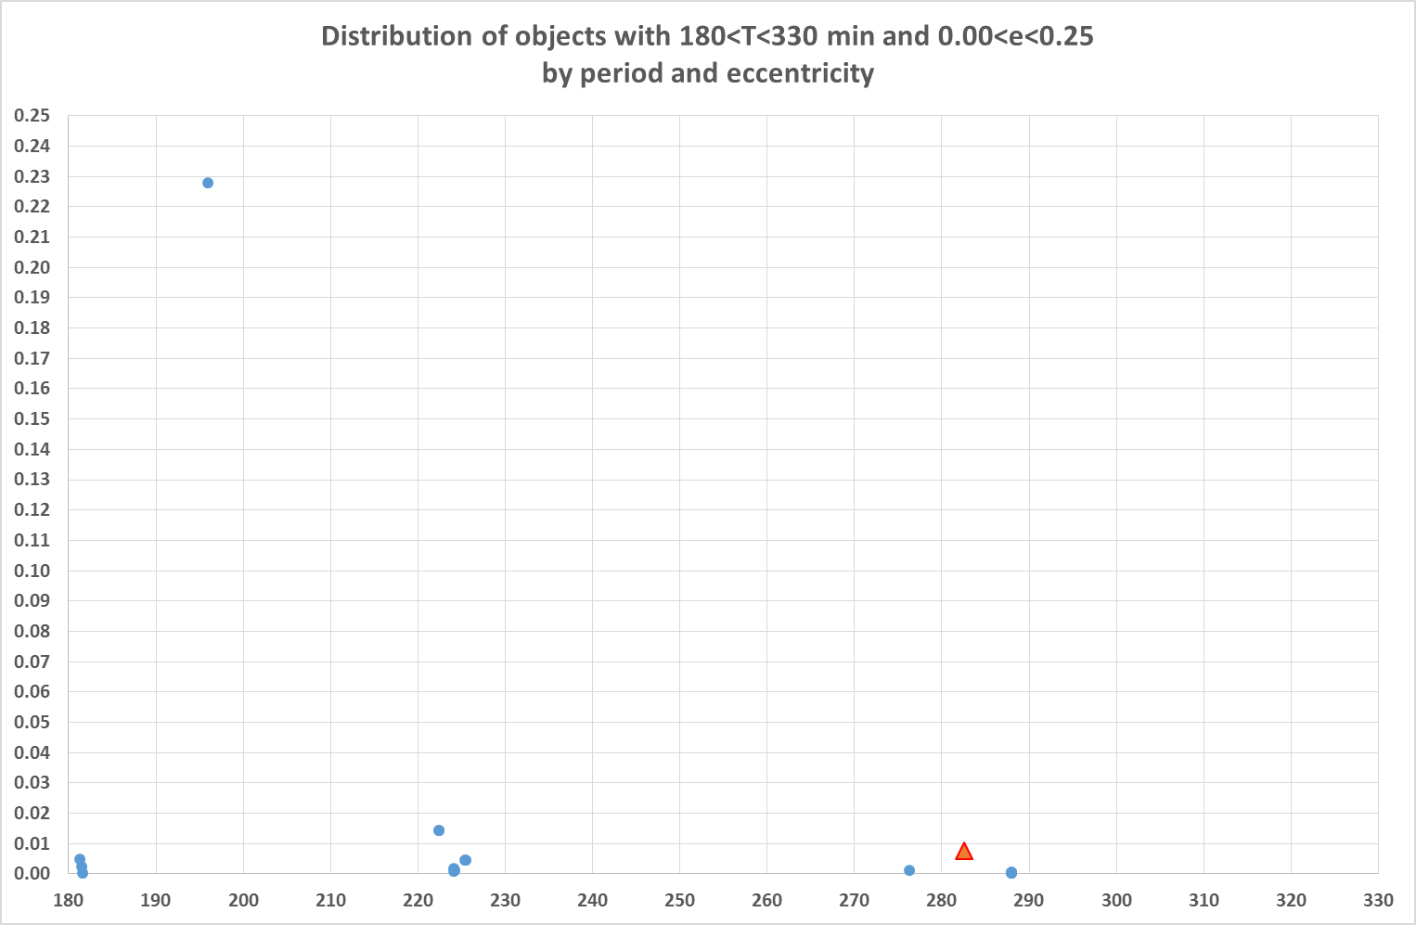
Analysis of possible origin (2)

Slide 12
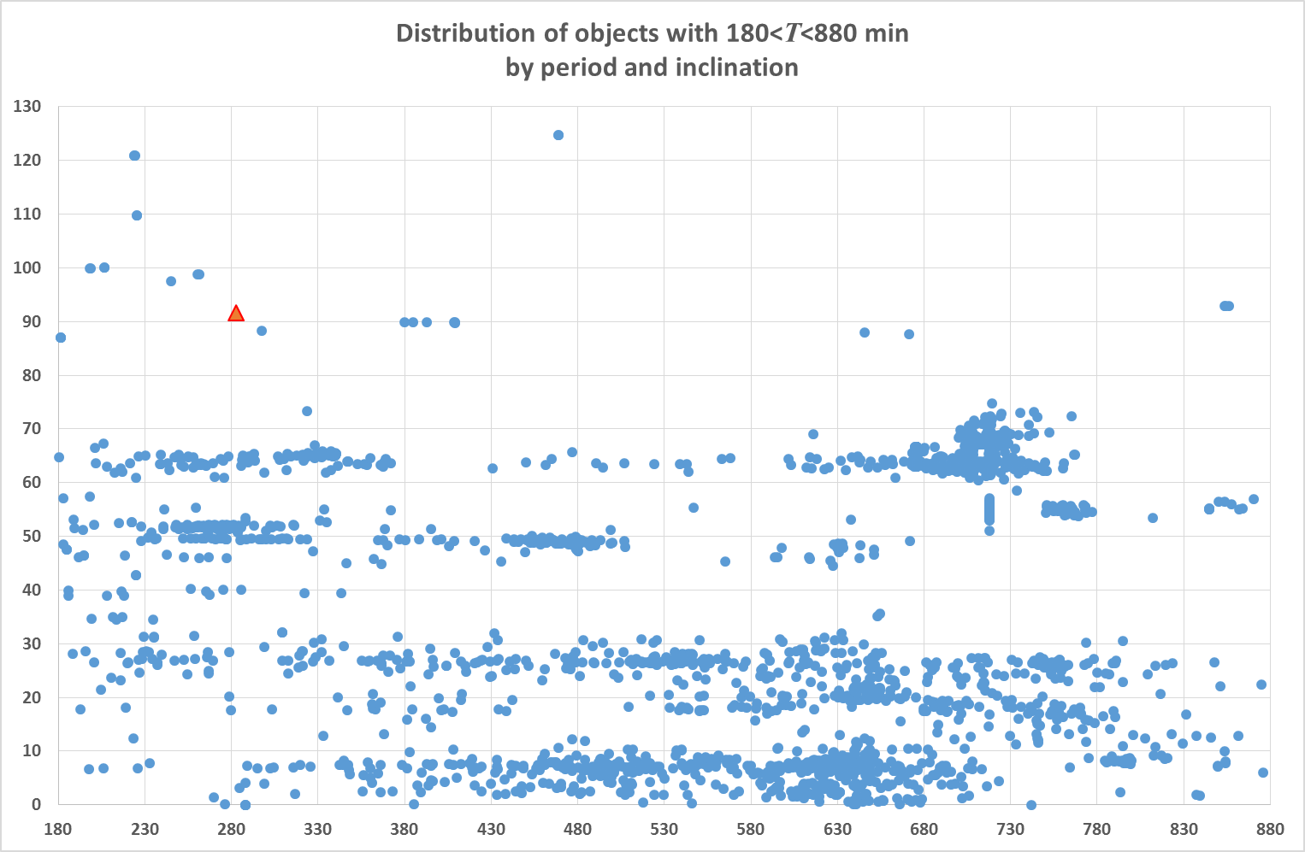
Analysis of possible origin (3)

Slide 13
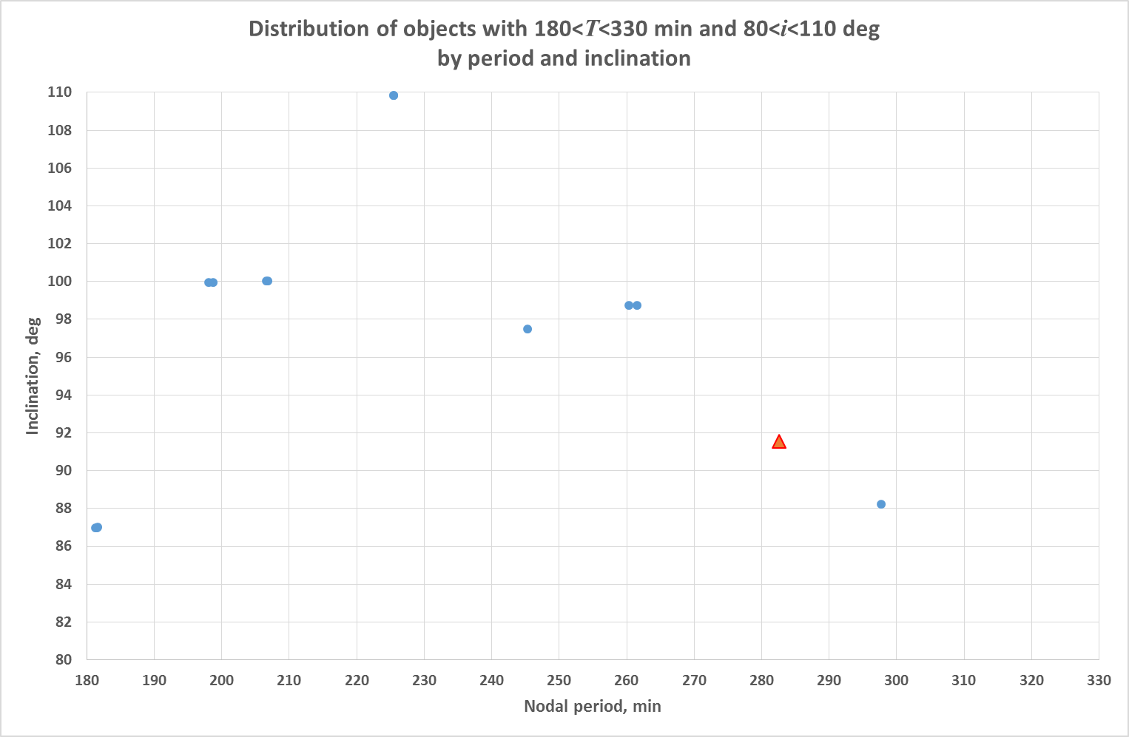
Analysis of possible origin (4)
SSN #16614 and #18231 (e=0.47)
SSN #36120 (e=0.35)
SSN #29519 (e=0.54)
SSN #2255 (THOR AGENA D R/B),
#2256 and 2511 (PAGEOS 1 DEB)
ISON #90212 (e=0…0.25),
(PAGEOS 1 DEB???)

Slide 14
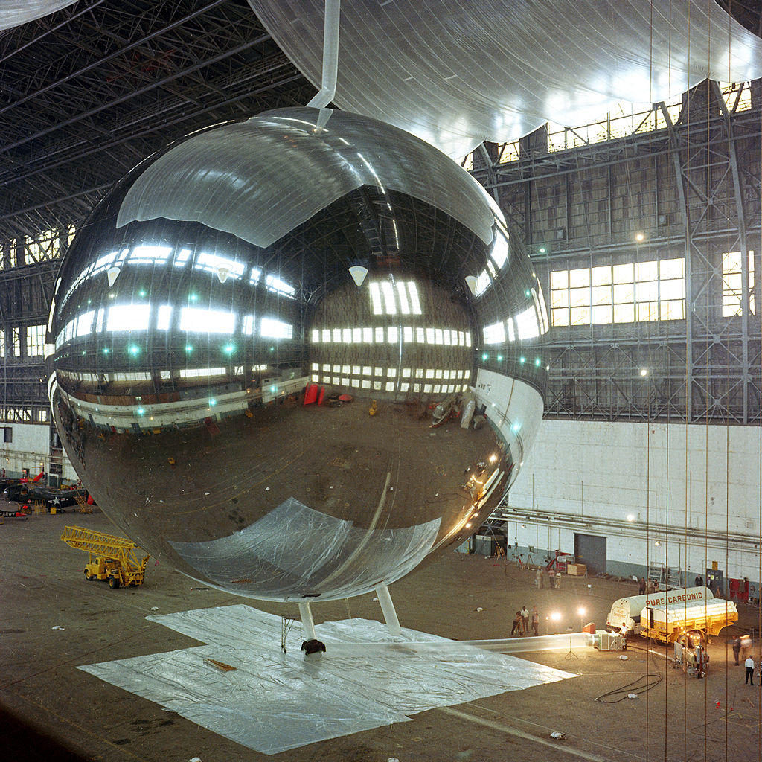
Analysis of possible origin (5)
PAGEOS 1 (d=30.48 m, consisted of a 12.7 µm thick Mylar plastic film coated with vapor deposited aluminum)
Disintegrated on 12 Jul 1975, other 5 break-up events occurred 1976, 1978, 1984, 1985
Is it possible that 90212 is PAGEOS 1 DEB (drifted up by 100 min in period comparing to remained pieces and THOR AGENA D R/B)?

