Slide 1
Tools used in KIAM space debris data center for processing and analysis of information on space debris objects obtained by the ISON network
Vladimir Agapov, Igor Molotov, Victor Stepanyants
Keldysh Institute of Applied Mathematics RAS
Alexander Lapshin
Astronomical Scientific Center
40th COSPAR Scientific Assembly
2-10 August 2014, Moscow, Russia

Slide 2
Overview
Operational procedures for scheduling, processing and analysis of optical measurements implemented in KIAM
Observation scheduling (survey mode, task mode)
Data processing (tracks association, determination of improved orbit, new objects cataloguing)
Data analysis (conjunctions, orbit determination characteristics)
Results of Molniya-type surveys as an example of application of developed tools

Slide 3
Simplified operational flow
UCT archive analysis
New object found?
Customers
requests
NO
YES
Success?
YES
OD and object properties est.
Requests analysis
Measurements
from facilities
IOD and track association
Orbital and properties archive
Observations scheduling (survey, tasking)
Schedule to facilities
Reporting to
customers
Conjunctions archive
Conjunction analysis

Slide 4
Orbit determination
Numerical propagator taking into account following perturbations (tunable for specific orbit):
Earth gravity (selection of a model possible)
Moon gravity (DE405)
Sun gravity (DE405)
atmosphere (selection of a model possible)
SRP (cylinder or conical Earth shadow)
Estimation of 6, 7 or 8 parameters (state vector in combination with ballistic coefficient and/or SRP coefficient – decision is making automatically on what combination would be the most appropriate in particular OD) + covariance
Possibility of setting a-priory values for certain orbital parameters
Automatic selection of measurement arc where motion can be considered as ‘passive’
Automatic filtering of anomalous measurements
Two modes of operation: ‘individual’ or ‘package’
Tools for graphical analysis of results
Simple criterion (max in-track error within one orbit) to compare quality of different solutions

Slide 5
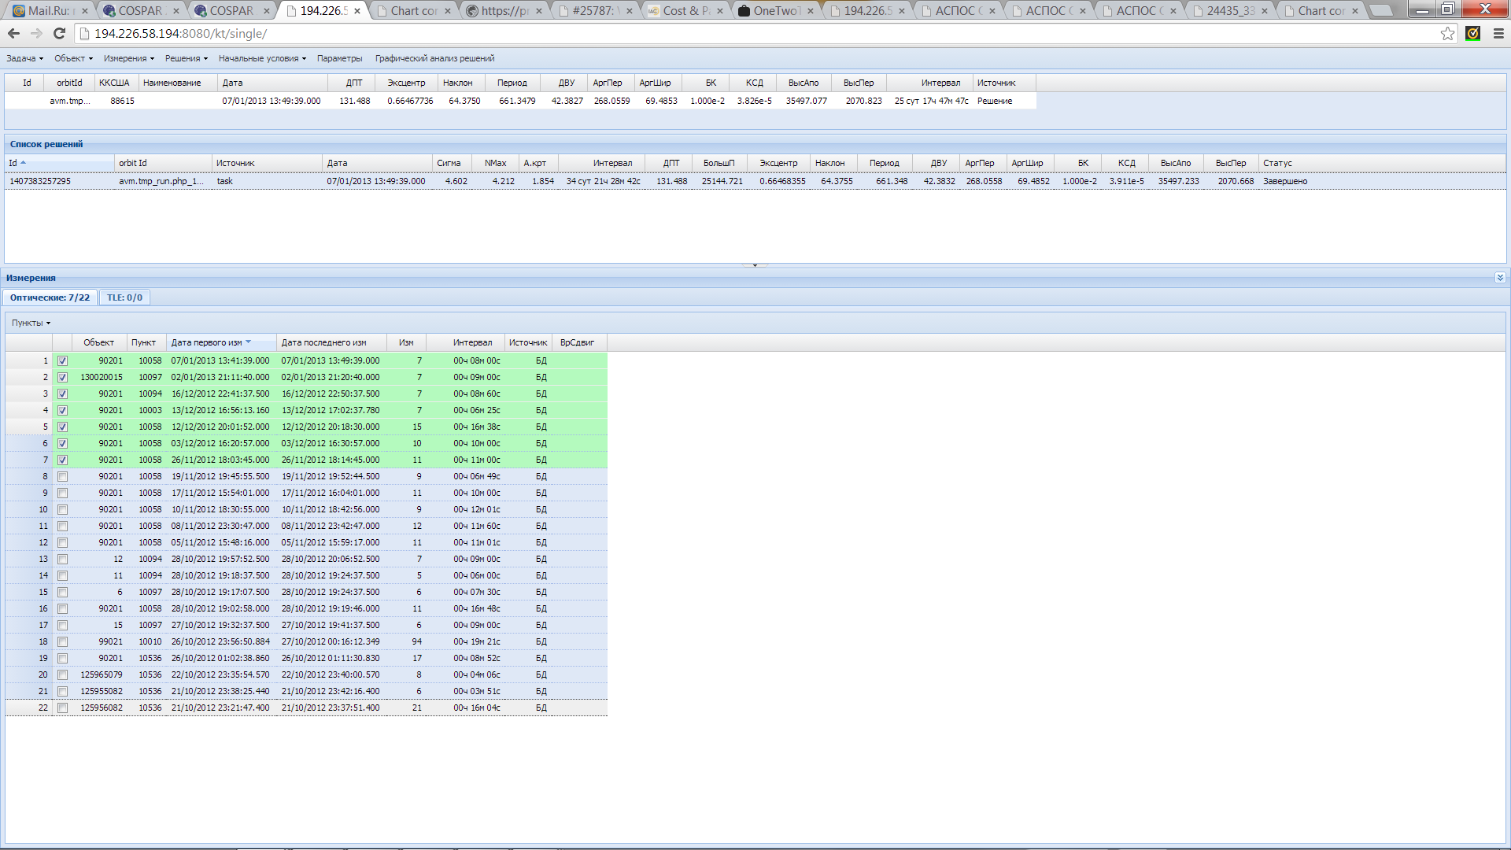
Orbit determination (2)
Obtained orbital solution
List of tracks associated with the object

Slide 6
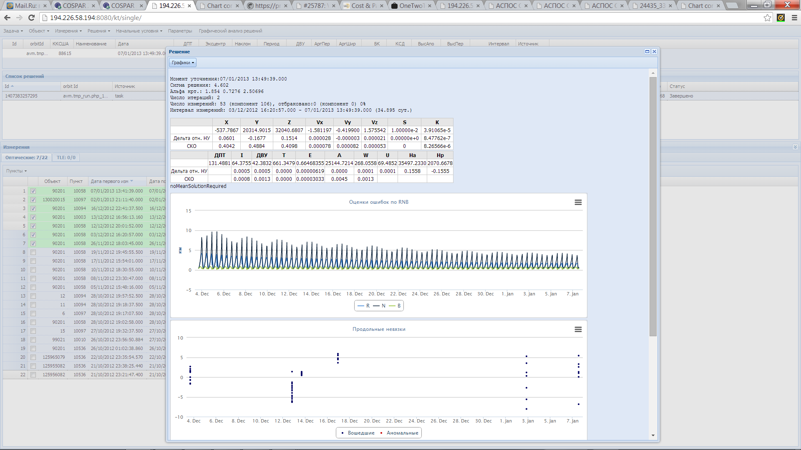
Orbit determination (3)
Results of OD (state vector,
estimation of errors)
RIC errors for the OD arc
Along-track residuals

Slide 7
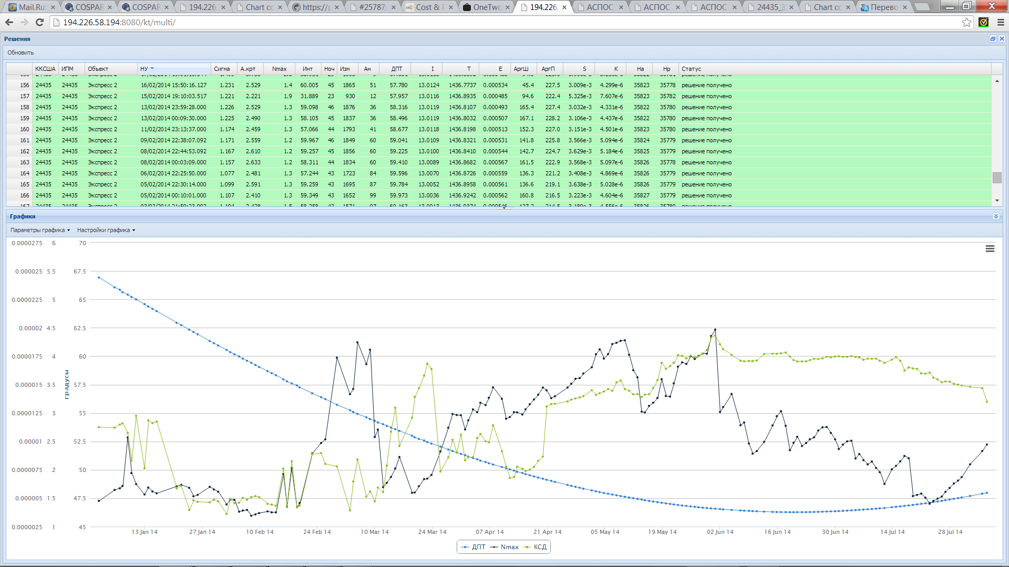
Orbit determination (3)
Longitude, deg E
Max in-track error, km
SRP estimations

Slide 8
Conjunction analysis
Only orbits numerically derived from ISON optical measurements are using (including independent solutions for spacecraft having orbital data provided by their operators)
If required, additional measurements are collected in order to improve orbit for both objects in conjunction
Search for all conjunctions satisfying given criteria in miss-distance (total, in-track and radial)
Control of reliability of the result (by means of calculation ratio of appropriate miss-distance component and estimation of predicted state vector error component)
Standard conjunction assessment message (in XML format) is sending to a customer

Slide 9
Conjunction analysis (2)
EXPRESS-2 – EUTE 28B case
Analysis based on orbital solutions before EUTE 28B manoeuvre on Aug 5
Closest conjunction on Aug 7
Analysis based on orbital solutions after EUTE 28B manoeuvre on Aug 5
Closest conjunction on Aug 6

Slide 10
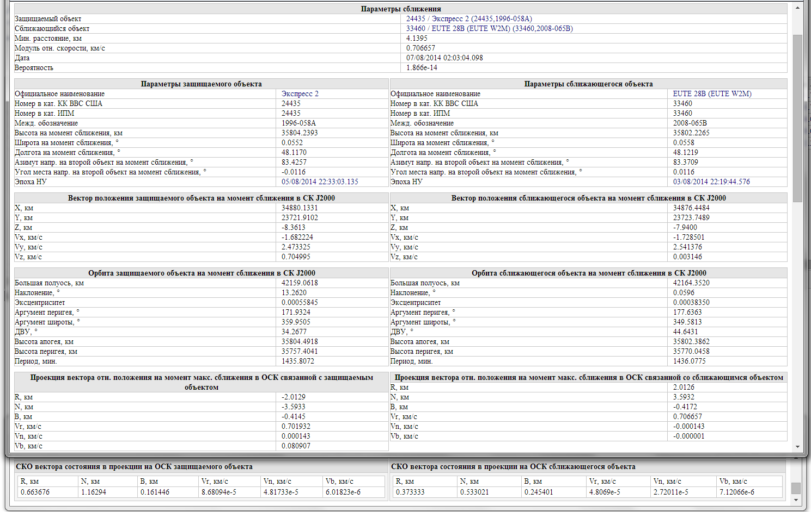
Conjunction analysis (3)
Conjunction parameters
J2000 state vector
components
for each object
Estimations of appropriate position/velocity
components in RIC for each object
Miss-distance components, km

Slide 11
Molniya-type HEO orbits
«True» Molniya-type orbits defined as having following parameters:
inclination is close to 63.4 deg → no precession of perigee
argument of perigee is in range 240-300 deg → apogee is over Northern hemisphere at high latitudes
orbital period is close to 718 min (half a sidereal day) → repeating ground track
eccentricity is in range 0.67-0.74 → high apogee and thus longer period of time for passing near-apogee part of orbit
18 known fragmentations of objects at «true» Molniya-type orbits occurred → more scattered distribution of all orbital parameters for fragments

Slide 12
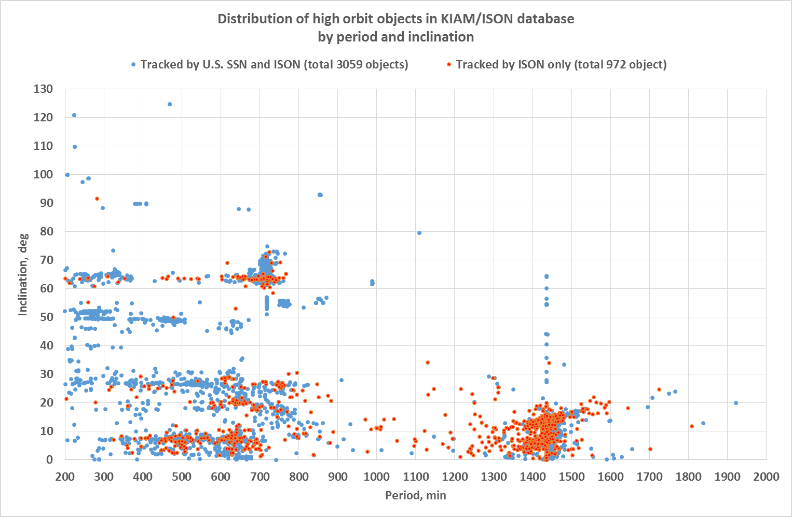
High orbit objects distribution (1)
Molniya-type HEO are
among these objects

Slide 13
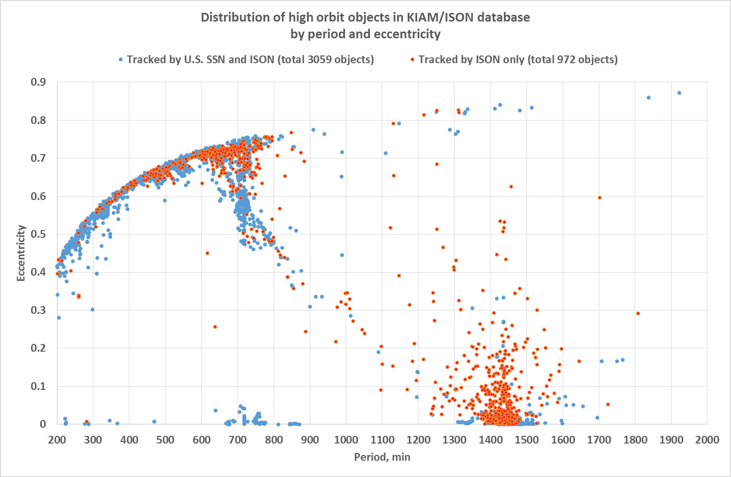
High orbit objects distribution (2)
Molniya-type HEO are
among these objects

Slide 14
Selection of objects by orbital parameters to define survey areas
Should be close to «true» Molniya-type orbits but with more wide range of parameters in order to cover possible fragments of explosions:
inclination: 63…72 deg
argument of perigee: no limit
orbital period: 600…800 min
eccentricity is in range 0.67-0.74
311 objects satisfies these criteria: 274 tracking by the U.S. SSN and ISON and 37 tracking by ISON only

Slide 15
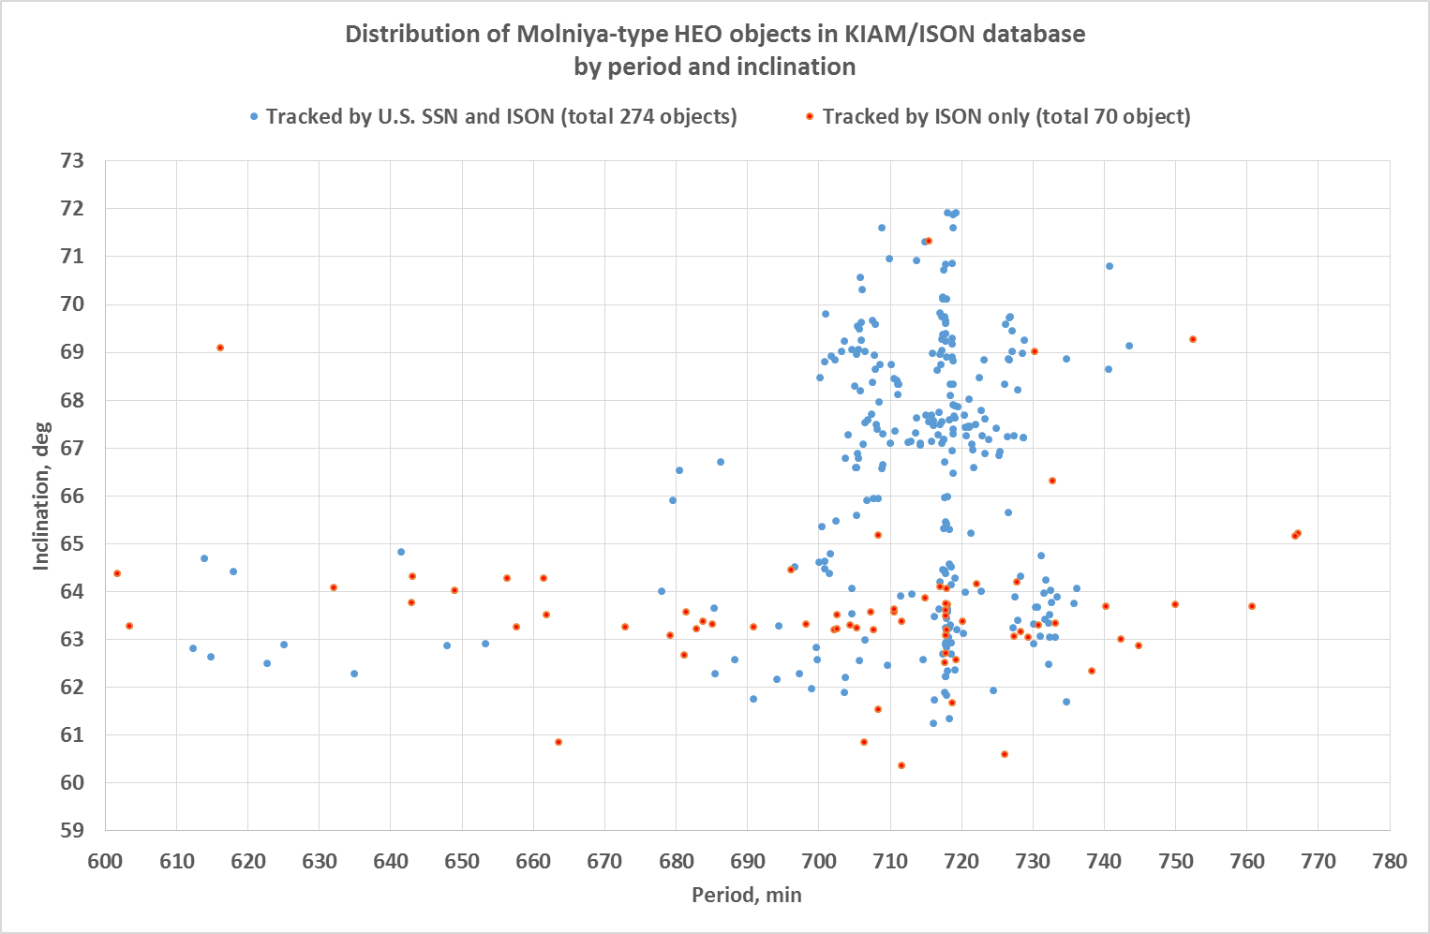
HEO objects selected to define survey area (1)
Culminating at higher declinations

Slide 16
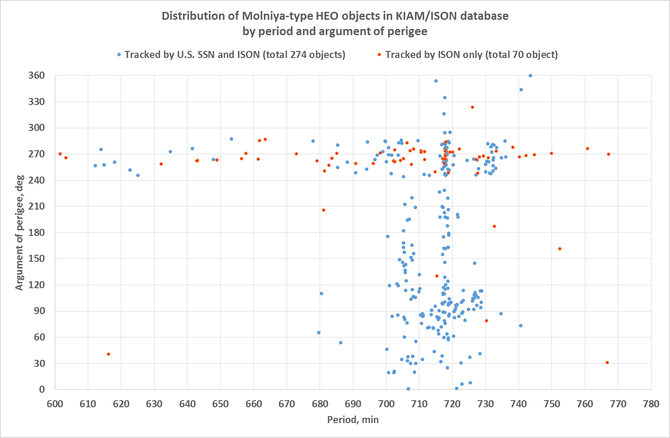
HEO objects selected to define survey area (2)
Apogee near equator –
candidates for detection
in GEO surveys
Apogee in Southern
hemisphere!

Slide 17
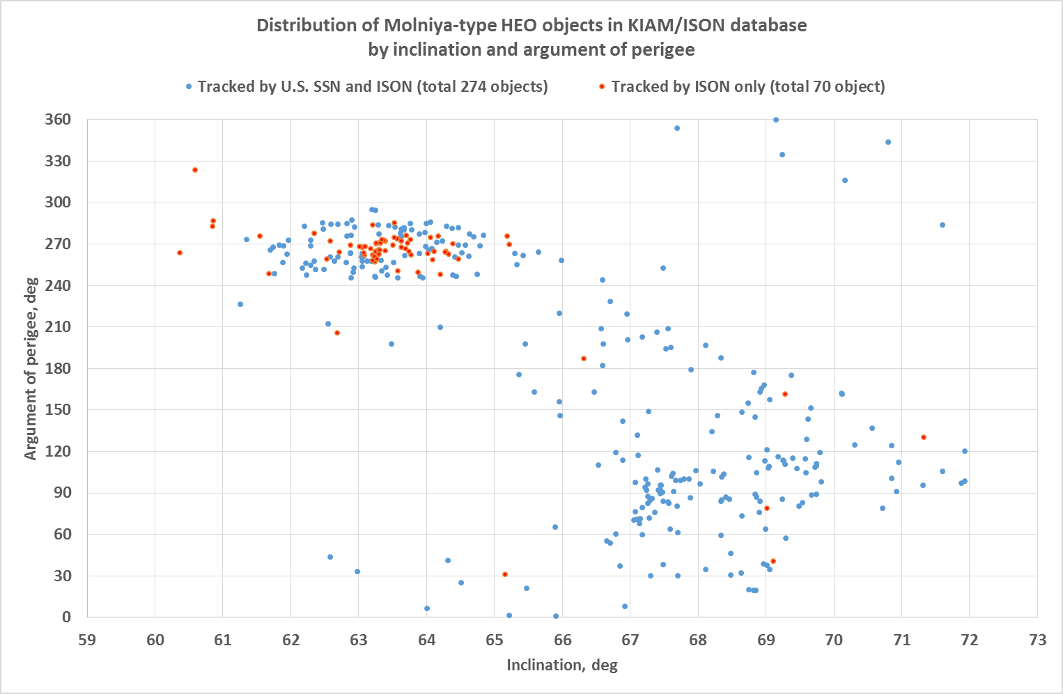
HEO objects selected to define survey area (3)
Apogee near equator –
candidates for detection
in GEO surveys
Apogee in Southern
hemisphere!

Slide 18
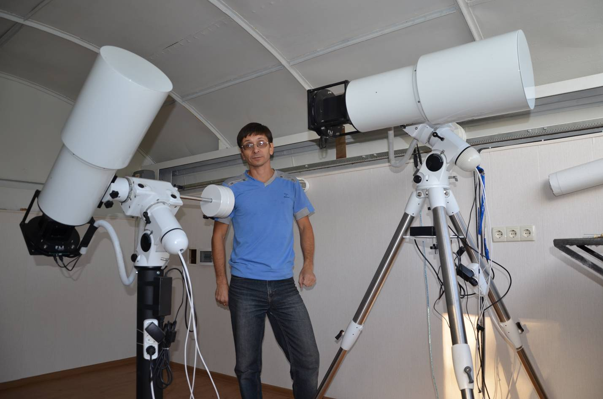
Molniya-type HEO surveys
Two 18 cm aperture VT-52c telescopes with 7 deg x 7 deg FOV
Installed in Nauchnyi-1
One telescope is using for GEO surveys, other – for Molniya-type HEO surveys in near-apogee region

Slide 19
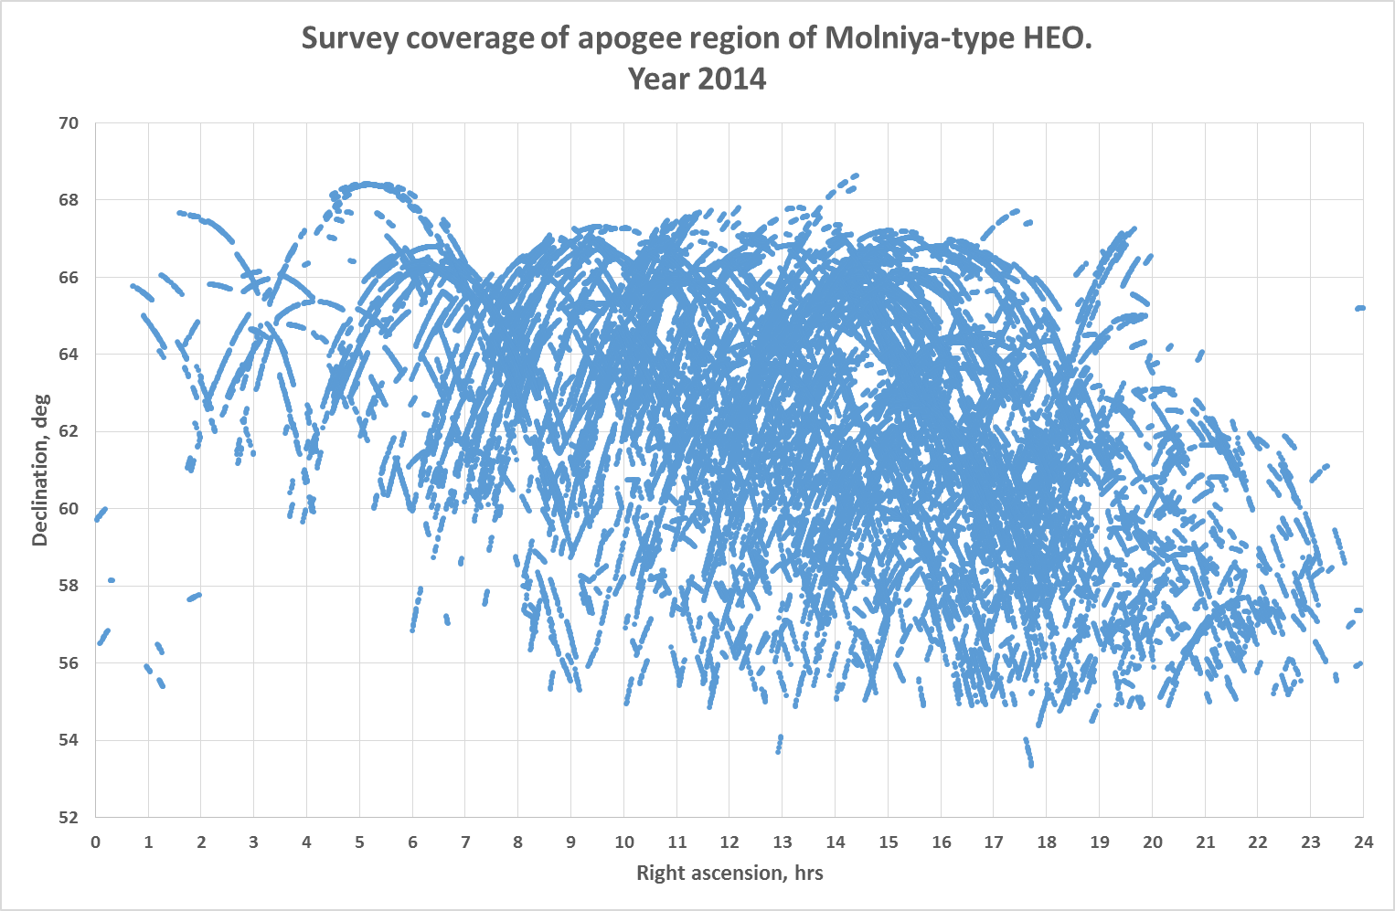
Real Surveys Coverage

Slide 20
Molniya-type HEO Surveys Statistics
Year | Number of observation nights | Number of measurements obtained | Number of individual objects observed
2012 | 103 | 95356 | 163
2013 | 188 | 186640 | 159
2014 (as of May 13) | 60 | 68383 | 132
TOTAL | 351 | 350379 | 188

Slide 21
Newly Discovered Objects in HEO Surveys. Year 2012
Total discovered – 21 objects
ISON Object # | Date of discovery | Period, min | Inclination, deg | Argument of perigee, deg | A/m, sq.m/kg | Std. visible magnitude
95633 | 03.03.2012 | 707.57 | 63.92 | 259.0 | 0.084 | 14.9
95652 | 23.04.2012 | 607.51 | 63.11 | 268.4 | 0.059 | 13.2
95660 | 07.05.2012 | 711.45 | 63.13 | 274.0 | 0.093 | 14.7
95678 | 01.06.2012 | 744.70 | 62.86 | 271.0 | 0.033 | 14.3
95666 | 05.06.2012 | 724.19 | 63.19 | 287.6 | 20.3 | 13.0
95702 | 05.06.2012 | 642.83 | 63.83 | 268.0 | 0.011 | 14.1
95669 | 14.06.2012 | 542.96 | 63.23 | 281.6 | 0.191 | 13.6
95707 | 09.08.2012 | 749.83 | 63.69 | 275.8 | 0.034 | 14.5
95709 | 15.08.2012 | 702.19 | 63.81 | 262.7 | 0.018 | 13.7
95710 | 21.08.2012 | 729.85 | 63.50 | 278.0 | 0.182 | 14.8
95729 | 11.09.2012 | 732.63 | 67.53 | 195.0 | 1.57 | 15.9
95730 | 11.09.2012 | 708.13 | 64.90 | 281.2 | 0.163 | 13.2
95752 | 12.09.2012 | 763.67 | 65.51 | 276.7 | 4.70 | 14.8
95740 | 13.09.2012 | 725.73 | 63.41 | 278.8 | 0.074 | 12.3
95782 | 28.09.2012 | 760.60 | 63.60 | 276.9 | 0.187 | 15.2
95779 | 06.10.2012 | 722.01 | 63.94 | 278.2 | 0.144 | 14.9
95781 | 07.10.2012 | 506.75 | 63.87 | 267.4 | 0.040 | 15.8
95793 | 17.10.2012 | 751.40 | 64.51 | 177.1 | 3.04 | 16.5
95796 | 14.10.2012 | 665.37 | 63.94 | 269.7 | 0.222 | 14.0
90201 | 21.10.2012 | 661.38 | 64.32 | 268.7 | 0.010 | 15.3
90229 | 18.11.2012 | 710.21 | 63.47 | 272.0 | 0.168 | 15.9

Slide 22
Newly Discovered Objects in HEO Surveys. Year 2013
Total discovered – 17 objects
ISON Object # | Date of discovery | Period, min | Inclination, deg | Argument of perigee, deg | A/m, sq.m/kg | Std. visible magnitude
90282 | 24.01.2013 | 727.44 | 63.16 | 264.3 | 0.143 | 13.6
90297 | 06.03.2013 | 740.30 | 63.73 | 269.6 | 0.010 | 13.0
90308 | 27.02.2013 | 643.01 | 64.36 | 266.6 | 0.022 | 15.8
90331 | 24.03.2013 | 664.32 | 60.77 | 276.7 | 0.483 | 14.0
90341 | 19.05.2013 | 706.52 | 60.80 | 274.8 | 0.412 | 14.1
90354 | 26.06.2013 | 710.49 | 63.53 | 275.9 | 0.074 | 16.2
90369 | 20.07.2013 | 674.42 | 63.35 | 269.3 | 0.267 | 14.5
90374 | 10.08.2013 | 706.57 | 61.76 | 271.6 | 3.20 | 12.7
90370 | 12.08.2013 | 679.07 | 63.14 | 262.9 | 0.170 | 13.6
90372 | 15.08.2013 | 711.55 | 60.42 | 258.1 | 0.222 | 14.9
90389 | 01.09.2013 | 733.27 | 63.21 | 272.7 | 0.221 | 14.9
90397 | 17.10.2013 | 690.37 | 63.52 | 259.0 | 0.381 | 14.4
90394 | 28.10.2013 | 730.93 | 63.28 | 265.5 | 0.064 | 13.8
90417 | 04.11.2013 | 705.02 | 63.31 | 265.2 | 0.373 | 14.7
90430 | 04.11.2013 | 634.21 | 60.71 | 263.6 | 57.9 | 14.8
90438 | 15.11.2013 | 727.70 | 64.32 | 249.0 | 0.098 | 14.2
90447 | 27.12.2013 | 742.39 | 63.01 | 267.6 | 0.230 | 15.5

Slide 23
Newly Discovered Objects in HEO Surveys. Year 2014 (as of May 13)
Total discovered – 5 objects
ISON Object # | Date of discovery | Period, min | Inclination, deg | Argument of perigee, deg | A/m, sq.m/kg | Std. visible magnitude
90474 | 03.03.2014 | 719.74 | 63.43 | 272.4 | 0.167 | 13.7
90487 | 07.03.2013 | 729.30 | 63.10 | 268.7 | 0.017 | 16.1
90482 | 19.03.2014 | 707.20 | 63.58 | 274.0 | 0.191 | 13.2
90499 | 19.03.2014 | 738.47 | 62.35 | 277.8 | 0.579 | 15.1
90504 | 01.05.2014 | 601.61 | 64.38 | 269.97 | 0.152 | 14.7
43 new objects in total are discovered in surveys by now of which 7 ones are lost. Thus the overall number of currently tracking ISON-discovered objects at near Molniya-type orbits increased to 70.

Slide 24
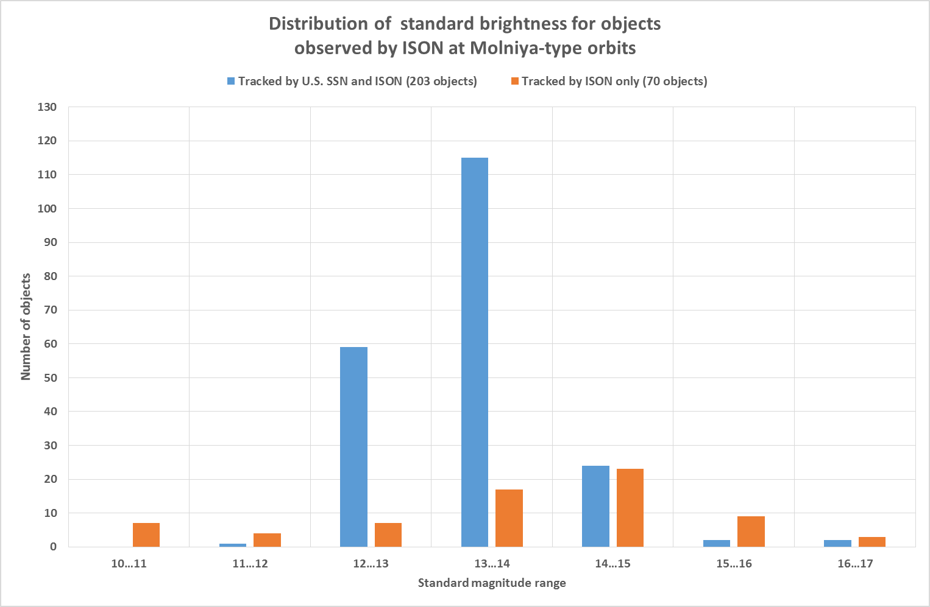
Brightness distribution for objects observing by ISON at Molniya-type orbits

Slide 25
Conclusion
A set of software tools is developed in KIAM to support ISON operations and obtained data analysis
OD tool provides high level of flexibility which is required to process measurements for different classes of orbits
Conjunction analysis is performing for spacecraft operating by Roscosmos
Near-apogee region of Molniya-type orbit was surveyed during 351 observation nights in 2012-2014 by a single small-class wide FOV (7x7 deg) instrument
40 new objects are discovered (7 of them are lost at present)
ISON is tracking at present 70 objects (or 25.5%) more than published by the U.S. SSN for the same class of objects

