Slide 1
Asteroid Observation in Mongolia
Conference for primitive bodies and spaceguard on Nov. 6-7, 2014, National Astronomical Observatory, Japan.
N.Tungalag¹, S.Schmalz², V.Voropaev³ , I.Molotov³
¹Research Center of Astronomy and Geophysics, Ulaanbaatar, Mongolia, namkhai_tungalag@yahoo.com
² Leibniz Institute for Astrophysics, Potsdam, Germany, sergiuspro@yahoo.de
³ Keldysh Institute of Applied Mathematics, RAS, Moscow, Russia, voropaev@live.ru , im62@mail.ru

Slide 2
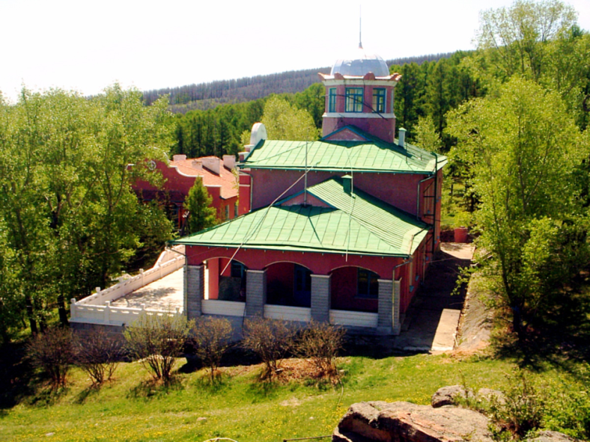
• About observatory
The astronomical observatory Khureltogoot is located on the Bogdkhan Mountain, about 20 km south of the capital city Ulaanbaatar.
Latitude: 47°51'56'' N,
Longitude: 107°03'10'' E,
Altitude: 1620 m
The observatory operates at the Research Centre of Astronomy and Geophysics (RCAG), government research organization in Mongolia specializing in fundamental astronomical and geophysical research.

Slide 3
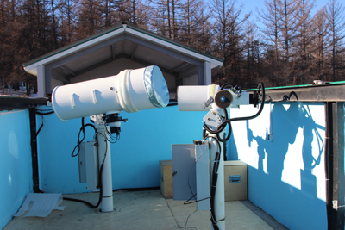
• Asteroid observations at the Khureltogoot observatory
Since 2012, in collaboration with ISON (International Scientific Optical Network coordinated by Keldysh Institute for Applied Mathematics, Russia) we conduct a large amount of astronomical observations of space debris, asteroids, and the optical afterglows of gamma-ray bursts (GRBs).
Main instruments are two telescopes:
40 cm telescope ORI-40 with the field of view of 2.3×2.3
VT-78a 19.2 cm telescope with field of view of 7×7 degrees

Slide 4
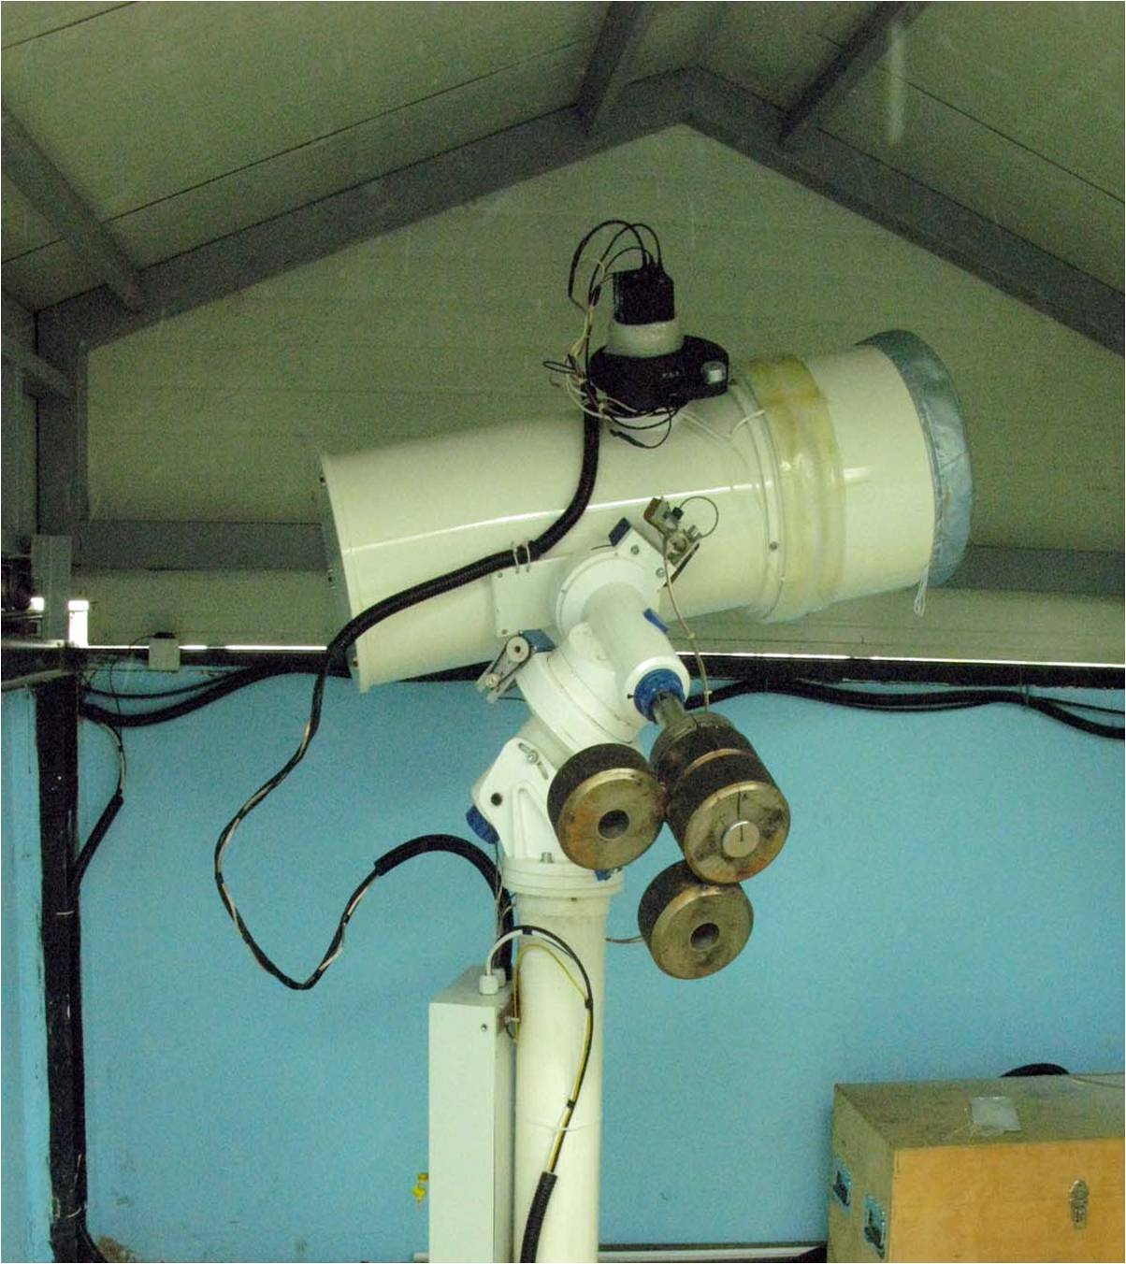
Asteroid observations began in 2014 and carried out with the telescope ORI-40 mainly.
40 cm telescope ORI-40 with the field of view of 2.3×2.3 degrees, on a robotic WS-240 mount. The telescope is controlled by the CHAOS TCS software; CCD image processing is done using the APEX II software platform developed within the ISON project.

Slide 5
• MPC code
On February 5, 2014 the Khureltogoot Observatory was assigned the observatory code O75 by Gareth Williams of the Minor Planet Center (MPC), only a week after the start of minor planet observation with the ORI-40 telescope.
• Asteroid survey
Multiple observations of minor planets have been carried out to discover new objects. Each survey run under the usage of CHAOS software, which allows both automatic batch and manual pointing of the telescope and image acquisition.

Slide 6
• Asteroid survey
Image reduction and astrometric measurements were done with the CoLiTec package. First results showed that the detection magnitude limit of ORI-40 is at ~19.5 mag for objects with small zenith distance. Thus, it is a rather difficult task to discover new asteroids, because most of asteroids brighter than 19 mag are already known, only near-Earth asteroids (NEAs) and comets are potential targets for a survey. We plan now photometric observations for asteroids brighter than 19 mag, that will compose light-curves, on whose basis physical and dynamical parameters of an asteroid can be determined.

Slide 7
• NEO confirmation
On April 12, 2014 our first NEO confirmation was issued by the MPC in MPEC 2014-G75 for the Apollo-family asteroid 2014 GY48 which is included in the list of the potentially hazardous asteroids (PHAs). Due to the relatively low limiting magnitude of the ORI-40 telescope, such observations are restricted only to the brightest NEOs posted on the NEO confirmation page (NEOCP).

Slide 8
At present time 4 NEO confirmations were issued by the MPC in circulars (MPEC), in which ISON-Khureltogoot Observatory (O75) appears as confirming observatory.
http://www.minorplanetcenter.net/mpec/K14/K14G75.html
http://www.minorplanetcenter.net/mpec/K14/K14T09.html
http://www.minorplanetcenter.net/mpec/K14/K14T45.html
http://www.minorplanetcenter.net/mpec/K14/K14U79.html

Slide 9
Thank you for attention!

