Slide 1
MMT Observation Database for Light Curve Analysis
Vladimir Agapov
Presentation for the WG1 session
33rd IADC meeting, Houston

Slide 2
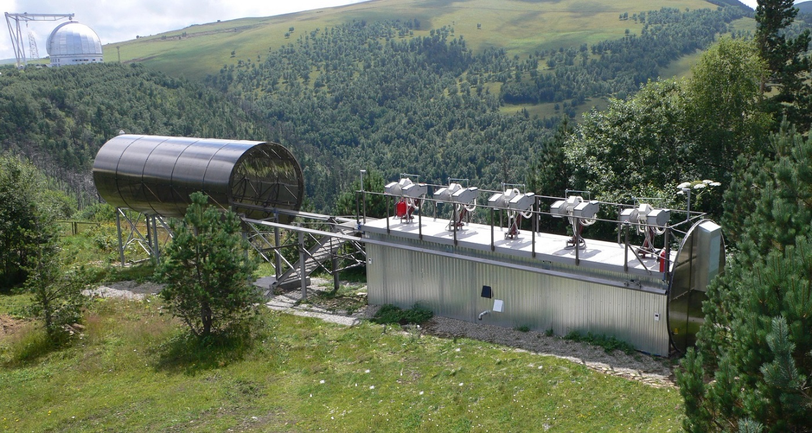
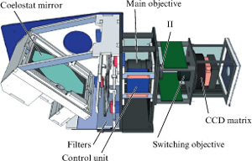
MMT – Multichannel Monitoring Telescope
(Mini-MegaTORTORA)
Developed jointly by Kazan Federal University (Russia), Special Astrophysical Observatory of the Russian Academy of Sciences and Parallax Ltd company
Put into operation in June 2014
Main purpose – search for optical transients: GRB afterglow, nova, SN, variable stars, etc

Slide 3
MMT Characteristics
Location: 41°25'53.3" E, 43°38'59.5" N, 2030 m
9(10) channels (2 per mount, 5 mounts)
Each channel consists of Canon objective (71 mm, 1:1.2) + Neo sCMOS Andor 2560x2160 pix (6.5x6.5 µm, 30-60% QE for 4000-8000 A range) + BVR filters + polaroid
900 square degrees coverage for the whole system
Each channel on different field center or all channels on same field center
10 frames per second
Sensitivity (S/N=5, B filter, 22^{m}/sq.arcsec background sky brightness) :
  12^{m} – for 0.1 s exposure time,
  14.5^{m} – for 10 s (100 stacked frames),
  17^{m} – for 1000 s (10000 stacked frames)
Information flow – 1 Gb per second
Amount of data collected per night – up to 6 Tb per channel

Slide 4
MMT use for space debris observations
Objects on near-Earth orbits have been detecting as one of a kind of optical transients (no dedicated observations of space debris!)
A few hundred detectable objects are crossing FOV of the system during one night
Fully automated selection of optical transients that can be associated with orbital objects

Slide 5
MMT space debris observations database (1)
Photometric and astrometric observation have been collecting
Astrometric – low accuracy (due to large image scale), so has limited usefulness
Photometric observations (light curves) are much more interesting
Normally obtained without filters but sometimes – with B, V or R filter
Measurements have been associated with known orbital objects using public orbital data – official TLE distributing via SpaceTrack or produced by amateurs
Accessible via Web at http://astroguard.ru/satellites

Slide 6
MMT space debris observations database (2)
33455 tracks for 4093 satellites are collected between Jun 4, 2014 and Mar 27, 2015
Data for 1800 satellites are already made available for public
All light curves are classified as Periodic, Aperiodic and Non-variable:
  Periodic - significantly periodic light curves
  Aperiodic - stochastic brightness variations or not enough data to estimate the period
  Non-variable - brightness is not varying significantly
Search of data can be performed by object name, catalogue number, range of brightness variation period, type of variability
Data are averaged for each satellite but data for every individual track can be also accessed

Slide 7
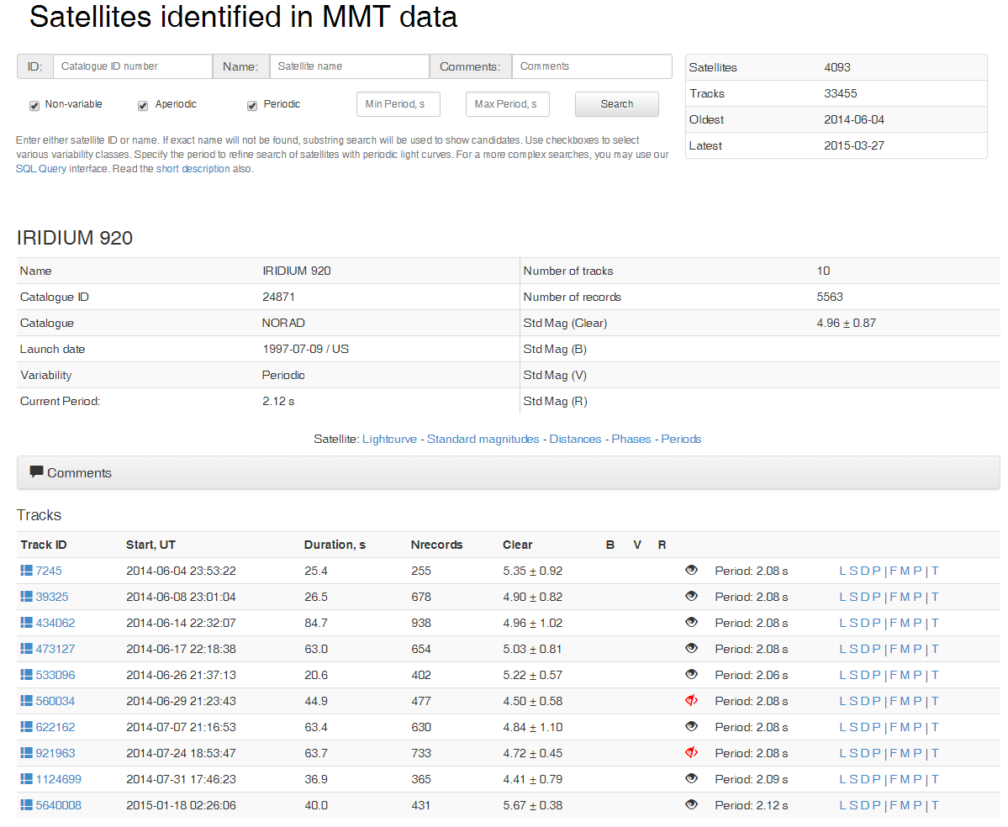
Object 24871 (IRIDIUM 920) example

Slide 8
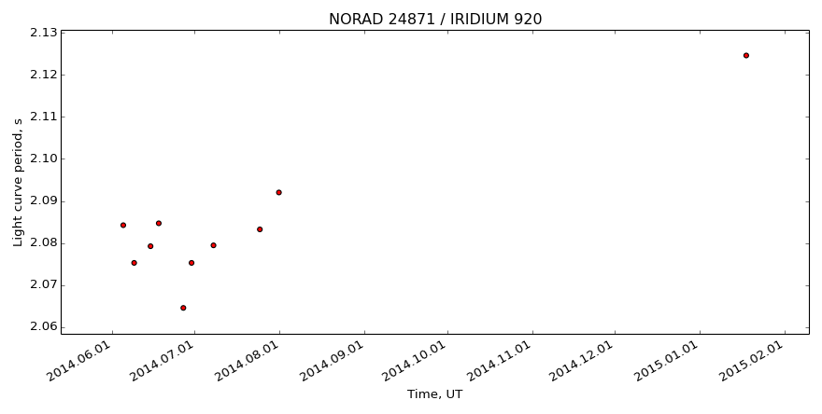
Object 24871 (IRIDIUM 920) example
Light curve periods for all collected tracks

Slide 9
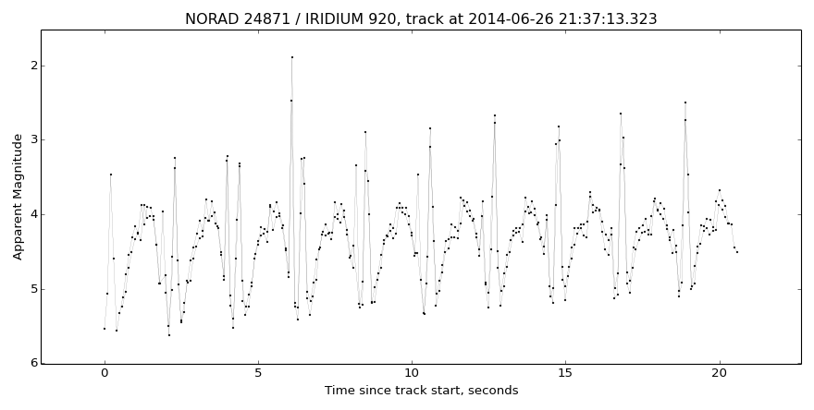
Object 24871 (IRIDIUM 920) example
Light curve for individual track

Slide 10
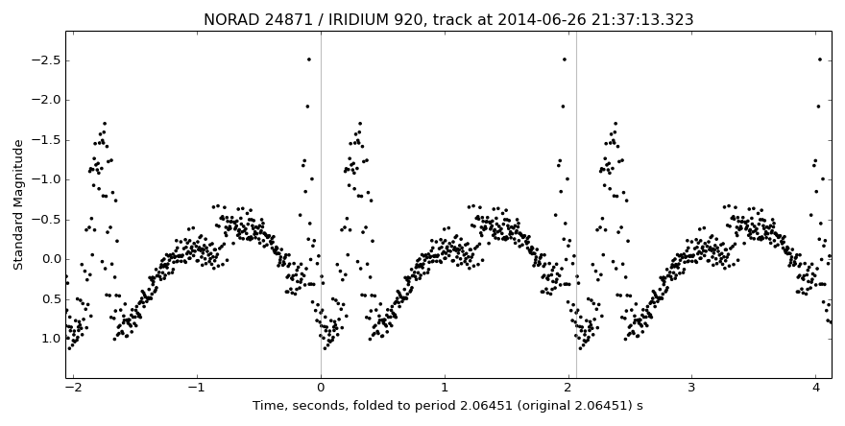
Object 24871 (IRIDIUM 920) example
Folded light curve for individual track

Slide 11
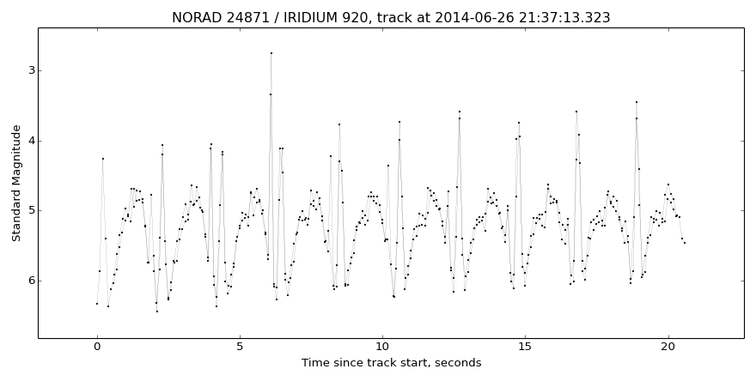
Object 24871 (IRIDIUM 920) example
Standard magnitudes (1000 km distance, 90 deg phase angle)
calculated for individual track

Slide 12
MMT Web Site
Satellites observations http://astroguard.ru/satellites
Meteors observations http://mmt.favor2.info/meteors

