Slide 1
Update on results of Molniya-type HEO surveys performed by ISON in 2014
Vladimir Agapov (KIAM RAS)
Roscosmos delegation
Presentation for the WG1 session
33rd IADC meeting, Houston

Slide 2
Molniya-type HEO orbits
«True» Molniya-type orbits defined as having following parameters:
inclination is close to 63.4 deg → no precession of perigee
argument of perigee is in range 240-300 deg → apogee is over Northern hemisphere at high latitudes
orbital period is close to 718 min (half a sidereal day) → repeating ground track
eccentricity is in range 0.67-0.74 → high apogee and thus longer period of time for passing near-apogee part of orbit
18 known fragmentations of objects at «true» Molniya-type orbits occurred → more scattered distribution of all orbital parameters for fragments

Slide 3
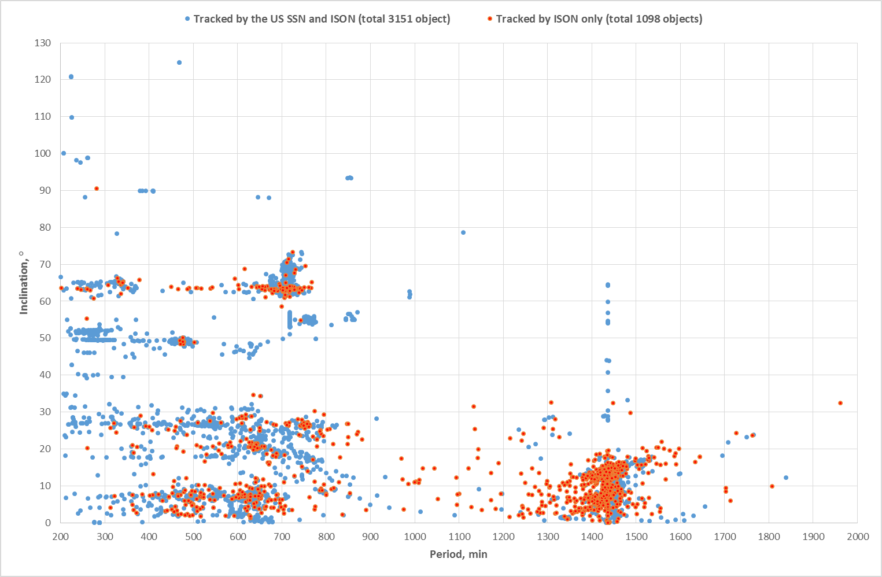
High orbit objects in KIAM/ISON database (as of Mar 30, 2015) Period vs. Inclination distribution
Objects at Molniya-type HEO orbits
are among of members of this group
Molniya-type HEO are
among these objects

Slide 4
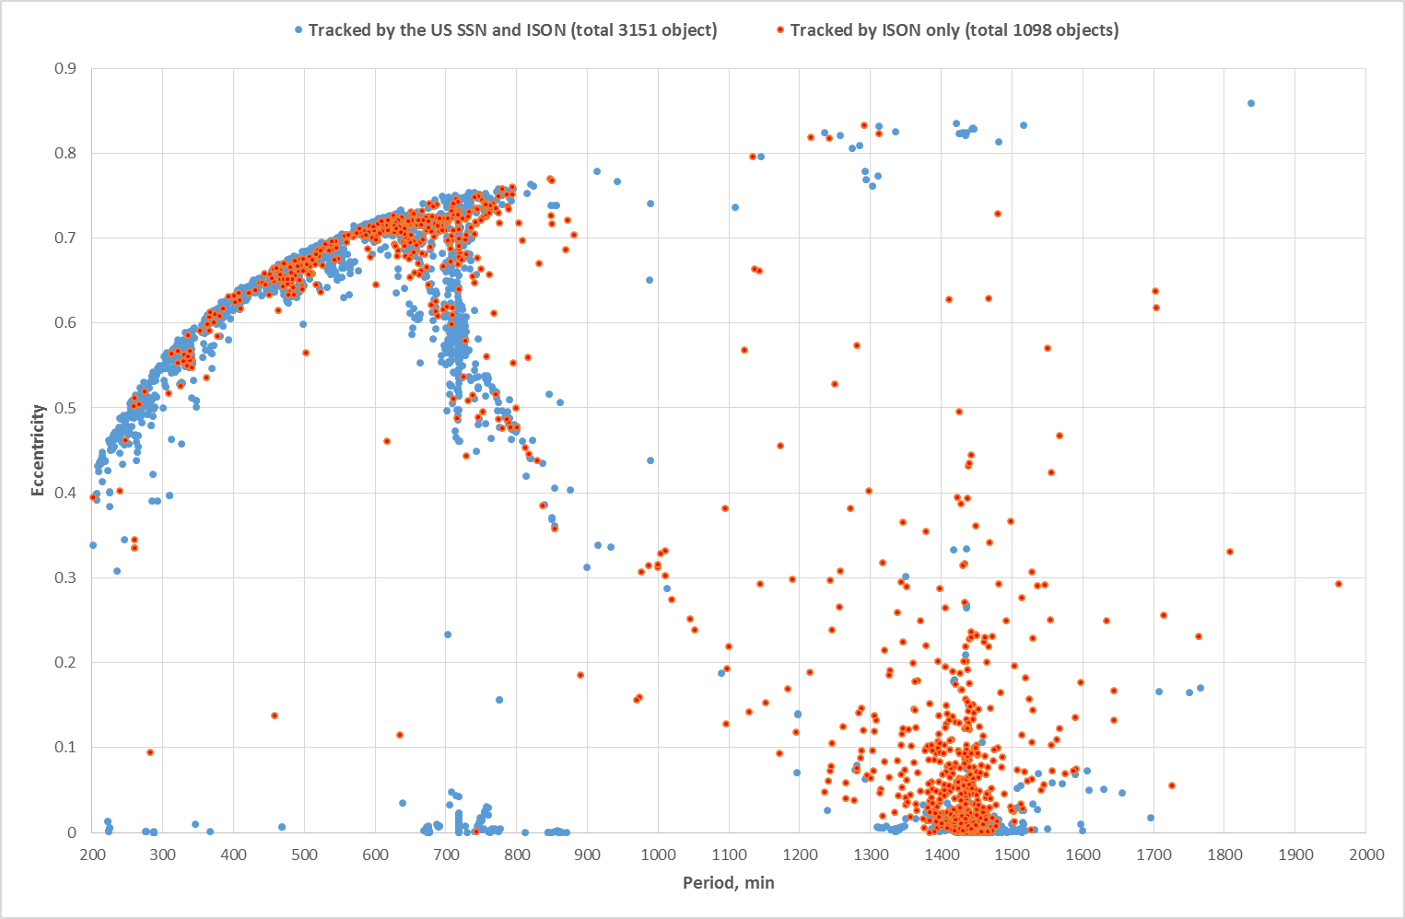
High orbit objects in KIAM/ISON database (as of Mar 30, 2015) Period vs. Eccentricity distribution
Objects at Molniya-type HEO orbits
are among of members of this group

Slide 5
Definition of the group of interest by orbital parameters (also using to define survey areas)
Should be close to «true» Molniya-type orbits but with more wide range of parameters in order to cover possible fragments of explosions:
inclination: 58…73 deg
argument of perigee: no limit
orbital period: 600…800 min
eccentricity is in range 0.45-0.75
Criteria are slightly revised comparing to the previous year report to include all Molniya-type HEO objects with period close to a half of sidereal day (717-718 min)

Slide 6
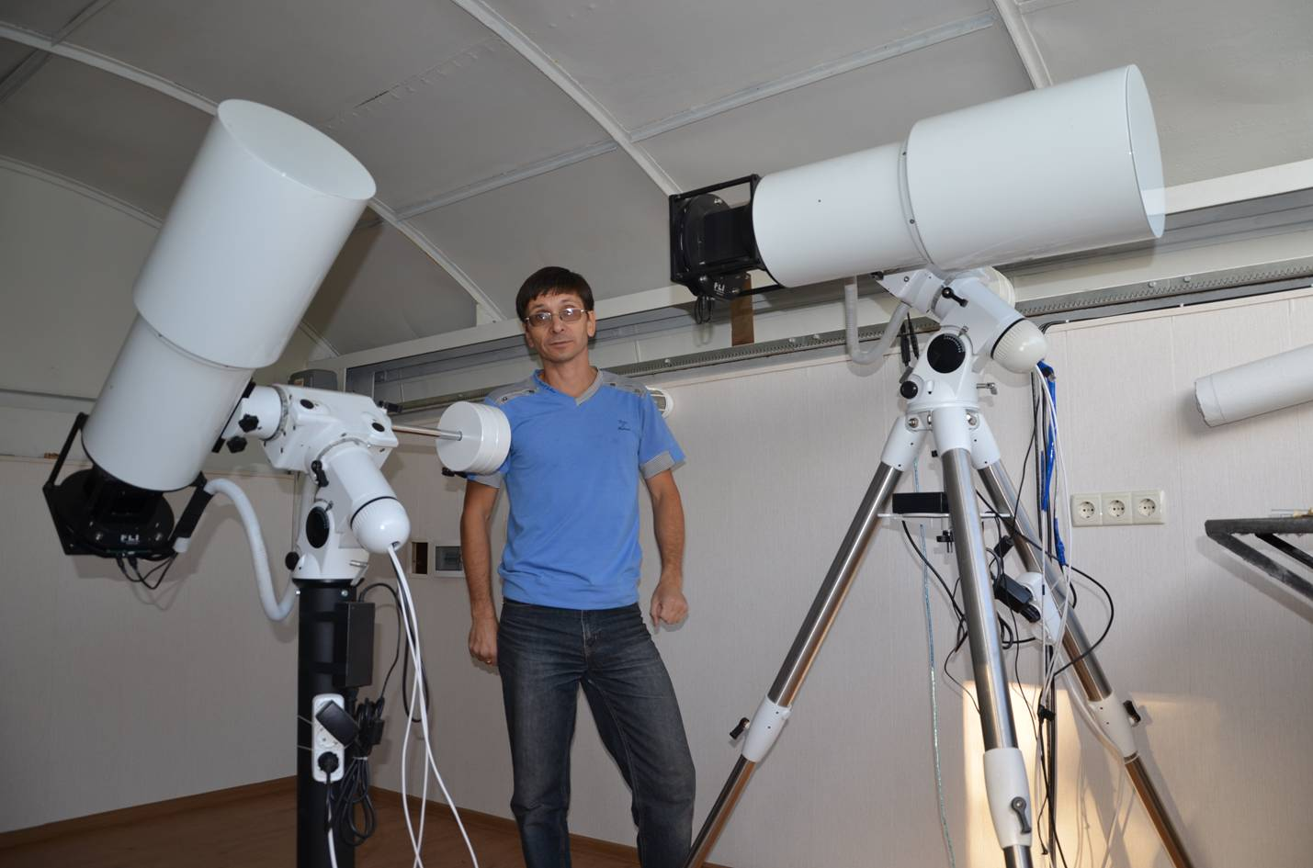
Equipment used for Molniya-type HEO surveys
VT-52c telescope
aperture – 180 mm equivalent focal length – 294 mm focal ratio – f/1.63 FOV angular diameter – 10° FOV linear diameter – 51.6 mm image scale – ~1.43 µm/arcsec
CCD – FLI ML9000 (3056x3056 pix, 12 µm)
Resulting FOV – 7.1 x 7.1 deg
Installed at Nauchnyi
One telescope is using for GEO surveys, second – for Molniya-type HEO surveys in near-apogee region

Slide 7
Equipment for Molniya-type HEO surveys (2)
Area around star clusters M46 and M47
imaged with VT-52c, exposure time 10 s,
no filters
M47 cluster (uncropped image)
7.1 deg

Slide 8
Molniya-type HEO Surveys Updated Statistics
Year | Number of observation nights | Number of measurements obtained | Number of individual objects observed
2012 | 106 | 96701 | 180
2013 | 197 | 189482 | 197
2014 (as of Sep 30) | 155 | 131057 | 229
TOTAL | 458 | 417240 | 281

Slide 9
Population of the group of interest in KIAM/ISON database (as of Mar 30,2015)
At present KIAM/ISON database contains orbital and brightness information for 352 objects with orbits satisfied given definition of the group of interest:
274 tracking by the US SSN and ISON and
78 tracking by ISON only

Slide 10
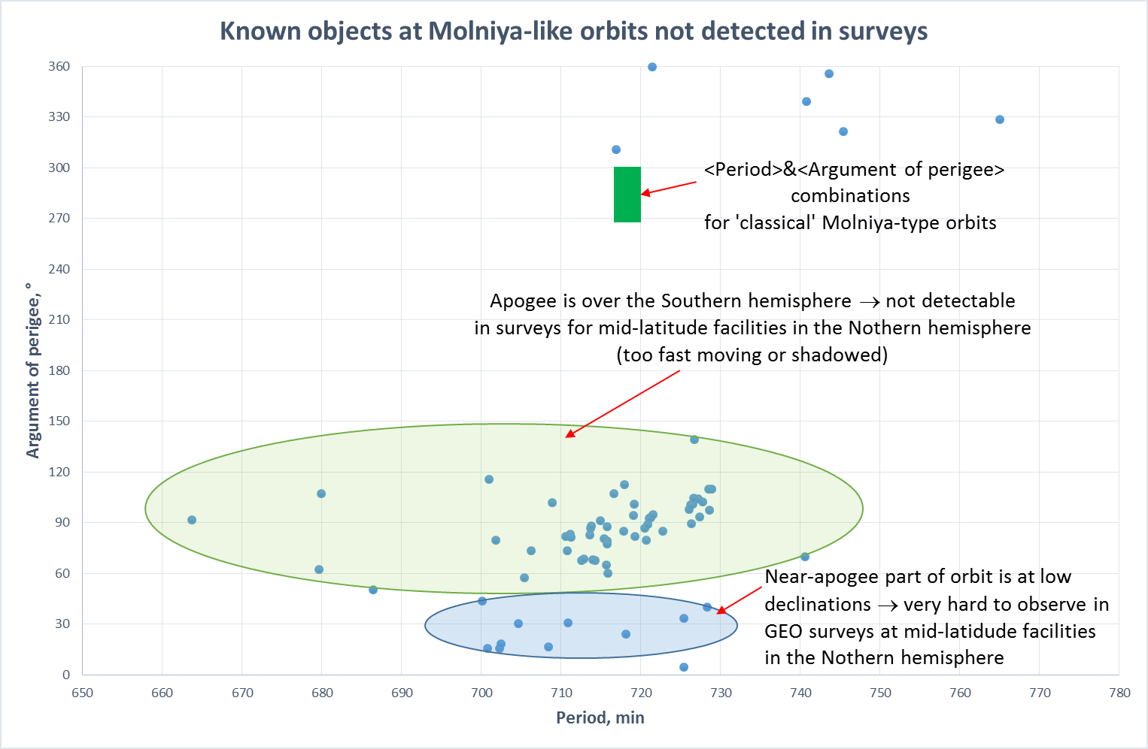

Slide 11
Newly Discovered Objects in HEO Surveys. Year 2014
Total discovered – 15 objects
ISON Object # | Date of discovery | Period, min | Inclination, deg | Argument of perigee, deg | A/m, sq.m/kg | Std. visible magnitude
90474 | 03.03.2014 | 719.74 | 63.43 | 272.4 | 0.167 | 13.7
90487 | 07.03.2013 | 729.30 | 63.10 | 268.7 | 0.017 | 16.1
90482 | 19.03.2014 | 707.20 | 63.58 | 274.0 | 0.191 | 13.2
90499 | 19.03.2014 | 738.47 | 62.35 | 277.8 | 0.579 | 15.1
90504 | 17.04.2014 | 601.61 | 64.38 | 269.97 | 0.152 | 14.7
90505 | 18.04.2014 | 724.58 | 72.86 | 317.7 | 1.31 | 14.4
90516 | 26.06.2014 | 677.64 | 63.14 | 261.8 | 0.055 | 15.6
90517 | 29.06.2014 | 727.48 | 67.72 | 79.9 | 0.50 | 14.0
90531 | 30.07.2014 | 707.57 | 62.20 | 193.7 | 0.025 | 16.4
90553 | 29.07.2014 | 662.71 | 64.37 | 30.2 | 1.71 | 15.9
90565 | 27.08.2014 | 717.43 | 63.46 | 254.4 | 0.007 | 16.5
90566 | 27.08.2014 | 702.76 | 62.70 | 261.5 | 0.004 | 15.9
90575 | 15.08.2014 | 693.47 | 65.01 | 35.3 | 0.706 | 16.5
90604 | 04.11.2014 | 666.85 | 64.10 | 265.8 | 0.159 | 17.4
92037 | 13.12.2014 | 707.49 | 62.84 | 266.70 | 0.01 | 10.3

Slide 12
Newly Discovered Objects in HEO Surveys. Year 2015 (as of Mar 30)
Total discovered – 4 objects
ISON Object # | Date of discovery | Period, min | Inclination, deg | Argument of perigee, deg | A/m, sq.m/kg | Std. visible magnitude
90639 | 23.01.2015 | 741.07 | 63.60 | 256.5 | 0.26 | 15.0
90640 | 18.01.2015 | 686.02 | 63.31 | 262.6 | 0.25 | 15.1
90644 | 31.01.2015 | 698.26 | 58.48 | 149.6 | 2.16 | 15.0
90670 | 16.03.2015 | 709.45 | 67.12 | 72.9 | 0.01 | 16.2
Number of objects discovered in surveys of apogee region of Molniya-type
orbits continues to grow despite of use small aperture telescopes for
observations

Slide 13
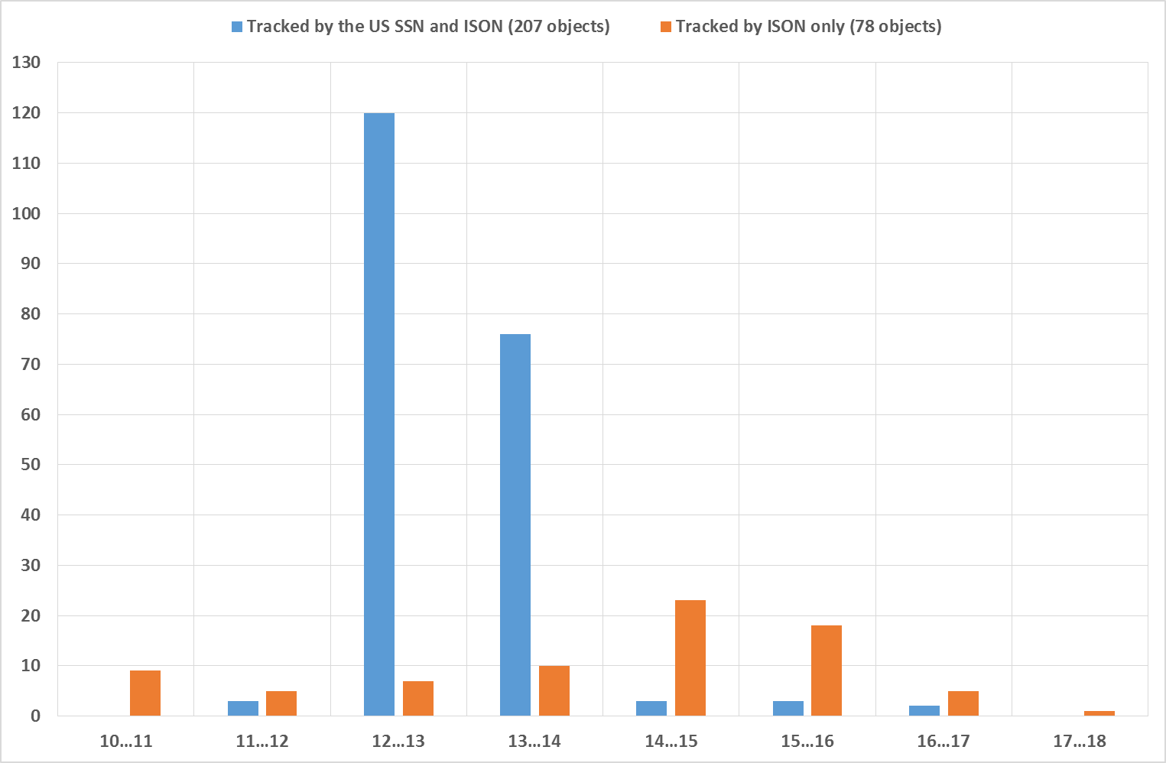
Standard brightness distribution for objects observing by ISON at Molniya-type orbits in 2014

Slide 14
Conclusions
Near-apogee region of Molniya-like orbits over the Northern hemisphere was surveyed during 458 observation nights in 2012-2014 by a single small-class (19 cm) instrument with wide FOV
53 new objects are discovered with even this small equipment
19 of discovered objects are considered lost at present → follow-up observations are required to recover them and keep them tracking (more powerful instruments have to be used)
For the subgroup of objects at Molniya-like orbits studied in surveys ISON is tracking at present 64 more objects than the US SSN (based on orbital data publishing at SpaceTrack) → that is 31% increase in known population of pretty large space debris objects (d>0.8 m) for this subgroup (40% if to take into account those objects that are discovered but considered lost at present)!
Population of debris at Molniya-like orbits need to be studied further using more powerful instruments

