Slide 1
Dedicated Roscosmos optical observation facilities operated in 2014: characteristics and results of operation
Vladimir Agapov, Igor Molotov,
Nikolay Sakva

Slide 2
ASPOS dedicated operational telescopes (2014)
Two dedicated mini-observatories EOP-1 with 3 telescopes in each:
40 cm,
25 cm,
2x19.2 cm
Three separate telescopes:
OES-65 (65-cm),
OES-50 (50-cm),
OES-25 (25-cm)

Slide 3
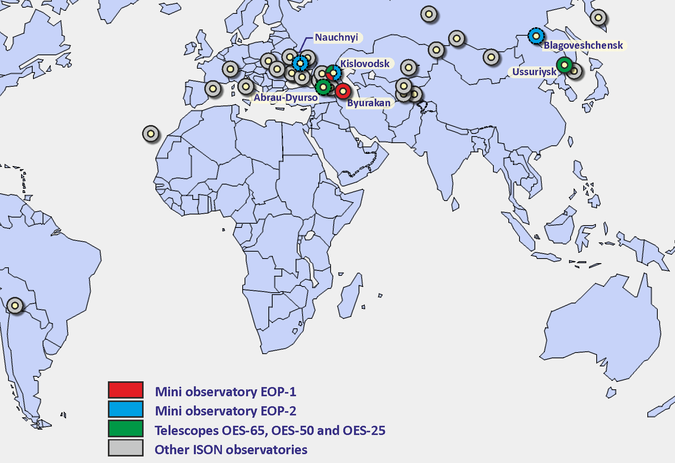
Location of telescopes of Roscosmos

Slide 4
Characteristics of telescopes of Roscosmos that were operational in 2014
 | Telescope | Aperture | Quantity | Limited magnitude | FOV, deg
1 | VT-78e | 19.2 cm | 4 | 14.5 (survey mode) | 7x4.5
2 | ORI-25 | 25 cm | 3 | 16 | 3.3x3.3
3 | ORI-40 | 40 cm | 2 | 18 | 2.3x2.3
4 | ChV-500 | 50 cm | 1 | 17 | 1x1
5 | SANTEL-650A | 65 cm | 1 | 18.5 | 2.2x2.2

Slide 5
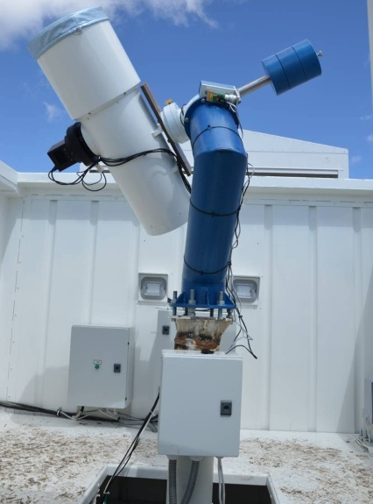
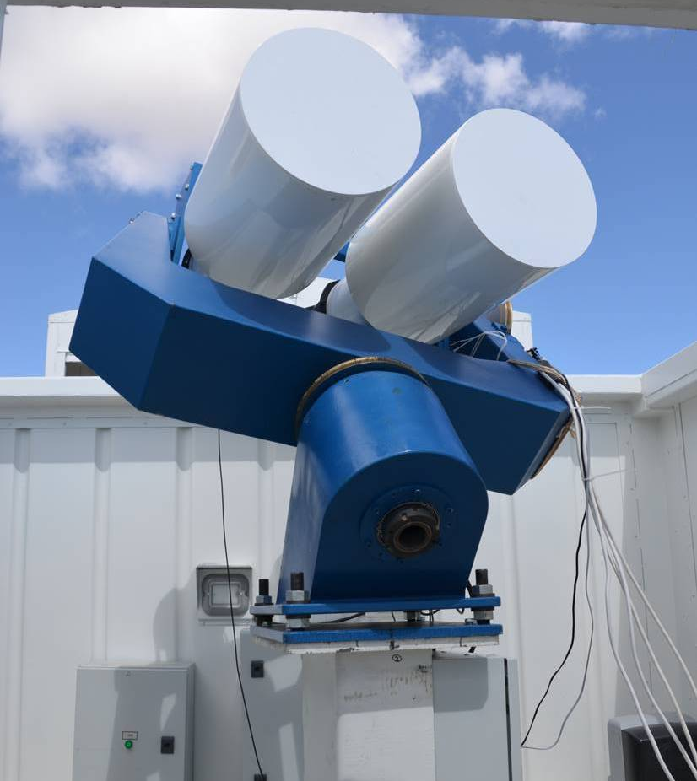
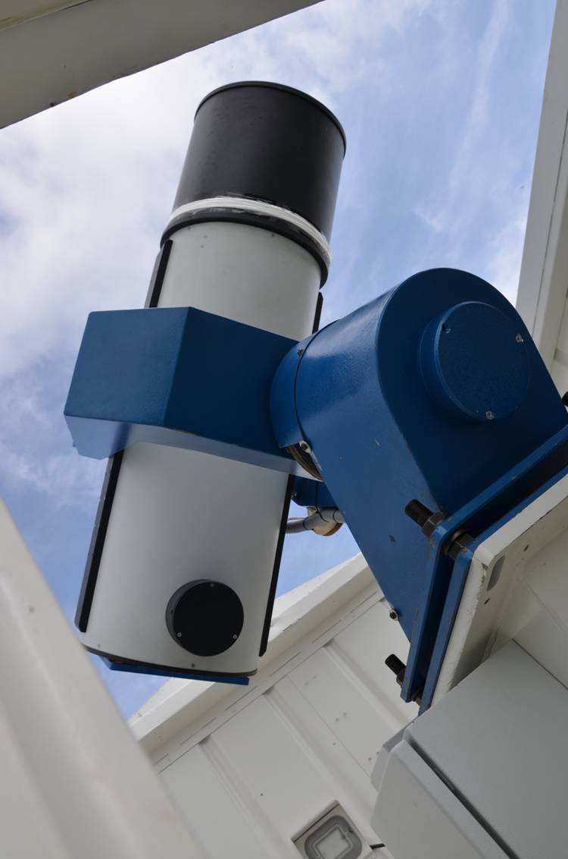
First EOP-1 deployed near Kislovodsk, North Caucasus
(25 cm, 2x19.2 cm and 40 cm)

Slide 6
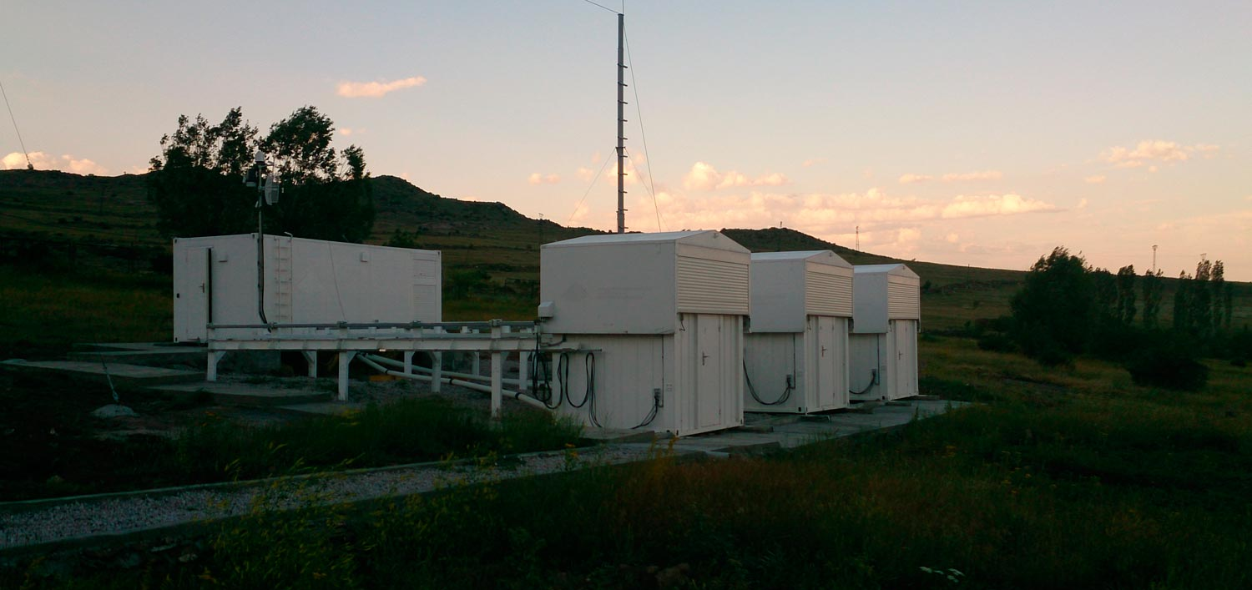
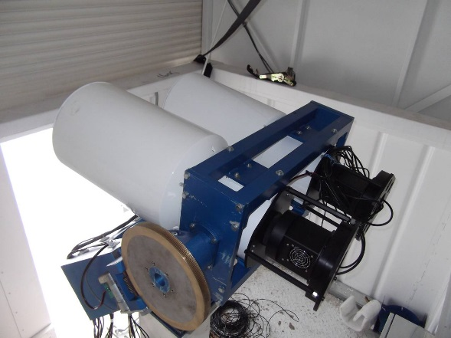
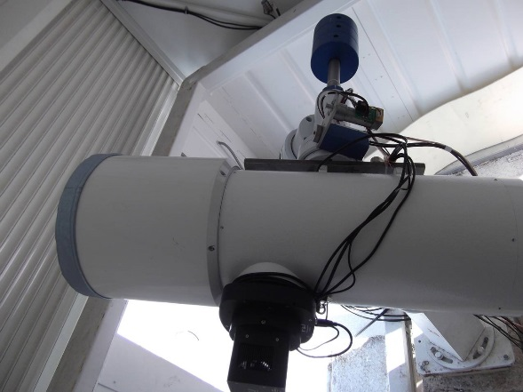
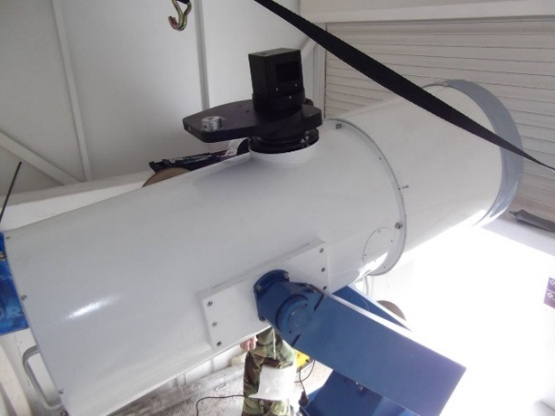
Second EOP-1 deployed near Byurakan, Armenia
(2x19.2 cm, 25-cm and 40 cm)

Slide 7
First EOP-2 deployed near Kislovodsk (put into operation in 2015):
65-cm, 40-cm and 4x19.2 cm telescopes

Slide 8
Operation of two EOP-1 (Kislovodsk and Byurakan) and OES-65 in Ussuriysk
Scheduling of observations is provided by KIAM
2x19.2 cm telescopes are carrying out extended GEO surveys
25 cm telescopes are conducting follow up observations of objects discovered in surveys and also providing additional measurements to improve orbit for objects predicted to be a candidates for conjunctions
40 cm telescopes are conducting observations of faint objects
65 cm telescope is performing local GEO surveys to search new faint objects
All obtained measurements are collecting at KIAM database and are using for maintenance of the orbital archive and conjunction analysis

Slide 9
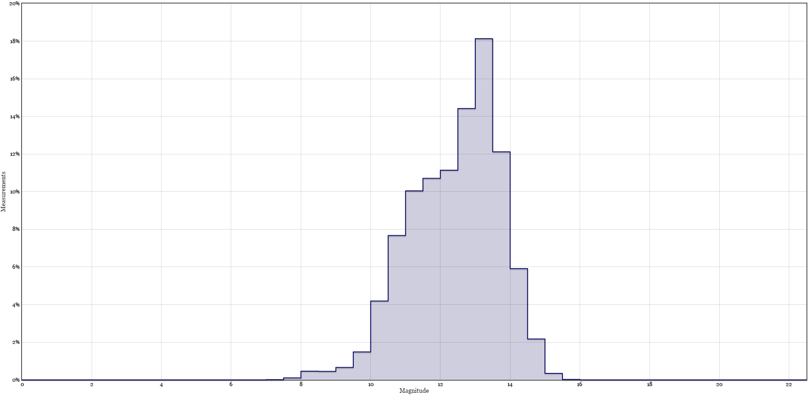
Measured magnitude distribution for all measurements obtained by EOP-1 telescopes in 2014 : 19 cm telescopes
19 cm Kislovodsk
19 cm telescope in Kislovodsk
detects more faint objects thanks to
higher altitude and more clear
atmosphere
19 cm Byurakan

Slide 10
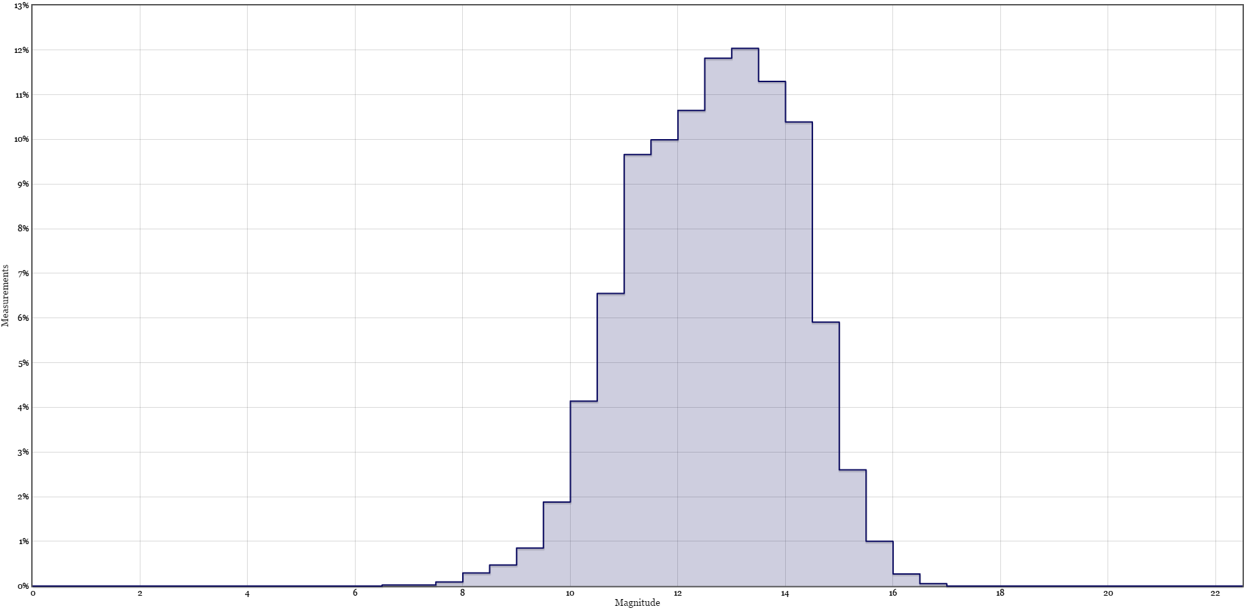
Measured magnitude distribution for all measurements obtained by EOP-1 telescopes in 2014: 25 cm telescopes
25 cm Kislovodsk

Slide 11
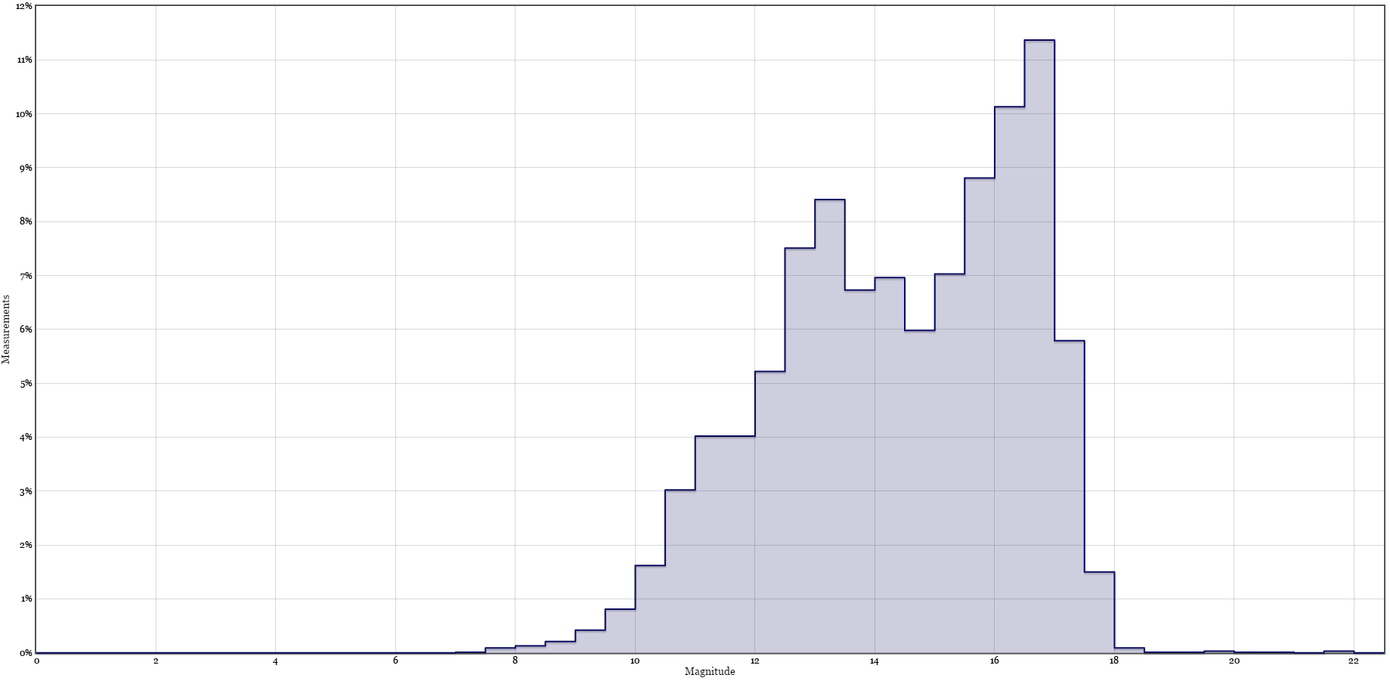
Measured magnitude distribution for all measurements obtained by EOP-1 telescopes in 2014: 40 cm telescopes
40 cm Kislovodsk

Slide 12
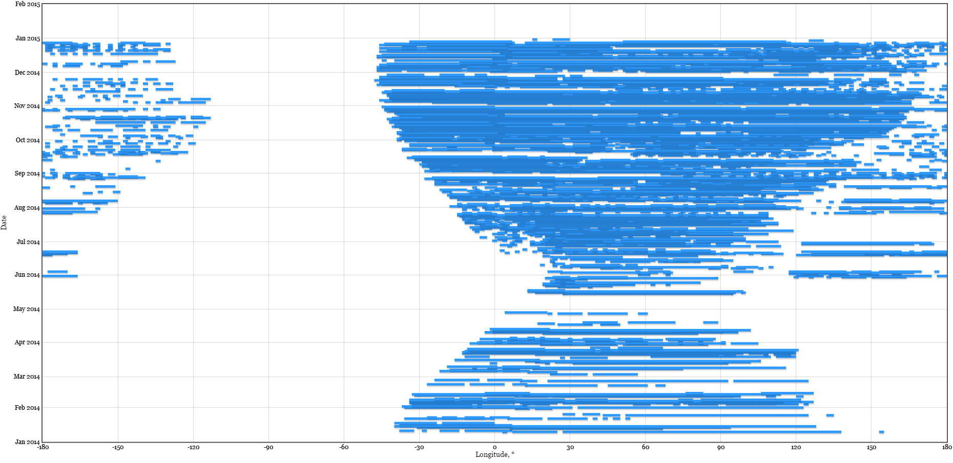
GEO coverage by two EOP-1 and OES-65 in 2014

Slide 13
Conclusions
Dedicated optical facilities developed within the framework of ASPOS OKP system provide significant amount of measurements for high altitude objects serving as a valuable supplement to data obtaining by ISON and providing increased reliability of monitoring of GEO, HEO and MEO objects
More than 2.2 millions of measurements are obtained in 2014 using two EOP-1, EOS-65 and EOS-50
Reliability of conjunction analysis results obtaining at KIAM is significantly improved thanks to extended GEO surveys and additional observations of objects predicted to be a candidate for possible conjunctions

