Slide 1
Increasing of new GEO/HEO space debris discovery rate with ISON optical network
Igor Molotov
Keldysh Institute of Applied Mathematics RAS,
Small innovation enterprise «KIAM Ballistics-Service»
im62@mail.ru, www.astronomer.ru

Slide 2
International Scientific Optical Network (ISON)
ISON is an open international project developed to be an independent source of data about space objects for scientific analysis and SSA
Additional scientific goals: space debris, asteroids, Gamma-Ray Bursts afterglow
Main area of monitoring: GEO and HEO
ISON cooperates with 39 observation facilities of various affiliation with 94 telescopes in 17 countries. Additionally operation of 11 telescopes is in preparation (negotiations are carried out with observatories of 7 countries)
Keldysh Institute of Applied Mathematics of the Russian Academy of Sciences (KIAM) coordinates the ISON project, maintains space objects database and provides conjunction analysis for Russian satellites at high orbits

Slide 3
ISON Research Goals in Space Debris Area
Estimation of real population of space debris at high geocentric orbits
Determination of physical properties of discovered space debris objects
Determination of probable sources of newly discovering space debris fragments
Verification of existing evolution models of space debris distribution
High orbit space debris risk assessment
Improvement of technologies of studying of space debris population using optical instruments
Improvement of motion models for space debris objects with complex physical properties

Slide 4
ISON structure
7 telescope subsets:
global GEO survey (down to 15.5^{m})
extended GEO survey (down to 14^{m})
deep GEO survey (down to 17^{m})
- tracking the faint (fainter than 15.5^{m}) space debris at GEO and GTO
tracking the bright GEO and GTO objects
tracking the bright LEO and HEO objects
for observation of asteroids
*one telescope provides survey of the Molnya-type orbits
**extended GEO surveys produce HEO object detections

Slide 5
Current observations conducted upon user’s requests
Support of conjunction analysis (Roscosmos/ TsNIIMash)
Space situation analysis (Vimpel Corporation)
Information support of the GEO launch operations (Reshetnev ISS company)
Observation of Radioastron mission, observations of the launches of Galileo at MEO (Lavochkin Association)
Observations of Yamal-300K at Far East GEO slot (Gazprom space systems)

Slide 6
ISON managerial news:
New company «Small innovation enterprise «KIAM Ballistics-Service» have been established to separate the scientific and commercial aspects of the ISON activities
Quantity of ISON telescopes is already too much, therefore it have been divided on three segments with own scheduling centers under supervising of six companies : SIE KIAM BS (14 pcs), ASC (9), NCT (8), Vimpel Corp. (8), KIAM RAS (3+ 11 pcs. of contributing observatories) 21 telescopes of TsNIIMash (6 observatories EOP-1, EOP-2 + 3 pcs):
- Support of conjunction analysis – 29 telescopes – TsNIIMash (31% data) + NCT (9%)
- Space situation analysis – 17 telescopes of Vimpel Corp. (4%) and ASC (13%)
- Study of space debris population, provision of services for other users – 28 telescopes (43% data), core of the ISON project - KIAM cooperation + SIE KIAM BS

Slide 7
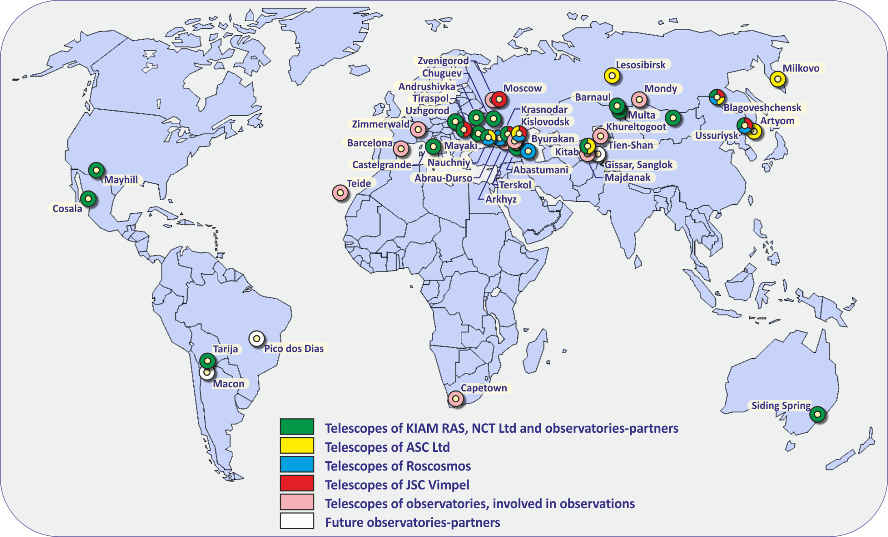
Map of observatories of collaborating with KIAM
Map of ISON observatories

Slide 8
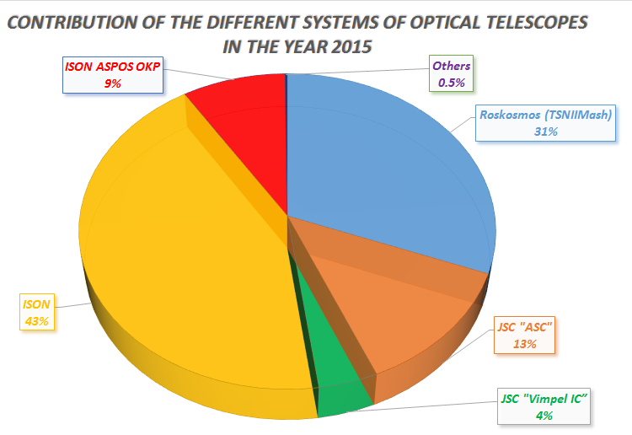
Comparable productivities of segments of ISON telescopes in 2015

Slide 9
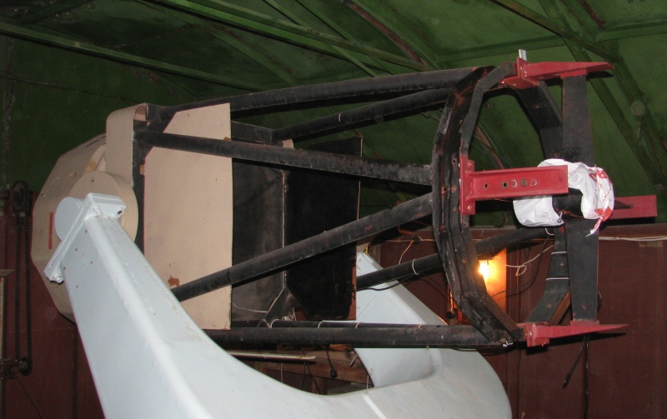
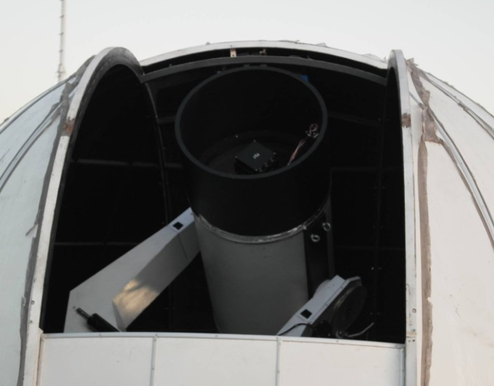
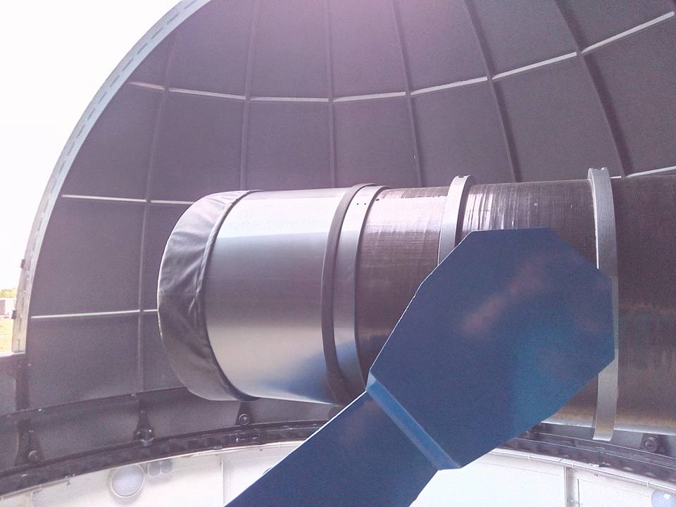
10 new telescopes for faint GEO objects observations
One 80-cm telescope K-800 (55’x55’) in Terskol (North Caucasus) and one 60-cm Ceiss-600 (50’x50’) in Tarija, Bolivia
Two 65-cm SANTEL-650 telescopes (2.2°x2.2°) in Kislovodsk (North Caucasus) and Blagoveschensk (Far East)
Two 50-cm ORI-50ML telescopes (2°x2°) in Kislovodsk (North Caucasus) and Nauchniy-3 (Crimea)
Four 40-cm telescopes ORI-40 (2.3°x2.3°) in Nauchniy-3, Kislovodsk and Blagoveschensk

Slide 10
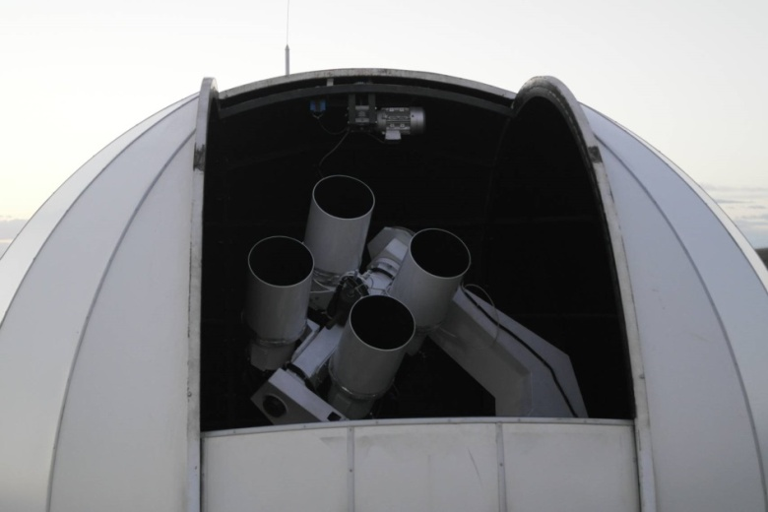
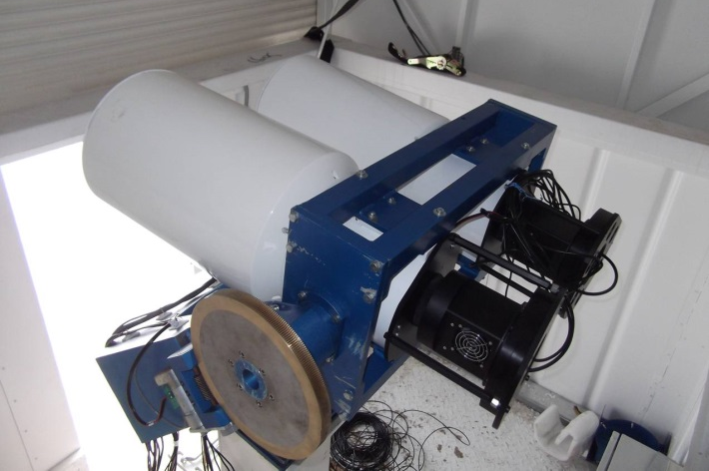
Subsystem for extended GEO surveys was enlarged with 5 new telescopes
Two 4x19.2-cm telescopes systems (9°х14°) in Kislovodsk and Blagoveschensk
Two 2x19.2-cm telescopes system (9°х7°) in Nauchniy-3
30-cm telescope GenonMax (4.7°x4.7°) in Nauchniy-3
+ old five 19.2-cm and one 18-cm telescopes (7°х7°)

Slide 11
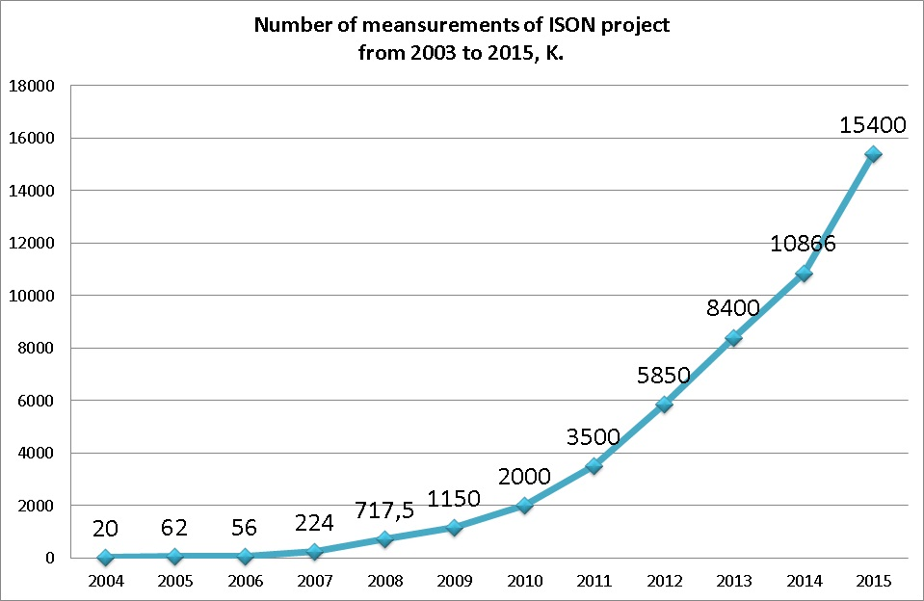

Slide 12
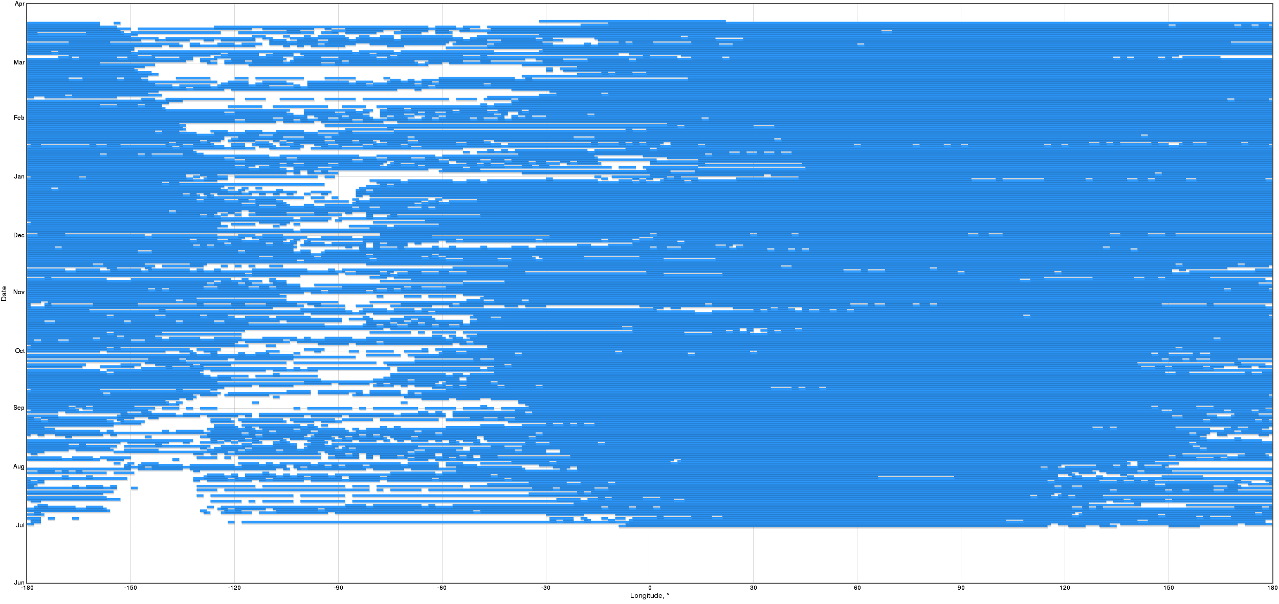
GEO coverage by ISON in July 2015-March 2016

Slide 13
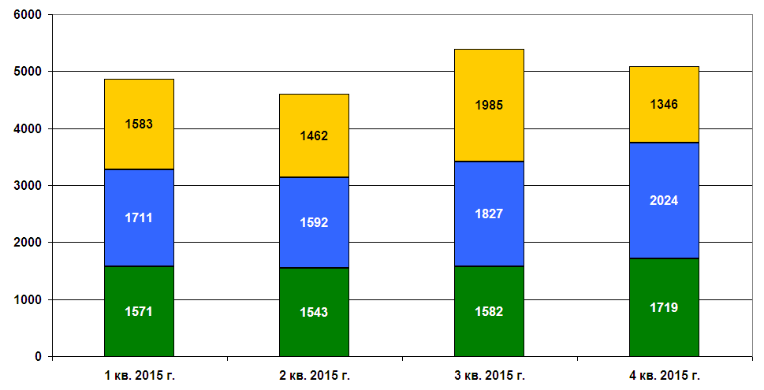
Types and quantity of ISON observed objects in 2015 quarterly
Green – GEO, blue – HEO, yellow – LEO

Slide 14
Observed high orbit objects quarterly
Quarter | GEO bright | GEO faint | HEO bright | HEO faint
1 – 2016 | 1380 | 410 | 1430 | 370
4 – 2015 | 1340 | 380 | 1520 | 510
3 – 2015 | 1310 | 270 | 1390 | 440
2 – 2015 | 1320 | 220 | 1230 | 360
1 – 2015 | 1300 | 240 | 1470 | 370
4 – 2014 | 1280 | 260 | 1100 | 340

Slide 15
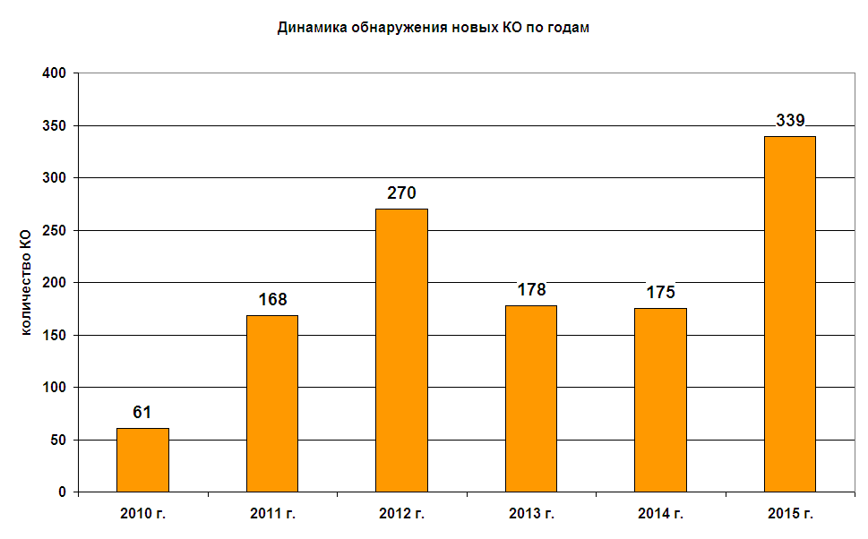
Annual new objects discovery statistic

Slide 16
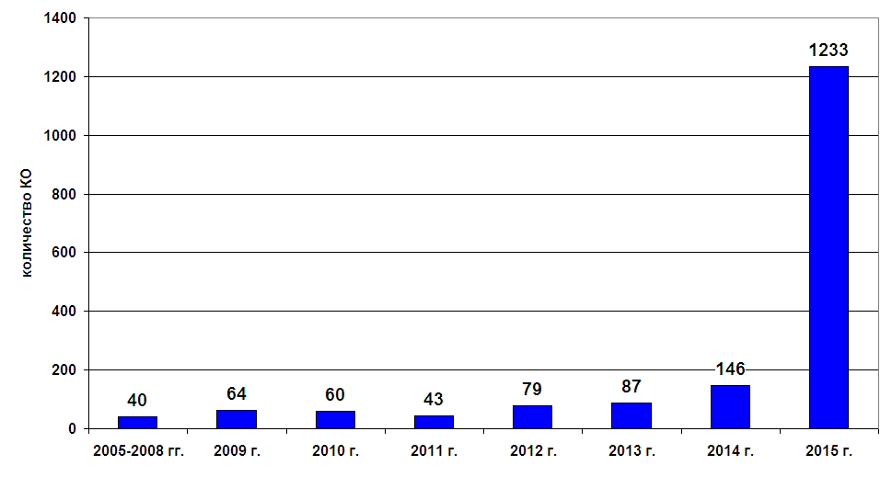
Distribution of 1742 non-TLE objects on year of last measurements

Slide 17
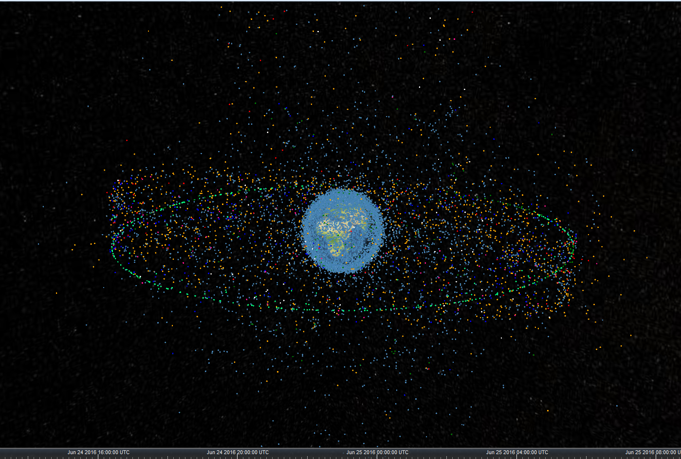
Display KIAM RAS space debris database on
24.06.2016 12:13:19 UTC
27/32

Slide 18
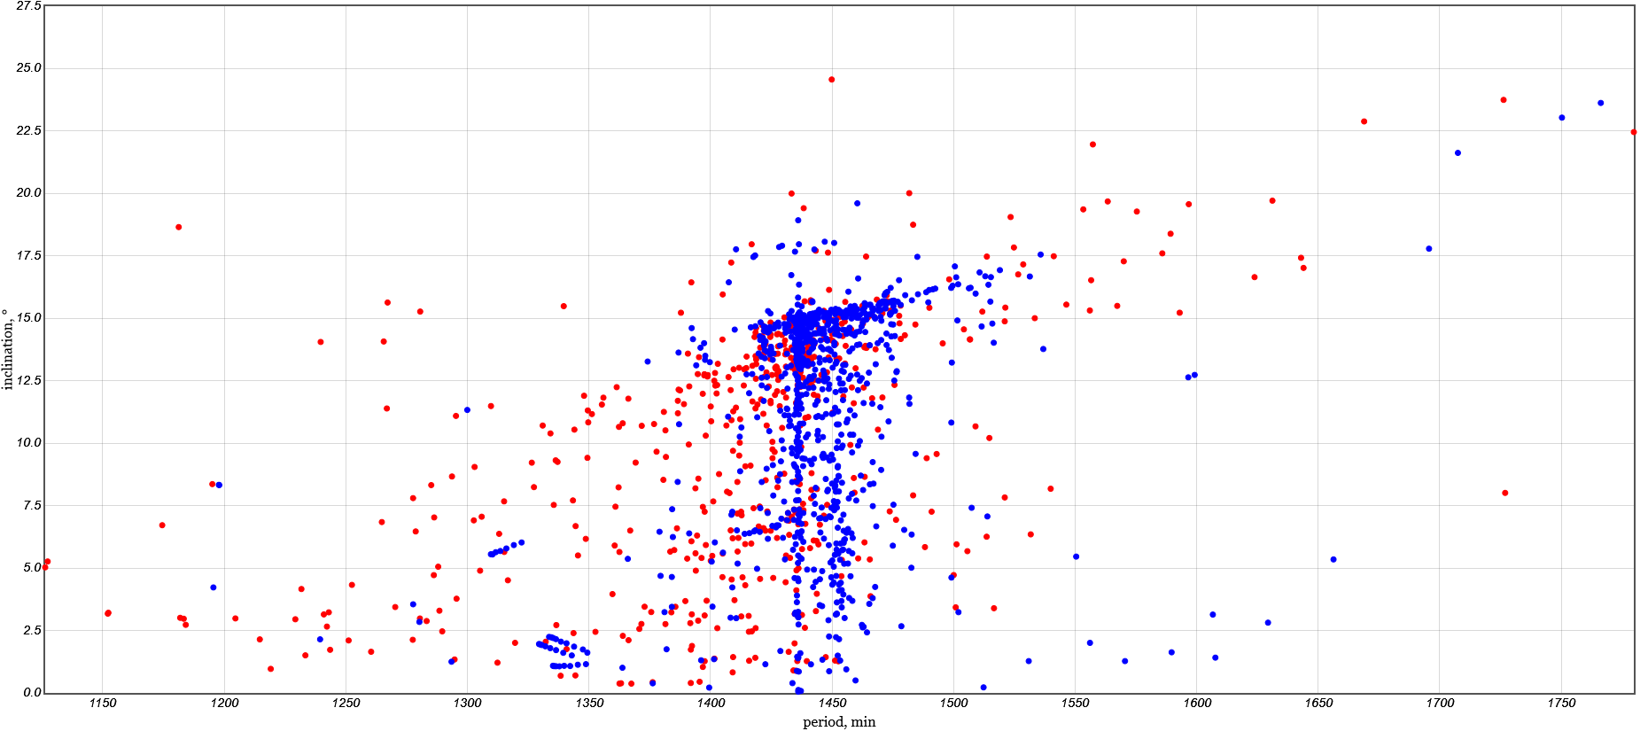
Inclination - Period distribution of GEO space debris objects in KIAM database

Slide 19
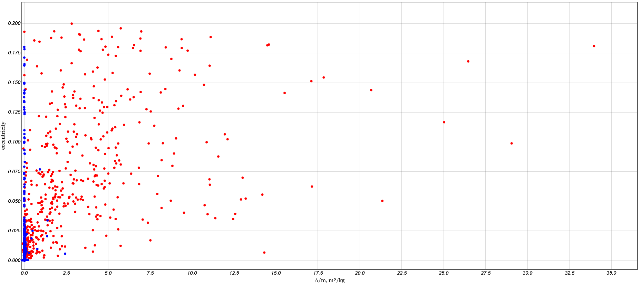
Eccentricity – A/m distribution of GEO space debris objects in KIAM database

Slide 20
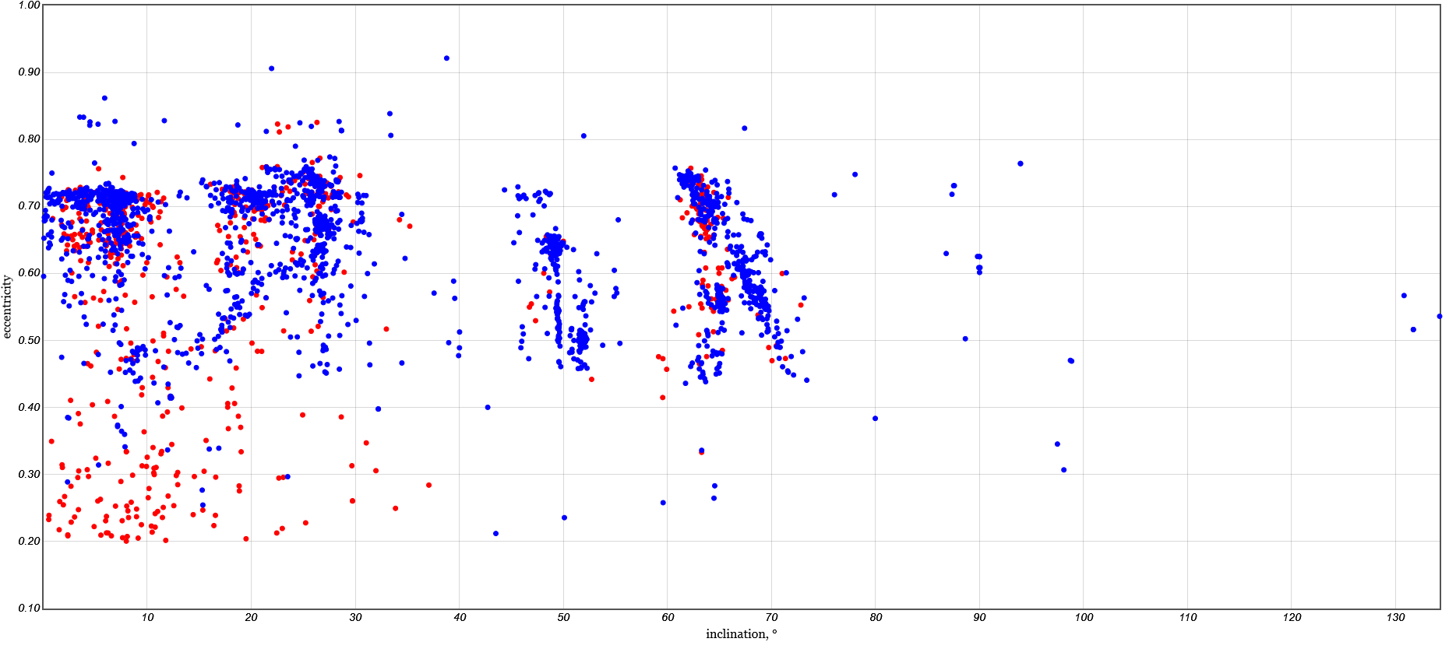
Eccentricity – Inclination distribution of HEO space debris objects in KIAM database

Slide 21
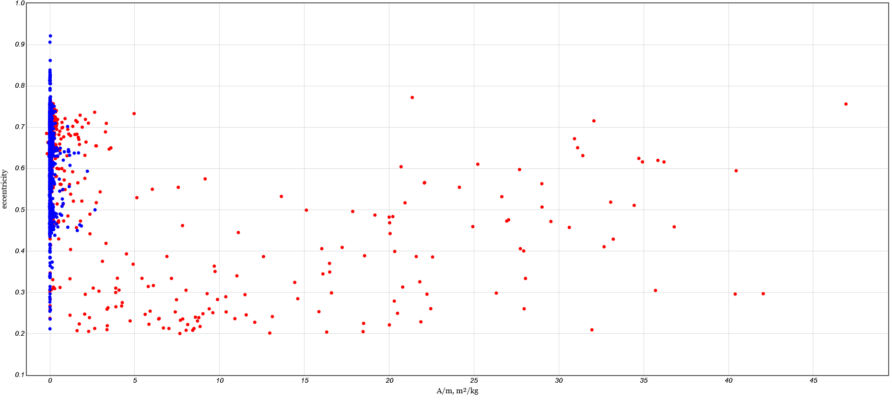
Eccentricity – A/m distribution of HEO space debris objects in KIAM database

Slide 22
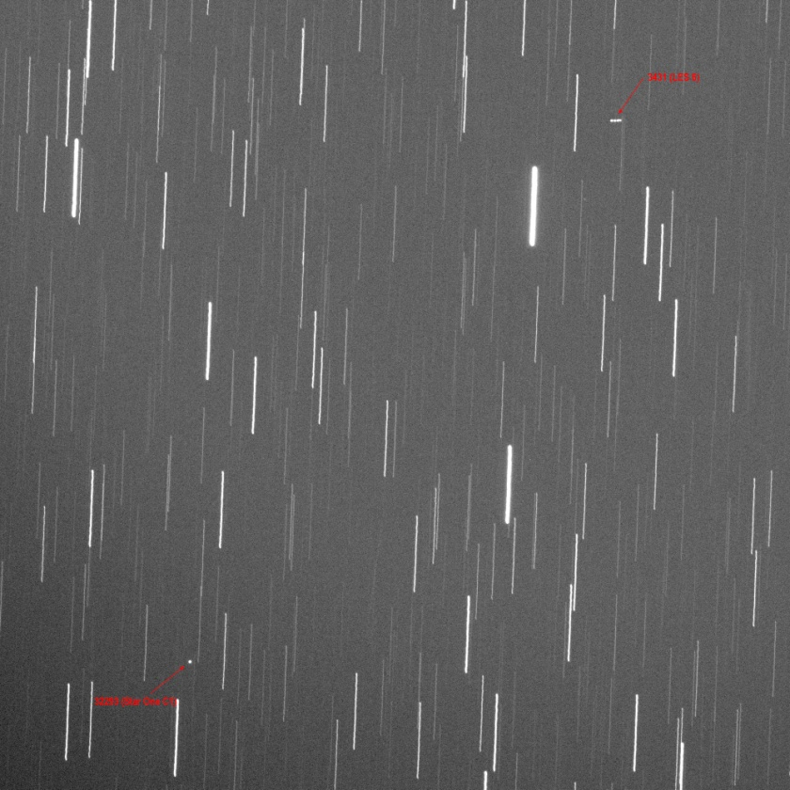
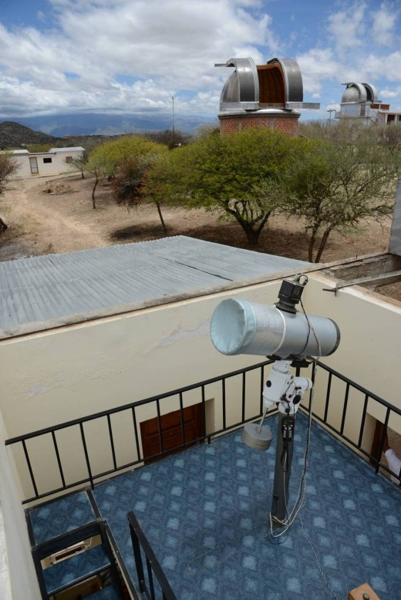
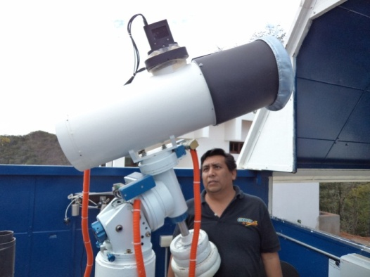
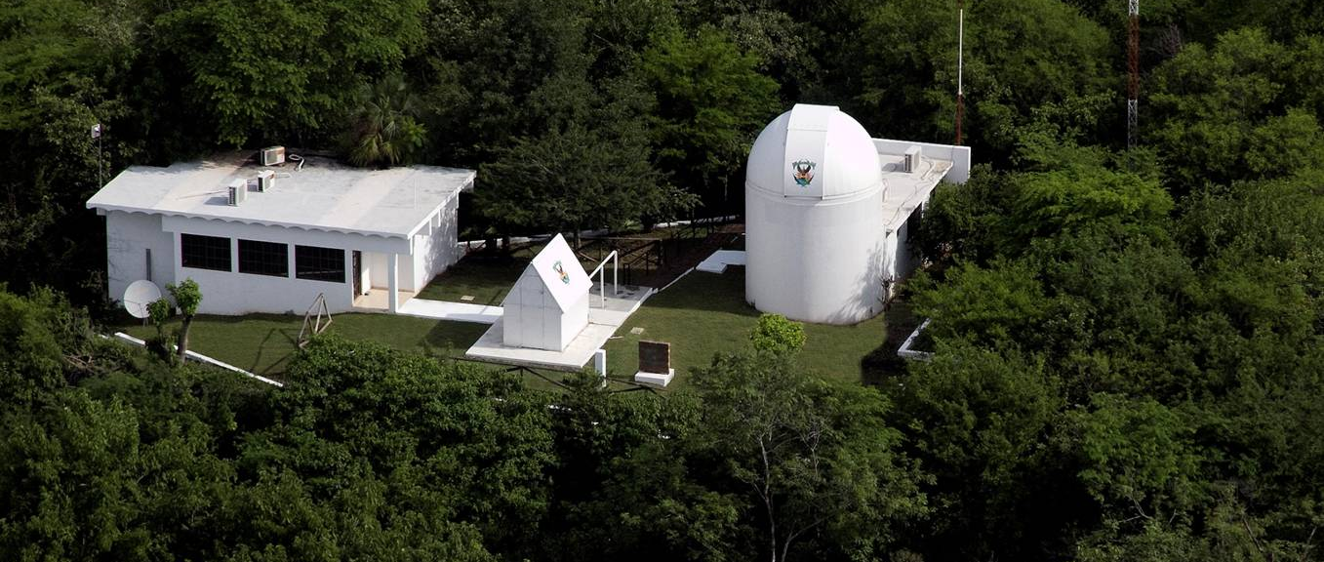
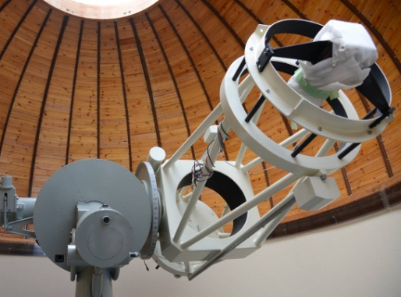
First ISON observations of close approach in Western Hemisphere: Star One C1 + Les 6
May 31 – June 8, 2016 with participation of 3 telescopes in two university observatories – Tarija (Bolivia) and Cosala (Mexico)

Slide 23
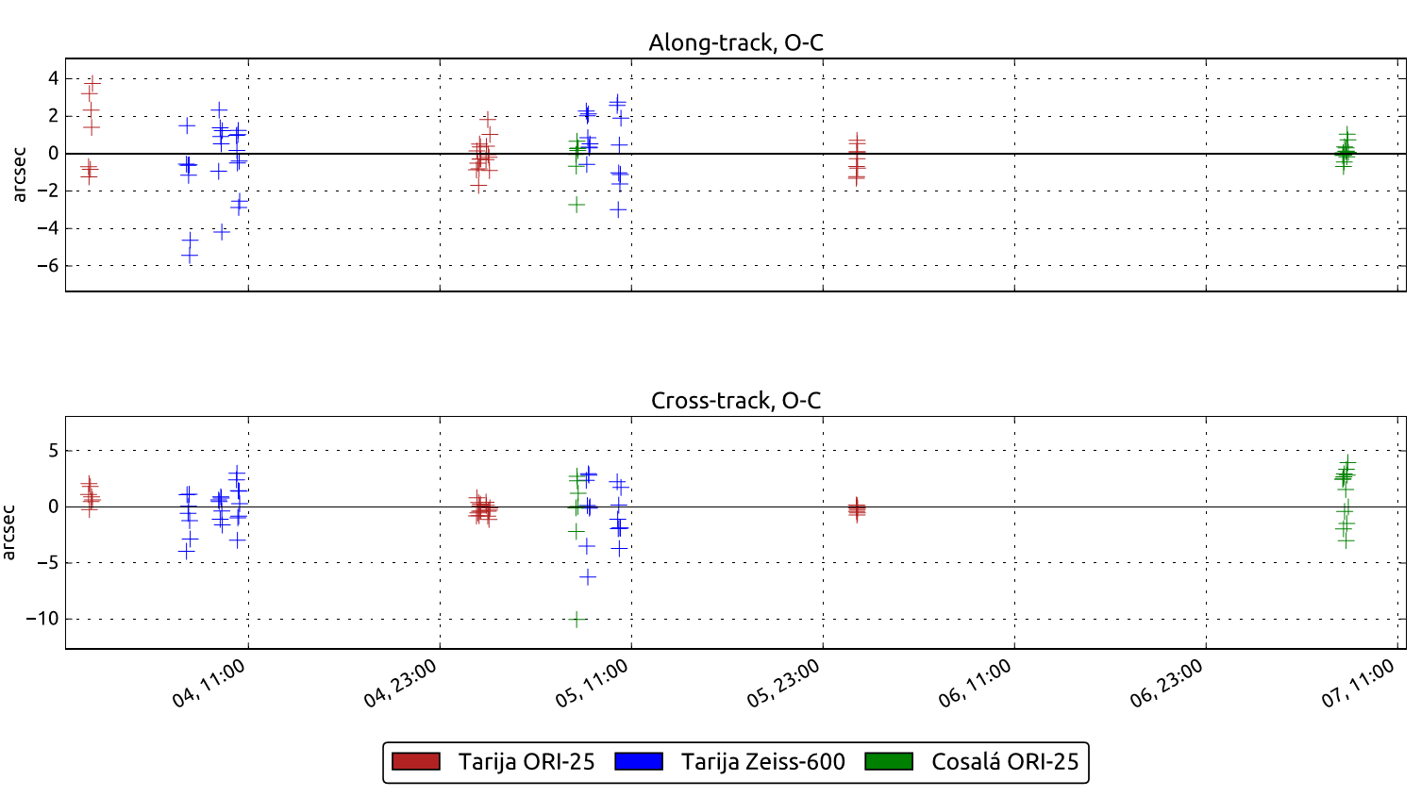
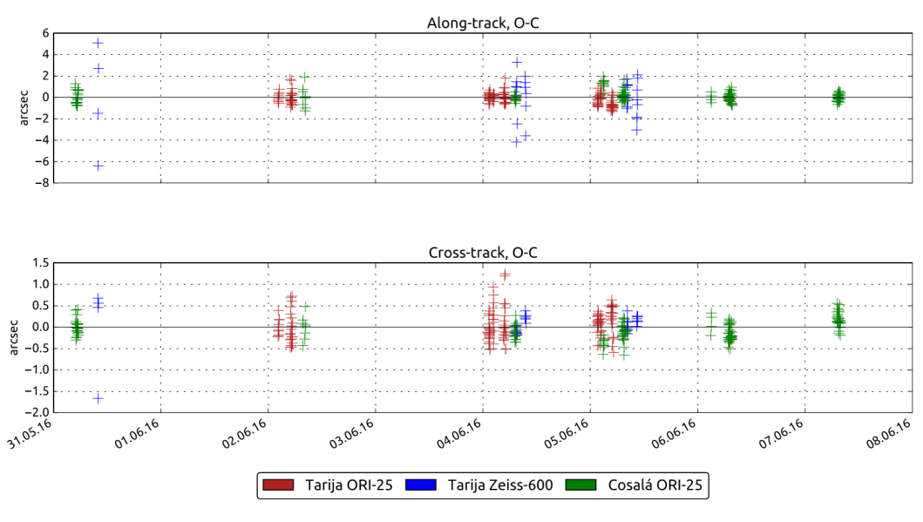
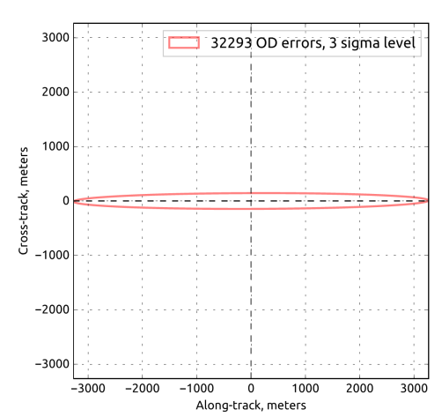
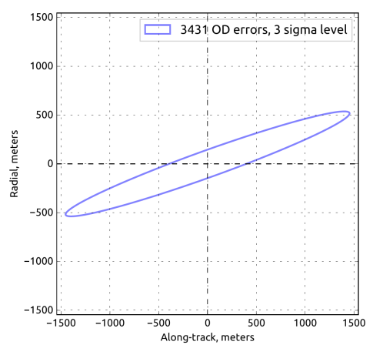
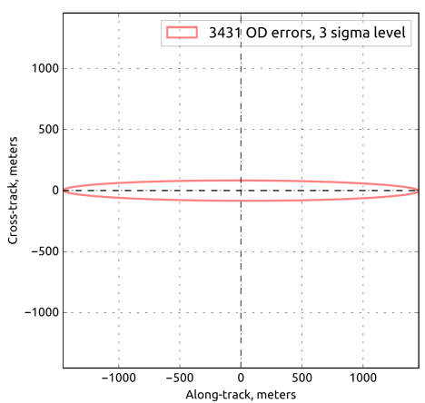
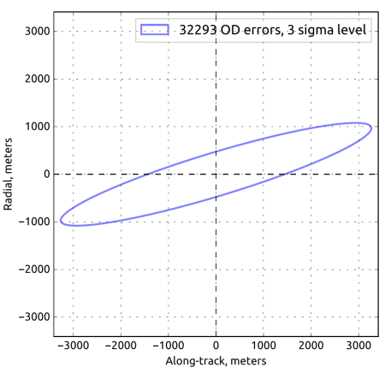
Analysis of obtained measurements
mean square deviation for passive faint Les 6 objects along/cross is 1.53”/2.08” (see projection of covariance matrix errors)
mean square deviation for active bright Star One C1 object along/cross is 0.91”/ 0.31” (see projection of covariance matrix errors)

Slide 24
Conclusion
15 new telescopes were putted in operation for observations during 2015-2016 years
New objects discovery statistics have been impoved - 339 new objects were discovered in 2015 (175 – in 2014).
71 telescopes of 34 observation facilities is producing 15.4 million measurements on space debris in 2015
Our knowledge on HEO-objects have been significantly upgraded. Currently KIAM database contains orbital information on 2635 HEO, 2094 GEO and 338 MEO objects
First ISON observation of close approach in Western Hemisphere have been arranged. Currently there are 4 telescopes in two observatories in Tarija (Bolivia) and Cosala (Mexico). Third observatories is arranging now in Nuevo Leon (Mexico)

