Slide 1
GMV/ISON COMBINED OPTICAL CAMPAIGNS
ESDC 2017
D. Escobar, PhD
F. Ayuga
A. Antón
A. Águeda
I. Molotov
April 20th 2017, ESOC

Slide 2
Outline
ISON telescope network
GMV/ISON campaigns
Use cases:
Orbit determination
Ranging station calibration
Collision risk evaluation
End-of-life operations

Slide 3
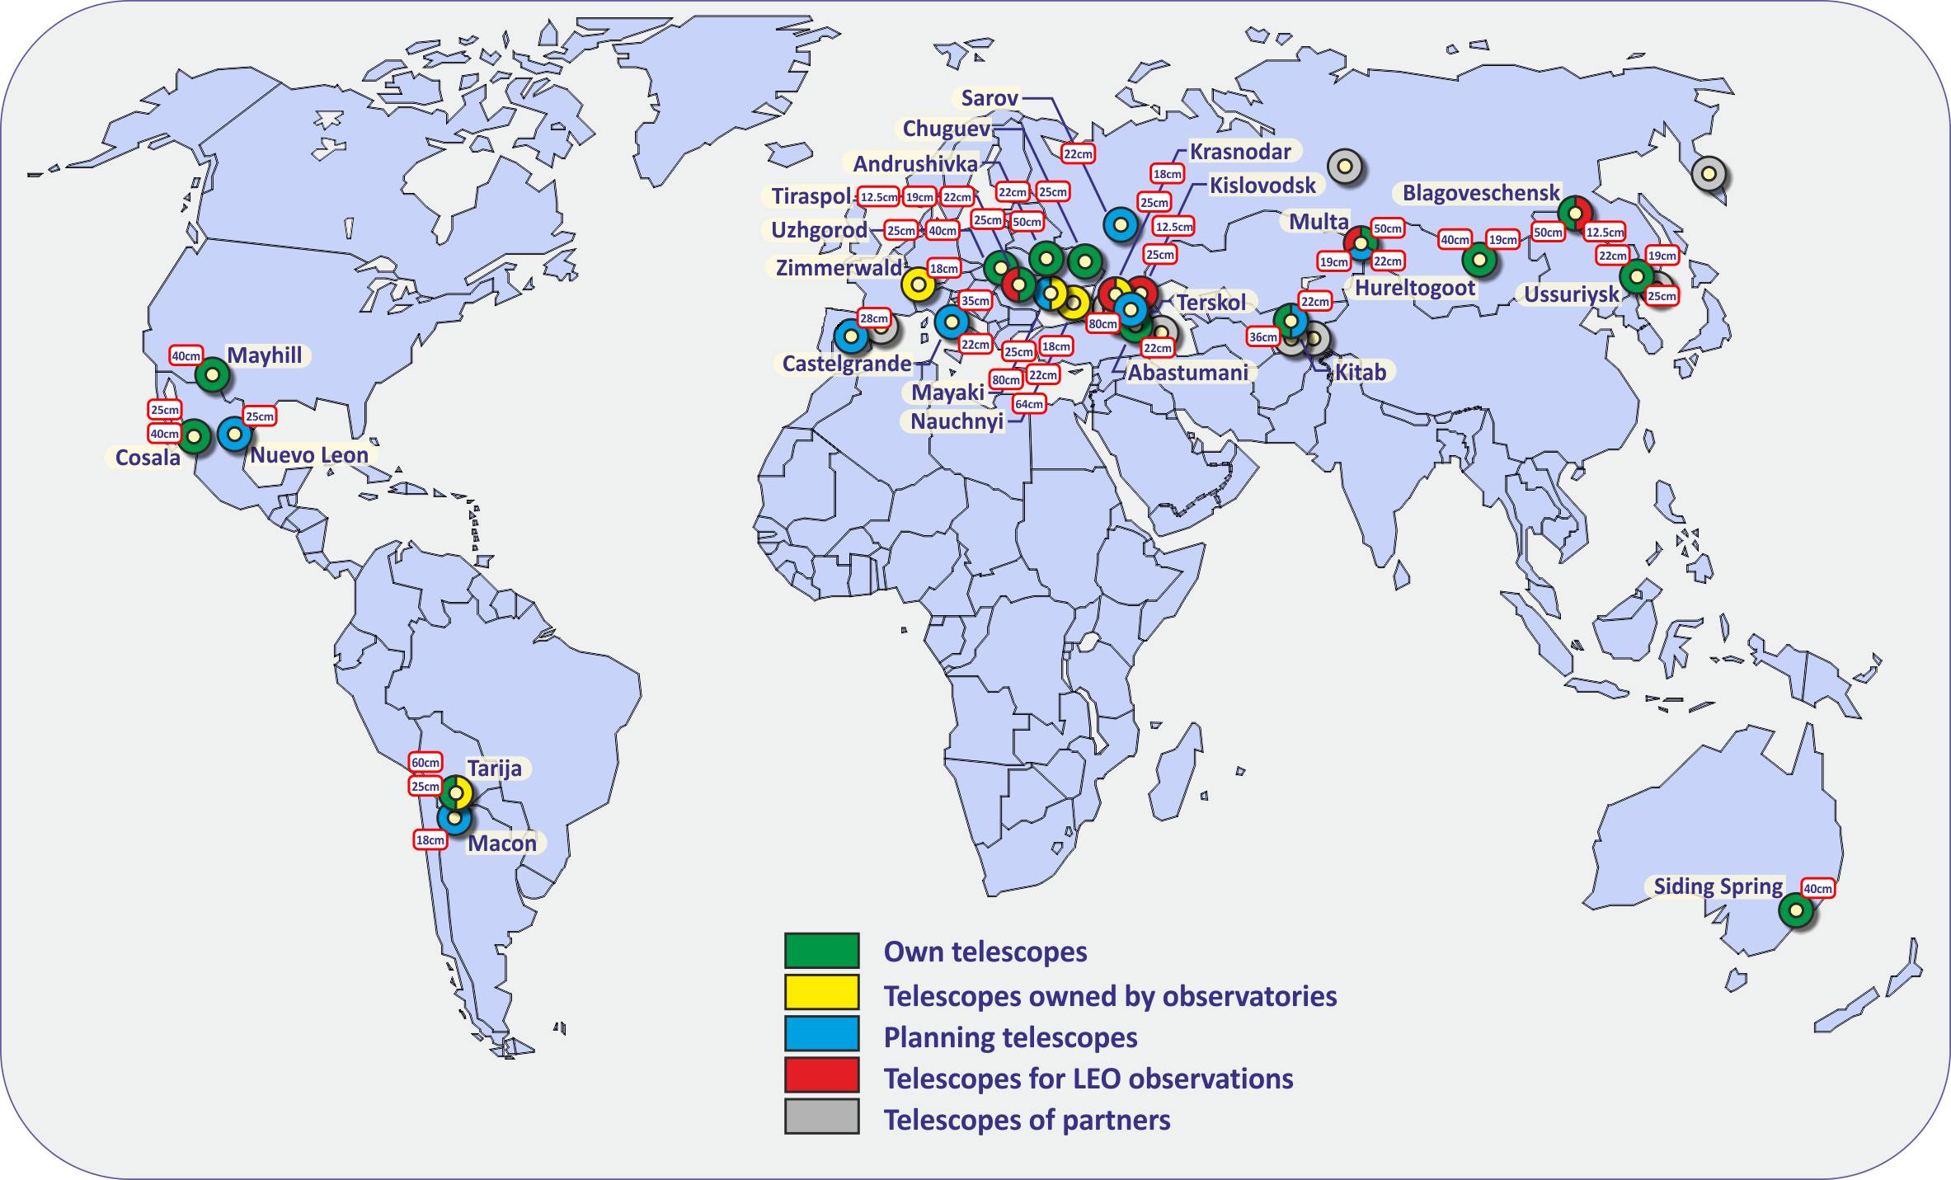
ISON telescope network
World-wide coverage, with telescopes in both hemispheres
High-availability thanks to high number of telescopes with de-correlated weather conditions
High-accuracy of optical data (~ 1 arcsec)
High number of both survey and tracking telescopes (>90)
ISON sub-network devoted to provide commercial services
Use for operational support in various scenarios
Orbit determination with data fusion
Ranging station calibration
Collision risk evaluation
LEOP, IOT, EOL, contingency, …
World-map of ISON telescope network

Slide 4
GMV/ISON campaigns
GMV and ISON have cooperated in dedicated optical campaigns in 2016 (Apr, May, Jun, Jul) and 2017 (Apr) (list per satellite-group):
A1, B1 07/04/2016-18/04/2016 → station calibration
B2 15/04/2016-20/04/2016 → station calibration and manoeuvre estimation
C2 09/05/2016-17/05/2016 → station calibration
D2, D3 06/05/2016-17/05/2016 → station calibration
E1, E2, F1 31/05/2016-08/06/2016 → collision avoidance (proof-of-concept)
B3 08/06/2016-16/06/2016 → collision avoidance
D1, D4 26/06/2016-08/07/2016 → station calibration
G1, G2 01/07/2016-08/07/2016 → station calibration and manoeuvre estimation
M7 01/04/2017-10/04/2017 → de-orbiting operations of Meteosat-7
H1 12/04/2017-21/04/2017 → station calibration during IOT
ISON sub-network used providing commercial services
Processing performed by GMV with in-house software:
catmai → optical data correlation (from survey telescopes)
sstod → orbit determination with optical and ranging data, station bias calibration and manoeuvre estimation
closeap → conjunction detection and collision risk evaluation

Slide 5
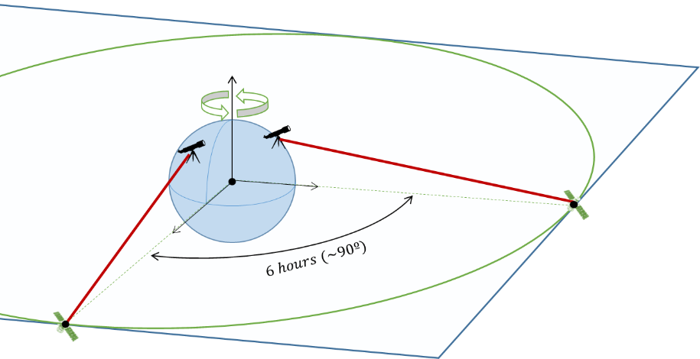
Orbit determination
GEO operators use ranging stations for orbit determination purposes
Ranging data from 2 stations with different longitudes are normally used
Optical telescopes can provide angular data, quite complementary to ranging data
Data fusion as part of orbit determination
Optical-only orbit solutions are also possible
Potential use in nominal and non-nominal operations (LEOP, manoeuvres, station unavailability)

Slide 6
Orbit determination
ISON optical telescopes have been used for OD:
With optical measurements only (optical-only OD)
In combination with ranging data (data fusion OD)
Estimating manoeuvres if executed (indicated with * below)
Main results:
Varying number of sensors used (optical/ranging)
Optical data residuals RMS around 1 arcsec (0.27 millideg)
Satellite ID | Optical |  | Range |  | Optical-only OD residuals |  | Data fusion OD residuals
 | Sensors | Obs. # | Stations | Obs. # | R. A. RMS [mDeg] | Dec. RMS [mDeg] | R. A. RMS [mDeg] | Dec. RMS [mDeg] | Range RMS [m]
A1 | 4 | 1184 | 2 | 408 | 0.27 | 0.22 | 0.28 | 0.22 | 3.6
B1 | 4 | 989 | 2 | 144 | 0.26 | 0.23 | 0.28 | 0.23 | 5.2
B2* | 4 | 460 | 2 | 94 | 0.25 | 0.22 | 0.27 | 0.22 | 2.2
C2 | 9 | 2024 | 4 | 176 | 0.27 | 0.25 | 0.27 | 0.25 | 7.4
D2 | 7 | 3281 | 2 | 239 | 0.22 | 0.18 | 0.22 | 0.18 | 1.9
D3 | 7 | 3671 | 2 | 241 | 0.21 | 0.19 | 0.21 | 0.19 | 1.0
F1* | 8 | 1028 | 2 | 215 | 0.24 | 0.25 | 0.27 | 0.29 | 5.1
D1 | 9 | 1302 | 2 | 251 | 0.25 | 0.21 | 0.25 | 0.21 | 0.9
D4 | 7 | 1472 | 2 | 286 | 0.22 | 0.20 | 0.22 | 0.20 | 1.8
Orbit determination statistics

Slide 7
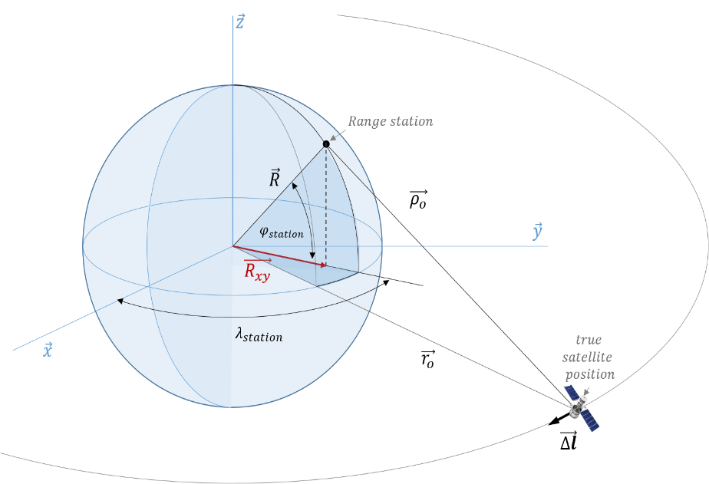
Ranging station calibration
Ranging stations used by GEO operators are affected by biases
These biases impact orbit determination solutions with an along track orbital bias
Uncalibrated stations degrade orbital solutions and increase collision risk uncertainty
Ranging stations thus need accurate calibration (~1m)
One way of performing the calibration is the data fusion with optical data obtained from the ISON network
 | Orbital Biases [m]
 | Radial | Along-track | Cross-track
 | 1.4 | 352.8 | -2.8
 | 2.2 | 238.9 | -2.9
 | -6.6 | 472.5 | -6.6
 | 3.0 | 221.0 | -4.2

Slide 8
Ranging station calibration
Orbit comparisons show benefits of ranging station calibration
a) Orbit estimated with ranging data using operator biases
b) Orbit estimated with data fusion using calibrated biases
c) Orbit estimated with ranging data using calibrated biases
Biases depend on software/models → calibration must be performed with operator’s flight dynamics system
Satellite ID | Provided Range Bias vs Data Fusion (b vs a) Mean [m] |  |  | Estimated Range Bias vs Data Fusion (c vs a) Mean [m]
 | Radial | Along-track | Cross-track | Radial | Along-track | Cross-track
A1 | 0.0 | 410.2 | 0.5 | 0.1 | 3.6 | -0.5
B1 | -1.5 | -862.6 | 0.1 | 1.5 | 32.9 | -0.1
B2* | -0.1 | 2598.0 | 1.5 | 0.5 | 16.3 | -2.1
C2 | 6.5 | -784.0 | 0.3 | -6.6 | 229.2 | -0.5
D2 | 0.2 | 583.8 | 0.6 | 0.0 | 31.0 | -0.6
D3 | -4.3 | 727.5 | 0.2 | 0.0 | 1.9 | -0.3
F1* | -1.1 | 465.1 | -28.6 | 1.5 | 9.6 | 29.4
D1 | -5.9 | 843.9 | 10.1 | -0.1 | -7.0 | 0.7
D4 | 0.0 | 590.2 | 0.2 | -0.3 | -2.5 | -0.3

Slide 9
Collision risk evaluation
GEO satellites have high-risk collisions with space debris orbiting the GEO regime
~ 2-3 events per year and satellite require refined analysis with current population
Refinement may be performed with optical tracking campaigns on target and chaser, to ensure same processing in both orbit solutions
3 collision risk evaluation campaigns have been executed by GMV and ISON together
Chaser ID | Optical |  | Optical data residual
 | Sensors | Obs. # | R. A. RMS [mDeg] | Dec. RMS [mDeg]
03431 | 3 | 116 | 0.335 | 0.416
20693 | 7 | 769 | 0.300 | 0.270
02717 | 2 | 650 | 0.219 | 0.203
 | Chaser Norad Id | Target RMS [m] | Chaser RMS [m] | TLE Prediction TCA | Estimated TCA | TLE Prediction Miss Distance [km] | Estimated Miss Distance [km]
 | 03431 | 142.0 | 178.1 | 20:15:00 | 20:15:14 | 50 | 36.5
 | 20693 | 181.8 | 213.4 | 02:53:33 | 02:53:31 | 20 | 32.6
 | 02717 | 144.2 | 133.9 | 15:58:40 | 15:58:35 | 14.5 | 15.7

Slide 10
Meteosat-7 end-of-life support
EUMETSAT has recently performed de-orbiting operations on Meteosat-7
Support needed due to the availability of only one ranging station
GMV/ISON have provided operational support through the daily provision of:
Optical tracking data transformed to azimuth/elevation
Estimated orbit from data fusion of optical data provided by ISON and ranging data provided by EUMETSAT
Estimated manoeuvres for under/over-performance analysis
Report with main results of the operational activities
Daily provision of predicted orbit (considering manoeuvre plan) to ISON for telescope tasking
Processing performed by GMV with:
catmai → optical data correlation (from survey sensors)
sstod → orbit determination with optical and ranging data

Slide 11
Meteosat-7 end-of-life support
Main results of the campaign:
15+ survey telescopes providing optical data from well before the actual de-orbiting operations until the end
10+ tracking telescopes providing optical data during de-orbiting operations lasting initially 5 days
More than 11000 optical observations (pairs of RA-Dec measurements) obtained by ISON for Meteosat-7 during the deorbiting operations
Optical residual RMS in the order of 1 arcsec for all telescopes
7 manoeuvres estimated within the same orbit determination process plus two pseudo-manoeuvres due to venting activities
Provision of tracking data and orbital products to the EUMETSAT only few hours after local dawn for EUMETSAT OD activities
Successful deorbiting of Meteosat-7 by EUMETSAT !

Slide 12
Meteosat-7 end-of-life support
Animated GIF of Meteosat-7 generated by CrAO observatory during the de-orbiting phase

Slide 13
Conclusions
ISON and GMV have been cooperated in several optical campaigns in a very fruitful way
ISON network has shown high-availability, high-accuracy and high flexibility in terms of telescope dedication, provision of additional available survey data, and reaction against bad weather conditions
ISON optical data and GMV processing in combination have been proved to be successful in operational campaigns
Several scenarios have been executed:
Orbit determination with data fusion
Ranging station calibration
Collision risk evaluation
End-of-life operations
More operational campaigns are on-going and coming

Slide 14
Thank you
D. Escobar, PhD
F. Ayuga
A. Antón
A. Águeda
I. Molotov

