Slide 1

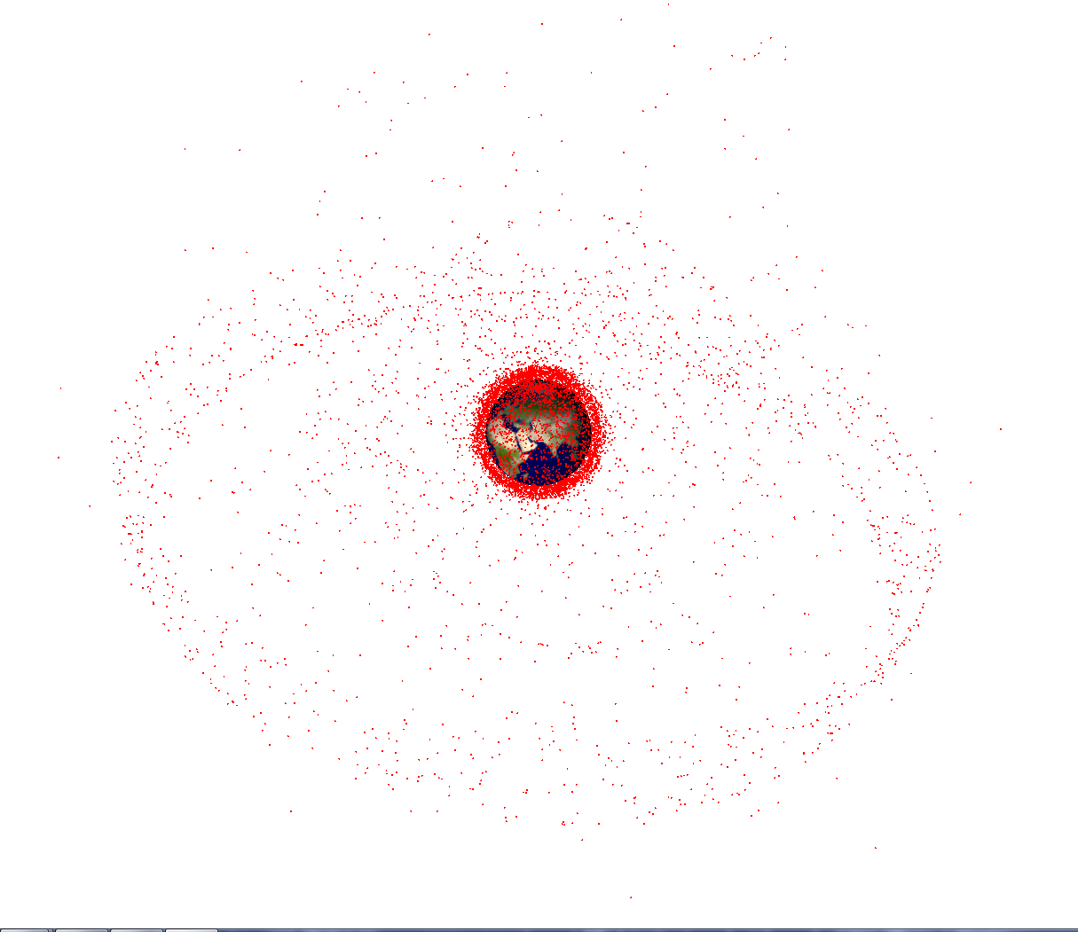
IMPROVEMENT OF SPACE DEBRIS MODEL IN MEO AND GEO REGIONS ACCORDING TO THE CATALOG OF KELDYSH INSTITUTE OF APPLIED MATHEMATICS (RUSSIAN ACADEMY OF SCIENCES)
PhD I. Usovik, D. Stepanov, PhD V. Stepanyants, PhD M. Zakhvatkin, I. Molotov
Dr. Prof. A. Nazarenko
ЦНИИМАШ
TSNIIMASH
7-th European Space Debris Conference
2017

Slide 2
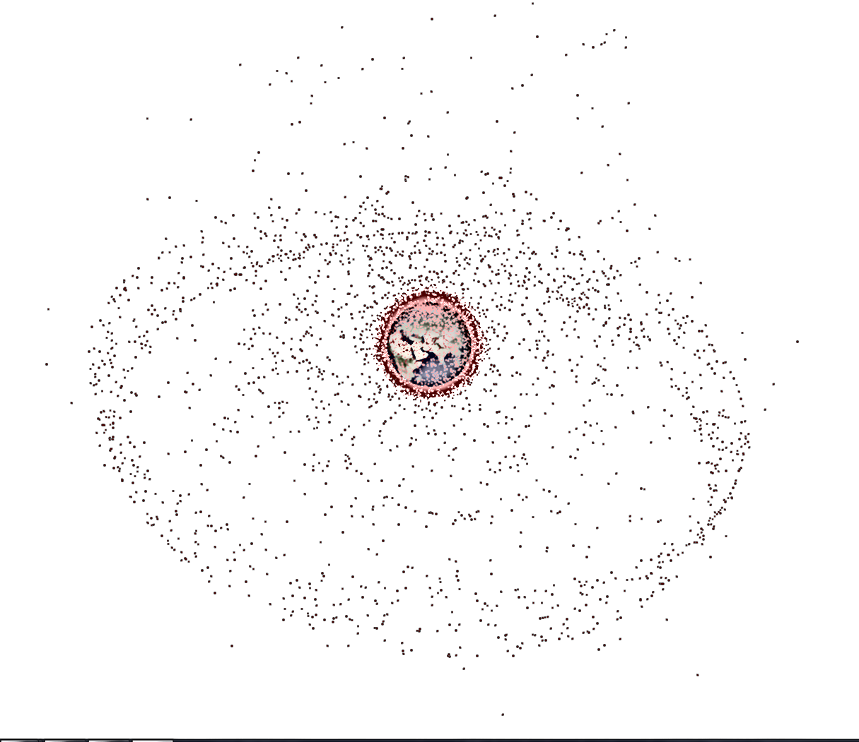
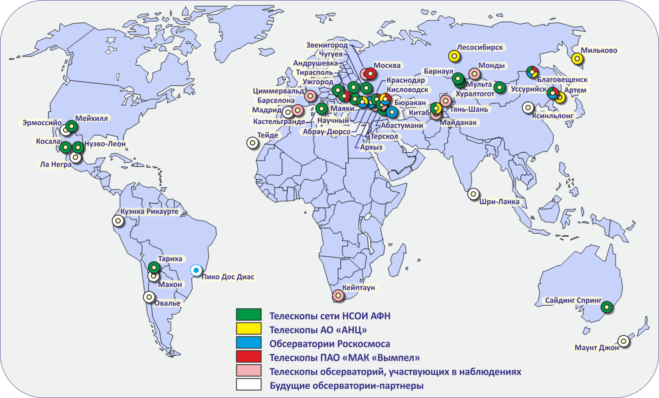
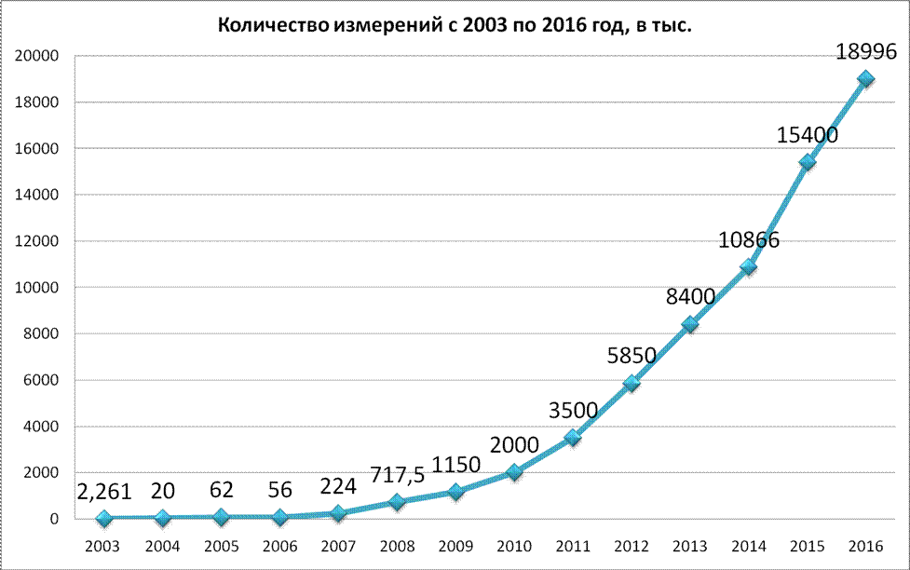
KIAM RAS catalog
ЦНИИМАШ
TSNIIMASH
For the beginning of 2017, in the catalog TsSITO KIAM RAS orbits 2190 space objects (SO) on GEO, 2635 SO on HEO and 338 SO on MEO are supported
The KIAM RAS catalog contains the fullest information about objects on high orbits
Figure 1 – Observatory fills data TsSITO
Figure 2 – Number of measurements coming to TsSITO

Slide 3
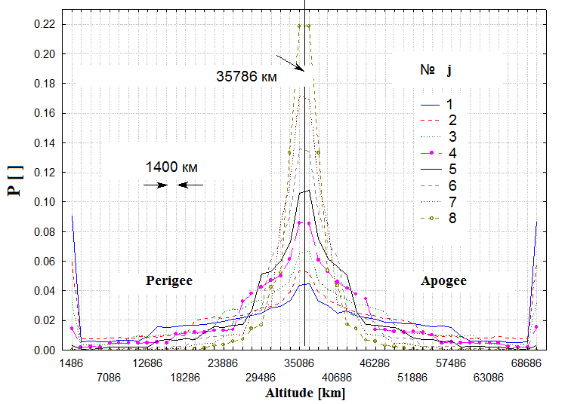
General provisions of the SDPA model
ЦНИИМАШ
TSNIIMASH
1. Objects lager than 1 mm in size are considered.
2. Altitude-latitude distribution of spatial density catalogued SO, and statistical distributions of value and direction of their velocity are under construction on basis SO catalog.
3. The assumption that all small particles of space debris which are and crossing MEO and GEO regions, were generated as a result of explosions and destructions is used.
4. Dependence number generated particles on their sizes pays off with use of k(>d) relation number of particles the size lager d to number catalogued SO.
5. Maximum ΔV of particles at explosion depends from their mass, have a random values and equiprobable possible directions.
6. The ratio between sizes of particles and their mass
is accepted fixed, according to data of table 1.
Table 1 - Average mass of SD different sizes
j | 1 | 2 | 3 | 4 | 5 | 6 | 7 | 8 | 9
d_{j}, сm | 0.1 | 0.25 | 0.5 | 1.0 | 2.5 | 5.0 | 10 | 25 | 75
k_{d} (>d) | 4 10⁴ | 3.5 10³ | 5.5 10² | 88 | 20 | 7.2 | 3.2 | 2.0 | 1.0
m, kg (d_{j,j+1}) | 8.6 10⁻⁶ | 5,8 10⁻⁵ | 2.8 10⁻⁴ | 1.8 10⁻³ | 0.01 | 0.064 | 0.40 | 5.0 | 1750
Figure 3 – Distributions of perigee and apogee altitude SD different sizes after explosion on GEO

Slide 4
Characteristics of catalogued objects in GEO region
ЦНИИМАШ
TSNIIMASH
(known)
Figure 4 – Dependence of inclination (period) for known and
unknown SO
On figures dependences of inclination(period) for known (with the international number) and unknown (without the international number) objects in the catalog are represented.
(unknown)
Figure 5 – Dependence inclination(RAAN)

Slide 5
Characteristics of catalogued objects in GEO region
ЦНИИМАШ
TSNIIMASH
(known)
(unknown)
Figure 6 – Histograms of average magnitude
(known)
(unknown)
Figure 7 – Histograms of average relation area to mass

Slide 6
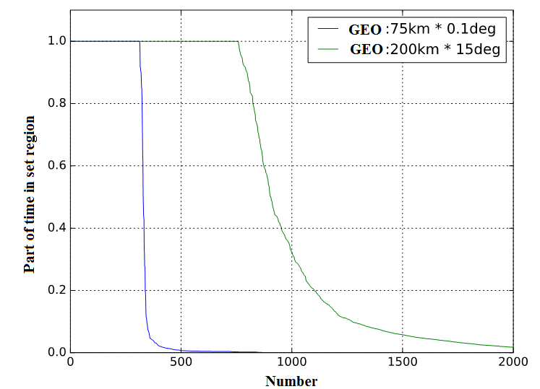
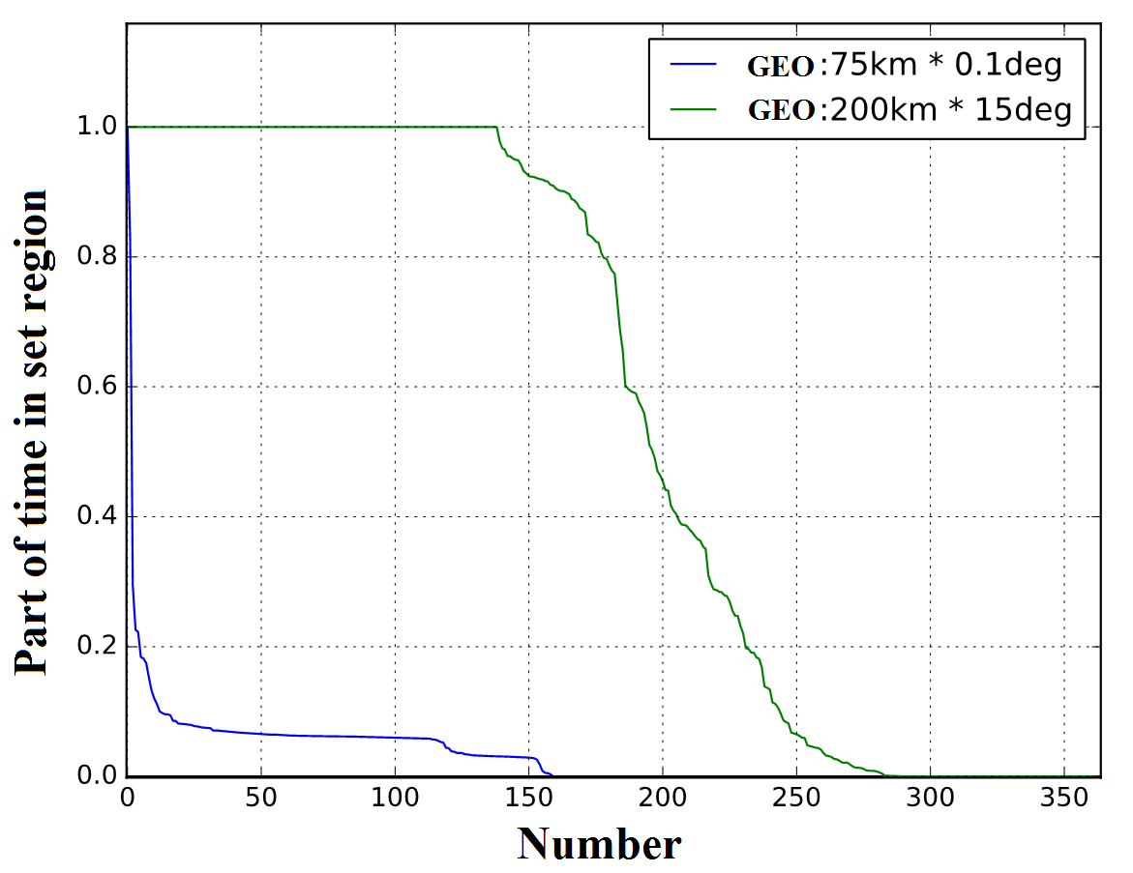
Estimation cumulative number of SO in
GEO protected region
ЦНИИМАШ
TSNIIMASH
Estimation of hit frequency catalogued objects to GEO protected region and to functioning region of geostationary S/C is carried out.
By results of calculation with use of high-accuracy model on an interval of 15 days at the protected region constantly there are 758 objects, 138 from which are launched approximately till 1990.
The amount of the objects crossing the protected region at least once during this time exceeds 2450.
Figure 8 – Time spent share assessment in GEO protected region
Figure 9 – For objects launched till 1990

Slide 7
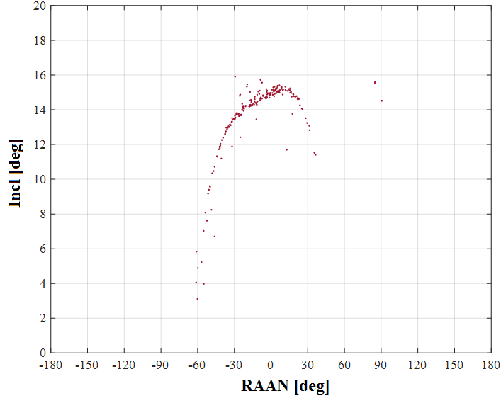
Large SO in GEO protected region
ЦНИИМАШ
TSNIIMASH
Figure 17 – SO with NORAD numbers < 20000 (till 1990)
Dependence inclination (RAAN) for known SO launched till1990 in GEO protected region is presented

Slide 8
Verification SDPA model for GEO region
ЦНИИМАШ
TSNIIMASH
Estimates of S/m and magnitude allow to estimate the size and mass of fragments approximately. For calculation of magnitude (m) of d, spherical SO diameter, and albedo ρ at range of R at zero phase coal the formula is used
where ρ = 0.09-0.12 for fragments of space debris and ρ = 0.2 for S/C and upper stages. Known magnitude of SO allows to calculate diameter of object and its visible area
The knowledge of the area and relation area to mass provides possibility of determination mass of object
The estimates of number of objects depending on their sizes constructed on the basis of magnitude estimates according to the catalog including known and unknown objects in the GEO region are presented on right figures.
Figure 10 – Dependence N(>d)
Figure 11 – Coefficients k(>d)

Slide 9
Improvement model distributions of orbital parameters
ЦНИИМАШ
TSNIIMASH
For improvement distributions of spatial density and velocity of SD 10-75 cm in GEO region rated distributions of perigee altitudes and inclinations of unknown SO in the catalog are constructed. Dependence of eccentricity on perigee altitude is considered on a formula
where Δe_{j} – evenly distributed random variable having the range of values in interval ≈ ±0.05. In all cases of e_{j} ≥0. For construction spatial density Δe_{j} pays off with the random number generator.
Figure 12 – Distribution of perigee altitudes
Figure 13 – Distribution of inclinations

Slide 10
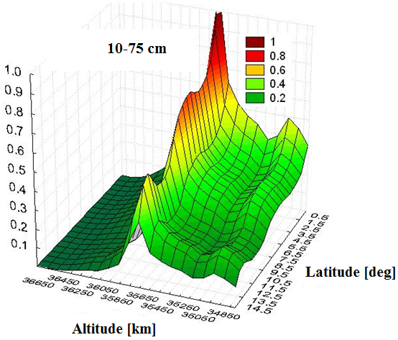
Improvement of spatial density distribution
SD 10-75 cm in GEO region
ЦНИИМАШ
TSNIIMASH
Rated distribution of spatial density SD 10-75 cm are presented on figure 14.
A characteristic feature of construction altitude-latitude spatial density distribution feature size 10-75 cm with the use of a rated spatial density is the independence from the size of the fragments. Therefore, this distribution can be represented as follows:
Figure 14 – Rated distribution of spatial density for SD 10-75 cm
Table 2 – Maximum spatial density and estimation number of SD in GEO region
k | 5 | 6 | 7 | 8
, см | 2.5 – 5.0 | 5.0 - 10 | 10 - 25 | 25 - 75
 | 2.593 10⁻⁹ | 8.506 10⁻¹⁰ | 2.551 10⁻¹⁰ | 2.126 10⁻¹⁰
 | 15900 | 4872 | 1461 | 1218

Slide 11
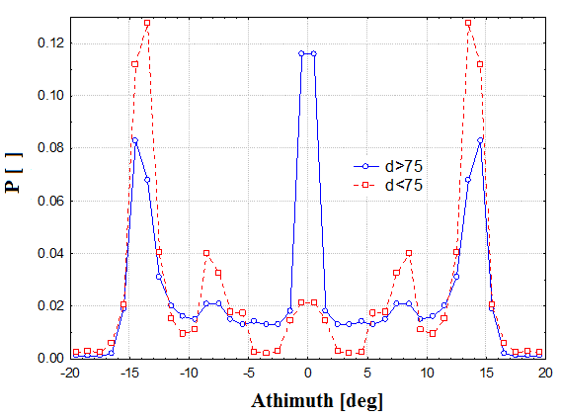
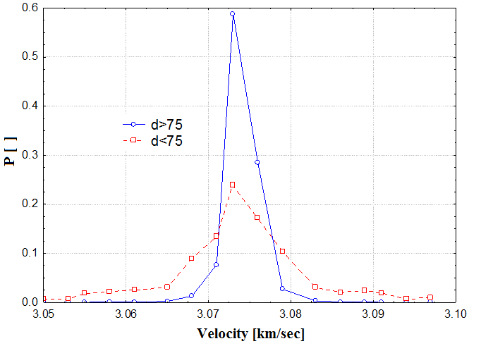
Improvement of SD velocity distributions in GEO region
ЦНИИМАШ
TSNIIMASH
With use of the techniques developed earlier, distributions of size and the directions of velocity concerning the direction on the East for two groups of objects are constructed. They are presented in figures 15 and 16.
The bigger dispersion of velocity values is characteristic of SD smaller than 75 cm and essential distinctions of distributions of the velocity vector direction.
Figure 15 –Distribution of vector velocity directions
Figure 16 – Distribution of velocity values

Slide 12
Estimation of mutual collision in GEO region
ЦНИИМАШ
TSNIIMASH
With use of the mutual collisions estimation technique developed earlier, the estimation of mutual collisions probability in the region 35700-35900 km on altitude and ± 1 degree on latitude for cataloged SO (> 75 cm) with SO of the different sizes is carried out. Results of estimation are presented in table 3.
From these results it is visible that the probability of mutual collisions of the catalogued SO (>75 cm) makes 0.00627 in a year. It means that the average interval between such collisions is equal ≈ 160 years, at current population of SD in GEO region. Probabilities of collisions catalogued SO with objects from 2.5 cm to 75 cm in size are 2-3 orders less.
Table 3 – Estimation of year collision probability for objects different size
j | 5 (2.5-5 cm) | 6 (5-10 cm) | 7 (10-25 cm) | 8 (25-75 cm) | 9 (>75 cm)
P (j,9) | 0.0002678 | 0.0000258 | 0.0000032 | 0.0000026 | 0.00627

Slide 13
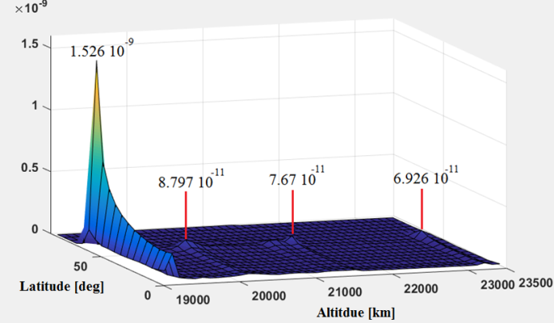
Improvement SDPA model in MEO region
ЦНИИМАШ
TSNIIMASH
Figure 18 – Altitude (Inclination), 2017
Figure 20 – Spatial density in GNSS region
Table 5 – Estimation SD different sizes
Figure 19 – Inclination (RAAN), 2017

Slide 14
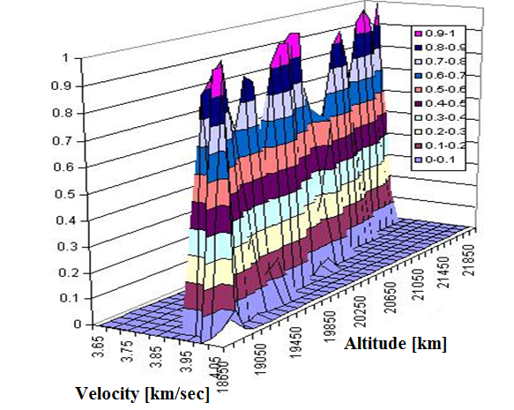
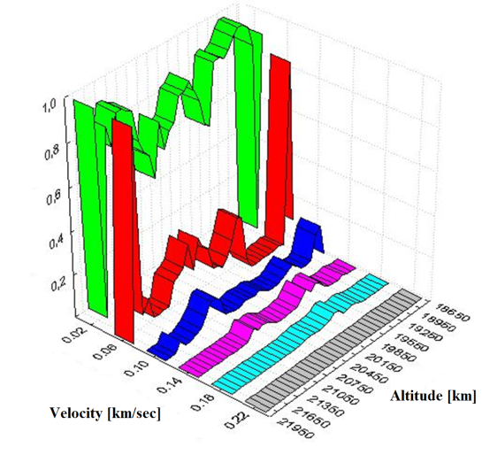
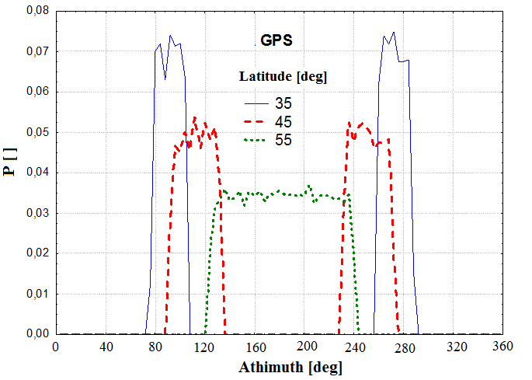
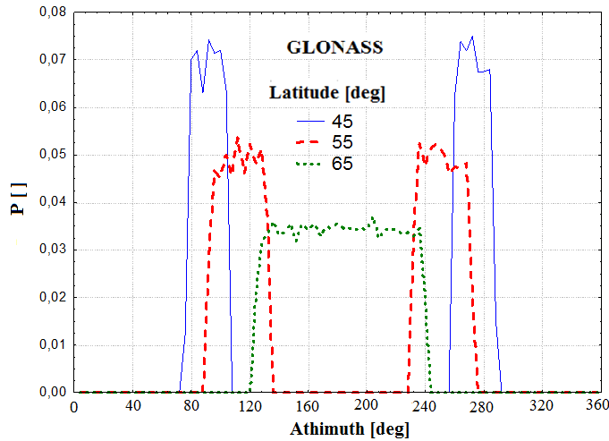
Velocity distributions in GNSS region
ЦНИИМАШ
TSNIIMASH
Figure 21 – Distributions of transversal and radial velocity
Figure 22 – Azimuth distributions of transversal velocity

Slide 15
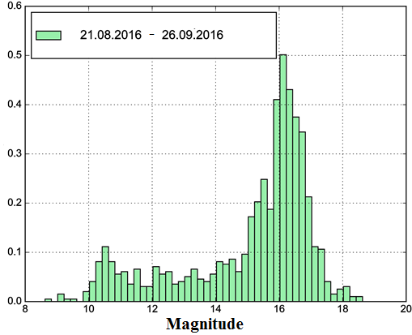
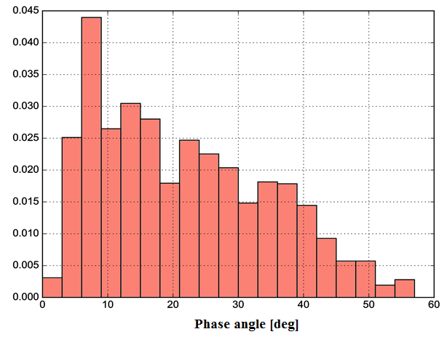
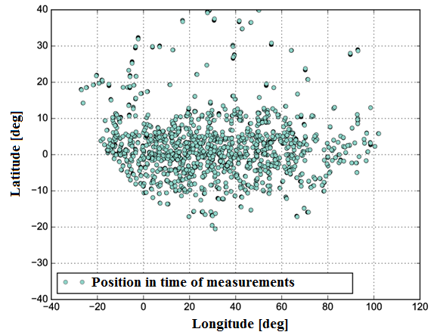
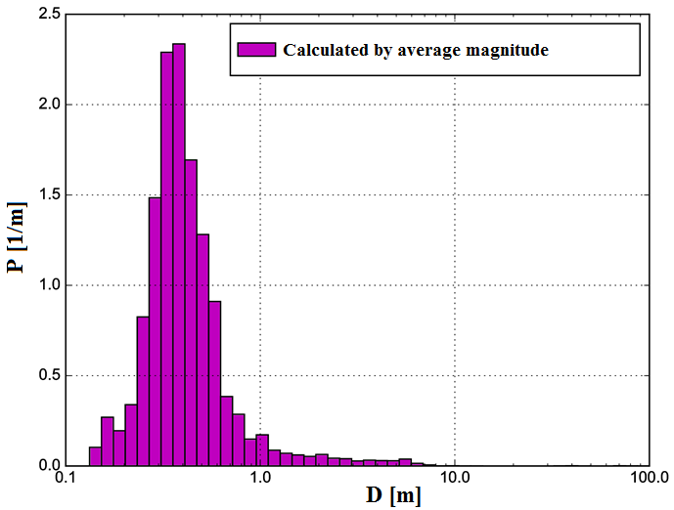
Offers on measurements for
SD model calibrations
ЦНИИМАШ
TSNIIMASH
Figure 23 – Histogram of GEO SO magnitude in experimental measurements
Figure 24 – Distribution of phase angles of experimental measurements in GEO region
Figure 25 – Distribution of objects angular coordinate in experimental measurements
Figure 26 – Histogram of object size
estimations

Slide 16
ЦНИИМАШ
Conclusions
TSNIIMASH
The analysis of TsSITO KIAM RAS catalog is carried out
With use of the catalog data SD model parameters are improved.
The estimation of probability of mutual collisions in the vicinity of a maximum of spatial density protected GEO region is carried out.
The analysis of experimental measurements for verification of SDPA model is carried out.
141070, Moscow region, Korolev, Pionerskaya str. 4
@:usovikiv@tsniimash.ru; phone: +7 (495) 513-50-13
www.tsniimash.ru
http://www.iki.rssi.ru/books/2013nazarenko.pdf

