Slide 1


ACAG8
THE ARAB CONFERENCE ON ASTRONOMY & Geophysics
Advanced Space Surveillance within Ground-Based Optical Systems
A. M. Abdelaziz and S.K.Tealib
Space Research Lab., NRIAG
October 9 -12 ,2023
Cairo-Egypt
ACAG-CONF.ORG

Slide 2
Introduction
Space Surveillance encompasses a series of activities aimed at detecting, tracking, orbit estimation, identification, and cataloging of artificial satellites and space debris, as well as natural celestial objects within Earth's vicinity. One fundamental method for observing and monitoring space objects involves an optical system, which typically comprises an optical telescope coupled with a CCD camera. This technique, known as photo-optical surveillance, plays a crucial role in tracking space objects.
In the photo-optical surveillance technique, simultaneous images of both space objects and stars are captured. Subsequent image analysis allows for the differentiation between stars and space objects. By measuring the distances between several reference stars surrounding the space object, one can determine the direction and motion of the space object. This information contributes to the primary goal of the Space Surveillance system, which includes establishing the final orbits of observed space objects, analyzing potential close encounters between space objects, satellites, or debris, estimating collision probabilities, and assessing the safety risks associated with activities in space.

Slide 3
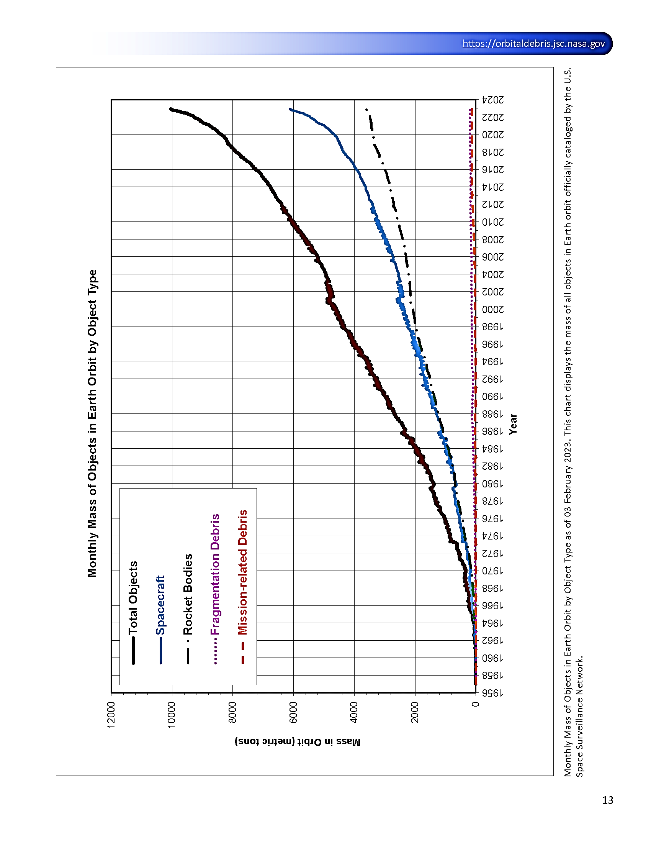
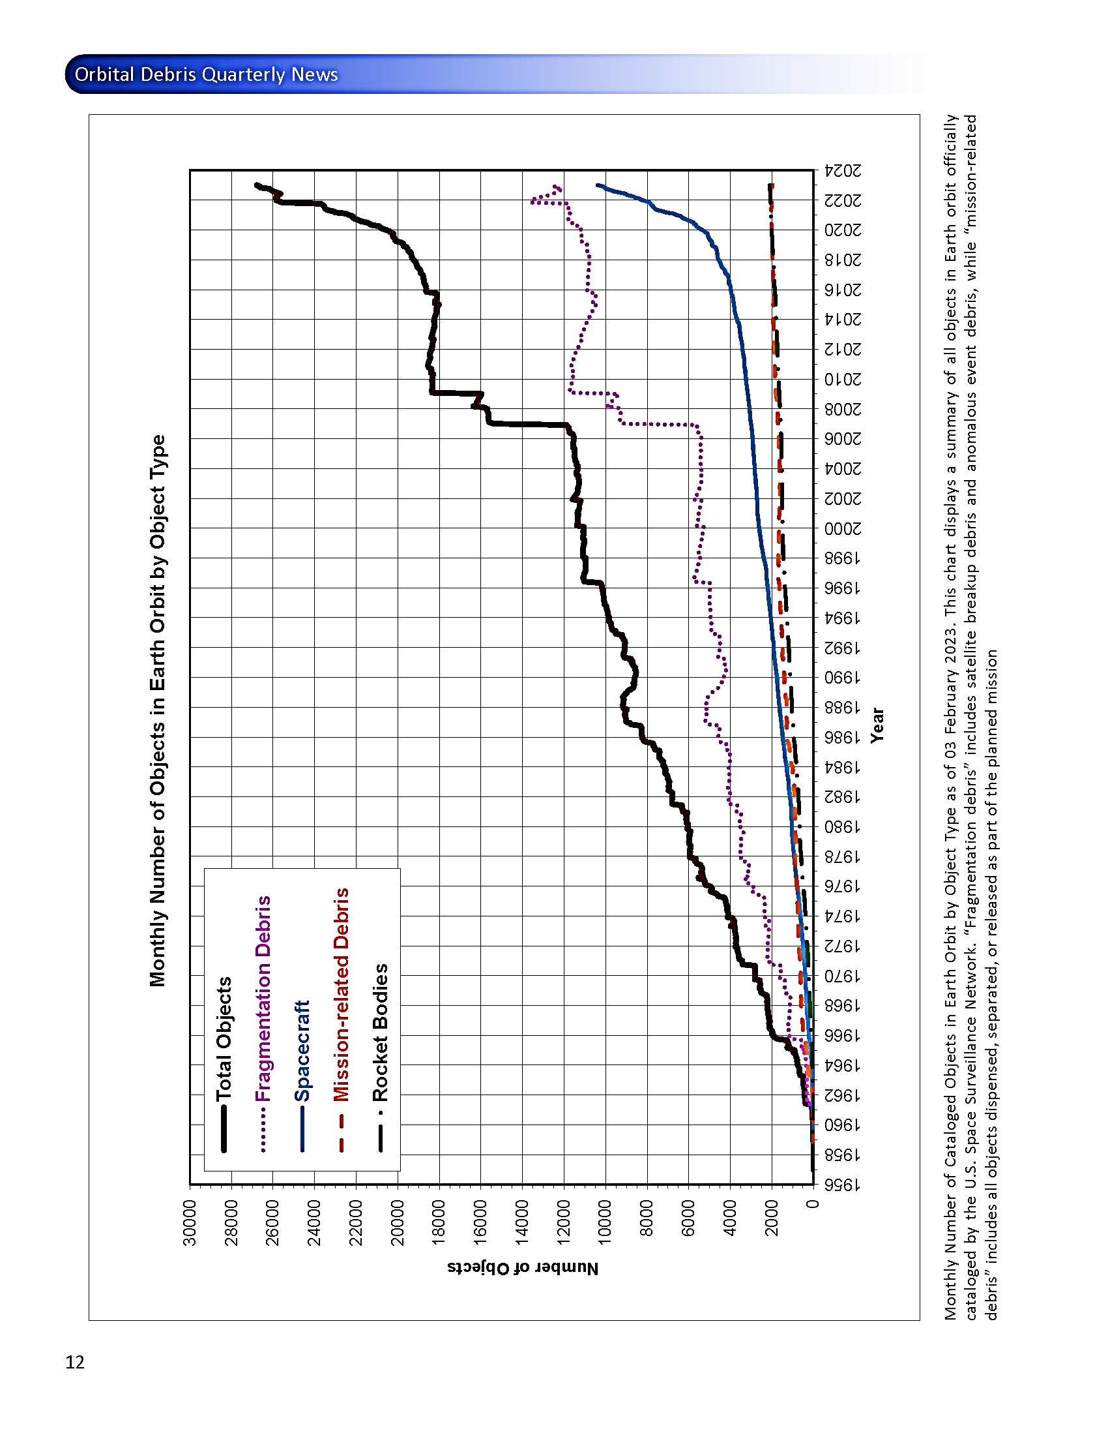
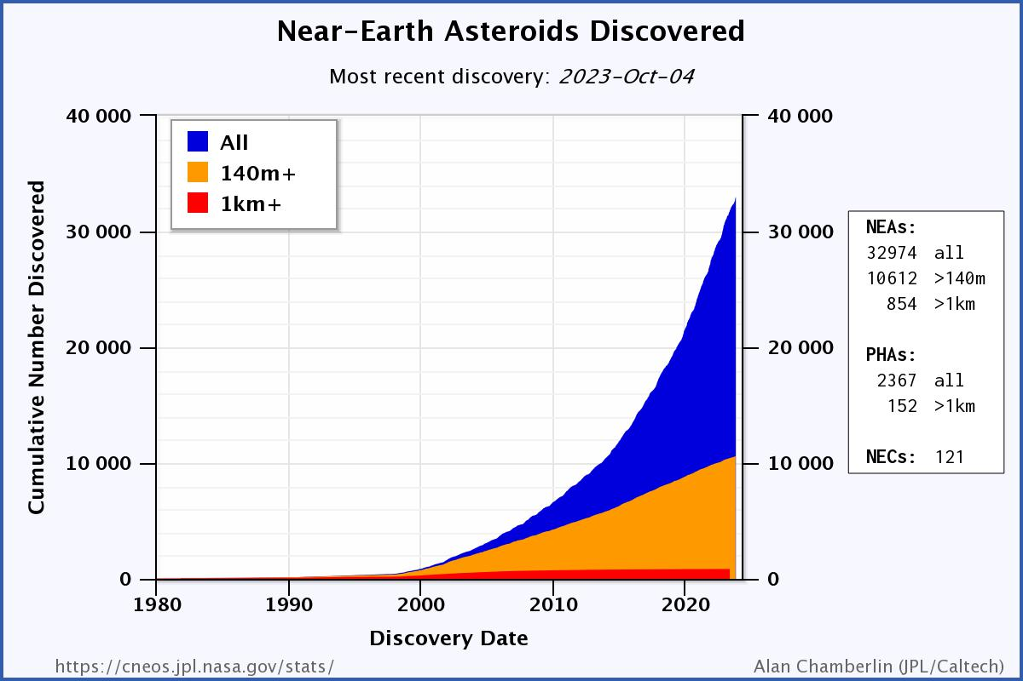
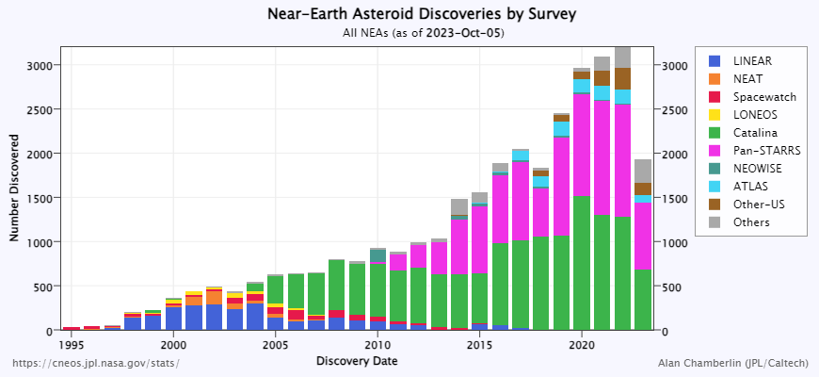
The Evolving Space Environment

Slide 4
Key Advantages of Ground-Based Optical Systems
High Resolution Imaging
Ground-based optical systems provide high-resolution images of space objects, enabling precise tracking, identification, and characterization. This capability is essential for differentiating between satellites, monitoring changes in their condition, and identifying potential threats or space debris.
Cost-Effectiveness
Compared to their space-based counterparts, ground-based optical systems are cost-effective to build, maintain, and upgrade. They offer a valuable alternative for nations and organizations with budget constraints, contributing to the democratization of space surveillance capabilities.
Versatility
Ground-based optical systems are versatile and capable of observing a wide range of space objects, including satellites in various orbits, celestial bodies, and potentially hazardous near-Earth objects. This adaptability makes them invaluable tools for multiple applications, from national security to planetary defense.
Continuous Monitoring
Ground-based systems operate continuously, providing uninterrupted surveillance of the night sky. This persistence ensures timely detection of space objects and the ability to track their movements, facilitating rapid responses to potential security threats or collision avoidance.

Slide 5
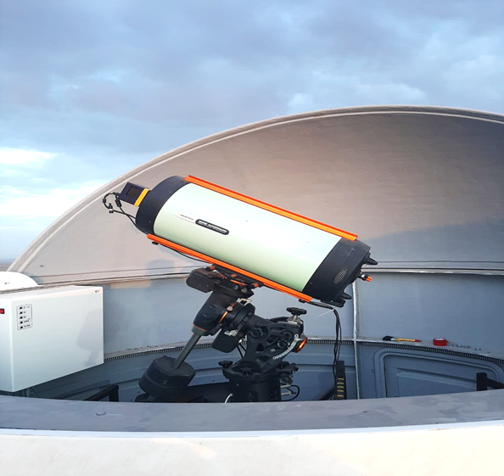
Optical Satellite Tracking Station (OSTS)-NRIAG
Items | Characteristics
Telescope Series | Celestron 11" Rowe-Ackermann Schmidt Astrograph with CGE Pro Mount
Telescope Aperture | 11"
Telescope Focal Ratio | f/2.2
Telescope Focal Length | 620 (mm)
Telescope Mount Type | Equatorial
CCD device | FLI MicroLine ML11002 Monochrome Camera Grade 2
Pixels | 4072 x 2720 pixels
Pixel Size (µm) | 9.0 x 9.0
System (FOV) | 3.4°×2.3° (7.81) degree square
Pixel scale | 2.98”/pixel
Limited magnitude | 14.9 mag

Slide 6
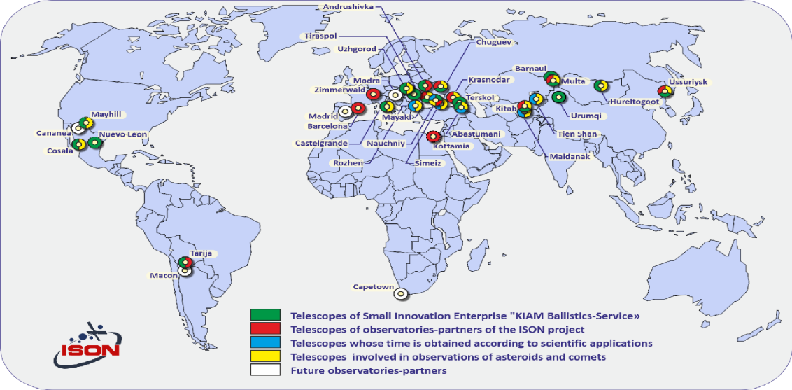
International Collaboration
International collaboration plays a pivotal role in space surveillance. By sharing data and resources, space agencies and observatories worldwide enhance the capabilities of the global space surveillance network. This collaborative approach is essential for addressing common challenges and ensuring the security and sustainability of space activities.
Map of the ISON observatories that includes the OSTS in Egypt

Slide 7

Data Calibration Images
CCD cameras consist of thermally-related dark current noise. This means that at higher temperatures, additional electrons are freed in the structure of the CCD chip, and this in turn creates excess noise in the output imaging.
To compensate for this, CCD cameras are cooled. Residual dark current interference is then removed with dark calibration frames. These are CCD images that are taken with the camera shutter closed and the device at the same temperature as it is during science imaging. we utilized Darks calibration images to accomplish this. Because Darks were taken at the same exposure rate and CCD temperature as the science images, the additional calibration image, known as Bias, was not included in the process. The phase angle (α) is the angle between the Earth and Sun position vectors from the reference frame of the target object. and by Phase curves, we can describe the reduction in the reduced magnitude of an asteroid with increasing phase angle, intrinsic properties determine the apparent brightness, and the absolute magnitude of an asteroid (H). The apparent mean (V) magnitude of the asteroid if placed at a heliocentric distance r = 1 au, geocentric distance Δ = 1 au, and a phase angle of α = 0°. It is related to the mean observed magnitude V (r, Δ, α) by
the reduced magnitude
the phase function

Slide 8
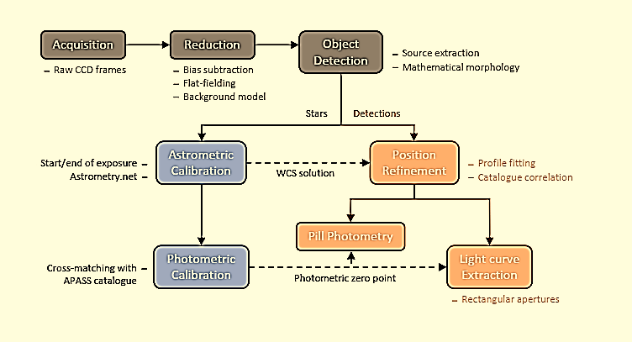
Diagram outlining the analysis pipeline

Slide 9
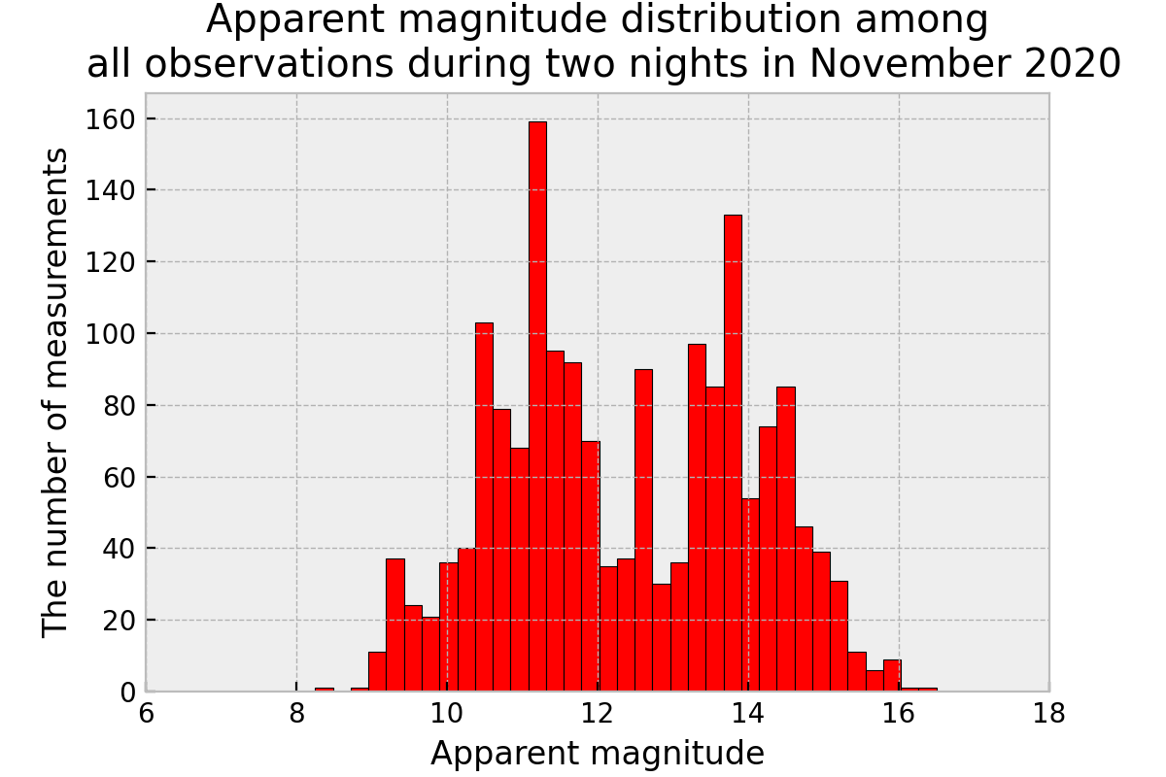

Slide 10
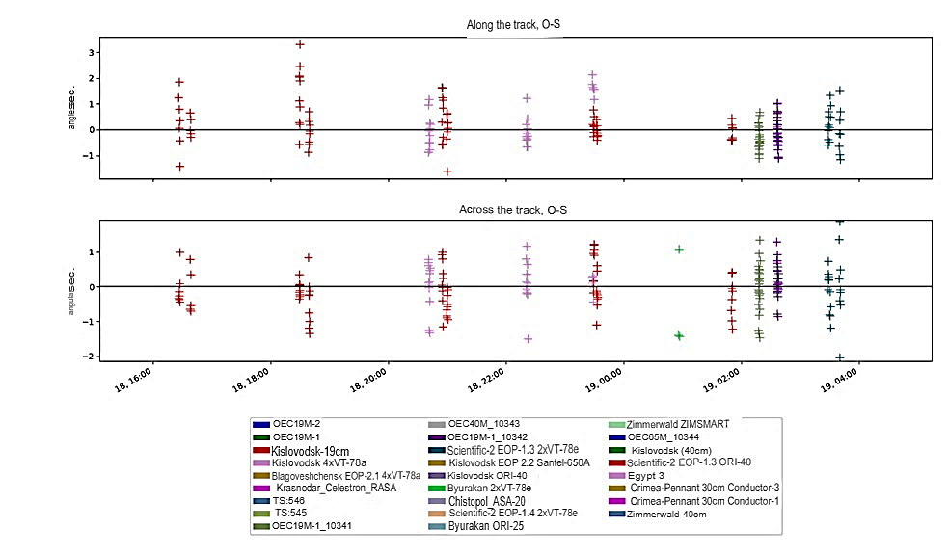
SO 11862
Residuals of measurements of 11890 [and other] for SO 11862 in night on 2023-01-19.
The upper image long track, lower image – is a cross-track.

Slide 11
Code of observat. | Name of observatory and aperture of telescope | Start, UTC | End, UTC | Along aver., " | Along rms, " | * aver., " | * rms, " | N meas.
10093 | Kislovodsk-19 cm | 2023-01-18 16:25:53 | 2023-01-18 16:26:56 | 0.352 | 1.029 | -0.065 | 0.513 | 7
10093 | Kislovodsk-19 cm | 2023-01-18 16:37:22 | 2023-01-18 16:38:11 | 0.122 | 0.444 | -0.152 | 0.580 | 5
10093 | Kislovodsk-19 cm | 2023-01-18 18:28:41 | 2023-01-18 18:39:29 | 0.700 | 0.956 | -0.254 | 0.488 | 19
10311 | Kislovodsk-4x19 cm | 2023-01-18 20:40:38 | 2023-01-18 20:42:30 | -0.091 | 0.672 | 0.062 | 0.712 | 13
10093 | Kislovodsk-19 cm | 2023-01-18 20:54:32 | 2023-01-18 21:00:24 | -0.274 | 2.414 | 2.740 | 13.085 | 20
10311 | Kislovodsk-4x19 cm | 2023-01-18 22:20:17 | 2023-01-18 22:22:09 | -0.098 | 0.520 | 0.111 | 0.629 | 13
11890 | Egypt3-28 cm | 2023-01-18 23:27:40 | 2023-01-18 23:29:53 | 1.656 | 0.207 | -1.043 | 2.568 | 7
10093 | Kislovodsk-19 cm | 2023-01-18 23:28:45 | 2023-01-18 23:33:08 | 0.044 | 0.272 | -0.047 | 1.337 | 19
10302 | Byuarakan 2x19 cm | 2023-01-19 00:55:57 | 2023-01-19 00:57:00 | -9.807 | 3.792 | -3.942 | 3.946 | 7
10093 | Kislovodsk-19 cm | 2023-01-19 01:49:55 | 2023-01-19 01:50:58 | -0.115 | 0.337 | -0.286 | 0.602 | 9
10341 | Crimea 2x19 cm-1 | 2023-01-19 02:17:26 | 2023-01-19 02:19:05 | -0.275 | 0.478 | -0.034 | 0.687 | 27
10342 | Crimea 2x19 cm-2 | 2023-01-19 02:36:08 | 2023-01-19 02:37:47 | -0.060 | 0.472 | 0.171 | 0.446 | 29
10321 | Crimea 2x19 cm | 2023-01-19 03:28:20 | 2023-01-19 03:41:08 | 0.014 | 0.845 | -0.040 | 0.869 | 21
* transverse residuals paired with longitudinal ones

Slide 12
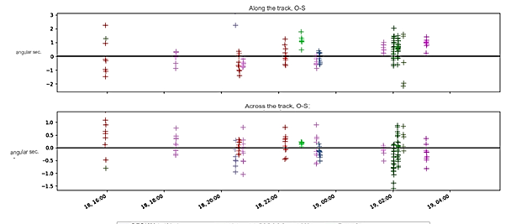
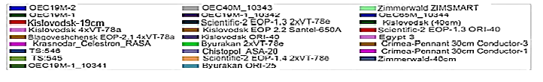
SO 3691
Residuals of measurements of 11890 [and other] for SO 3691 at night on 2023-01-19. 11890.
The upper image long track, lower image – is a cross-track.

Slide 13
Code of observat. | Name of observatory and aperture of telescope | Start, UTC | End, UTC | Along aver., " | Along rms, " | * aver., " | * rms, " | N meas.
10311 | Kislovodsk-4x19 cm | 2023-01-18 15:55:58 | 2023-01-18 15:57:26 | 0.458 | 1.616 | 0.592 | 0.626 | 8
10302 | Byuarakan- 2x19 cm | 2023-01-18 15:57:15 | 2023-01-18 15:58:11 | -4.116 | 3.462 | 2.658 | 1.170 | 5
10093 | Kislovodsk-19 cm | 2023-01-18 18:23:51 | 2023-01-18 18:24:54 | -0.004 | 0.219 | 0.152 | 0.260 | 10
10995 | Chistopol 20 cm | 2023-01-18 20:28:42 | 2023-01-18 20:30:21 | 3.609 | 0.690 | -0.044 | 1.081 | 8
10311 | Kislovodsk-4x19 cm | 2023-01-18 20:35:55 | 2023-01-18 20:37:39 | -0.449 | 0.549 | 0.059 | 0.218 | 10
10093 | Kislovodsk-19 cm | 2023-01-18 20:44:53 | 2023-01-18 20:45:56 | -0.528 | 0.235 | -0.115 | 0.447 | 10
10311 | Kislovodsk-4x19 cm | 2023-01-18 22:13:12 | 2023-01-18 22:15:04 | 0.107 | 0.522 | 0.119 | 0.391 | 11
11890 | Egypt3 | 2023-01-18 22:47:21 | 2023-01-18 22:48:53 | 1.162 | 0.427 | 0.172 | 0.065 | 7
10093 | Kislovodsk-19 cm | 2023-01-18 23:18:59 | 2023-01-18 23:20:02 | -0.306 | 0.312 | 0.000 | 0.508 | 10
10312 | Kislovodsk-40 cm | 2023-01-18 23:24:31 | 2023-01-18 23:27:07 | -0.053 | 0.304 | -0.173 | 0.124 | 13
10093 | Kislovodsk-19 cm | 2023-01-19 01:39:38 | 2023-01-19 01:40:41 | 0.600 | 0.315 | -0.114 | 0.193 | 8
10341 | Crimea 2x19 cm-1 | 2023-01-19 02:00:45 | 2023-01-19 02:11:08 | 0.591 | 0.588 | -0.258 | 0.448 | 57
10302 | Byuarakan- 2x19 cm | 2023-01-19 02:21:05 | 2023-01-19 02:22:08 | -2.503 | 2.284 | 1.216 | 1.993 | 9
10321 | Crimea 2x19 cm | 2023-01-19 03:09:37 | 2023-01-19 03:10:49 | 0.955 | 0.339 | -0.219 | 0.278 | 9
* transverse residuals paired with longitudinal ones
Residuals of measurements of 11890 [and other] for SO 3691 in night on 2023-01-19.

Slide 14
Apparent Magnitude
where -26.74 is the apparent visual magnitude of the sun
The phase function can be written as:

Slide 15
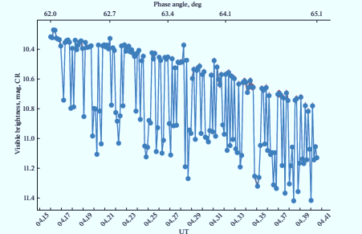
Light Curve OF SO 3691
light curve is a graph that shows the brightness of an object over a period of time (the potential for rotation) depending on solar radiation pressure forces
Light curves carry an extensive set of information about the object’s dynamical and physical properties
Visible light curve of SO 3691 observation on January 20, 2023

Slide 16
Optical Surveillance on Asteroids
Astrometry
Orbit Determination
Photometry
Size Estimation
Identification
Tracking
Shape & Spin State
Analysis
Internal Structure
Break-up?
Impact Energy Prediction
Optical Surveillance
Risk
Analysis

Slide 17
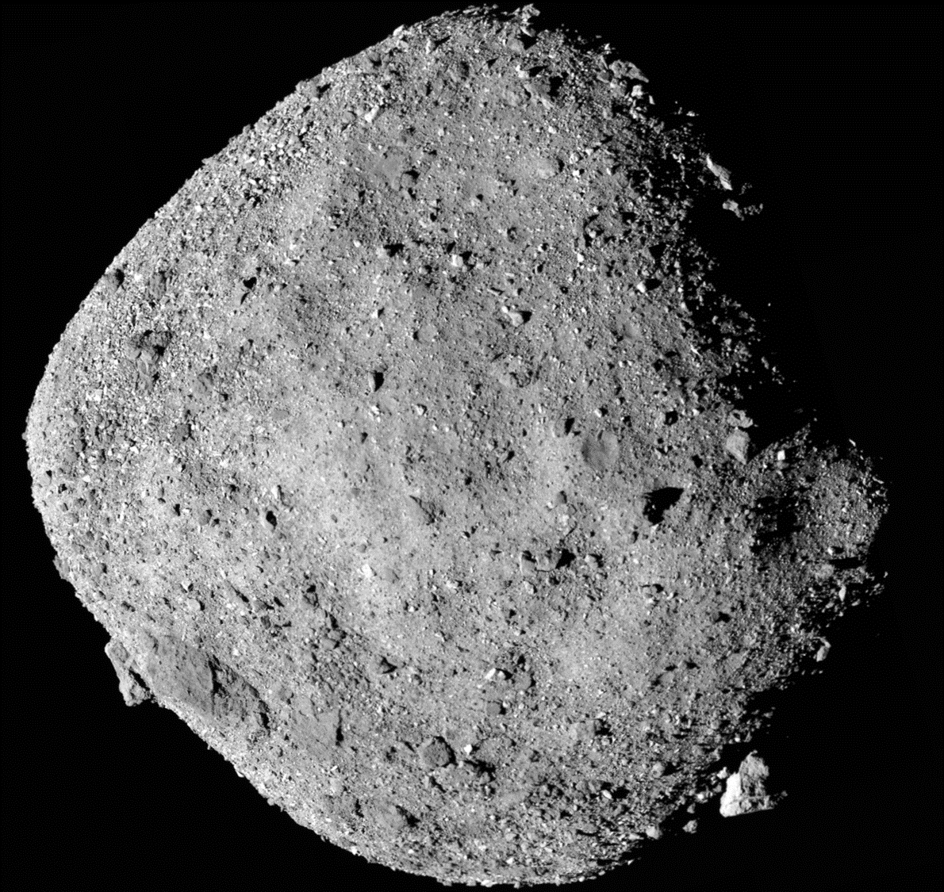

Physical Properties of Near-Earth Asteroids (NEAs)
  Shape
  Spin
  Surface Mineralogy
  Orbit
Fundamental parameter for studying NEAs

Slide 18
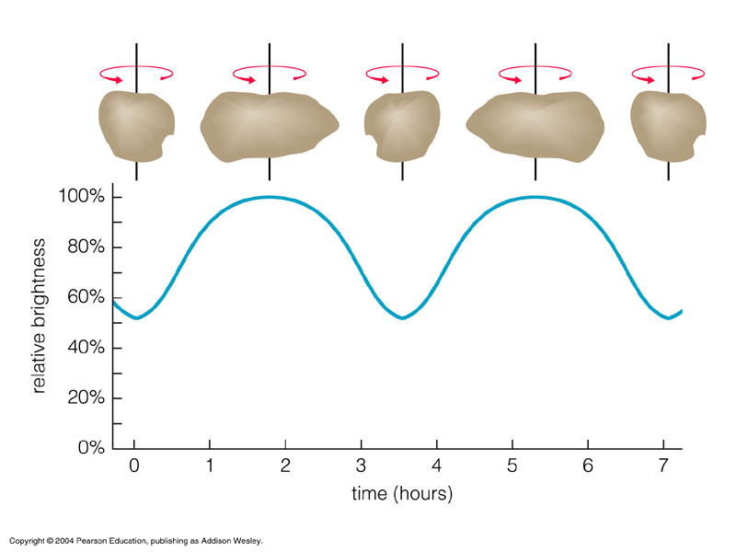
Shape & Spin of Asteroids
Lightcurve
Changing asteroid brightness is caused by following reasons:
Due to rotation & irregular shape
Due to changing distance
Due to changing phase
Due to changing albedo
So we can obtain the physical properties from asteroid lightcurves:
rotational period
distance
phase coefficient : H-G parameter
color
pole orientation & shape modeling

Slide 19
1866 Sisyphus (1972 XA) Near Earth Asteroid
Sisyphus is a mid-sized asteroid whose orbit crosses the orbit of Earth. NASA JPL has classified Sisyphus as a "Near Earth Asteroid" due to its orbit's proximity to Earth. Still, it is not considered potentially hazardous because computer simulations have not indicated any imminent likelihood of future collision.
Sisyphus orbits the sun every 952 days (2.61 years), coming as close as 0.87 AU and reaching as far as 2.91 AU from the sun. Sisyphus is about 8.5 kilometers in diameter, making it larger than 99% of asteroids and comparable to the San Francisco Bay.
The rotation of Sisyphus has been observed. It completes a rotation on its axis every 2.40 hours..

Slide 20
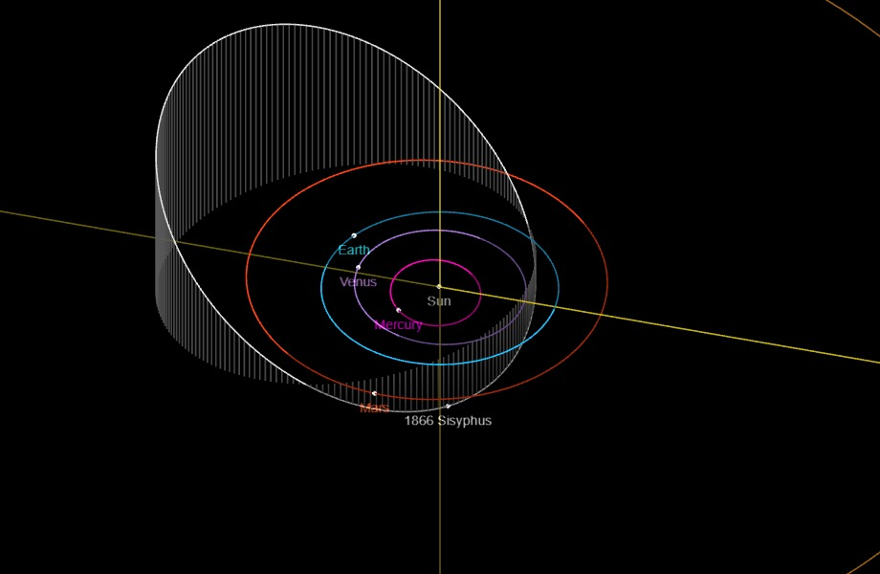
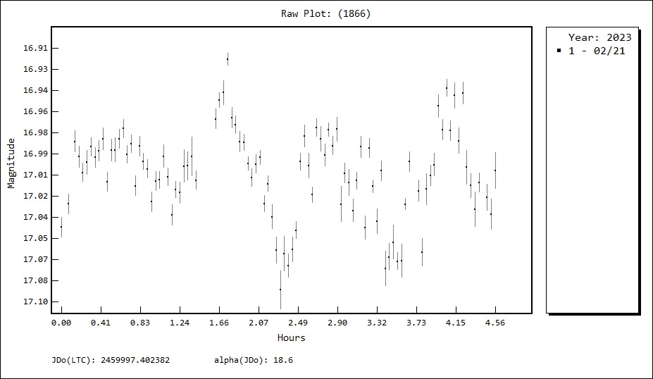
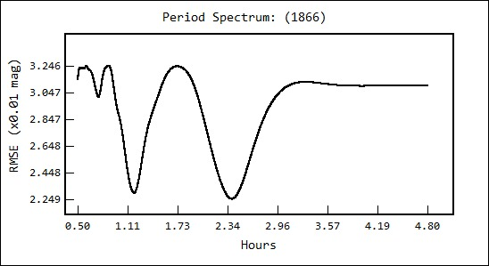
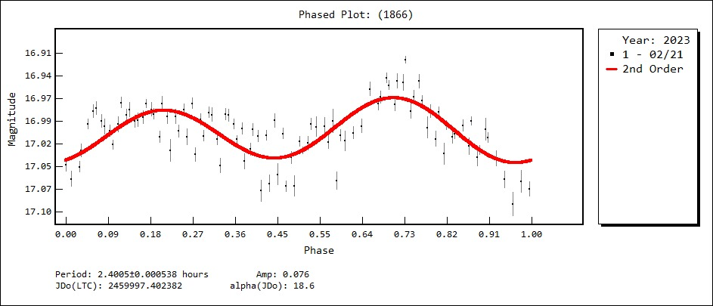

Slide 21
Asteroids 2962 Otto & 349 Dembowska observations
CCD photometric observation of 2962 Otto and 349 Dembowska asteroids were carried out in 19 December 2022 at OSTS (M40) , Kottamia observatory.
Data processing , analysis and rotation period were done with Tycho tracker software .
Asteroid 2962 Otto was discovered on 1940 December 28 . It is asteroid belt with the semi-major axis of 2.5676533 AU, eccentricity 0.0395662, inclination 15.64576 degrees.
Asteroid 349 is a large asteroid of the main belt, discovered on 9 December 1892. a Semi-major axis of 2.9268 AU, inclination 8.2419 degrees, Eccentricity 0.0911322.
Asteroid | Time dd-mm-year | Sky Condition | Img. Exp. | Total of Images | Dark exposure
2962 | 2022 12 19.70940 - 12 19.85523 | Clear | 60 | 28 | 60
349 | 2022 12 19.70940 - 12 19.90951 | Clear | 60 | 18 | 60

Slide 22
Error data measured of the observed Asteroids 2962 Otto
Time yr-mo-day | Right Ascension |  | Declination
 | (h-mm- s) | residual | (deg min sec) | residual
2022 12 19.70940 | 04 08 48.09 | 1.48 | +29 40 08.9 | 0.455
2022 12 19.71036 | 04 08 48.14 | 0.045 | +29 40 09.1 | 0.55
2022 12 19.71133 | 04 08 48.03 | 0.686 | +29 40 08.7 | 0.043
2022 12 19.73023 | 04 08 47.07 | 2.27 | +29 40 14.1 | 3.38
2022 12 19.73119 | 04 08 46.83 | 0.074 | +29 40 11.2 | 0.377
2022 12 19.74124 | 04 08 46.19 | 0.176 | +29 40 13.3 | 1.39
2022 12 19.74174 | 04 08 46.19 | 0.234 | +29 40 13.1 | 1.14
2022 12 19.75258 | 04 08 45.45 | 0.513 | +29 40 13.2 | 0.077
2022 12 19.76182 | 04 08 44.88 | 0.35 | +29 40 14.3 | 0.195
2022 12 19.77223 | 04 08 44.23 | 0.262 | +29 40 15.4 | 0.197
2022 12 19.78267 | 04 08 43.58 | 0.143 | +29 40 15.9 | 0.394
2022 12 19.79307 | 04 08 42.89 | 0.573 | +29 40 17.3 | 0.071
2022 12 19.80355 | 04 08 42.22 | 0.673 | +29 40 17.9 | 0.546
2022 12 19.81392 | 04 08 41.58 | 0.47 | +29 40 17.8 | 1.7
2022 12 19.82439 | 04 08 40.84 | 1.49 | +29 40 18.3 | 2.25
2022 12 19.83478 | 04 08 40.37 | 0.95 | +29 40 17.5 | 4.09
2022 12 19.84504 | 04 08 39.66 | 0.15 | +29 40 21.4 | 1.2

Slide 23
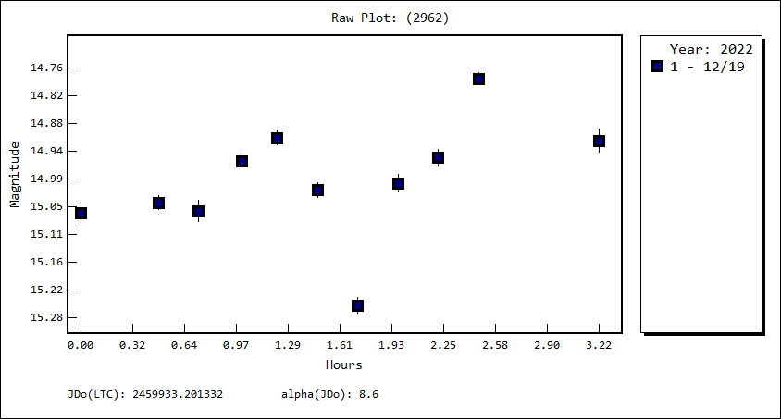
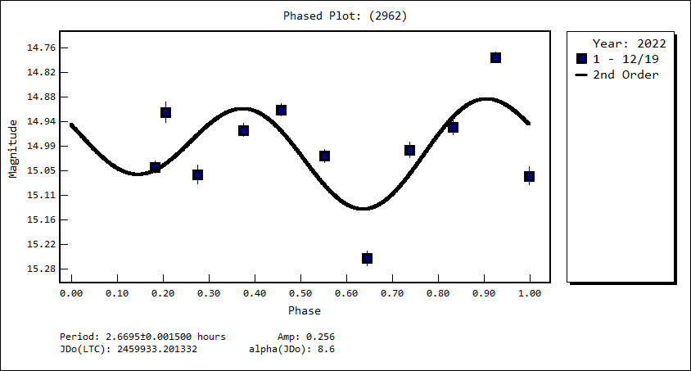

Slide 24
Error data measured of the observed 349 Dembowska
Time yr-mo-day | Right Ascension |  | Declination
 | (h-mm- s) | residual | (deg min sec) | residual
2022 12 19.70940 | 04 07 44.60 | 0.896 | +29 17 36.6 | 0.826
2022 12 19.71036 | 04 07 44.56 | 0.793 | +29 17 36.5 | 0.794
2022 12 19.71133 | 04 07 44.51 | 0.815 | +29 17 36.4 | 0.763
2022 12 19.73023 | 04 07 43.57 | 0.771 | +29 17 35.0 | 0.71
2022 12 19.73119 | 04 07 43.53 | 0.667 | +29 17 35.1 | 0.879
2022 12 19.74124 | 04 07 43.06 | 0.239 | +29 17 34.1 | 0.605
2022 12 19.74174 | 04 07 43.00 | 0.697 | +29 17 34.4 | 0.941
2022 12 19.75258 | 04 07 42.47 | 0.528 | +29 17 33.4 | 0.733
2022 12 19.76182 | 04 07 42.01 | 0.486 | +29 17 33.3 | 1.31
2022 12 19.77223 | 04 07 41.49 | 0.455 | +29 17 32.1 | 0.889
2022 12 19.78267 | 04 07 41.02 | 0.255 | +29 17 30.7 | 0.275
2022 12 19.79307 | 04 07 40.56 | 1.07 | +29 17 30.6 | 0.966
2022 12 19.80355 | 04 07 39.88 | 0.929 | +29 17 30.5 | 1.67
2022 12 19.81392 | 04 07 39.42 | 0.124 | +29 17 30.4 | 2.38
2022 12 19.82439 | 04 07 38.97 | 0.878 | +29 17 27.4 | 0.202
2022 12 19.83478 | 04 07 38.38 | 0.004 | +29 17 26.8 | 0.428
2022 12 19.84504 | 04 07 37.81 | 0.712 | +29 17 25.6 | 0.053
2022 12 19.86600 | 04 07 36.84 | 0.378 | +29 17 21.1 | 2.74
2022 12 19.88687 | 04 07 35.78 | 0.21 | +29 17 19.0 | 3.1
2022 12 19.88749 | 04 07 35.77 | 0.486 | +29 17 19.3 | 2.74
2022 12 19.88868 | 04 07 35.69 | 0.22 | +29 17 19.0 | 2.94
2022 12 19.89733 | 04 07 35.23 | 0.129 | +29 17 19.1 | 2.11
2022 12 19.89794 | 04 07 35.22 | 0.14 | +29 17 18.8 | 2.36
2022 12 19.89914 | 04 07 35.20 | 0.664 | +29 17 19.0 | 2.06
2022 12 19.90951 | 04 07 34.65 | 0.256 | +29 17 17.4 | 2.77

Slide 25
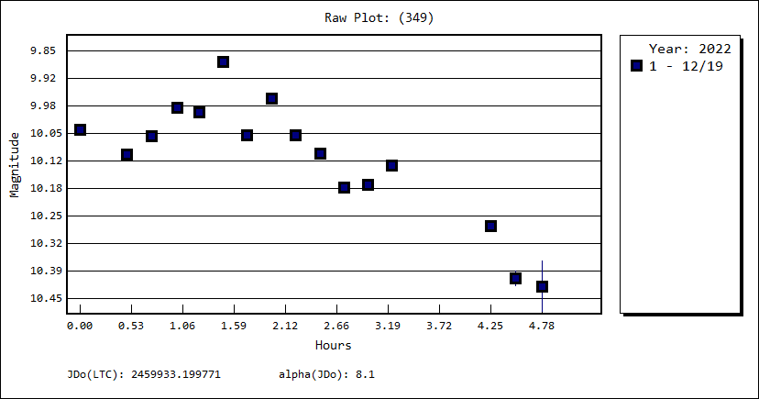
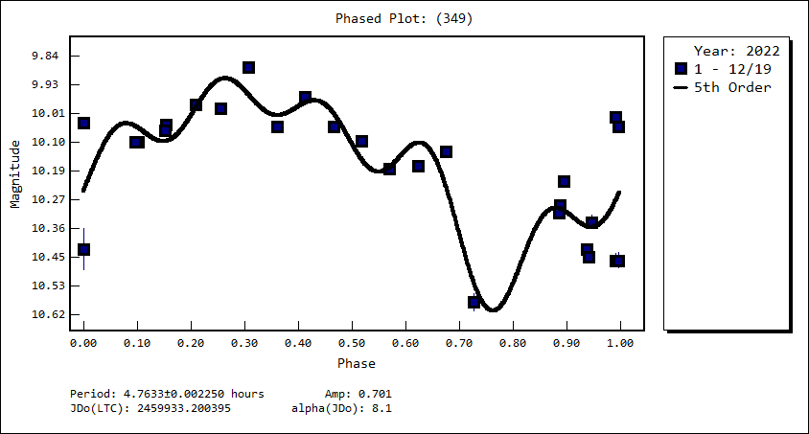

Slide 26
Conclusion
Ground-based optical systems represent a cornerstone of advanced space surveillance, providing critical space security and exploration capabilities. Their high-resolution imaging, cost-effectiveness, versatility, and continuous monitoring capabilities are indispensable in addressing the challenges posed by the evolving space environment. As technology continues to advance and international collaboration strengthens, ground-based optical systems will play a pivotal role in shaping the future of space activities, ensuring their safety, security, and sustainability.

Slide 27

+201113251476
NRIAG, Egypt
Ahmed_astro84@yahoo.com
ACAG-CONF.ORG

